Slide 1
The Cell Membrane

Slide 2
The cell. It is surrounded by the ‘cell membrane’. What exactly is this cell membrane? What is it made up of? Does it keep everything out of the cell? Does it keep everything inside the cell? It must be able to let some molecules in or out of the cell. Does it ever leak or leak on purpose? How does it hold the cytoplasm inside the cell? So many questions.

Slide 3
Cell Membrane Definition: The cell membrane is a biological membrane that separates the interior of all cells from the outside environment which protects the cell from its environment. Is the ‘plasma membrane’ the same as the ‘cell membrane’? YES. Then what is a ‘cell wall’? Don’t worry about the cell wall, that is found in plants. OK, then what is a cell membrane (plasma membrane) made up of?

Slide 4
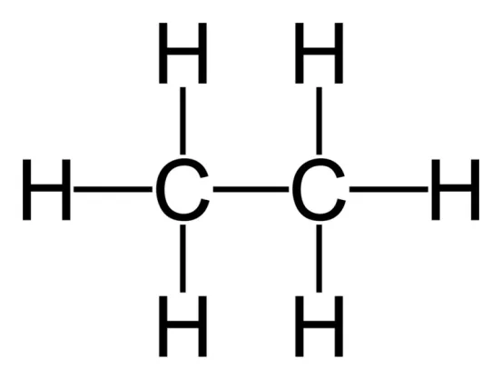
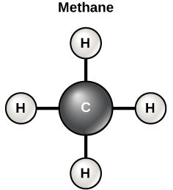
Consider a carbon atom. Done. Carbon atoms can form 4 covalent bonds. Keep it simple and attach 4 hydrogen atoms to each of those 4 bonds. You get methane. (Not important for us to know.) Now consider two carbon atoms bound together. OK, still simple. NOW consider only 3 carbon atoms linked together, but with this symmetry: each carbon has an –H and a –OH attached. This simple 3 carbon molecule is glycerol.

Slide 5
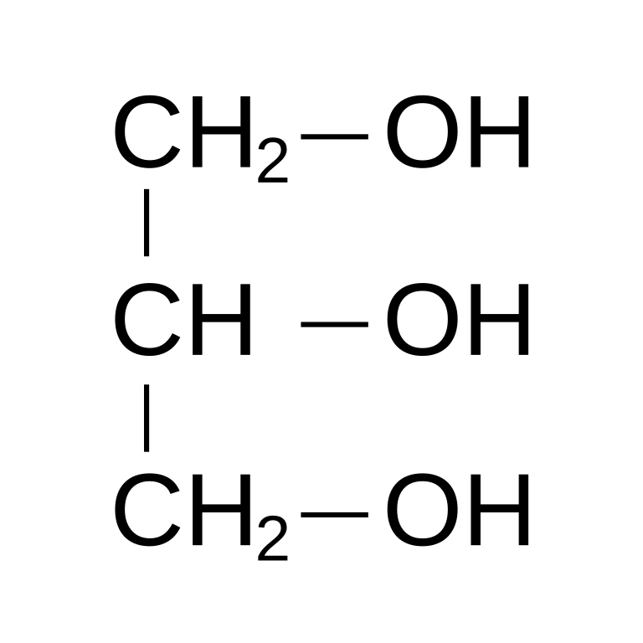
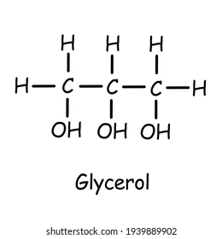
Glycerol…….Glycerol……Glycerol !

Slide 6
OK, I get it, glycerol, simple 3 carbon molecule, with each carbon having an –H and a –OH attached. Can we move on, getting back to what the cell membrane is made up of. I doubt the cell membrane is made up of glycerols.
To the left is the ‘acid’ group. It is simple also. It has a carbon doubled bonded to an oxygen and this carbon is also attached to the –OH group. The ‘R’ represents anything else that might be attached at the 4th bond carbon has. Anything that is called an ‘acid’ has this in its structure like citric acid or hydrochloric acid. Let’s make a very simple ‘acid’ by simply adding a string of carbons at the ‘R’ position.

Slide 7
Sorry but I went a little crazy with the number of carbons I added to that acid group. But you get the idea, all a fatty acid consists of is the acid group with carbons attached at the ‘R’ position. Simple molecule, a long molecule, but structurally simple. Since this fatty acid is not attached to anything it can also be considered a ‘free fatty acid’.

Slide 8
What always get confusing once anyone starts to talk about fatty acids is that there are a lot of them in nature. They are all basically the same, just different numbers of carbons in the ‘tail of carbons’ attached to the acid end. NOTE: the acid group can also be written ‘COOH’ (can you see why that is?). But we are not here to talk about oleic acid or palmitic acid.

Slide 9
Take a glycerol molecule and add one of these fatty acid string of carbons onto one of the 3 carbons glycerol has. Remove (break the bond) an H from the –OH on that top carbon of glycerol, and remove (break the bond) the –OH group from the acid end of the Fatty Acid. What you have removed are an –H and the –OH group…..well…..combine them and what do you have?

Slide 10
H + OH = HOH = H20 = water. A harmless water molecule is the byproduct of this reaction. And the string of carbons, the remaining fatty acid is now attached to the top carbon of glycerol. Do this identical reaction again for the middle carbon of glycerol and then do this identical reaction a third time to the bottom carbon of glycerol.

Slide 11
You have created using glycerol and the backbone a …… ‘triglyceride’ molecule. Each carbon of glycerol has that string of carbons attached.

Slide 12
Ain’t learning new stuff fun? Yep, learning sure is fun. Can we please get back to explaining what the plasma membrane is made up of!

Slide 13
Good ol’ triglyceride. It is sometimes called a ‘fat’ molecule, or a ‘lipid’ molecule. A big, bulky molecule, but actually kind of simple.

Slide 14
Time to show you a relative of the triglyceride. Just replace on the carbon tails (one of the fatty acids) with what is the ‘phosphate group’. That’s all. Take a minute and understand this diagram. Find the 3 carbon glycerol. See dangling down from the first two carbons are the two fatty acids (the two carbon tails). Extending up from the third carbon of glycerol is this newly introduced ‘phosphate group’. See it? It is phosphate with the ring of oxygens.

Slide 15
Since triglycerides are also known as fats or lipids. And this new molecule is closely related, it has a phosphate group attached. This new molecule is called a: phospholipid.

Slide 16
All the phospholipid consists of is the backbone of the 3 carbon glycerol / two carbon tails / the phosphate group right next to the glycerol backbone.

Slide 17
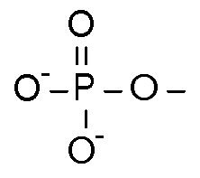
Look closely at the phosphate group please. The central phosphate atom has a ring of oxygens. Except for the oxygen that is double bonded to the phosphate atom, the other oxygens have negative charges on them. So this phosphate group is negatively charged. In chemistry, when something has a charge, it is called ‘Polar’. So the phosphate group is polar, hence the phosphate group in the phospholipid molecule makes that region of the phospholipid molecule ‘polar’.

Slide 18
The phospholipid molecule consists of the glycerol backbone with the phosphate group next to it and the two carbon tails. Well, the two carbon tails are called ‘tails’. They have no extra charges floating around. The ‘tails’ are non-polar. But the glycerol backbone + phosphate group = ‘head’. And since the negatively charged oxygens on the phosphate group make it ‘polar’, the ‘head’ of a phospholipid molecule is ‘polar’. Polar head, non-polar tails in a phospholipid molecule.

Slide 19
Water. H2O. It has small positive charges on the hydrogens and a small negative charge on the oxygen. So…..water is…….polar.

Slide 20
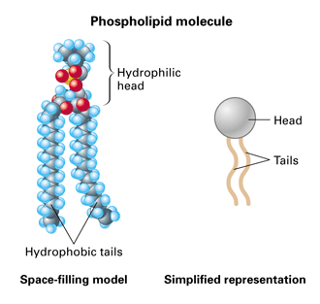
Did I mention that the head of the phospholipid is polar and that the two carbon tails are non-polar? Yes, I did. So, ….. The polar head of a phospholipid will be weakly attracted to polar water molecules. The small negative charges on the phosphate group will be weakly attracted to the small positive charges on any and all water molecules. Because the head of a phospholipid is attracted to water molecules, the head portion of a phospholipid is considered….”hydrophilic” (attracted to water). The tails have no charge, so they are neither attracted nor repelled by water molecules and so the tails of a phospholipid molecule are considered….. “hydrophobic”.

Slide 21
We’ve covered a lot. But this ‘story’ is not like reading a comic book or short novel. This is instructional material. You may want to reread it several times, even practice drawing some of the structures to actually ‘learn’ this new material. It has been quite a story, from glycerol and fatty acids, to triglycerides and now phospholipids.

Slide 22
What part of the phospholipid is hydrophilic? You are correct, the ‘head’. And what part of the phospholipid molecule is hydrophobic? Again, you are correct, the ‘tails’.

Slide 23
Let’s do an experiment. Let’s pour some phospholipid molecules into water. That’s the experiment.

Slide 24
A weird thing happened when you poured phospholipids into water. The hydrophilic heads (which are polar) arranged themselves right next to the polar water molecules and the non-polar (hydrophobic) tails point away from the water. Like little magnets, each phospholipid molecule plops into position. The phospholipid molecules all line up tail to tail, in this way keeping the tails away from the polar water. The polar heads of these phospholipid molecules line up next to the polar water molecules. Notice this arrangement, two layers of phospholipids, a bilayer of phospholipid molecules.

Slide 25
The phospholipid bilayer. Hydrophobic tails facing each other, the hydrophilic heads facing out being attracted by their charge to the charges on the water molecules which in the diagram below would be above and below this phospholipid bilayer.

Slide 26
You know what? Somewhere they teach you in physics that the smallest (least) surface area a sheet of anything can have is actually a sphere. So the sheet of phospholipids in water actually rounds up spontaneously into a sphere.

Slide 27
A sphere of lipid bilayer! Water inside. Water outside. Looks just like a cell membrane surrounding a cell!

Slide 28
The ‘extracellular space’ is the space outside of the cell. The ‘lumen of cell’ is the space inside of the cell.

Slide 29
It would be too simplistic to think that every cell’s plasma membrane is only made up of phospholipids. There are other molecules floating along with the phospholipids in the plasma membrane.

Slide 30
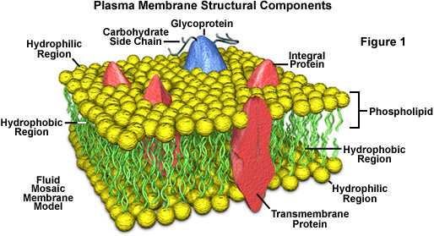
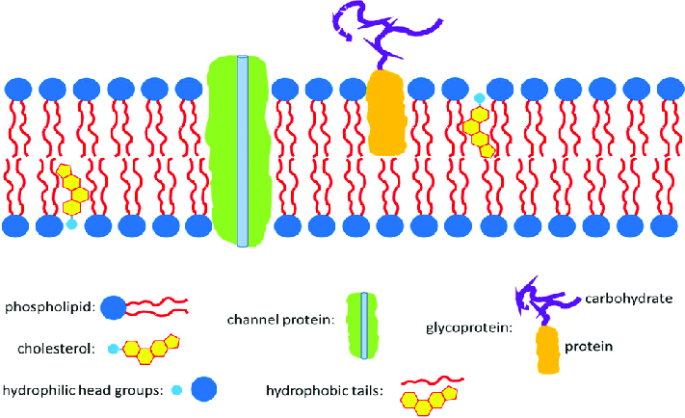
The Cell Membrane.

Slide 31
Now go to the textbook for detailed explanations of the following:
Intracellular fluid / Extracellular fluid / Interstitial fluid
Membrane Proteins / Membrane Glycoproteins / Membrane Glycolipids
Passive Transport / Active Transport
Diffusion / Facilitated Diffusion / Osmosis
Hypertonic / Hypotonic / Isotonic
Endocytosis / Phagocytosis / Pinocytosis
Receptor-Mediated Endocytosis
Exocytosis

Slide 32
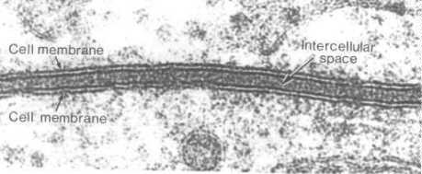
The end.

