Slide 1
Digestion of Nucleic Acids
Merly, Ashliy, Tomoki, Sharon

Slide 2
Table of contents
01
02
03
04
Chemical Structures
Mouth/Esophagus/Stomach
Structures & Functions
Mechanisms
Small Intestine
Other Conditions
Enzymatic Pathway
Absorption
Gout, Salvage pathway, de novo synthesis, hyperuricemia, defecation reflex, Valsalva maneuver

Slide 3
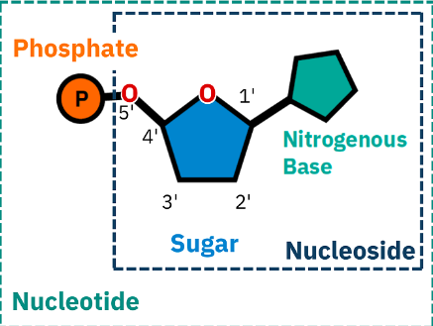
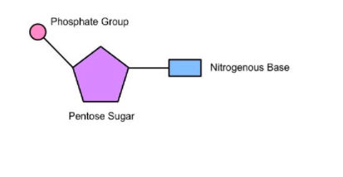
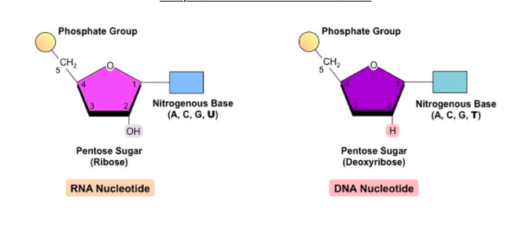
NUCLEIC ACIDS and their building blocks
NUCLEOTIDES = SUGAR BASE PHOSPHATE

Slide 4
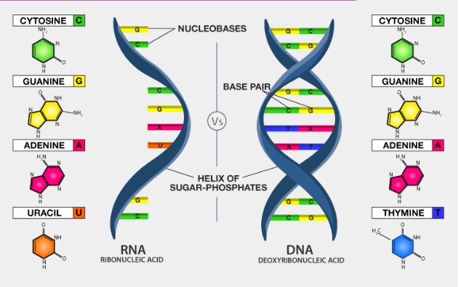
Nucleic Acids Structures/ Functions
RNA
DNA
STRUCTURE :
a) Single Stranded
b) Sugar (RIBOSE)+Phosphate
c) Types : tRNA, rRNA, mRNA
STRUCTURE:
a) Double Stranded
b) Adenine and Guanine (Purines)
c) Thymine and Cytosine (Pyramines)
d) Sugar (DEOXYRIBOSE) , phosphate + base
FUNCTION:
FUNCTION:
Carry out genetic instructions for the synthesis of proteins ( Protein Synthesis)
*derived from DNA
DNA blueprint for all cell functions

Slide 5
MOUTH
Mechanical digestion
Voluntary
SALIVA:
Salivary Glands /Enzymes (salivary amylase, lingual , lysosomes)
  Moisture
  Helps fight infection
  Helps to break down food into smaller particles
TEETH: mastication
PROPELS FOOD FOR SWALLOWING :
BOLUS: BALL OF FOOD + SALIVA
DNA : DeoxyRibose + phosphate +base still in tact
RNA : Ribose Base still in tact
ESOPHAGUS
involuntary
Upper esophageal sphincter
food into esophagus
Transports food by wavelike muscular contractions, called peristalsis,
Lower esophageal Sphincter
Cardiac Orifice

Slide 6
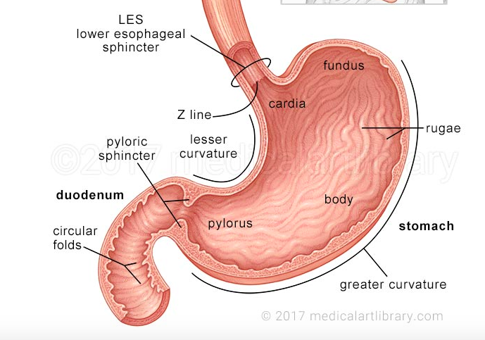
STOMACH
Hydrochloric Acid; Low ph→ weakens hydrogen bonds holding DNA double helix together
Acidity from HCL+ Pepsinogen= Pepsin
Bolus becomes CHYME- more liquid-like
DNA and RNA are now broken into smaller subunits
*DNA nucleotides still in tact
*RNA nucleotides still in tact
* DNA/ RNA nucleotide strands somewhat separated

Slide 7
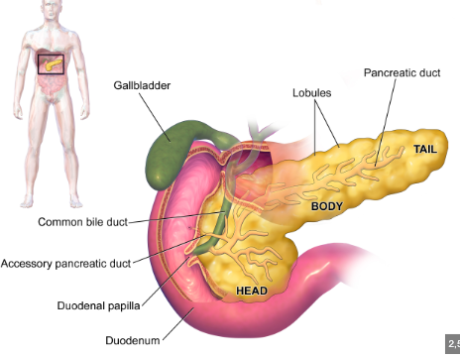
SMALL INTESTINE chemical digestion
Small intestine parts: the duodenum, the jejunum, and the ileum
DNA and RNA nucleotides break apart into individual sugar, bases and phosphates by enzymes in what is hydrolysis

Slide 8
What are the functions of nucleic acids?
DNA
RNA
Responsible for converting genetic information from DNA into amino acid sequences via protein synthesis
Results in functional proteins necessary for cellular processes
DNA is the blueprint for all cell functions
Stores all genetic information
Transcribed by mRNA for protein synthesis

Slide 9
Digestion

Slide 10
Digestion Process I
Mouth + Esophagus + Stomach…

Slide 11
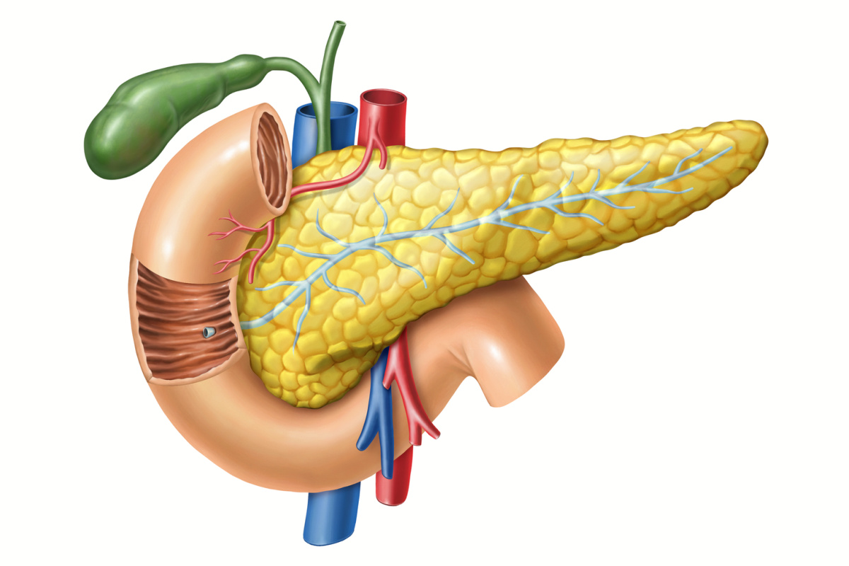
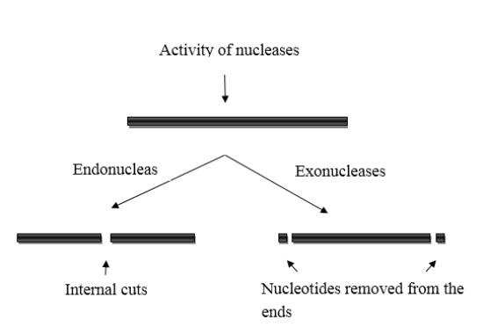
Digestion Process II
What about the pancreas?
Enzymatic Breakdown
Deoxyribonuclease: an enzyme the hydrolyze the phosphodiester bonds of DNA
Ribonuclease: breaks down RNA
Endonuclease: snips phosphodiester bonds of DNA and RNA in the middle
Exonuclease: cleaves the bonds at the end of fine chain
The pancreas releases important enzymes necessary for breaking down these nucleic acids!
Pancreatic fluids containing enzymes digest in the duodenum

Slide 12
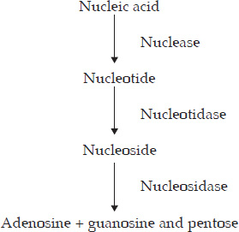
Digestion Process III
Small Intestine
Enzymes
After the pancreatic enzymes, the small intestine releases enzymes called nucleases
Smaller nucleic acids are broken down by nucleases into nucleotides
Nucleotides are further broken down into phosphate and nucleosides by nucleotidases
Nucleosidase finishes the breakdown process to: pentose sugar + nitrogen base
Nuclease
Nucleotidase
Nucleosidase
Phosphatases

Slide 13
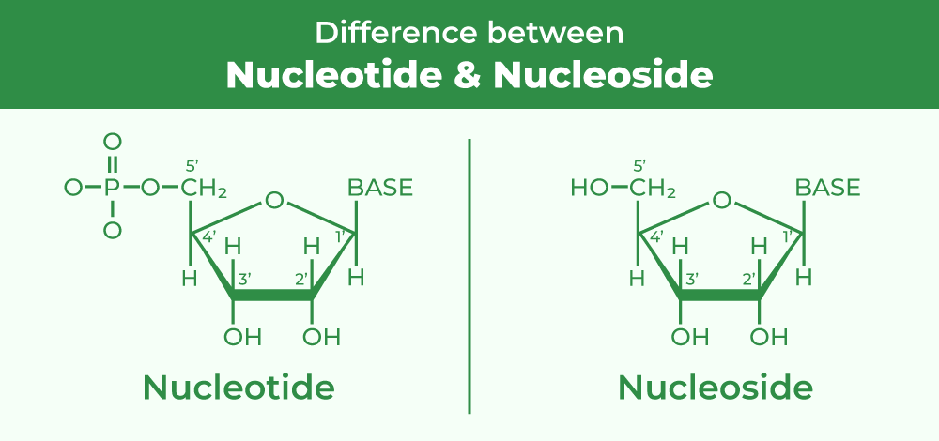
Difference Between Nucleotides vs Nucleosides
Nucleotide: contains nitrogenous base + 5-carbon sugar + phosphate group; serves as a building block for DNA and RNA
Nucleoside: nitrogenous base + 5-carbon sugar; building block for nucleotides. Also aids in metabolism

Slide 14
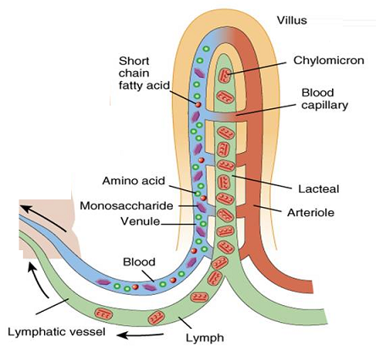
Absorption
Where does it all go?
Now we’re left with pentose sugars, nitrogenous bases, and phosphate groups!
They are now transported along the villus epithelium of the intestinal wall and transported into the bloodstream

Slide 15
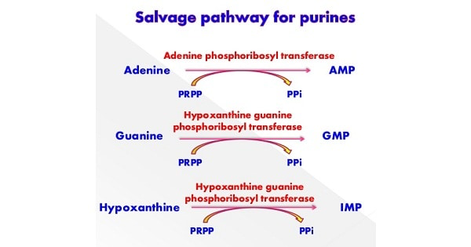
Salvage pathway
metabolic pathway in which the body reuses parts of breakdown molecules to make useful compounds again​
Key examples:
Purine, pyrimidine salvage pathway
Reuse of existing bases and nucleosides (recycle)
Essential in tissues with limited de novo synthesis

Slide 16
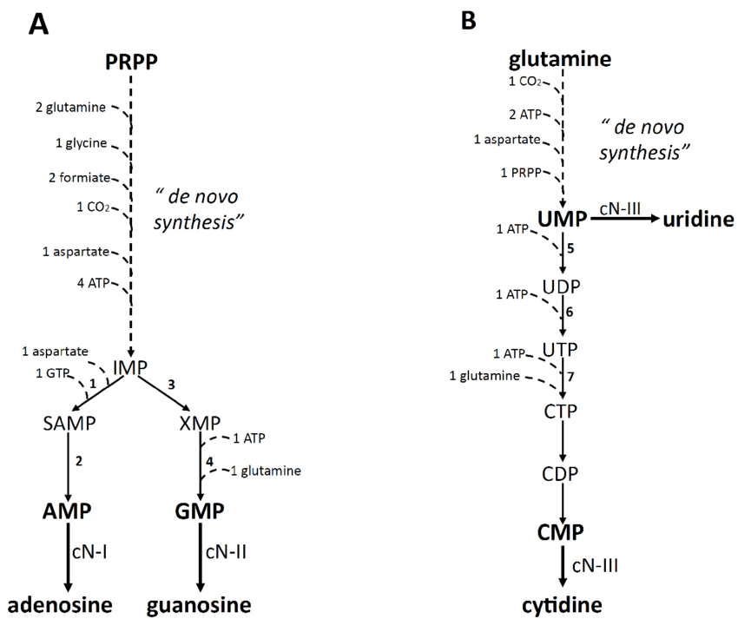
de novo synthesis
Metabolic pathway that produces new molecules from scratch
Key examples: nucleotide, lipid,
RNA synthesis
Synthesis from simple precursor molecules
Essential for cells with high proliferation or activation

Slide 17
Salvage pathway vs de novo synthesis
Salvage pathway
・starting with existing bases
・Low energy requirement
・Rapid production of nucleotides
de novo synthesis
・starting with basic molecules like amino acids or sugars
・High energy requirement
・can producing large amounts of nucleotides

Slide 18
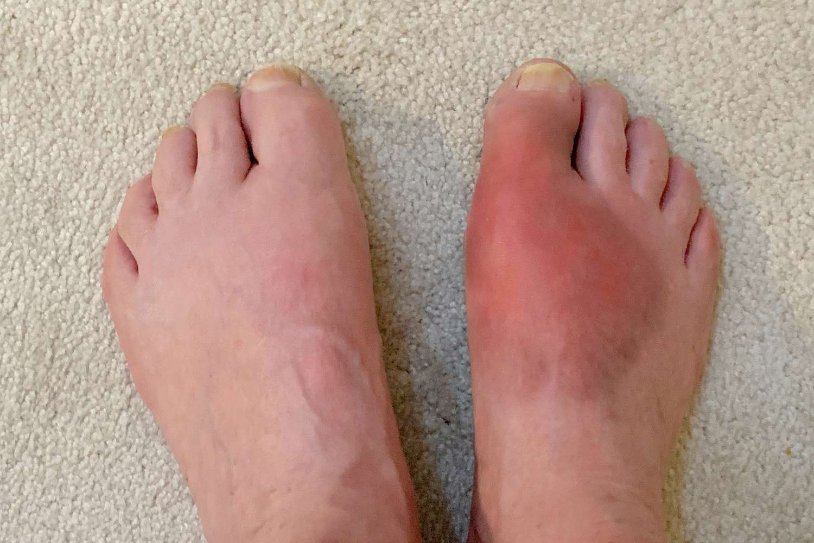
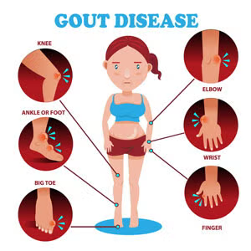
Gout
A type of arthritis that causes sudden, painful attacks of joint inflammation due to a buildup of uric acid crystals in the joints
Causes
・High purine foods, alcohol
・Genetics
・de novo purine synthesis is increased
Symptoms
・sudden attacks of intense pain, swelling, and redness
Treatment
・Lifestyle modifications
・Medications

Slide 19
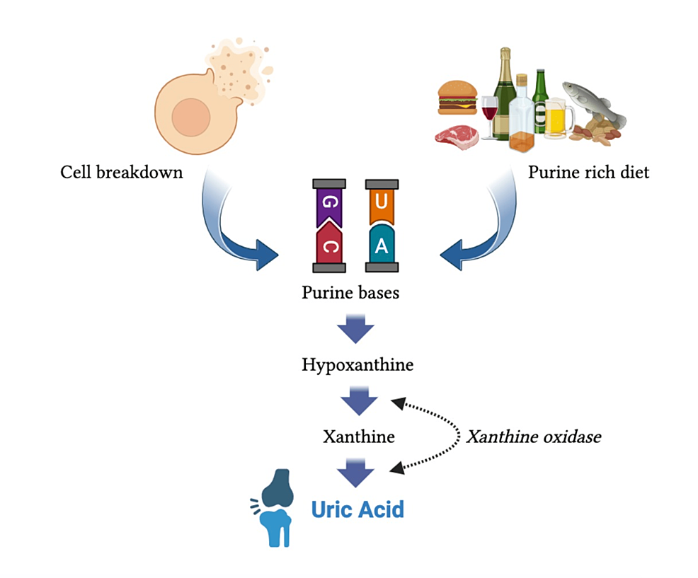
Hyperuricemia
What is it?
How is it caused?
What are the symptoms?
High uric acid in blood
Over production & under-excretion
Dx through blood tests
Normal lvls:
< ~60ml/dL women
< ~70ml/dL men
Uric acid is a waste product from purine breakdown
High purine diet= extra uric acid content in blood (too much, not enough being urinated out!)
Excessive alcohol consumption
Some uric acid clump together in sharp crystals: settle in joints or build up in kidneys…
Most patients are asymptomatic
HOWEVER, if left untreated, high enough levels of uric acid eventually may cause Gout &/or Kidney Stones!
Any Treatment???
Notes:
NORMALLY: uric acid dissolves in your blood, passes through your kidneys and leaves your body through the urine. TREATMENT: lower-purine diet, limit: red meat, sugar drinks, high-fructose corn syrup, alcohol & DRINK WATER!
if serious & leads to gout: NSAIDs or allopurinol/febuxostat which lower u/a production

Slide 20
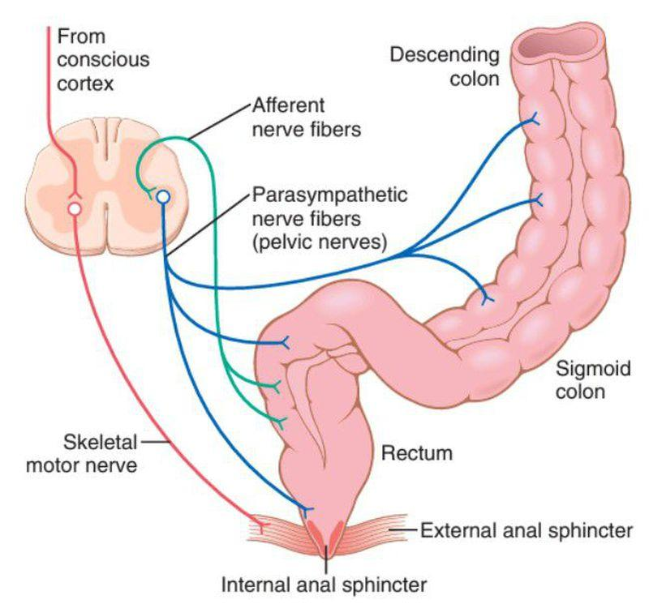
Defecation Reflex
The physiological process of BOTH involuntary and voluntary reflexes to remove stool from the body.
Involuntary
Voluntary
Initiation: stool enters rectum, triggering stretch receptors
Internal Anal Sphincter relaxes so the rectum can contract
Rectal muscles contraction in wave-like motion pushes stool
Decision: when ready to defecate, brain sends motor impulse allowing external anal sphincter to relax
Simultaneously, abdominal muscles & pelvic floor contract increasing abdominal pressure
Both movements allow bowels to be released
Notes:
the involuntary rectoanal inhibitory reflex causes the internal anal sphincter to relax, while voluntary control over the external anal sphincter can delay the urge to defecate. When the time is right, conscious control relaxes the external sphincter, allowing for the voluntary expulsion of feces.

Slide 21
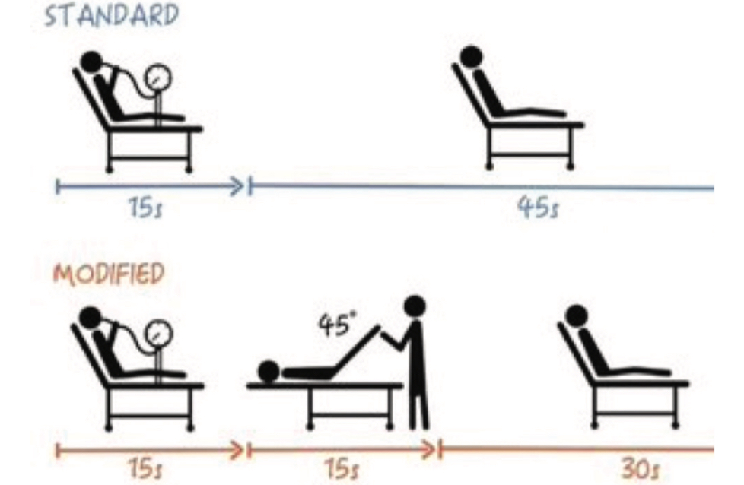
Valsalva Maneuver
What is it?
Why do we use it?
How do we use it?
It is a technique in which a patient forcefully exhales against a closed airway ( nose & mouth closed)
Treat SVT & other arrhythmias
Relieve ear pressure
Dx tool to assess A.N.S. & other heart conditions
Have patient go through 4 main phases:
Phase I: Strain= chest pressure (BP rise)
Phase II: Cardiac output reduced (HR rise)
Phase III: end of expiration (BP drops)
Phase IV: recovery phase (HR drops)
Notes:
Phase I: Straining increases pressure in the chest, which momentarily increases blood pressure and stimulates the vagus nerve.
Phase II: Blood return to the heart is reduced, causing a drop in cardiac output and blood pressure, which in turn makes the heart rate increase to compensate.
Phase III: Releasing the strain causes a sudden drop in pressure.
Phase IV: Blood pressure rapidly increases, and the heart rate slows down as the body recovers.

Slide 22
Thank you!

