Slide 1
Digestion of Carbohydrates
Gabriella, Aren, and Mikel
Spring 2026

Slide 2

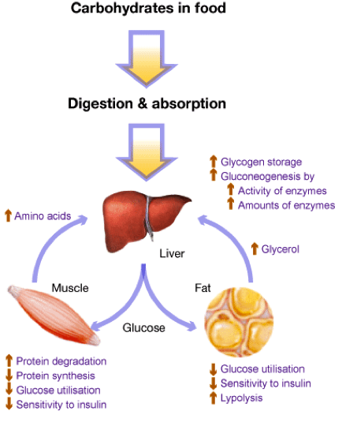
Function of Carbohydrates
Organic molecule composed of carbon, hydrogen, and oxygen (with modifications)
Primary source of energy for the majority of body tissues
  RBCs, brain, and renal medulla rely exclusively on carbohydrates
Minor structural and signaling roles
Comprises approximately 50% of the global diet
  Primarily as polysaccharide starches (amylose, amylopectin)
  Less commonly as disaccharides (maltose, galactose, lactose) or monosaccharides (glucose, fructose)

Slide 3
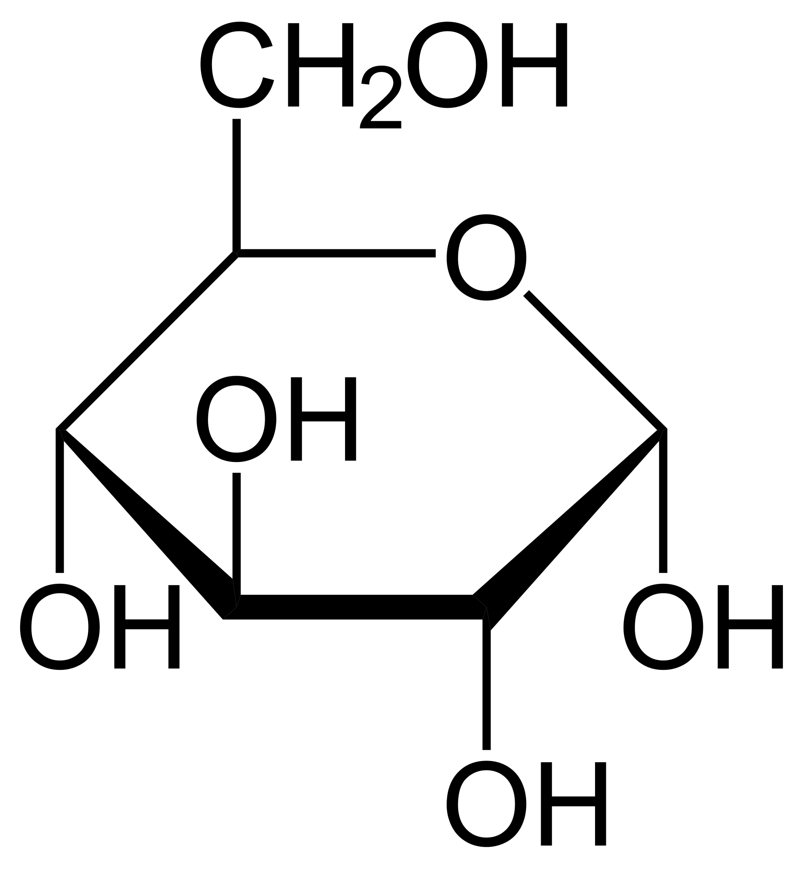
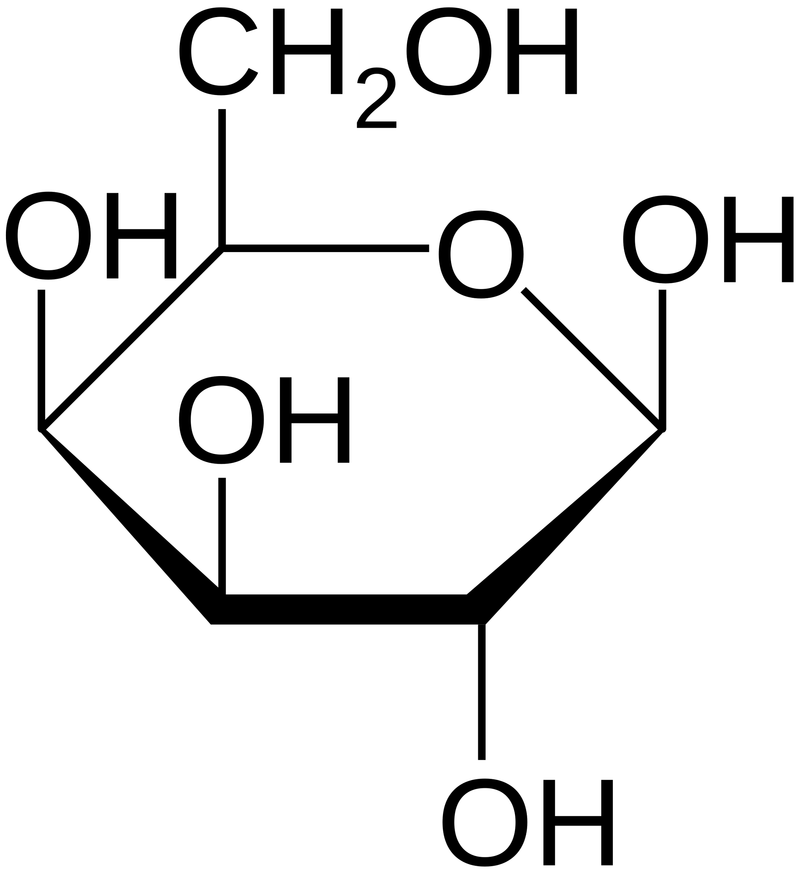
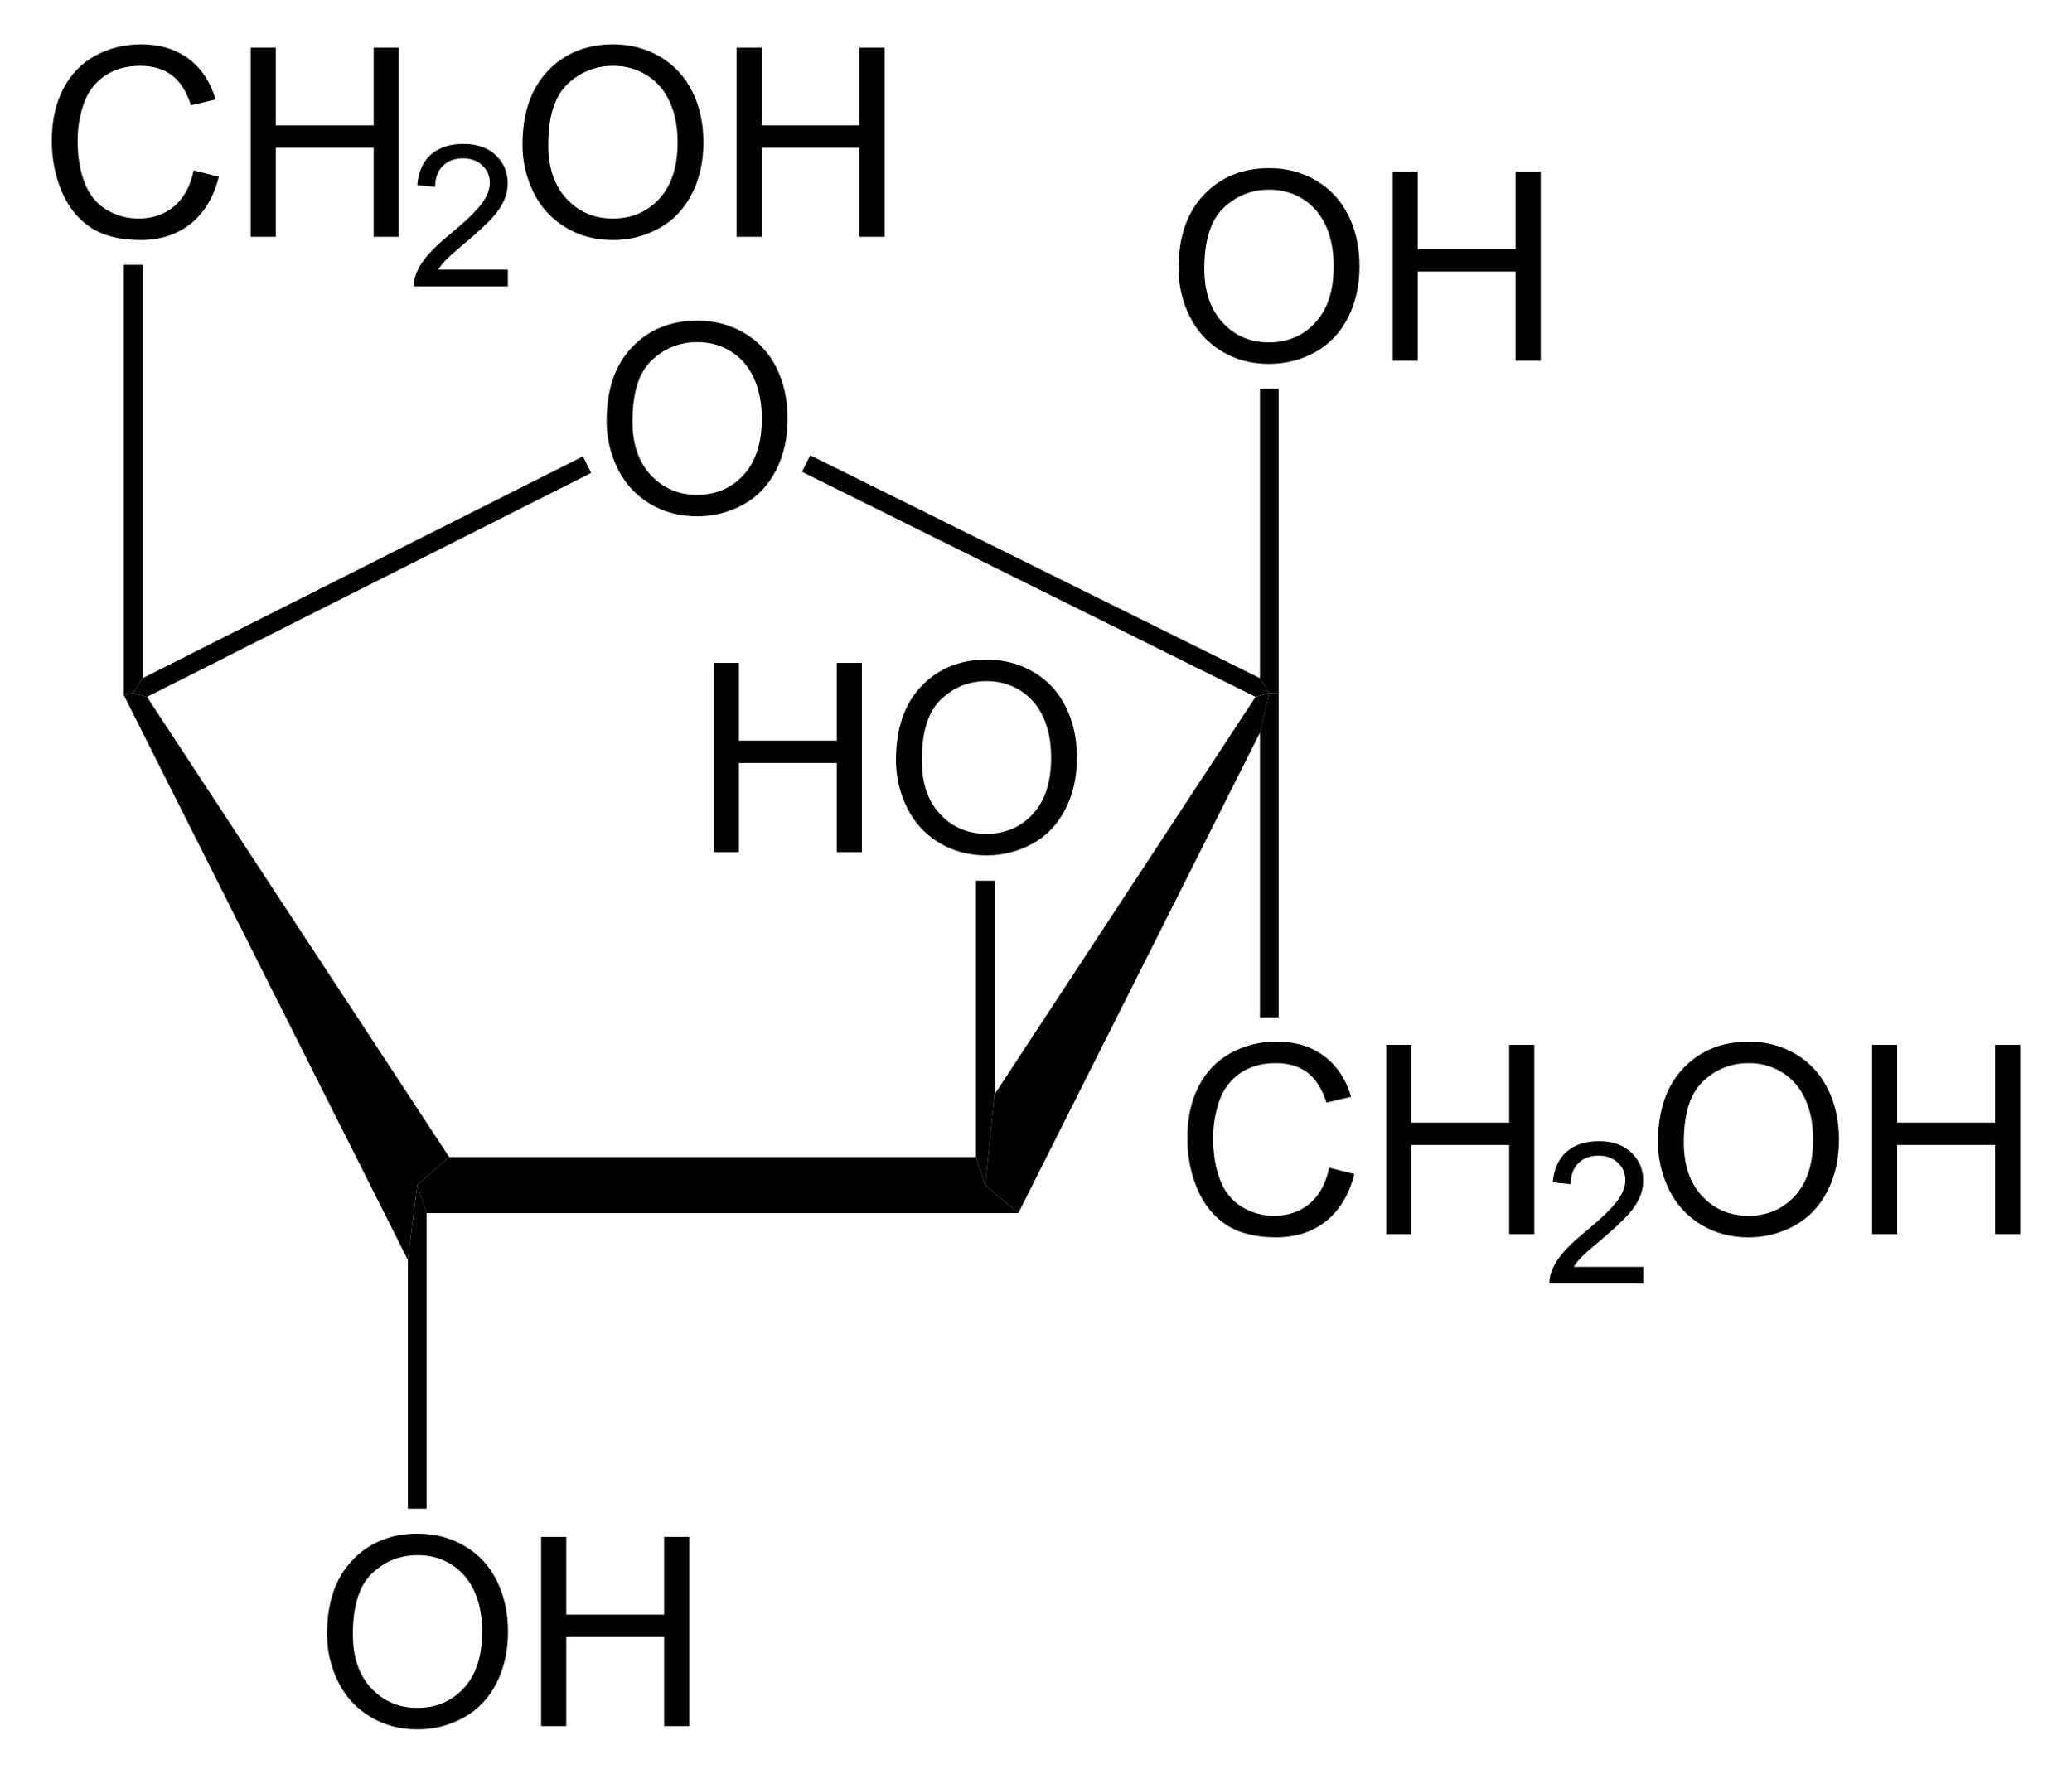
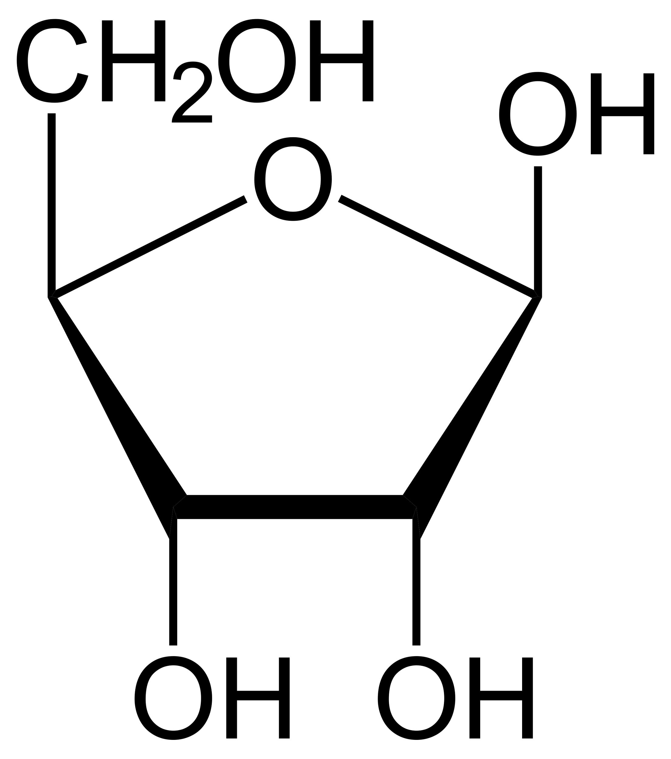
Structure of Carbohydrates: Monosaccharides
Simplest form of carbohydrate, consisting of one sugar unit with the general formula C_{n}H_{2n}O_{n}
Glucose
Galactose
Fructose
Ribose

Slide 4
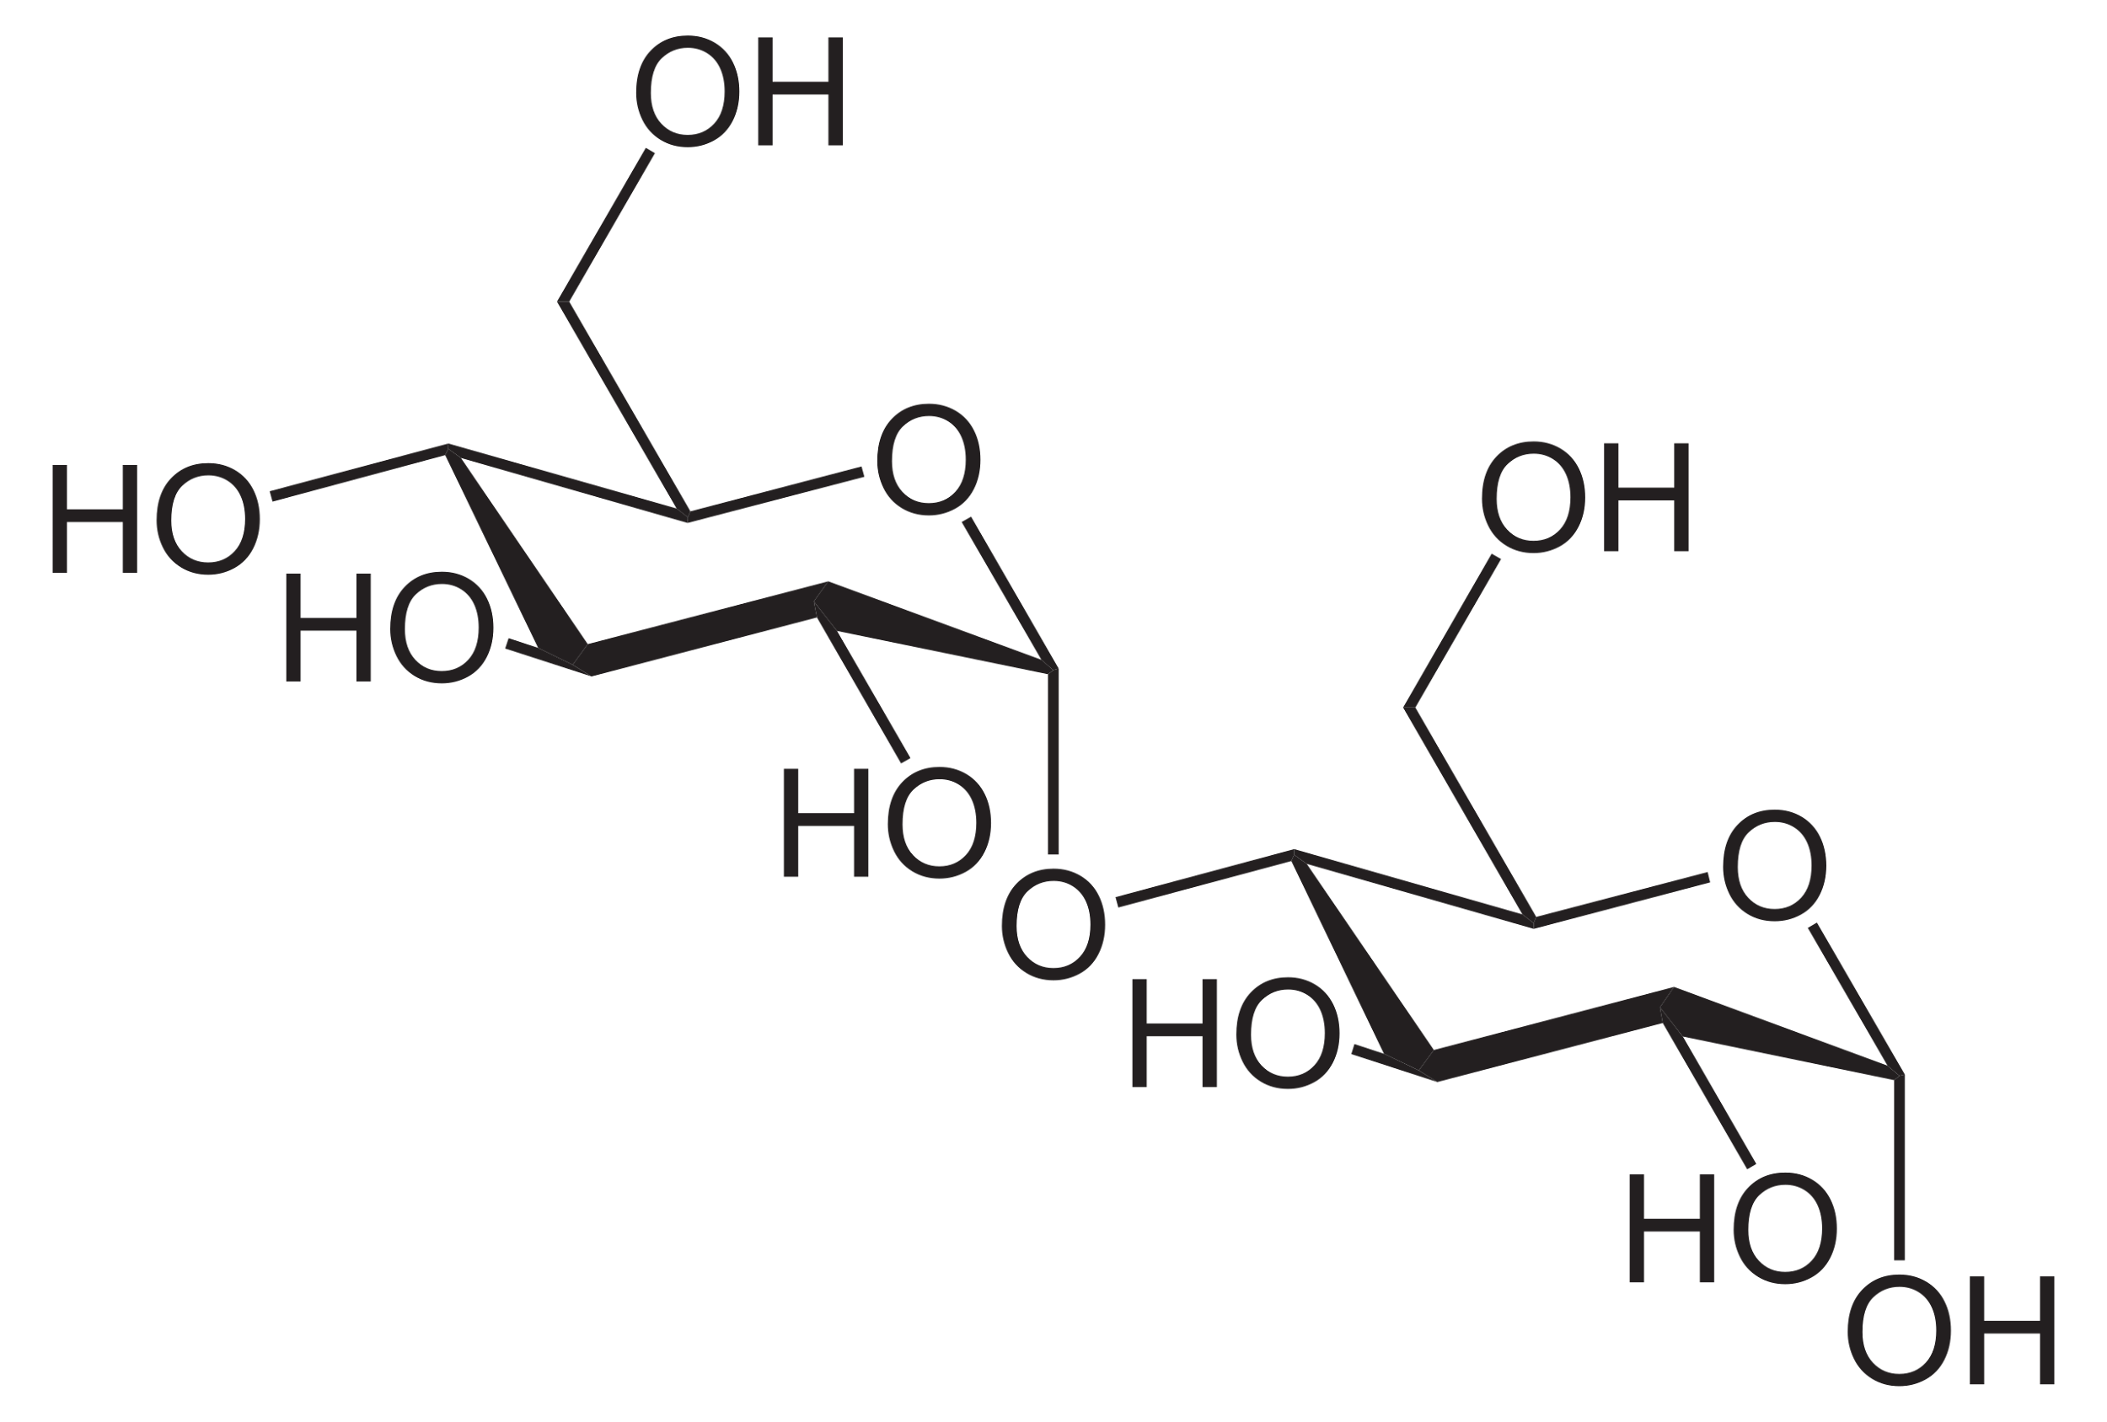
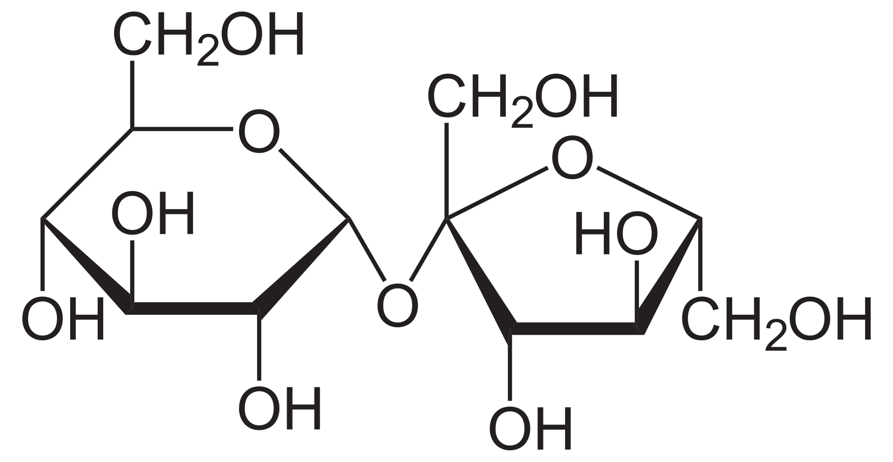
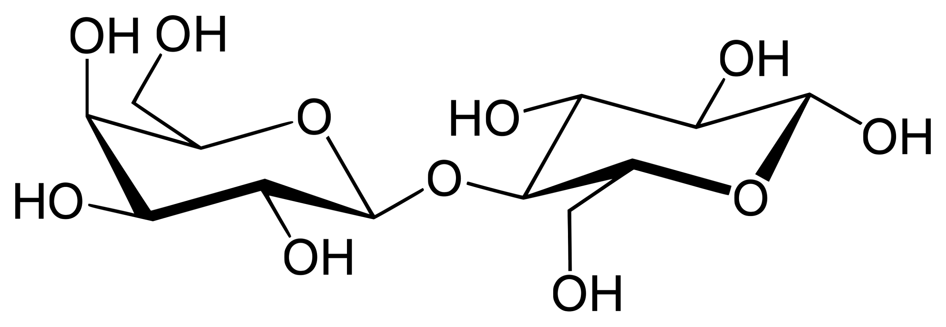
Structure of Carbohydrates: Disaccharides
Carbohydrate composed of two monosaccharides bound by a glycosidic linkage via dehydration synthesis
Maltose
(glucose + glucose; α-1,4 linkage)
Lactose
(glucose + galactose; β-1,4 linkage)
Sucrose
(glucose + fructose;
α-1, β-2 linkage)

Slide 5
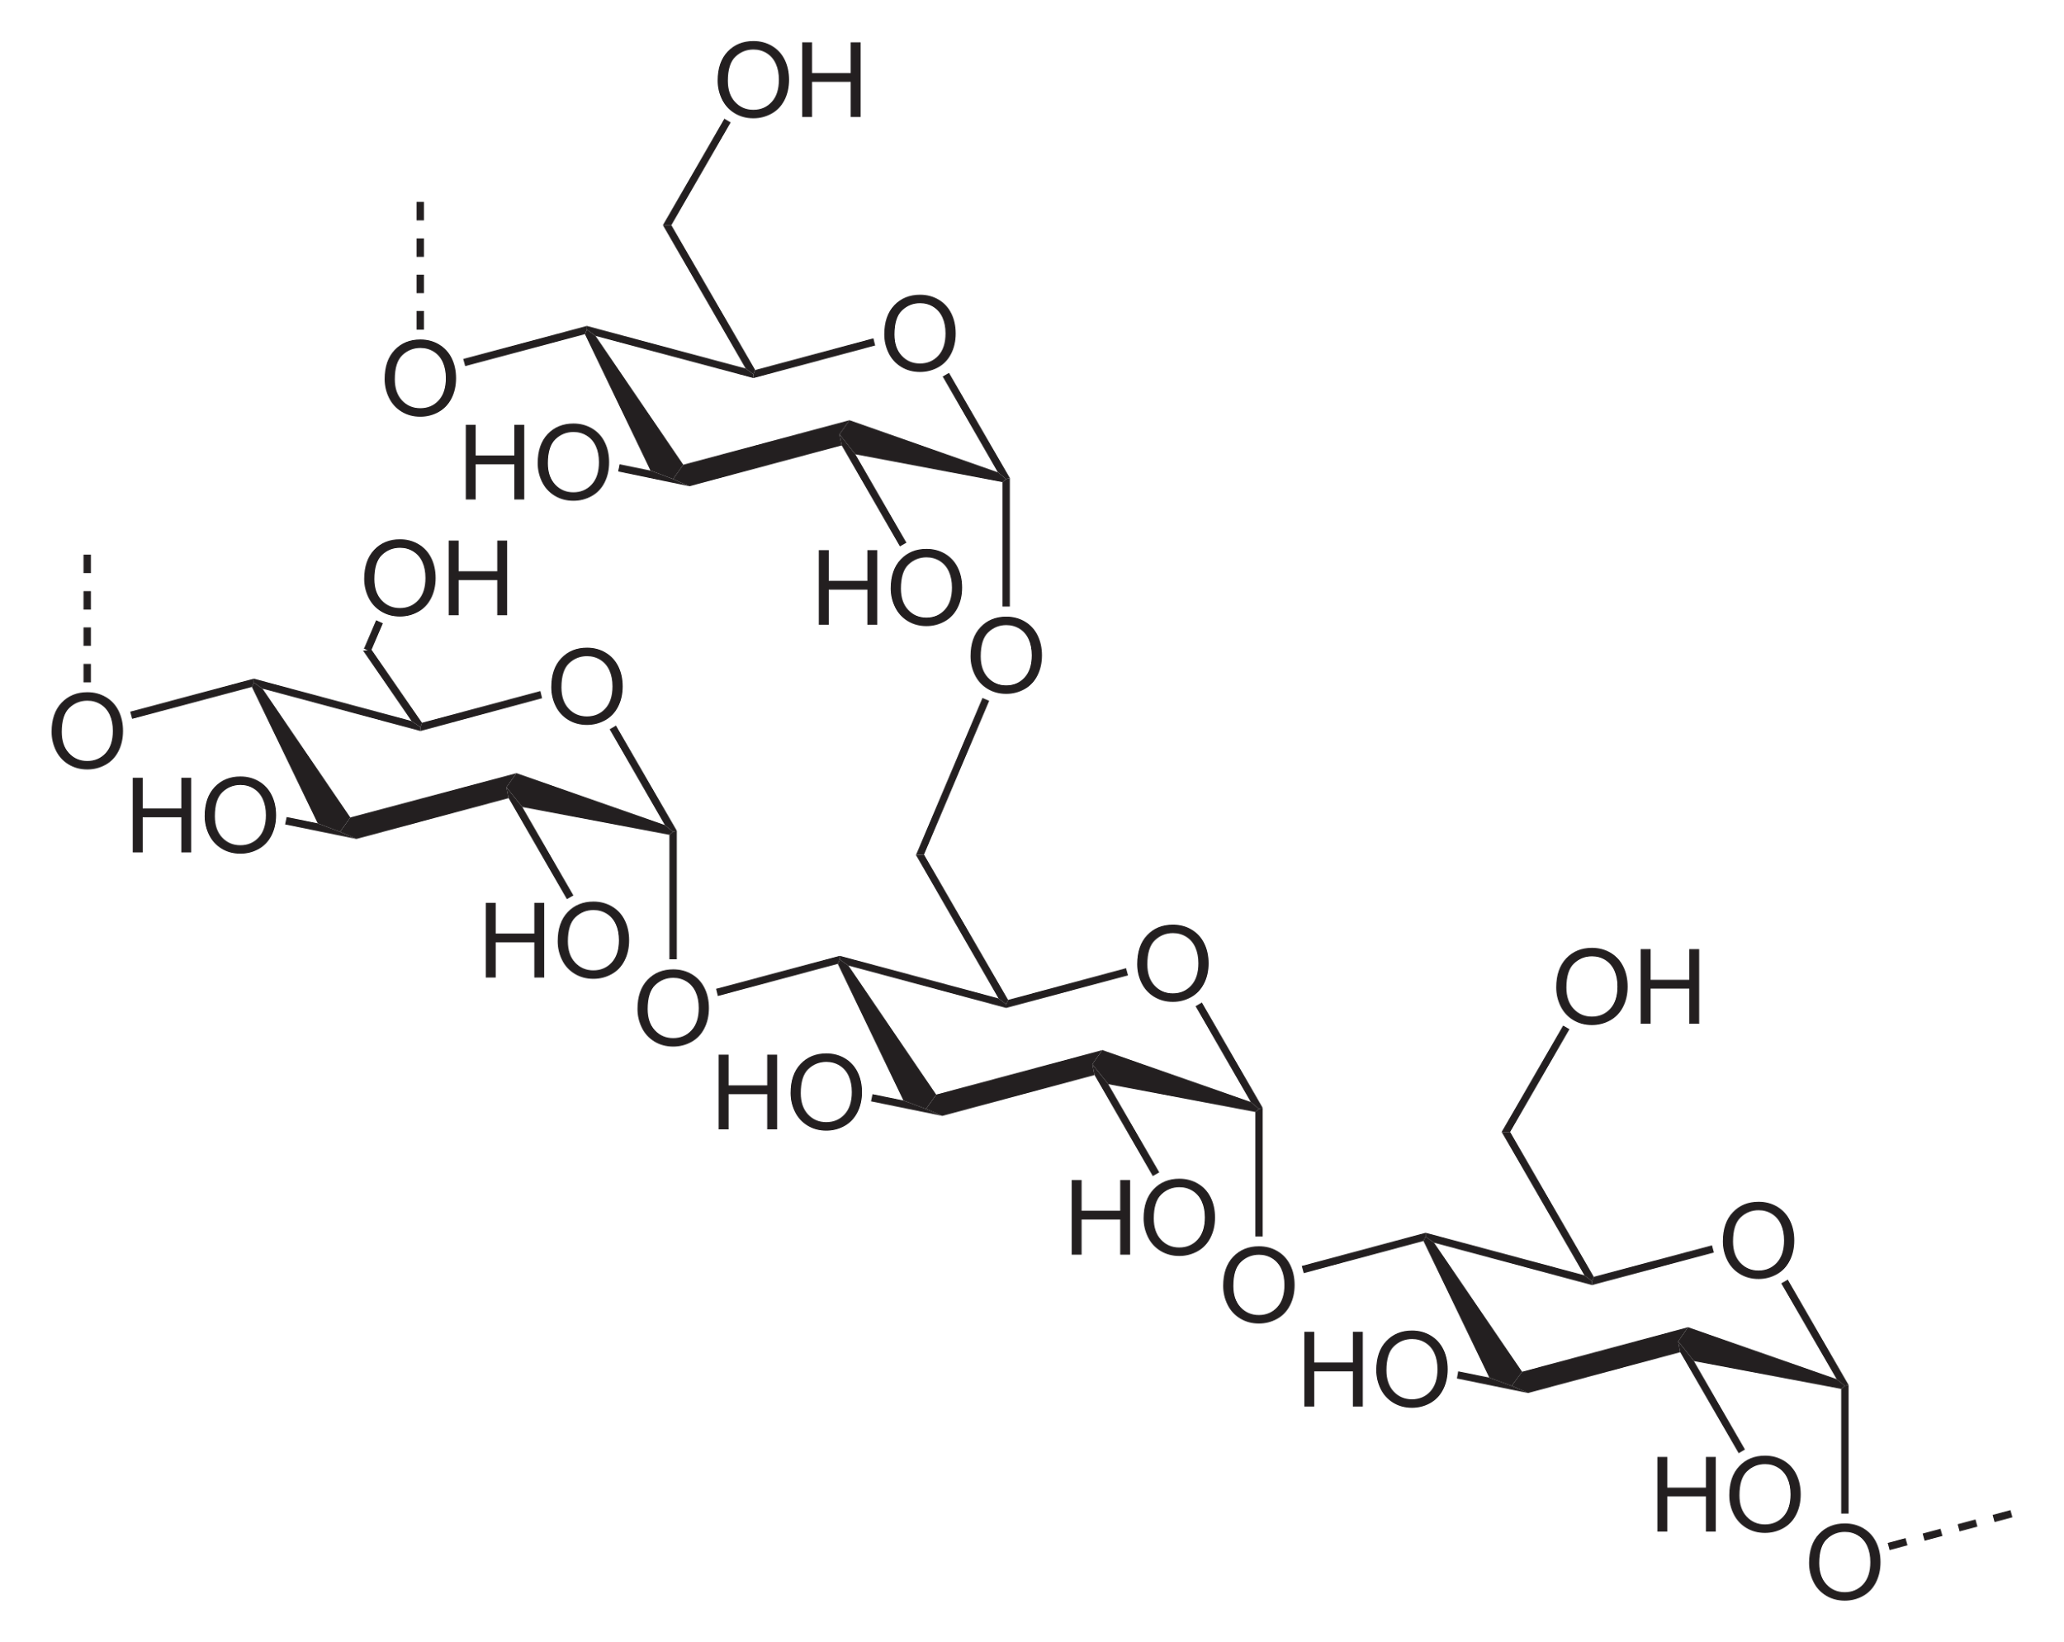
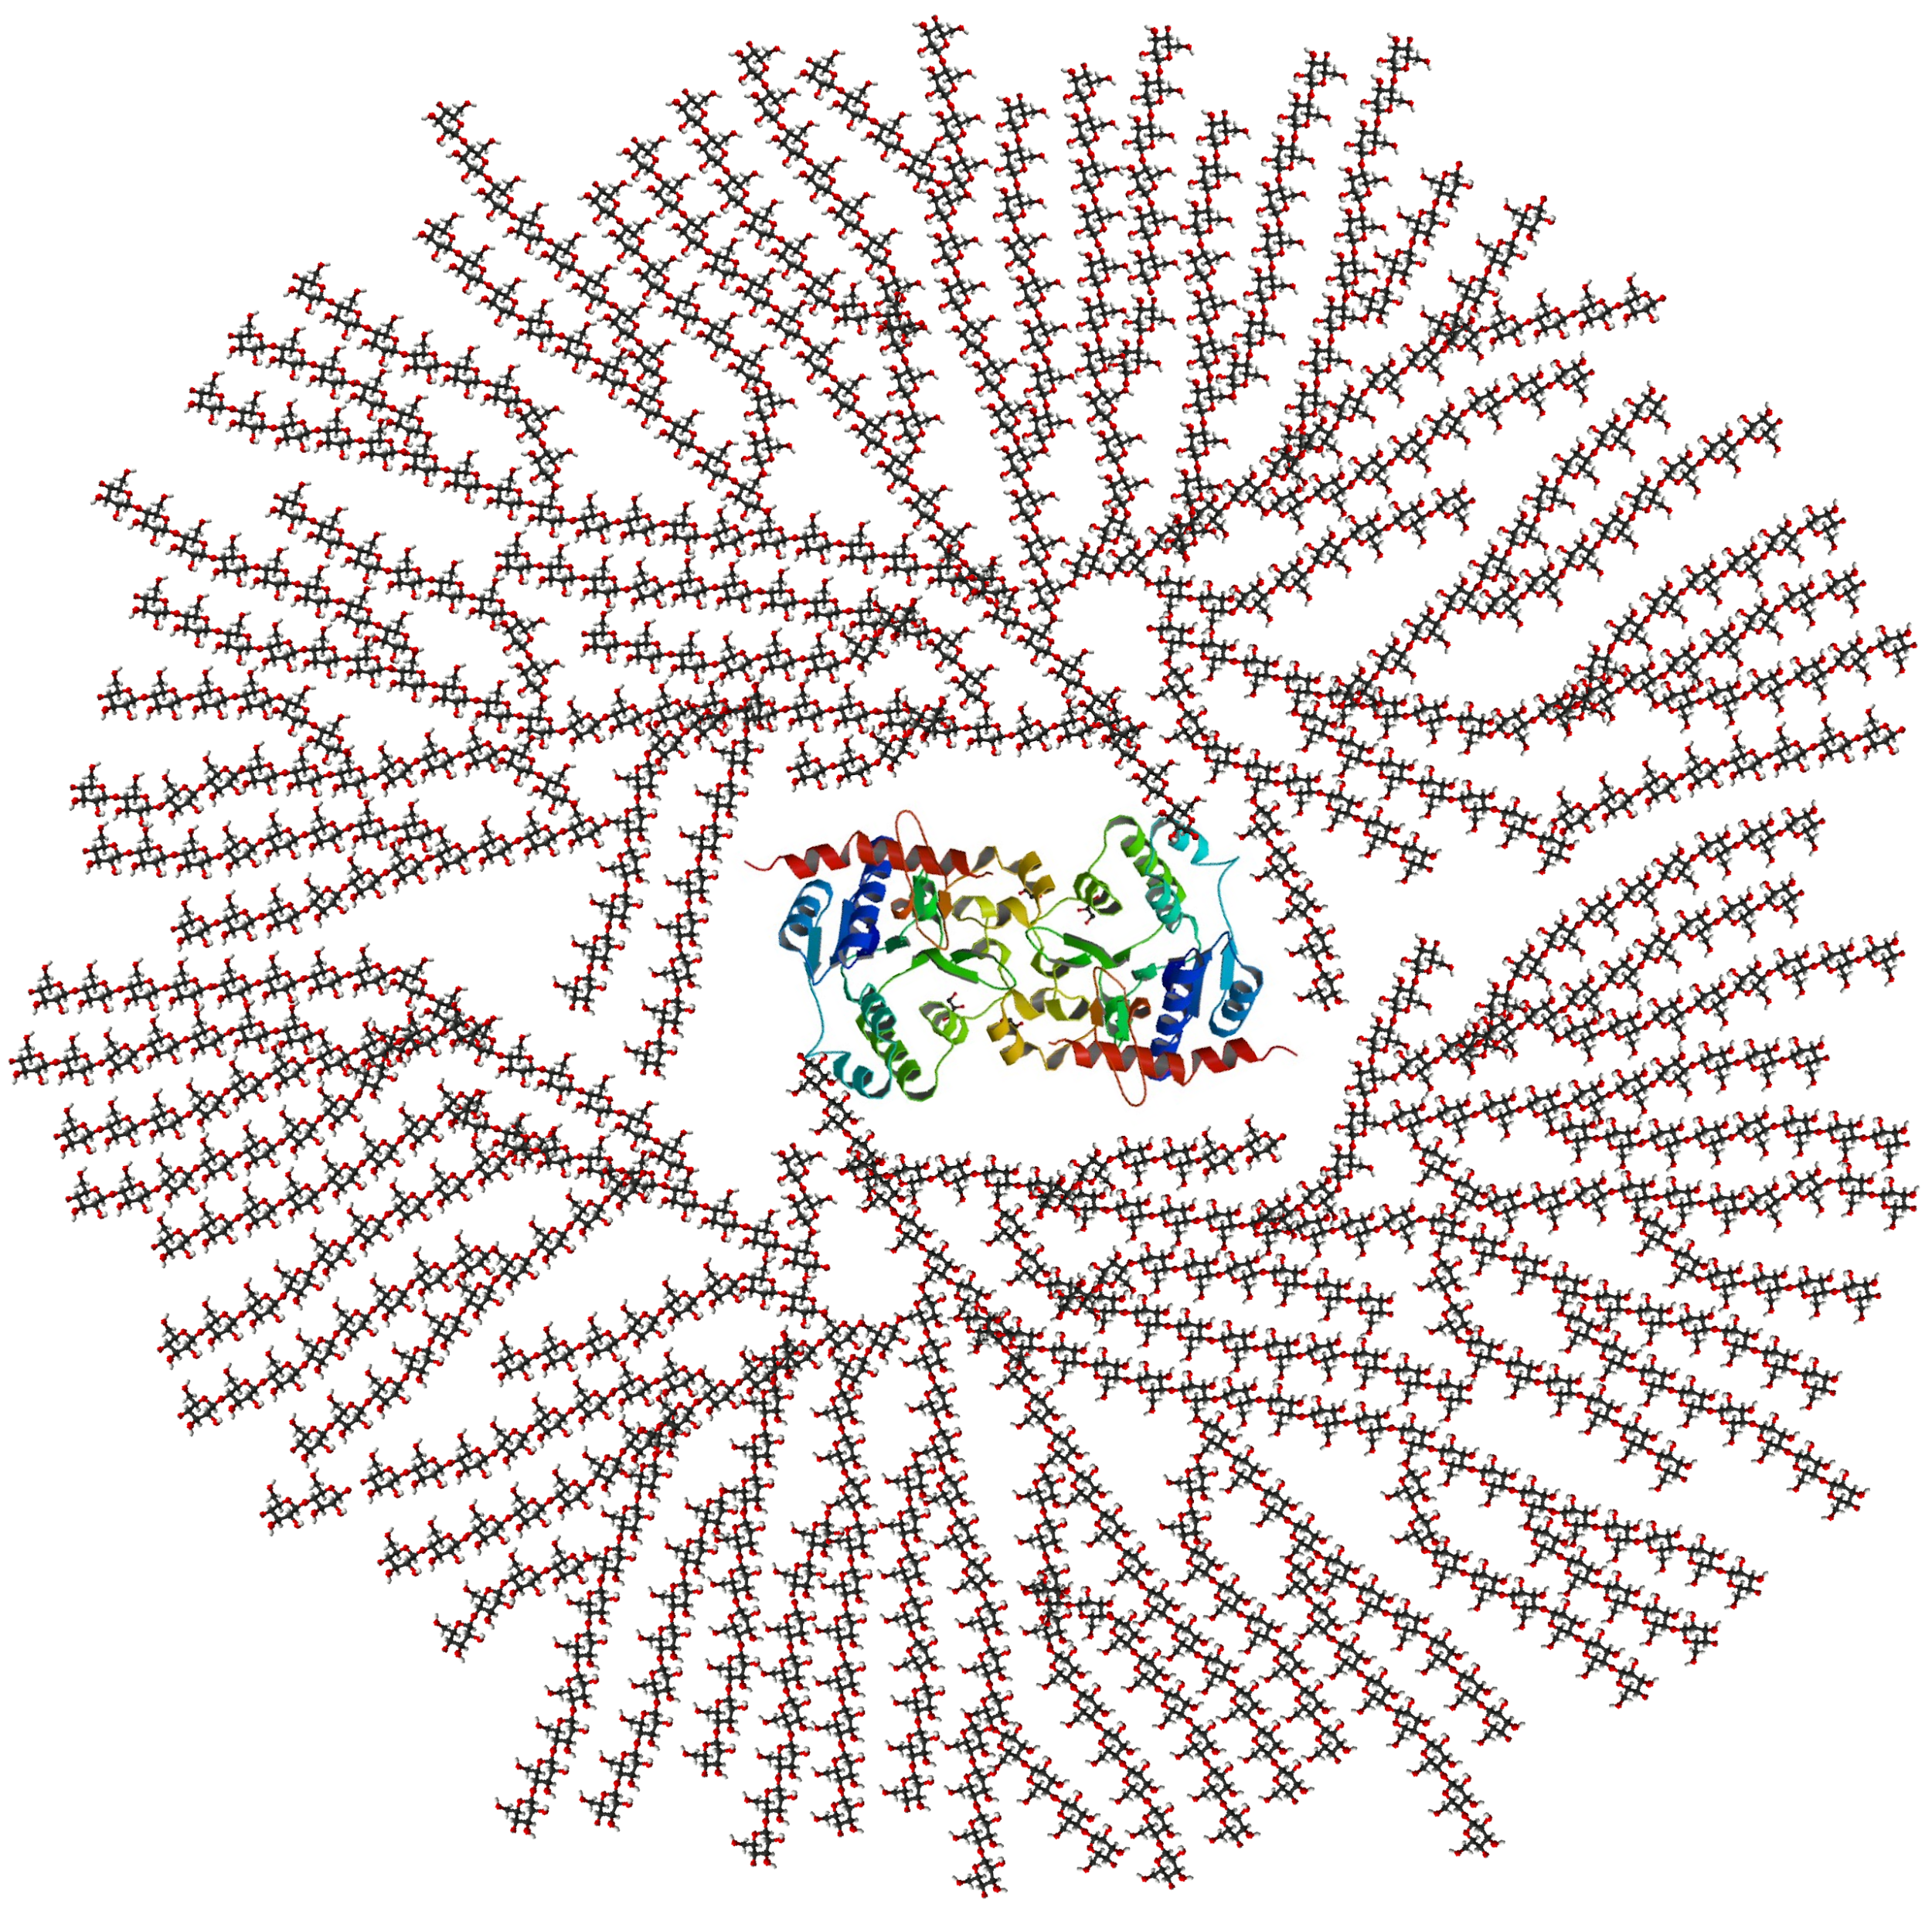
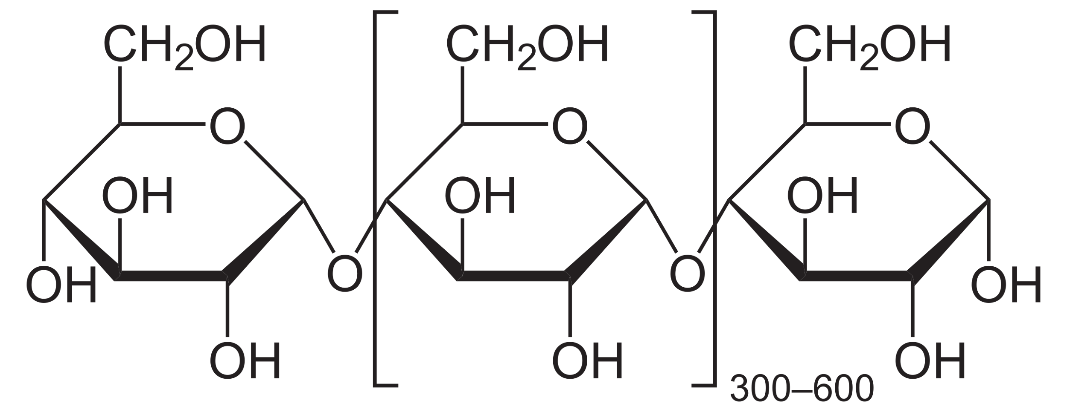
Structure of Carbohydrates: Polysaccharides
Carbohydrate composed of 100s - 1000s of linked monosaccharide units
Glycogen
Linear glucose chain (α-1,4 linkages) and branches (α-1,6 linkages) around central glycogenin protein
Amylose
Linear glucose chain (α-1,4 linkages)
Amylopectin
Linear glucose chain (α-1,4 linkages) and branches (α-1,6 linkages)

Slide 6
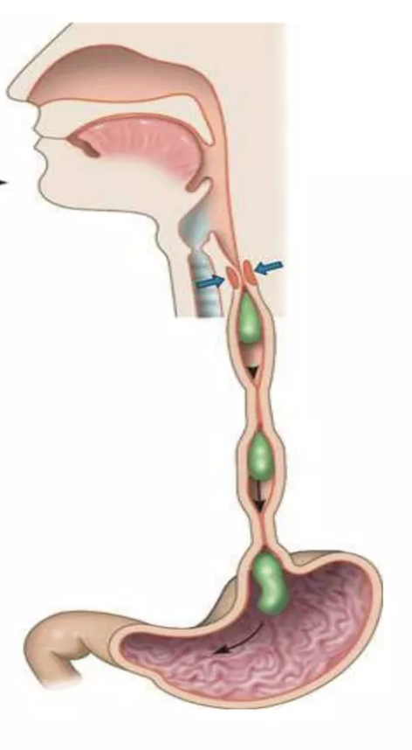
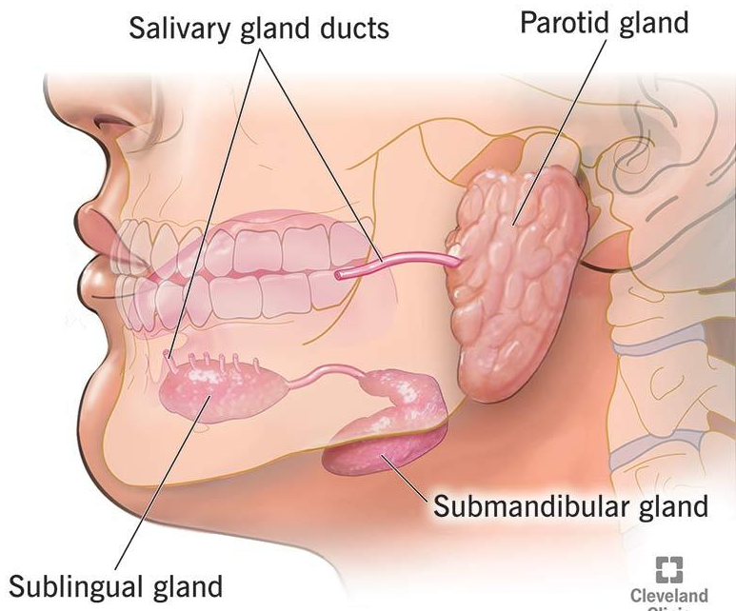
Carbohydrate Digestion in the Upper GI Tract
Mouth
  Mechanical digestion: teeth and tongue increase the enzymatic surface area via mastication
  Chemical digestion: salivary glands secrete salivary amylase to produce maltose and shortened polysaccharides from starch
Esophagus
  Transportation of the bolus via peristalsis
Stomach
  Denaturation of salivary amylase

Slide 7
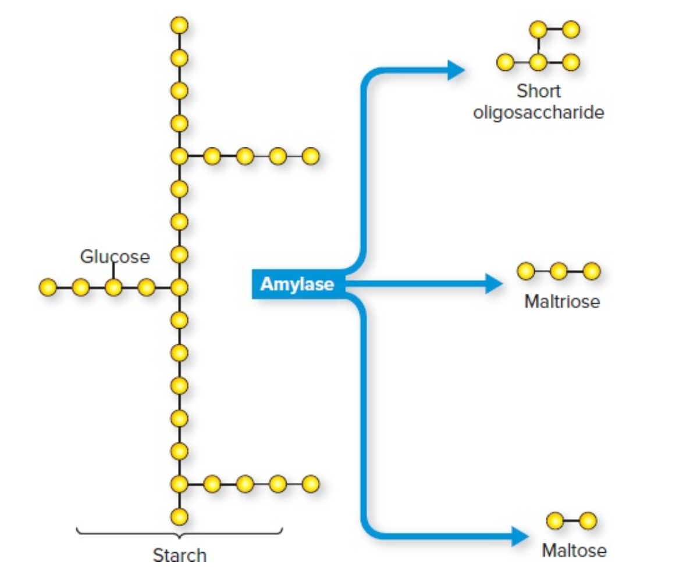
Small Intestine: Digestion in the Duodenum
Stomach → Pyloric sphincter → duodenum
Pancreatic amylase
  Starches (glucose chains!)
  ɑ-1,4 glycosidic bonds
  Maltooligosaccharide slurry
Sucrose and Lactose
  Unfazed by amylase
  No ɑ-1,4 linkage!

Slide 8
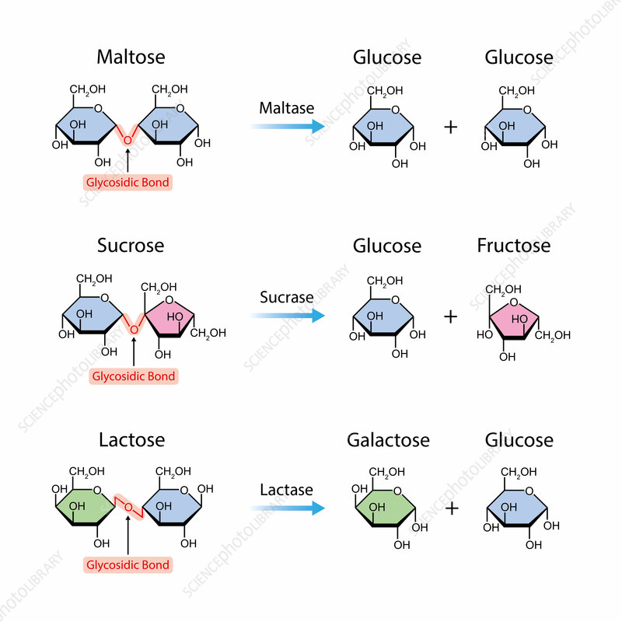
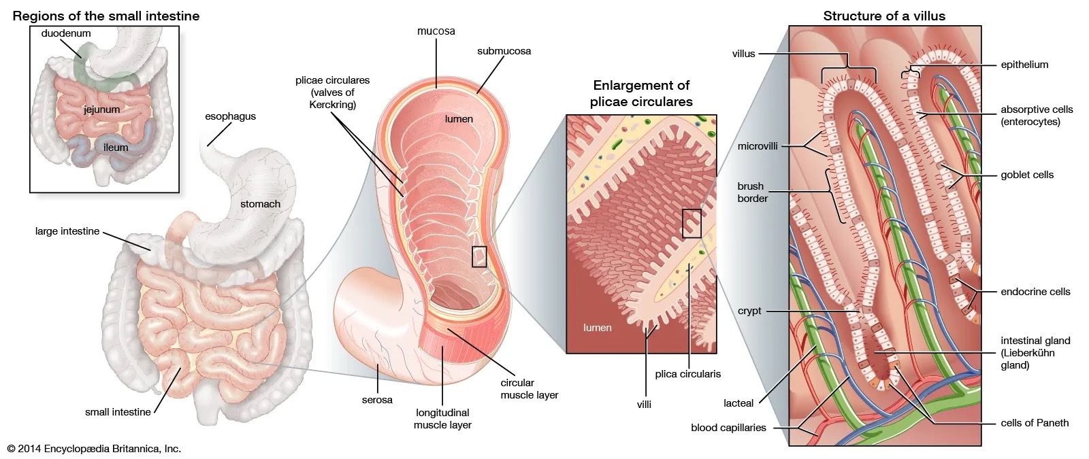
Small Intestine: The Brush Border
Brush Border
  Holds digestive enzymes and transports proteins
  Microvilli of the villi: Increase surface area
Finishing Carbohydrate digestion
  Lactase: lactose → glucose + galactose
  Sucrase: sucrose → glucose + fructose
  Maltase: maltose → glucose + glucose
  α-Dextrinase: branches → glucose

Slide 9
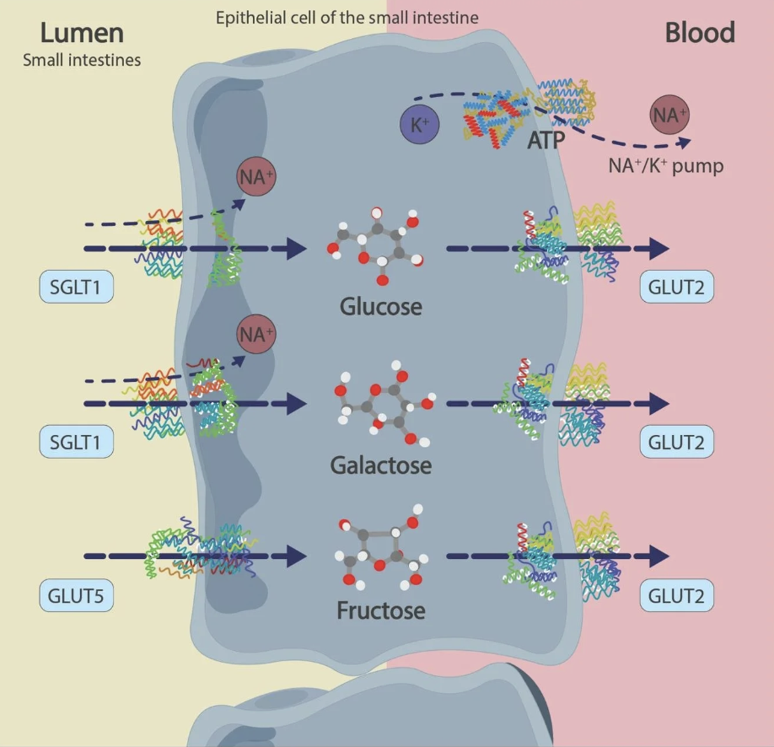
Small Intestine: Absorption
Transfer into the epithelial cell
  Na⁺/K⁺ ATPase: Moves sodium out of the intestinal cell, creating a low sodium concentration
  SGLT1: Brings glucose and galactose into the cell with sodium.
  GLUT5: Through facilitated diffusion, transports fructose inside the cell.
Transfers to the bloodstream
  GLUT2: facilitated diffusion; five and six carbons
  GLUT2: It is a facilitative glucose transporter in the intestine, that mediates the passive transmembrane transport of glucose

Slide 10
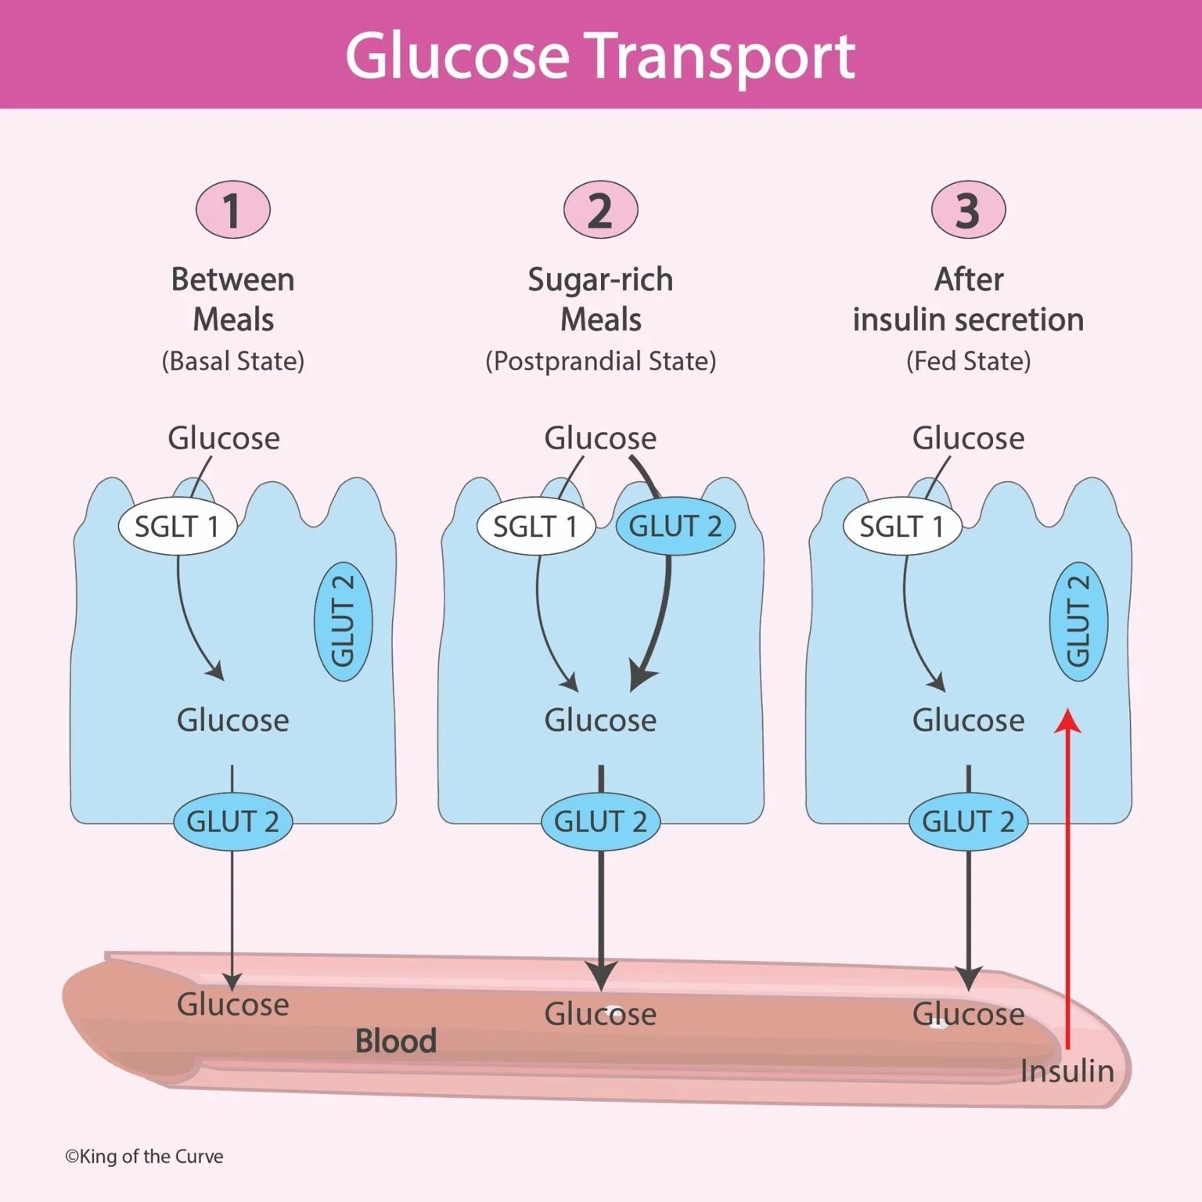
Path in the Blood Stream
As we know:
  Monosaccharides exit intestinal cells through GLUT2
  Sugars enter capillaries inside villi
  Transported through hepatic portal vein
  Delivered to the Liver
  Liver regulates glucose levels and nutrient storage

Slide 11
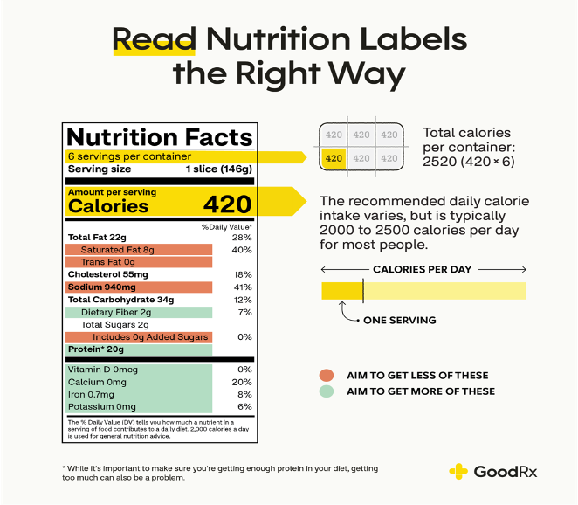
Calories
A calorie is a unit of energy.
In nutrition, calories refer to the energy people get from the food and drinks they consume and the energy they use in physical activity.
Calories are in the nutritional information on all food packaging.
1 kcal/kilocalorie = 1,000 cal

Slide 12
Three common fates of carbohydrates that were grate and we ate
Immediate use: ATP production.
Short-term storage: Glycogen via glycolysis.
Long(er)-term storage: Converted into fat (triglycerides).

Slide 13
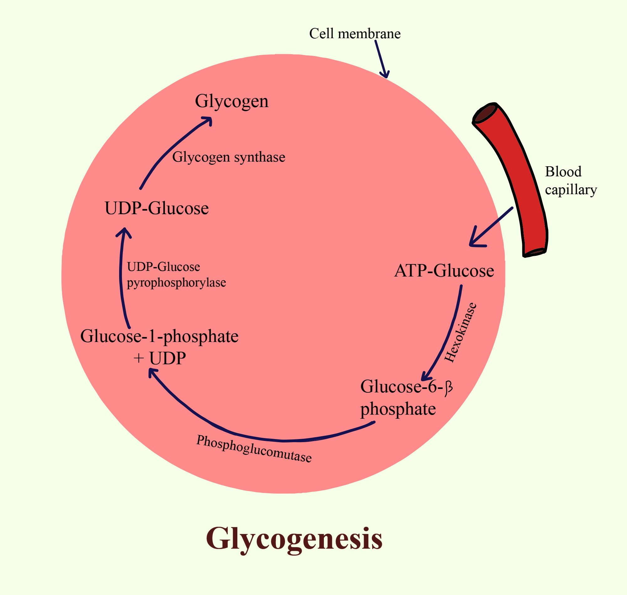
The G-words: Metabolic processess
Glycogenesis: Creating glycogen from glucose (storing).
Glycogenolysis: Breaking down glycogen from glucose (using storage).
Gluconeogenesis: Making “new” glucose from non-carbohydrate sources.
Glucose → glucose-6-phosphate → glucose-1-phosphate → glycogen

Slide 14
Building and storing
Glucose into Amino Acids: glucose provides the "carbon skeleton" to build non-essential amino acids. More than fuel. It’s a building material.
Glucose into fat: When glycogen stores are full, excess glucose is converted into triglycerides. This is a primary driver of weight gain.

Slide 15
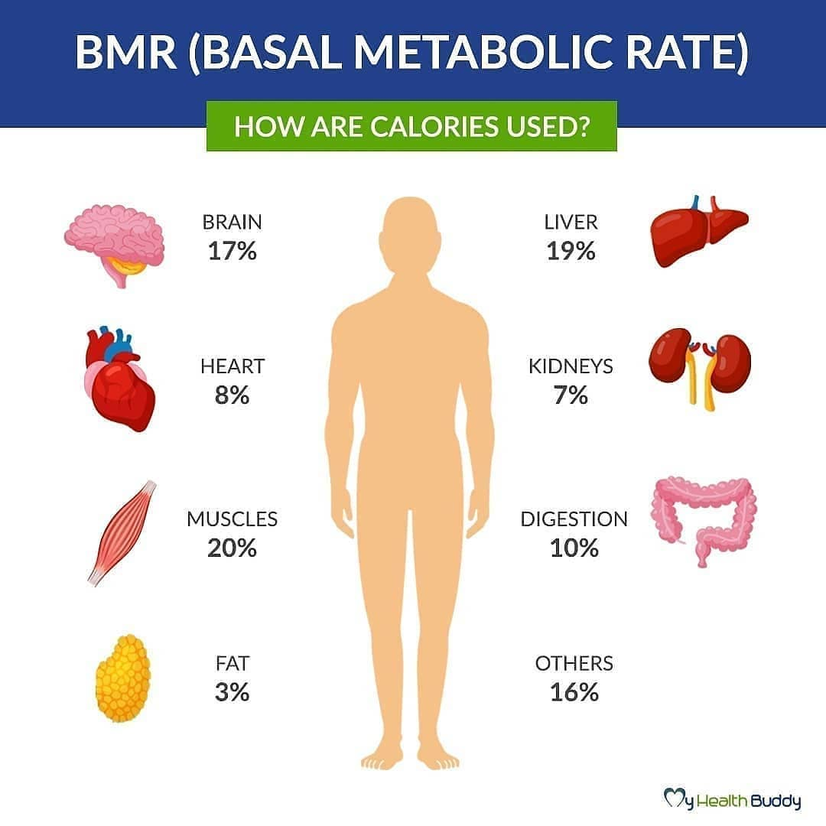
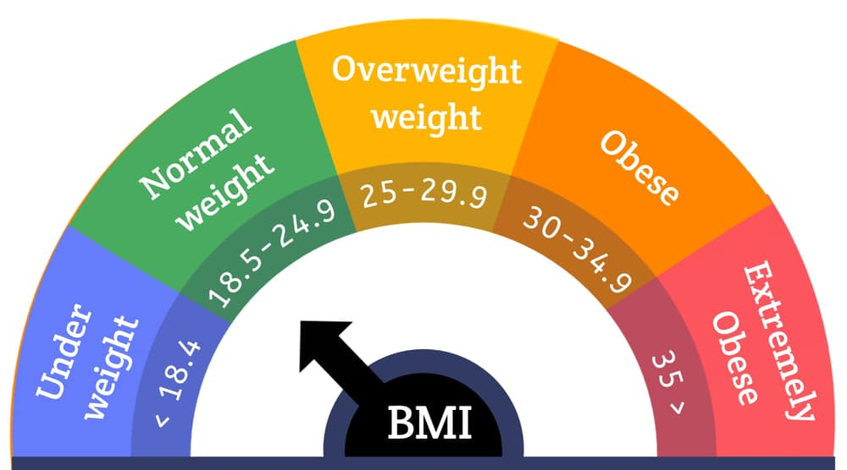
Energy metrics: BMR and BMI
The basal metabolic rate (BMR) is the number of calories your body uses to perform basic life functions while at rest.
The BMR accounts for up to 70% of calories burned in a day.
The body mass index (BMI) is used to estimate the amount of body fat by using your height and weight measurements.

Slide 16
The spark plugs (vitamins)
Water-soluble vitamins (B and C): Act as coenzymes in carbohydrate metabolism. Need them daily because they aren’t stored.
Fat-soluble vitamins (A, D, E, K): Vitamin D modulates glucose metabolism indirectly (via insulin sensitivity for example). Stored in fat tissue and liver.

Slide 17
Thank you!

