Slide 1
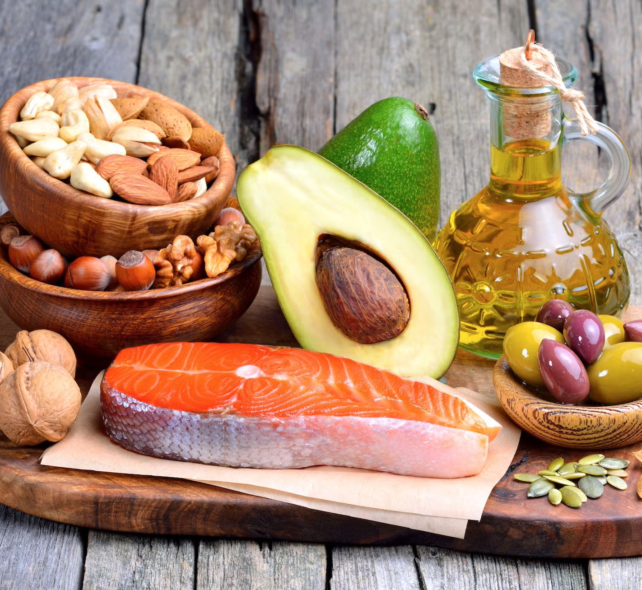
Digestion and Absorption of Fats
Group II
Christopher Sogan
Kelly Ryan
Nasreen Gutierrez

Slide 2
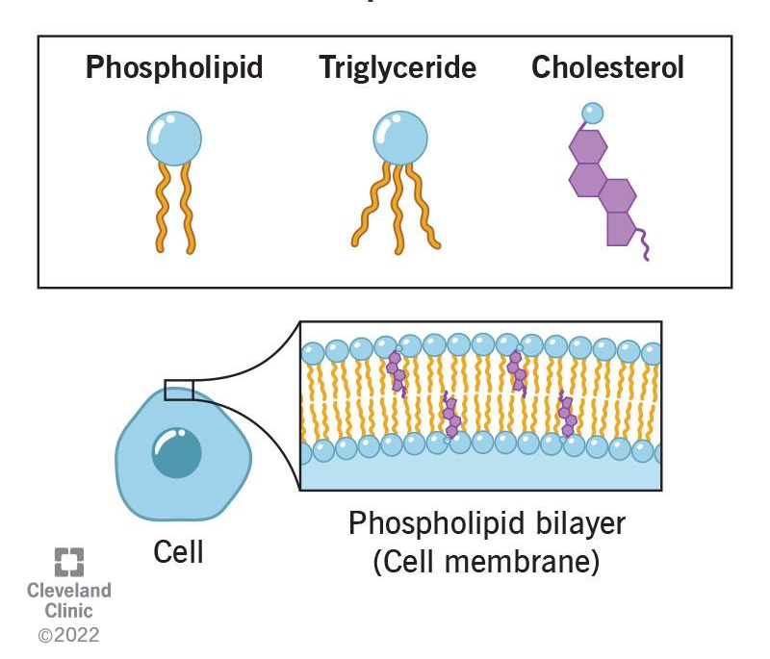
What are Fats?
Fats = Lipids
Nonpolar, hydrophobic, organic molecules
Consist of C, H, O

Slide 3
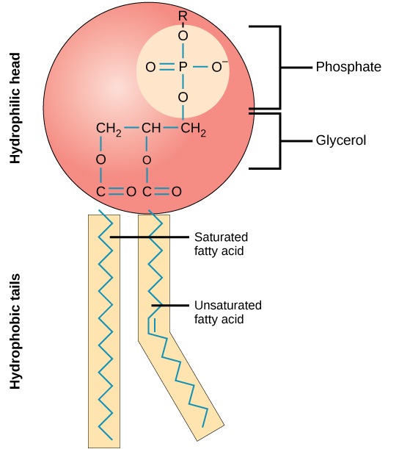
Phospholipids
Glycerol backbone
Phosphate group
2 fatty acid tails
Function:
Cell membrane structure
Protection/membrane fluidity
Cell-cell signaling

Slide 4
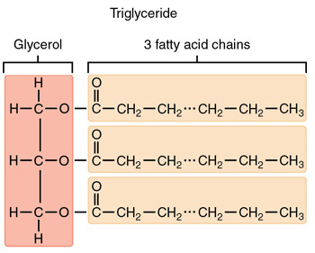
Triglycerides
Glycerol backbone
3 fatty acid tails
Function:
Long-term energy storage
Protection/insulation

Slide 5
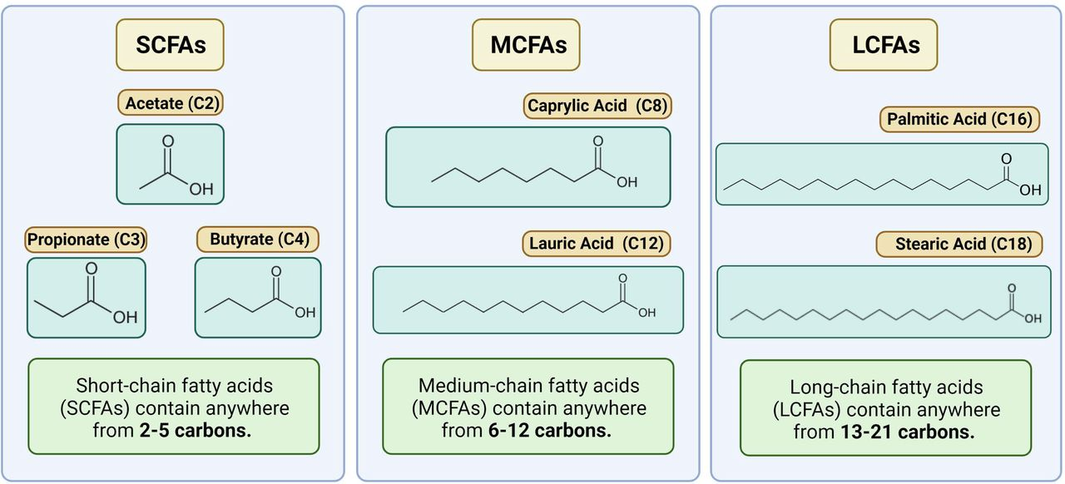
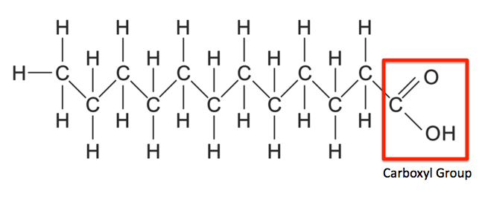
Fatty acids
Hydrocarbon chain
Carboxylic Acid group
Short Chain Fatty Acid
Produced by gut-friendly bacteria
Provide energy for colon cells
Reduce inflammation/regulate metabolism
Long Chain Fatty Acid
Energy source
Essential for membrane phospholipids
Produced by liver/found in food
Saturated vs. unsaturated

Slide 6
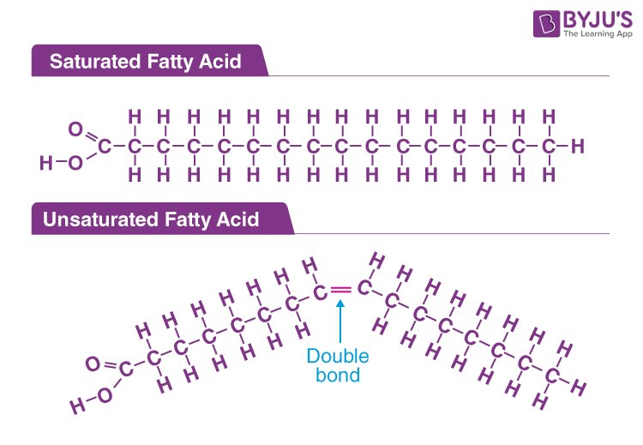
Types of fat
Saturated = single bonds
Straight chain; tightly packed; solid @ room temp
Dairy, meat, coconut oil
Increase risk for heart disease
Unsaturated = double bond
Kinked chain; liquid @ room temp
Olive oil, avocado, nuts
Improve heart health
Polyunsaturated = 2+ double bonds
Omega-3/Omega-6

Slide 7
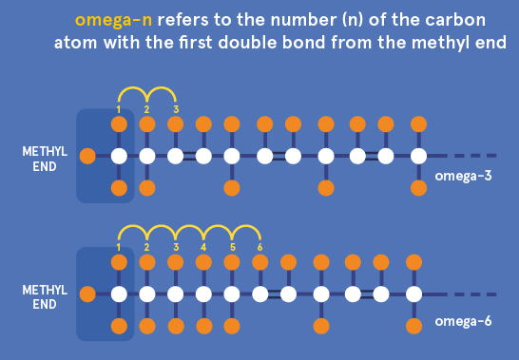
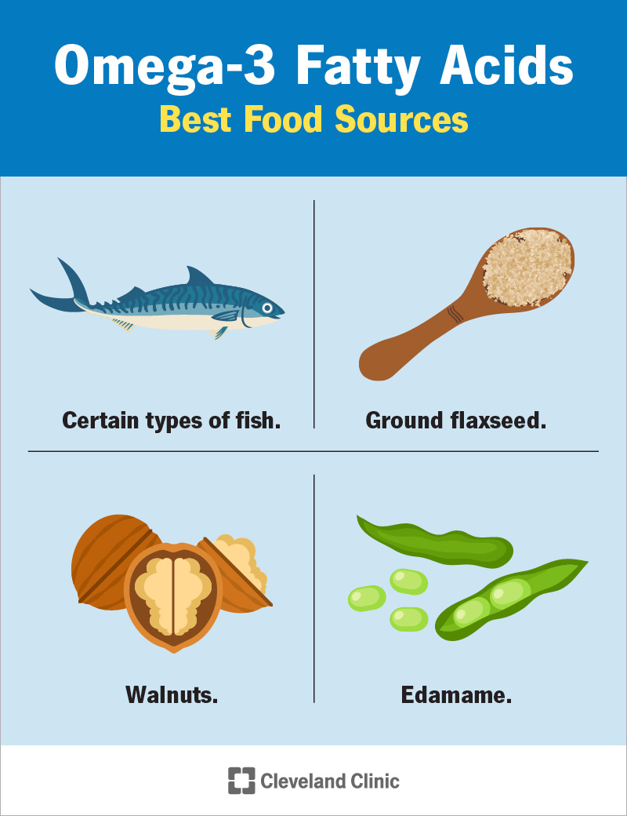
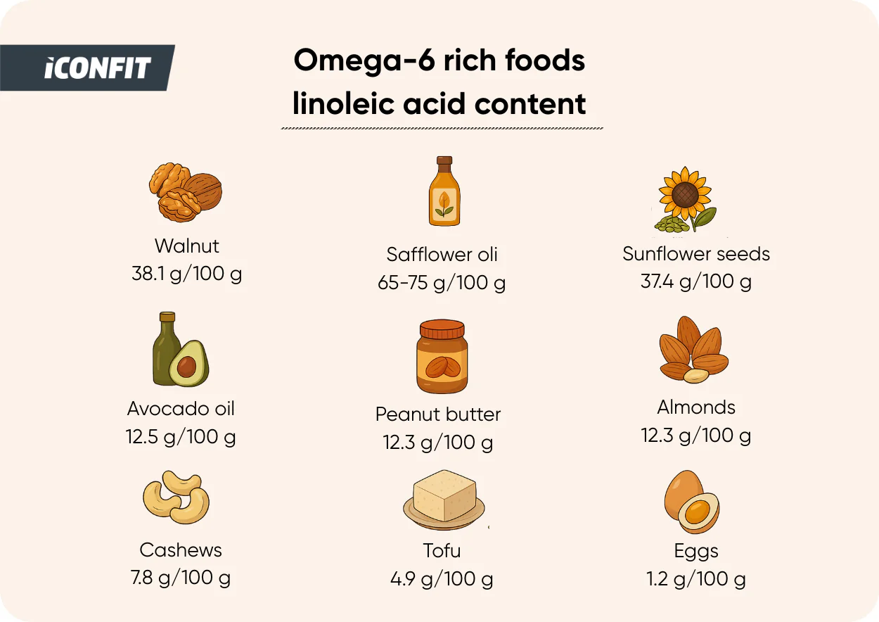
Essential Fatty Acids
OMEGA-3: Alpha-linolenic acid
Heart health/reduce inflammation
Brain/eye structure/function
Polyunsaturated fats
MUST be obtained from diet
OMEGA-6: Linoleic acid
Cell structure/immune response
Skin/hair health

Slide 8
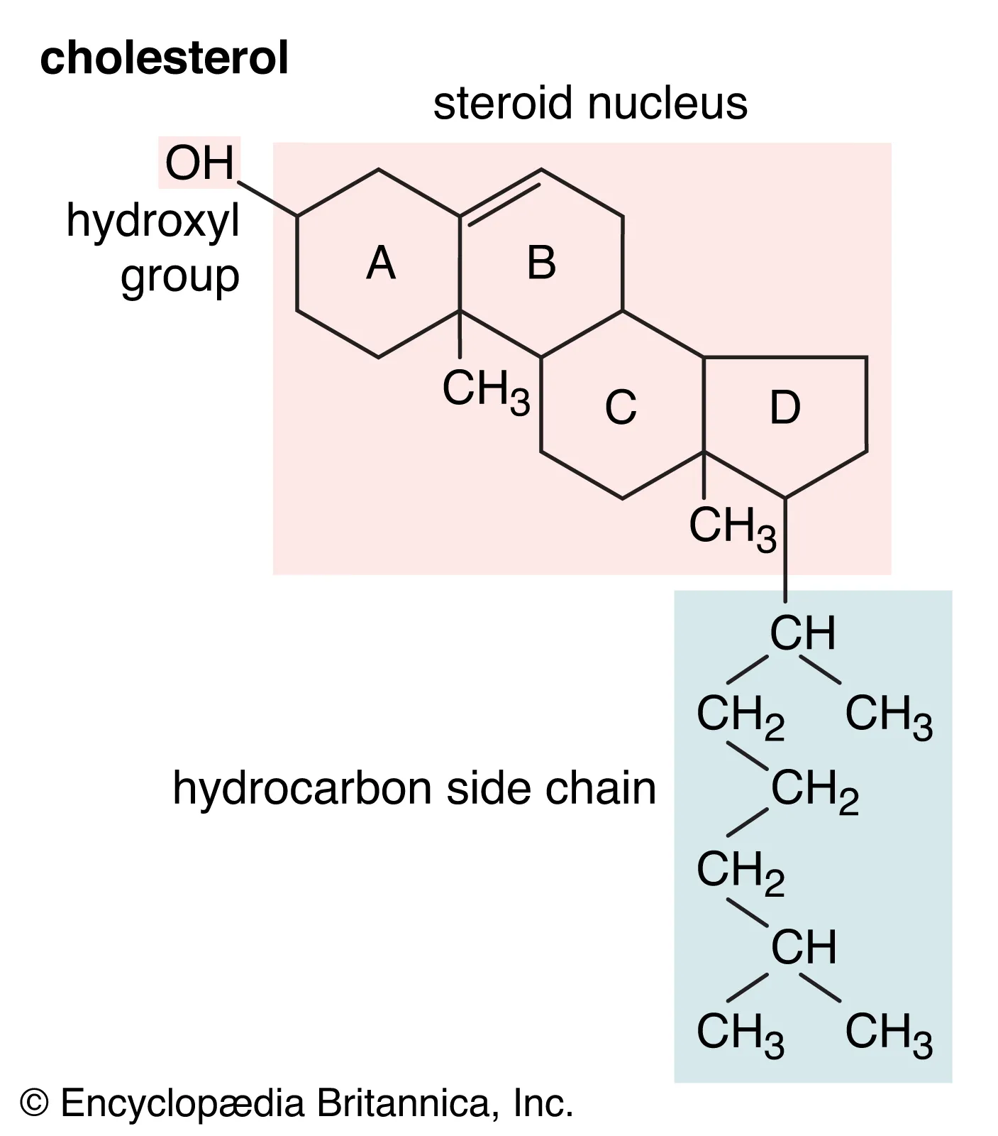
Cholesterol
4 fused hydrocarbon rings
Hydrocarbon tail
Hydroxyl group
80% made by liver
Function:
Cell membrane structure/fluidity
Hormone production
Produces bile/aids in digestion

Slide 9
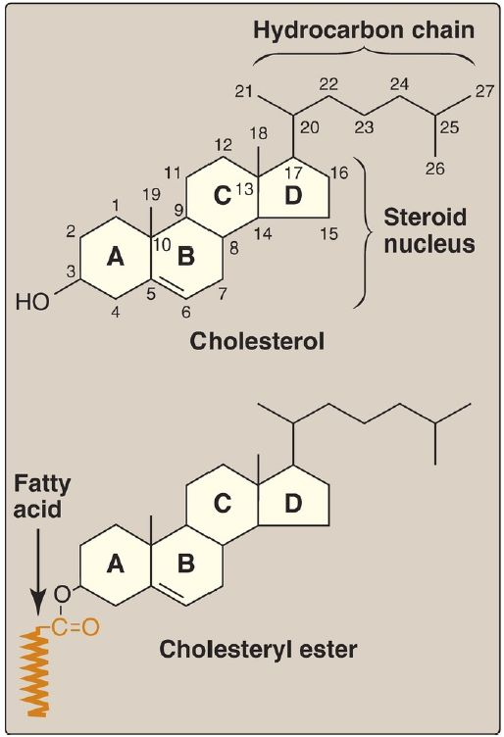
Cholesterol Ester
Cholesterol + fatty acid tail
Linked with ester bond at hydroxyl group
VERY hydrophobic
Function:
Storage/transport
High cholesterol ester = risk of atherosclerosis

Slide 10
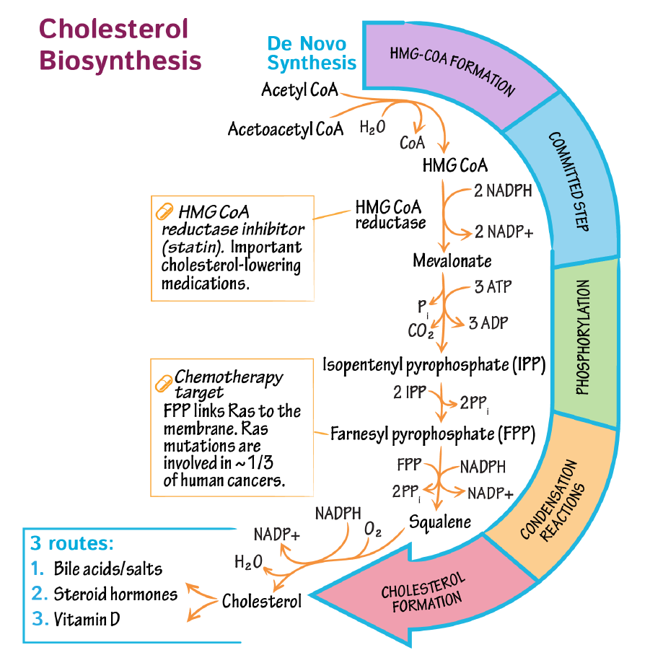
cholesterol synthesis pathway
Occurs in LIVER (cytosol/SER)
Requires ATP
Synthesis of HMG-CoA
HMG-CoA ---> Mevalonate
HMG-CoA Reductase: controls speed of cholesterol pathway (rate-limiting)
Negative Feedback Loop
Statins = HMG-CoA Reductase Inhibitors; reduce risk of stroke/heart attack
Mevalonate phosphorylated = IPP
6 IPP condense to form Squalene
19-step process to form Cholesterol

Slide 11
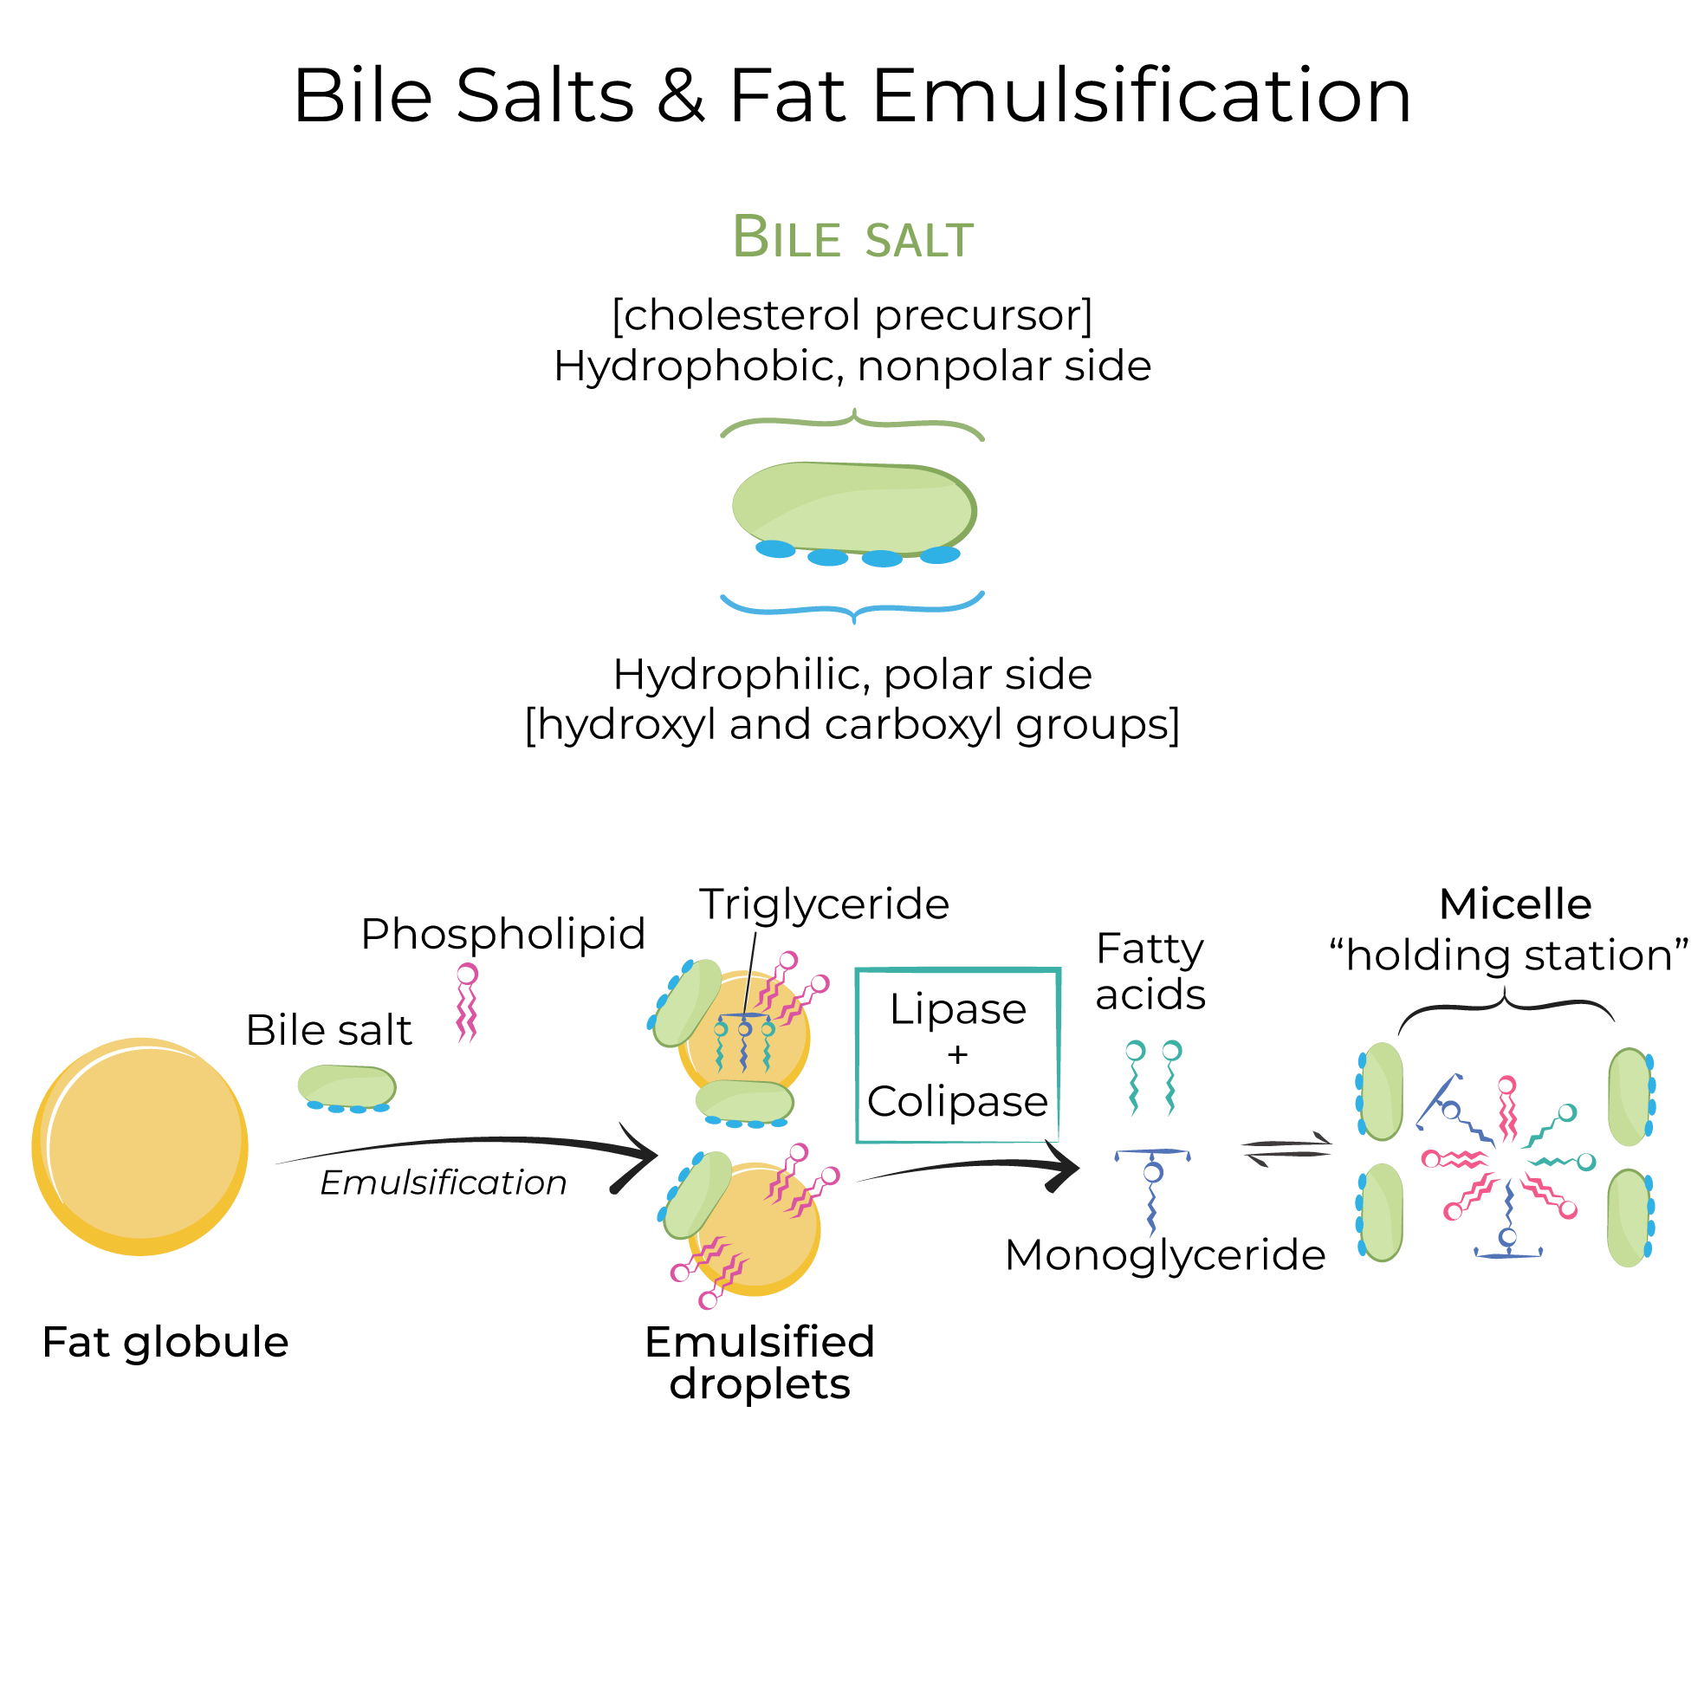
Bile Salts
Synthesized in liver from cholesterol
Stored in gallbladder & passed to small intestine
Amphipathic: hydrophilic/hydrophobic
Necessary for fat-soluble vitamin absorption (A, D, E, K)
Function:
Emulsification: increase surface area by breaking down large fat globules into triglycerides
Triglycerides --> Monoglyceride + fatty acids
Pancreatic Lipase: hydrolyzes/breaks down triglyceride
Pancreatic Colipase: cofactor to aid in binding of lipase to triglyceride

Slide 12
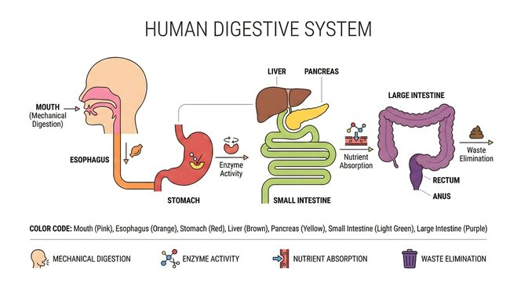
Mechanical & Chemical Digestion OF FATS
Mouth
Esophagus
Stomach
Small Intestine
Lymphatic System
Blood

Slide 13
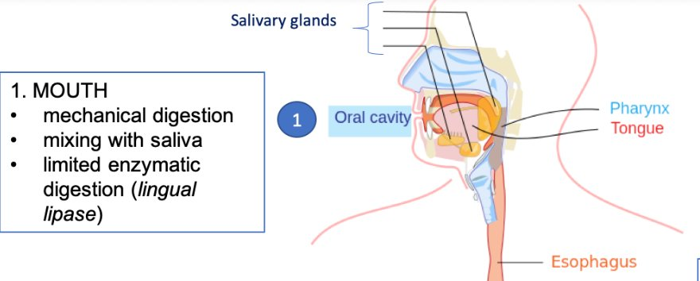
Mouth
Esophagus
MECHANICAL DIGESTION
Mastication
CHEMICAL DIGESTION
Lingual Lipase: salivary enzyme
MINOR fat breakdown
MECHANICAL DIGESTION
Peristalsis
Upper/lower sphincters
Allow food to enter esophagus & prevent backflow once food enters stomach

Slide 14
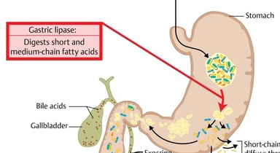
Stomach
MECHANICAL DIGESTION
Muscular walls churn & mix food with gastric juices
Peristalsis
CHEMICAL DIGESTION
Gastric Lipase
30% Triglycerides --> diglyceride + 1 fatty acid

Slide 15
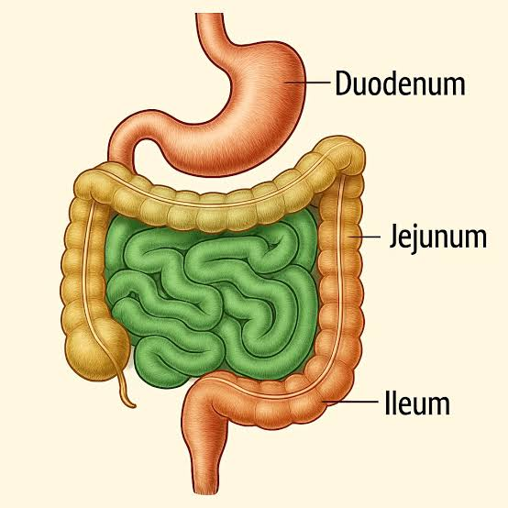
Small intestine
MECHANICAL DIGESTION
Bile salts released from gallbladder
Emulsification: breaks fat globules into triglycerides --> increase surface area for enzymes
CHEMICAL DIGESTION
Pancreatic Lipase released from pancreas
Triglycerides --> 1 monoglyceride + 2 fatty acids
Pancreatic Colipase: cofactor that anchors lipase to triglycerides
Micelles: bile salts + phospholipids
carry digested fats to microvilli of small intestine for absorption

Slide 16
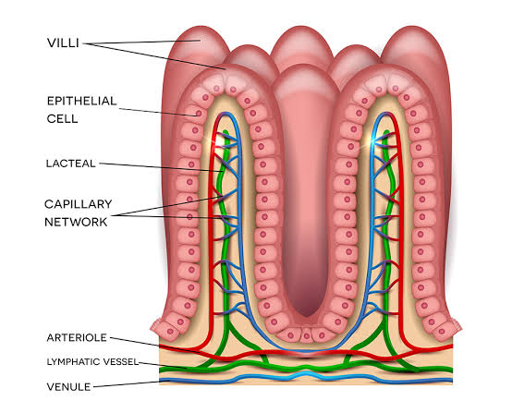
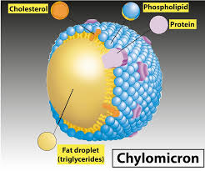
Absorption and Transport of Fats
Lipid fragments of micelle enter absorptive (epithelial) cells
Monoglycerides + fatty acids --> triglycerides
In Smooth Endoplasmic Reticulum
Short-chain fatty acids --> enter blood capillaries --> hepatic portal vein --> liver
Long-chain fatty acids packaged into chylomicrons within golgi apparatus
Chylomicrons = triglycerides & cholesterol (inside) + phospholipids & proteins (outside)
Too large for blood capillaries --> enter lacteals (lymphatic capillaries)
Lacteals --> thoracic duct --> left subclavian vein --> bloodstream --> fat to rest of body
Chylomicron remnants --> liver --> used to create VLDL

Slide 17
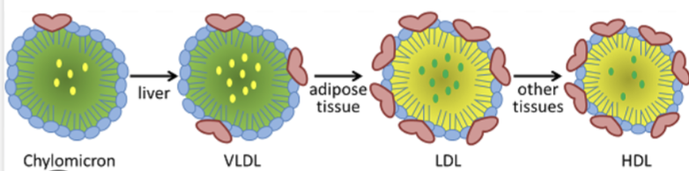
Lipoproteins:
a shell of phospholipids and apolipoproteins that transport triglycerides & cholesterol (ester) through the bloodstream
Chylomicron
Formed in small intestine
Transports dietary triglycerides & cholesterol
Enters lymphatic system into bloodstream
Remnants sent to liver
Largest/least dense
VLDL (Very Low-Density Lipoprotein)
Made by liver
Delivers triglycerides & cholesterol to body tissues
High triglyceride content = very low-density
LDL (Low-Density Lipoprotein)
Derived from VLDL
Triglycerides delivered to tissues = less fat + high cholesterol content
“Bad cholesterol” --> high LDL = buildup of cholesterol in arteries
HDL (High-Density Lipoprotein)
Collects waste (cholesterol) from extra hepatic tissue & returns to liver --> VLDL
“Good cholesterol” --> high HDL = lower heart disease risk
Mono/polyunsaturated fats

Slide 18
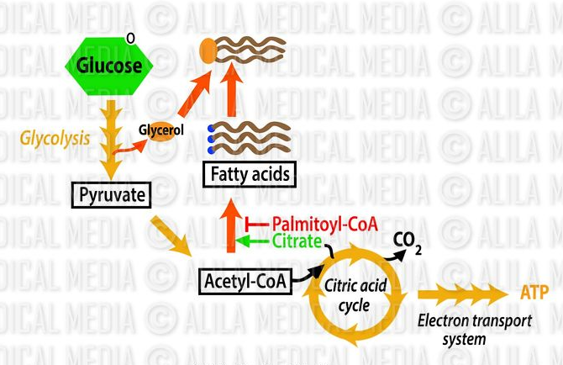
Lipogenesis
Occurs in liver
Glucose → Fat
Glucose → pyruvate → Acetyl-CoA
Liver synthesizes fatty acids from Acetyl-CoA
Fatty acids + glycerol = triglycerides --> VLDL
Delivered to adipose tissue for storage
Amino Acids → Fat
Excess amino acids (surplus protein) undergo deamination
Remove amine group from amino acid = carbon skeleton
Carbon skeletons → Acetyl-CoA → lipogenesis → triglycerides
Stored in adipose tissue
Less efficient pathway

Slide 19
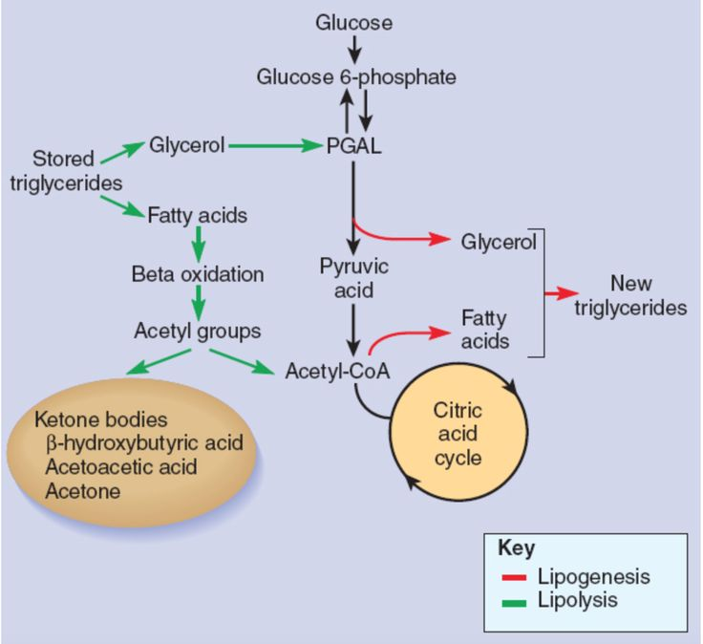
LIPOLYSIS
Fat for energy from low Glucose state
Fasting, exercise
Stored triglycerides from adipose tissue --> Free Fatty Acids (FFAs) + glycerol
FFAs released to bloodstream --> cells
Inside cells = beta-oxidation
FFAs into mitochondria --> Acetyl-CoA
Acetyl-CoA enters Krebs (Citric Acid) Cycle & ETC to generate a high amount of ATP for energy
Excess Acetyl-CoA accumulates in liver = Ketone Bodies --> Ketogenesis

Slide 20
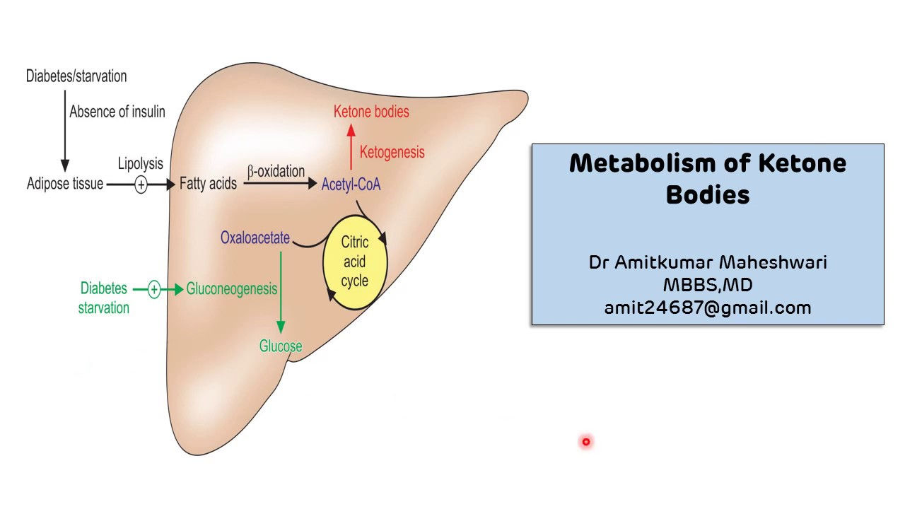
Ketogenesis
Occurs in mitochondria of hepatocytes (liver cells)
Fasting, starvation, low glucose
Stored FFAs from adipose tissue --> Acetyl-CoA by beta-oxidation
Excess Acetyl-CoA in liver = Ketone Bodies (B-hydroxybutyrate & Acetoacetate)
Ketone bodies (very energy dense) used as fuel by brain, heart, skeletal muscle

Slide 21
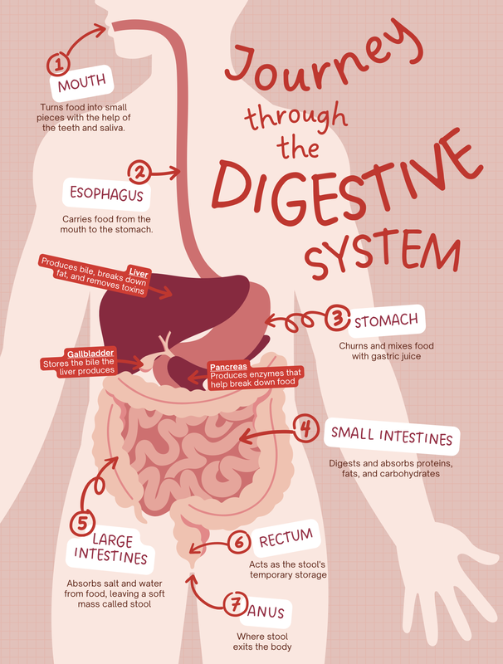
REVIEW
Fats = phospholipids, triglycerides, cholesterol
Cell membrane structure, energy storage, hormone/bile production
Saturated vs. Unsaturated
Cholesterol synthesized in liver
Makes bile salts to emulsify fat during digestion
Statins: HMG-CoA Reductase Inhibitors --> reduce cholesterol
Complex digestion & absorption in small intestine
Emulsification --> Pancreatic Lipase + Colipase
Absorptive cells reassemble --> Chylomicrons --> Lacteals --> bloodstream
Transport of fats require LIPOPROTEINS
Chylomicrons, VLDL, LDL, HDL
Glucose & Amino Acids --> Fat by Lipogenesis (Acetyl-CoA to FFAs = triglycerides)
Stored in adipose tissue
For Energy from low glucose state = Lipolysis
FFA to Acetyl-CoA by Beta-Oxidation
Acetyl-CoA --> Krebs/ETC = ATP
Excess Acetyl-CoA in liver makes Ketone Bodies: provide energy for brain, heart, skeletal muscle

Slide 22
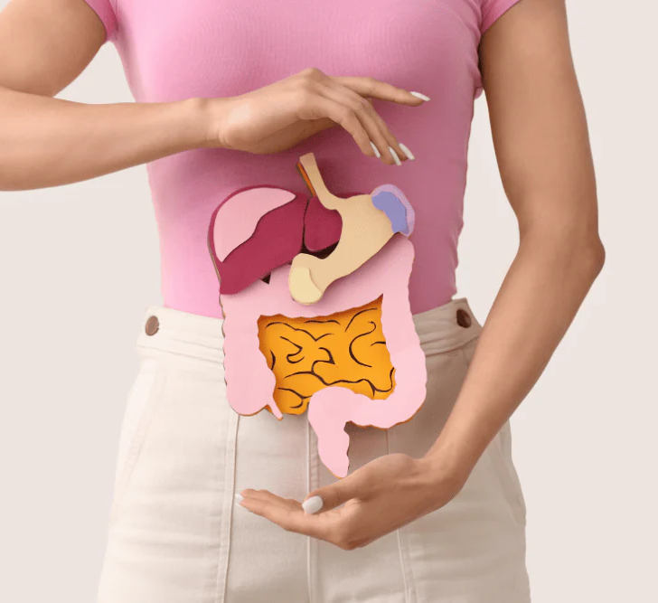
Thank you

