Slide 1
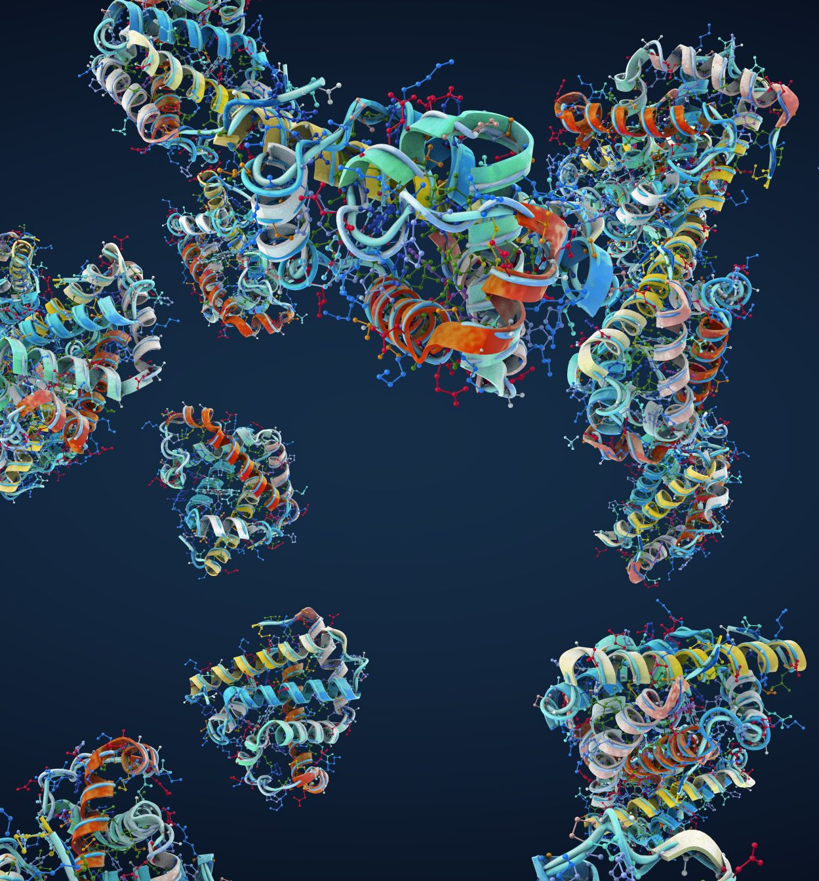
From PROTEIN to AMINO ACID : How the Body Breaks it Down
Presented by:
Lineth Olivera and Ellinor Eriksson

Slide 2
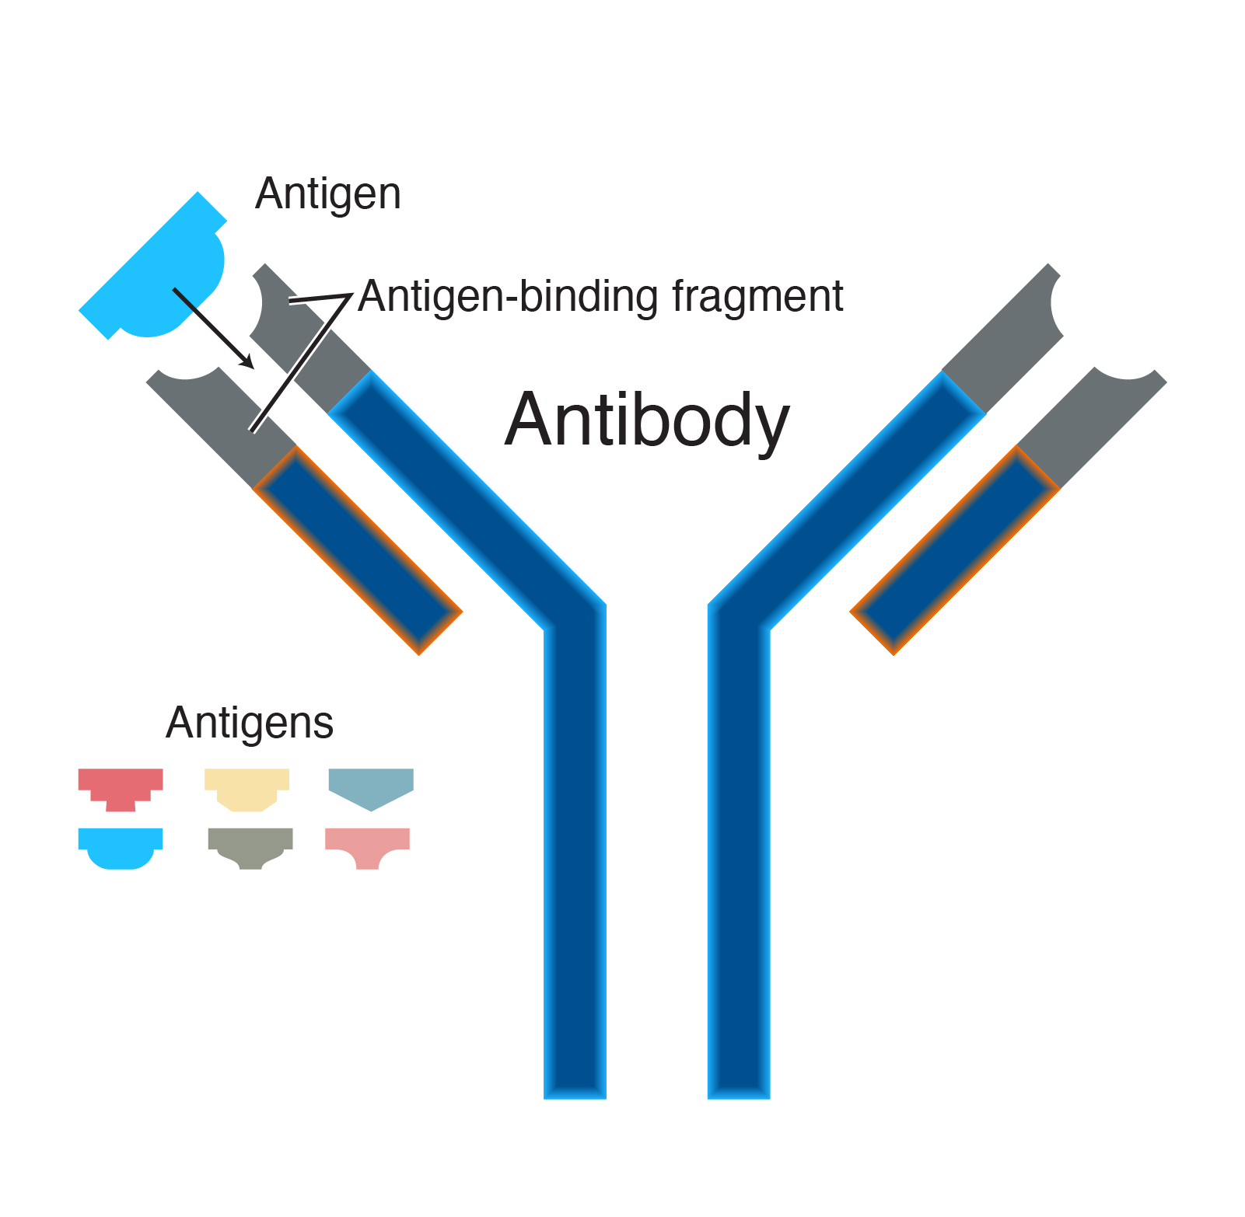
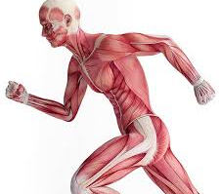
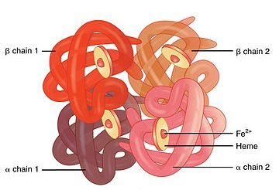
Why Do Proteins Matter?
Main Functions
Enzymes
Structural support
Transport
Hormones
Movement
Immune defense
Can be used for energy

Slide 3
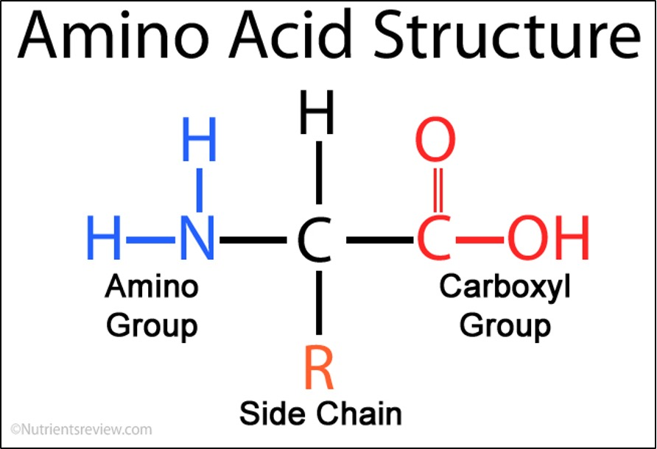
Protein Structure
Linear polymer chains made of Amino Acids linked together by peptide bonds
20 different amino acids
Amino Acid Structure:
Central Carbon
Amino group (NH2)
Carboxyl Group (COOH)
Hydrogen atom
Side chain (R group)

Slide 4
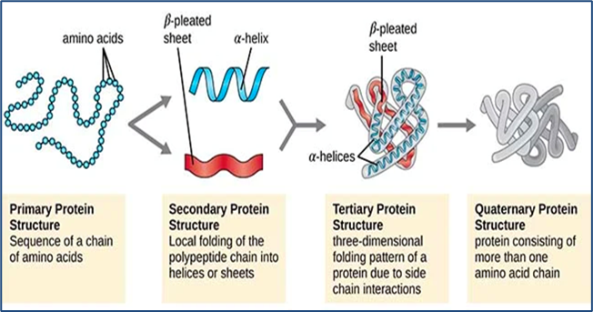
Protein Structure Levels
Primary Structure
Amino acid sequence
Peptide bonds
Secondary Structure
Local folding of chain
Alpha helix & beta sheet
Tertiary Structure
Full 3D shape of one protein
Determines function
Quaternary Structure
Multiple protein chains together
Forms larger functional protein

Slide 5
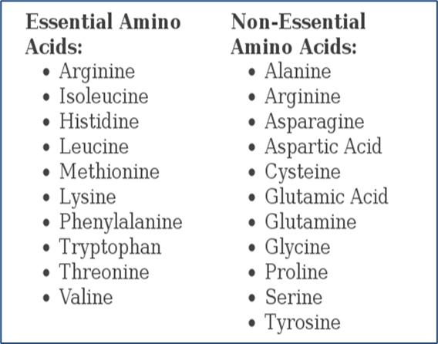
Essential vs Non-Essential Amino Acids
Essential Amino Acids:
There are 9 amino acids that are classified as essential
They cannot be produced by the body
Must be obtained through diet
Non – Essential Amino Acids:
There are 11 amino acids that are classified as non-essential
They are produced by the body
Formed through transamination

Slide 6
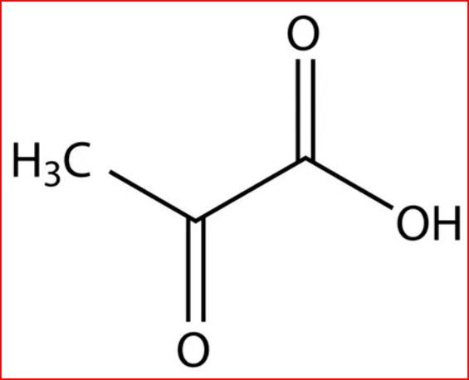
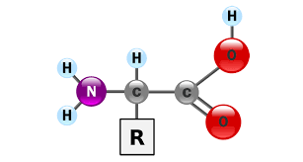
Amino Acids vs. Keto Acids
Amino Acids
Building blocks of proteins
Contain an amino group (NH₂)
Used for:
protein synthesis
enzymes
hormones
transport proteins
Keto Acids
Formed after removal of amino group
Amino group removed
Carbon skeleton remains
Used in energy metabolism

Slide 7
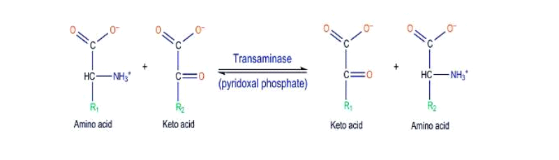
Deamination vs Transamination
Transamination
Transfers amino group (NH₂) to keto acid
Reversible reaction
Uses transaminase enzymes
Helps synthesize non-essential amino acids
Deamination
Removes amino group (NH₂)
Produces ammonia (NH₃)
Occurs mainly in liver
Used during amino acid breakdown
Forms keto acid for energy metabolism

Slide 8
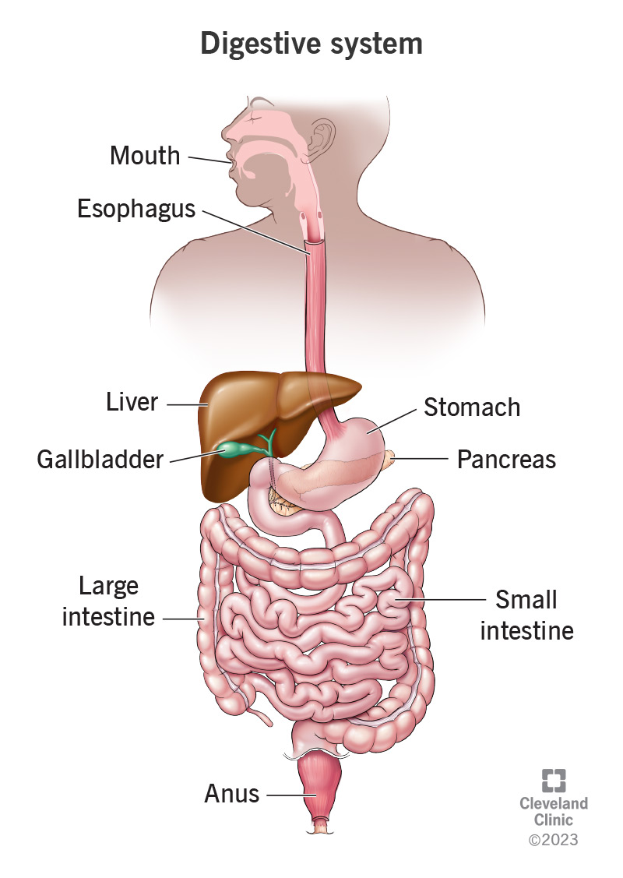
PATH OF PROTEIN DIGESTION
MOUTH
(mechanical)
↓
ESOPHAGUS
(transport)
↓
STOMACH
(chemical digestion begins)
↓
SMALL INTESTINE
(digestion completed, absorption begins)
↓
ABSORPTION
(amino acids enter blood)
↓
LIVER

Slide 9
Mouth and Esophagus : Before Protein Digestion Begins
MOUTH
"Mechanical digestion"
Saliva moistens food
Salivary lipase and amylase DO NOT digest proteins
Esophagus
Moves food to stomach through peristalsis
Transport only, no digestion

Slide 10
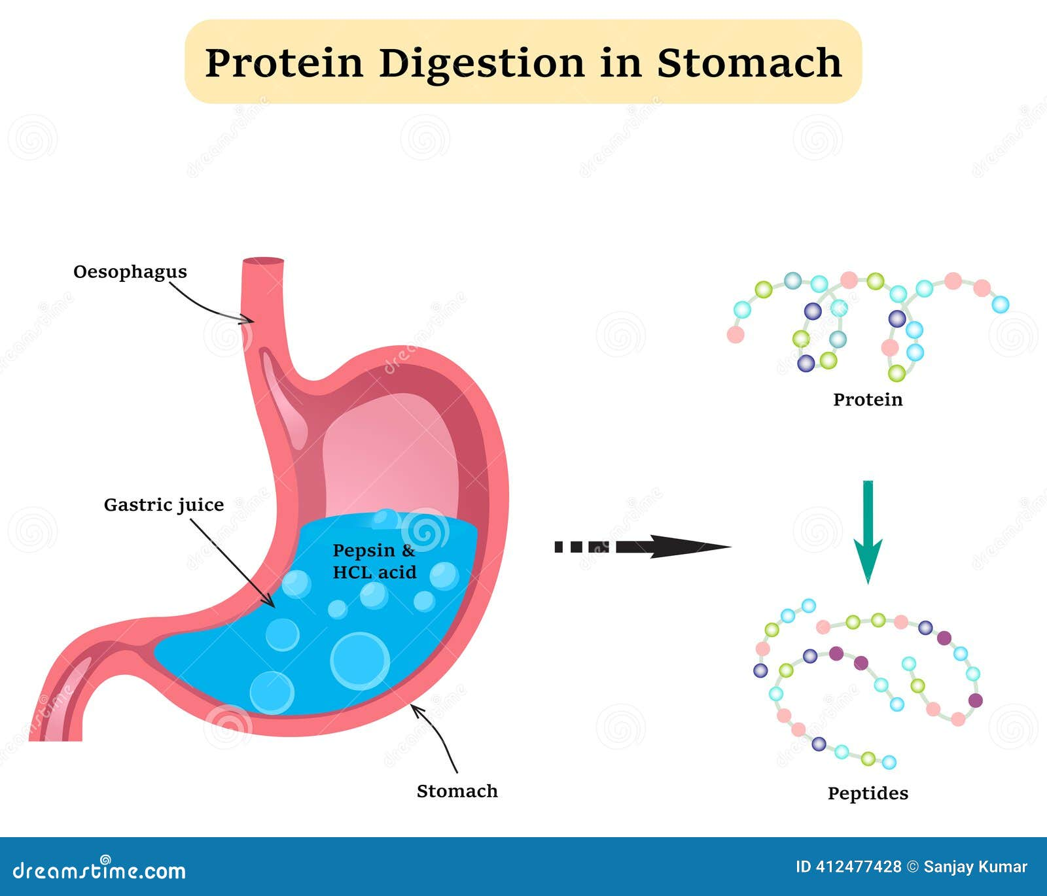
Stomach : Protein Digestion Begins
HCl in gastric juice denatures proteins
HCl activates pepsinogen into pepsin
Pepsin helps break polypeptides into shorter peptides
Churning mixes food into chyme
Chyme moves to duodenum

Slide 11
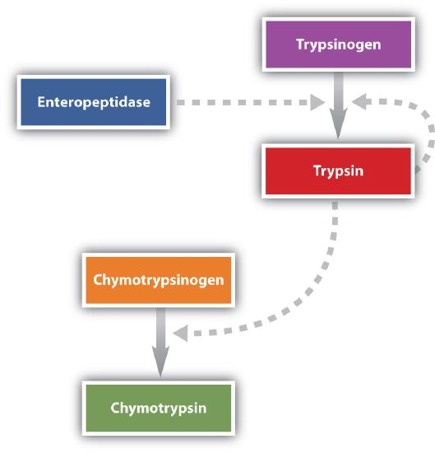
Small intestine : Where Most Protein Digestion Happens
Chyme enters the duodenum
Most protein digestion occurs here
Pancreas releases proteases into the small intestine
Enteropeptidase from brush border activates trypsinogen → trypsin
Trypsin activates more tryprinogen and other proteases

Slide 12
All enzymes + their differences
Enzyme | Where is it found | Key differences
Pepsin | Stomach | Polypeptides to peptides
Trypsin | Small intestine | Cleaves peptide bonds for lysine and arginine
Chymotrypsin | Small intestine | Cleaves peptide bonds for phenylalanine, tyrosine, and tryptophan
Elastase | Small intestine | Cleaves peptide bonds for alanine, glycine, and valine
Carboxypeptidase | Small intestine | Cleaves C-terminal end
Aminopeptidase | Brush border | Cleaves N-terminal end
Dipeptidase | Brush border | Cleaves dipeptide bond → dipeptide to two amino acids
*endopeptidase = within *exopeptidase = end

Slide 13
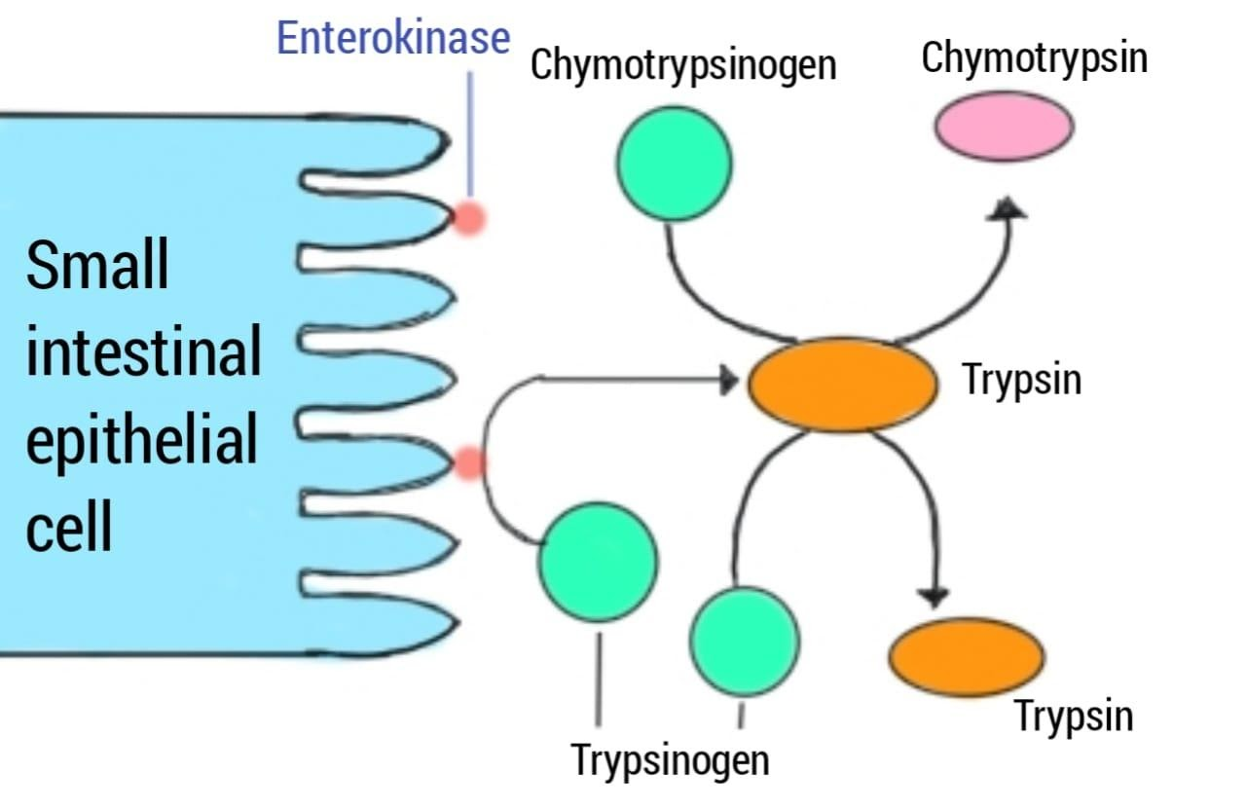
Brush border : Final Steps of Digestion
Microvilli covered surface
Increases surface area
Enzymes that finish small peptide digestion

Slide 14
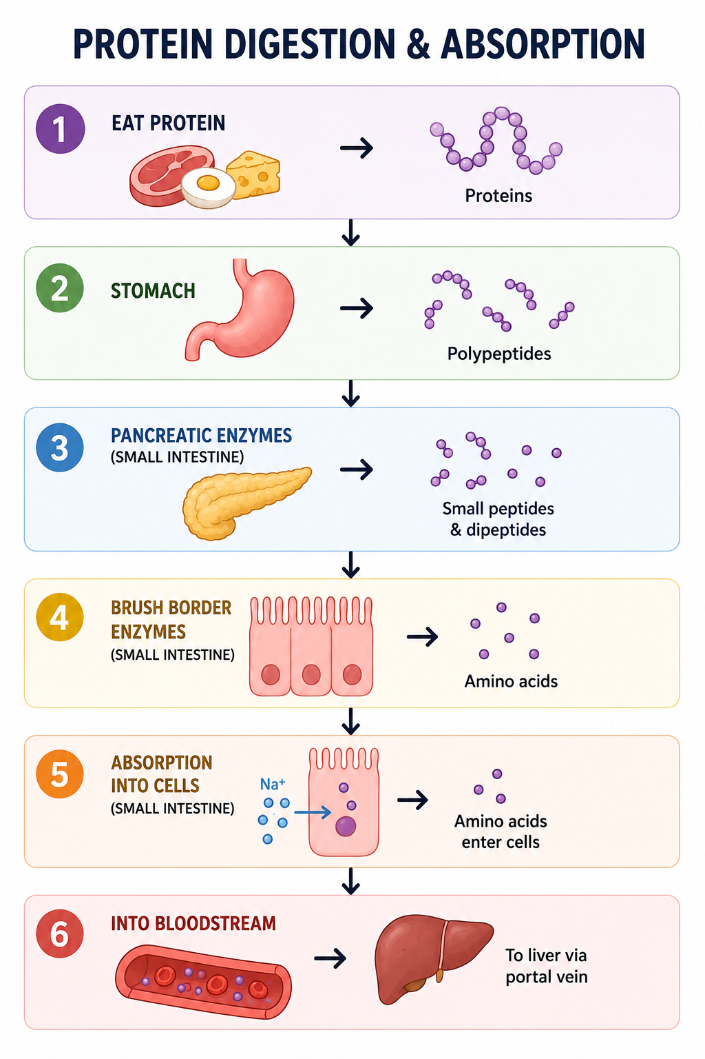
Absorption
Goal: Turn large proteins into Amino Acids so they can be absorbed into the bloodstream

Slide 15
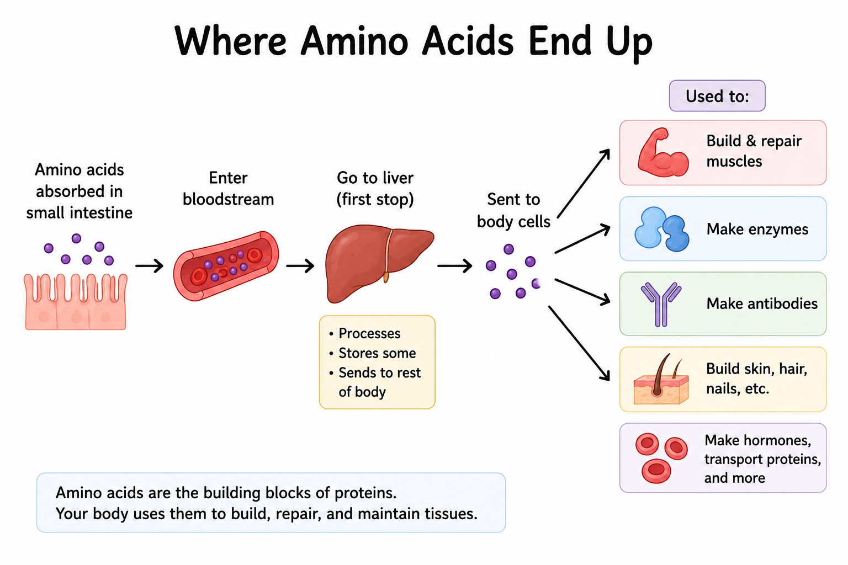
Where they end up

Slide 16
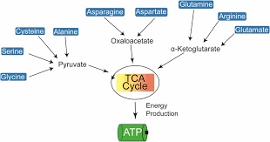
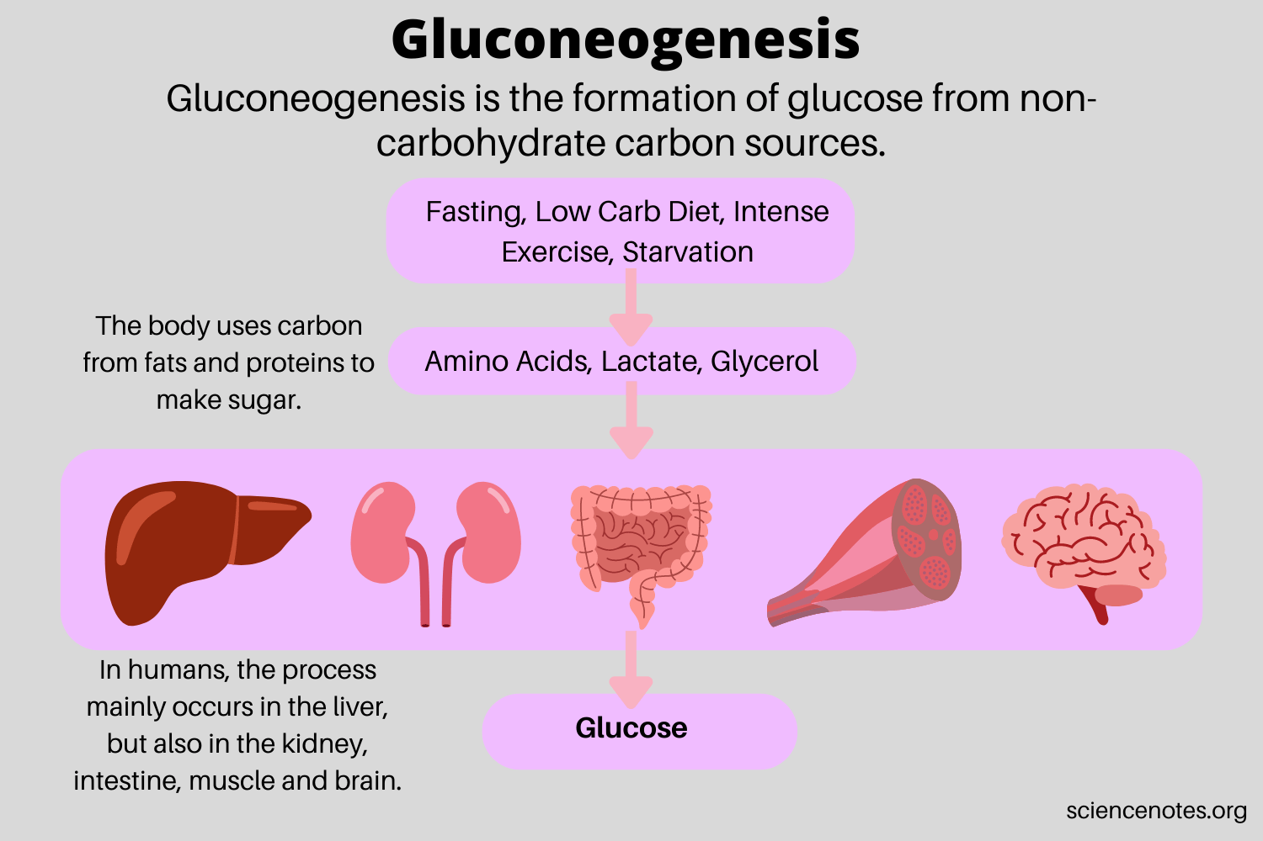
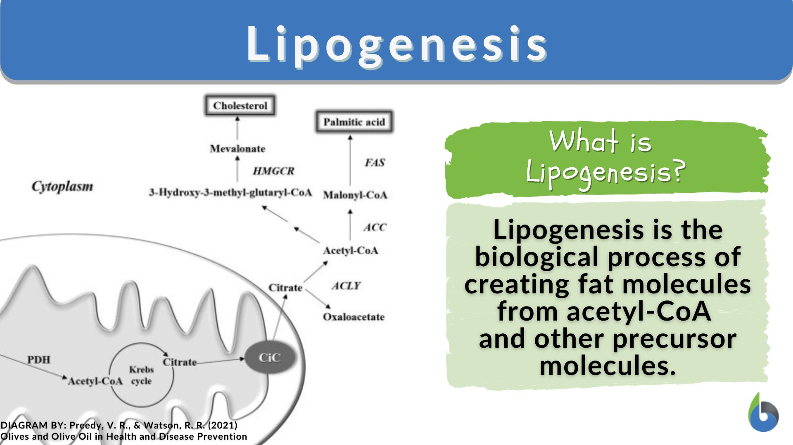
Amino Acids as Fuel : the citric acid cycle, gluconeogenesis, and lipogenesis

Slide 17
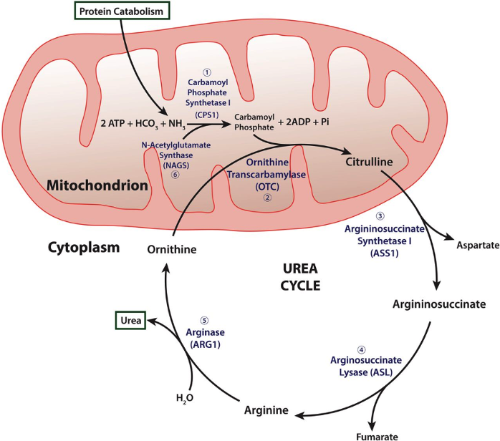
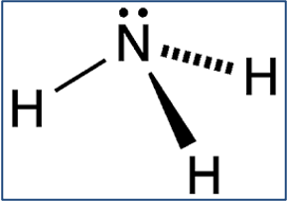
Ammonia and urea

Slide 18
The Big Picture
Proteins are chains of amino acids
Digestion is initiated in the stomach
Most breakdown happens in the small intestine
Enzymes and the brush border prepare amino acids for absorption
Absorbed amino acids can be used for growth, repair, and fuel

Slide 19
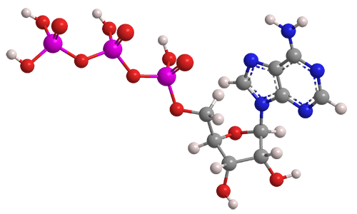
Protein digestion turns food into building blocks that cells can actually use.
*Like Paul's favorite molecule

