Slide 1
All Things Heart

Slide 2
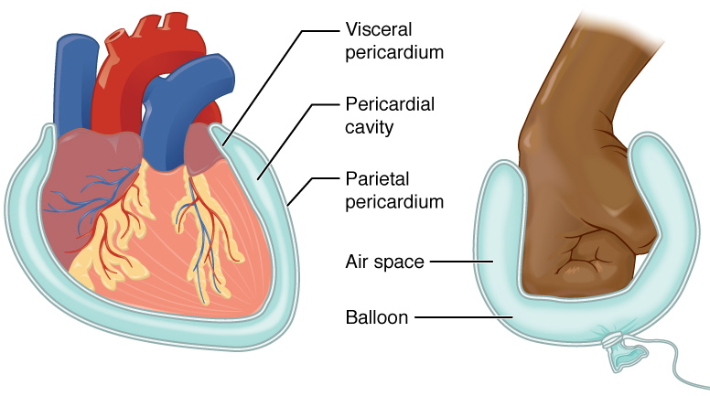
Visceral + Parietal Pericardium
Dense connective fibrous membrane holds heart in place
Deeper, two-layered serous membrane surrounds heart
Visceral = epicardium = lines heart surface
Parietal = fused to fibrous parietal sac
Space between is filled with fluid for protection & lubrication

Slide 3
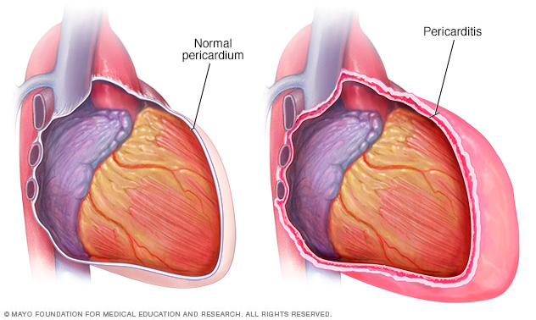
Pericarditis
Pericardium: double walled sac that surrounds the heart
Inflammation of the pericardium
Symptoms include chest pain caused by sac’s layers becoming inflamed and rub against each other
Can be attributed to viral, bacterial, fungal, and other infections
Most cases are mild, usually improve on their own
Can be treated with medication and surgery (rare)

Slide 4
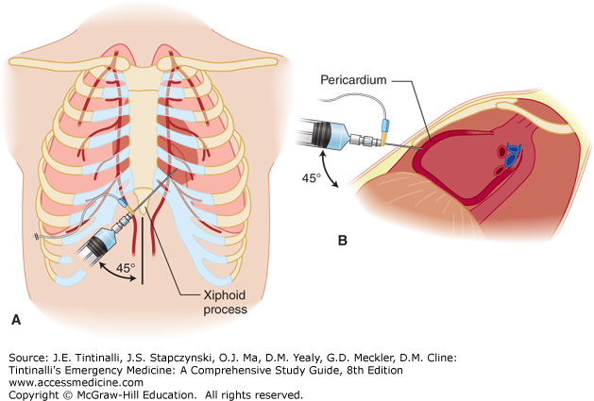
Pericardiocentesis
Also called pericardial tap, it is a procedure in which a needle and catheter remove fluid from the pericardium
The fluid is tested for signs of infection, inflammation, and the presence of blood and cancer
Done in emergencies to treat what is called cardiac tamponade, a life threatening rapid buildup of fluid around the heart that weakens its pumping
Relieve symptoms like shortness of breath
Doctor uses local anesthetic to numb an area on your chest, a needle will be inserted and then a catheter will be threaded into the sac around the heart that will then begin draining the fluid around your heart

Slide 5
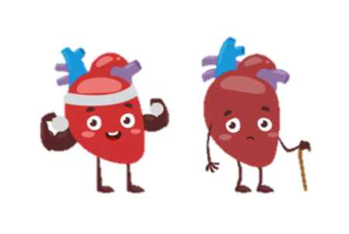
Hemopericardium (continue)
Symptoms
Symptoms of hemopericardium often include difficulty breathing, abnormally rapid breathing, and fatigue. In many cases, patients also report feeling chest pressure and have an abnormally elevated heart rate.
Diagnosis
Hemopericardium can be diagnosed using echocardiography, a cardiac ultrasound.Chest X-rays are also often taken when hemopericardium is suspected and would reveal an enlarged heart. Other observable signs include rapid heart rate, jugular venous distension, low blood pressure, and pulsus paradoxus.
Treatments
Hemopericardium is usually treated by pericardiocentesis, a procedure wherein a needle is used to remove the fluid from the pericardial sac.This procedure typically utilizes a needle that is inserted between the xiphoid process and the left costal margin until it enters the pericardial sac, then it can then be used to drain the fluid from the sac.A catheter is often left in the pericardium to continue draining any remaining fluid after the initial procedure.The catheter can be removed when the hemopericardium no longer persists.

Slide 6
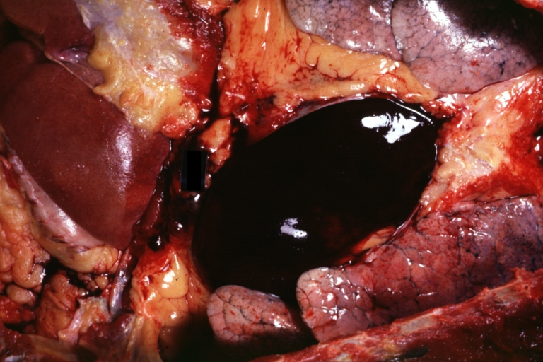
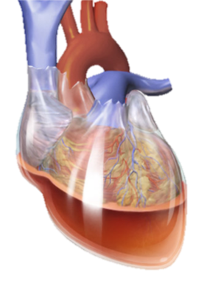
Hemopericardium
It refers to blood in the pericardial sac of the heart. It is clinically similar to pericardial effusion and, depending on the volume and rapidity with which it develops, may cause cardiac tamponade.
The condition can be caused by full-thickness necrosis (death) of the myocardium (heart muscle) after myocardial infarction, chest trauma, rupture in pulmonary artery and by over-prescription of anticoagulants. Other causes include ruptured aneurysm of sinus of Valsalva and other aneurysms of the aortic arch.

Slide 7
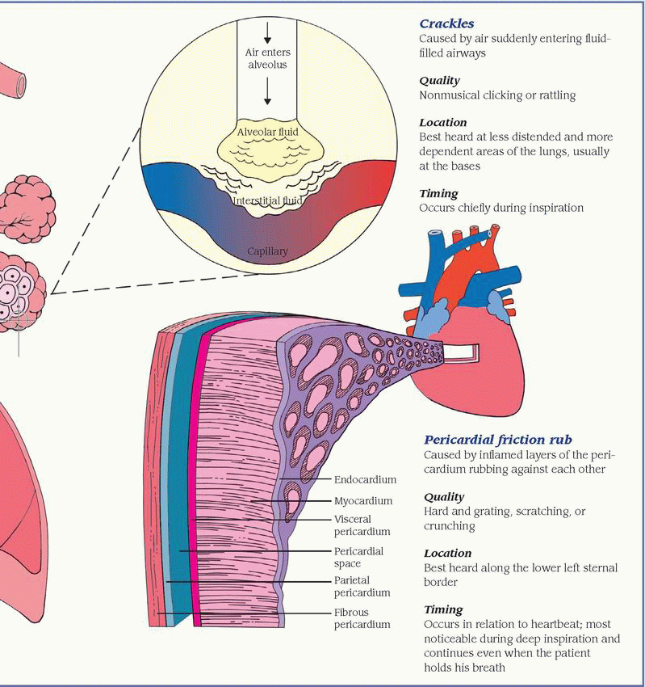
Pericardial Friction Rub
A low pitched, grating or creaking sound that occurs when inflamed pleural surfaces rub together.
More often heard on inspiration than expiration, pleural friction rub is easy to confuse with Pericardial rub.
To determine whether it is pleural friction rub or a pericardial rub, ask the patient to hold his/her breath briefly.
If the sound continues it is a pleural friction rub because the inflamed pericardial layers continue to rub each with each heartbeat- a pleural rub stops when breathing stops.
an audible medical sign used in the diagnosis of pericarditis. Upon auscultation, this sign is an extra heart sound of to-and-fro character, typically with three components, ONE systolic and TWO diastolic.

Slide 8
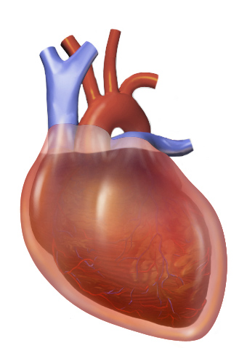
Cardiac Tamponade
Cardiac tamponade is the compression of the heart through infiltration of fluid in the pericardial sac.
The pericardial sac surrounds the heart and allows the heart to expand and pump with ease. When blood, pus, or fluid enters this sac, it can compress the heart and keep it from pumping as easily as it should.
As the fluid builds, it compresses the heart until it cannot beat. This leads to decreased cardiac output, loss of perfusion and, eventually if not treated, cardiac arrest.
The most common causes of tamponade are trauma and cardiac rupture. Progressive tamponade can progress slowly for a time, but it will eventually require treatment. Sudden tamponade is a medical emergency and must be dealt with immediately.

Slide 9
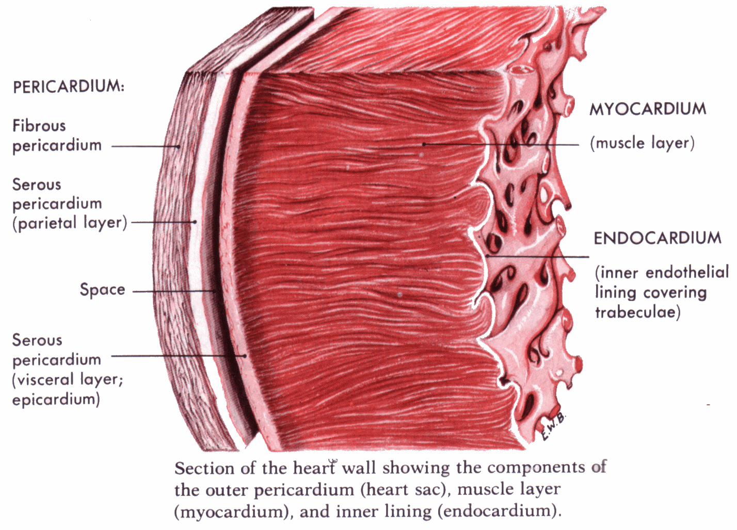
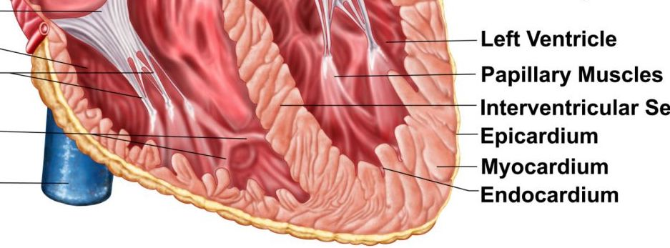
Endocardium, Myocardium, Epicardium
The heart wall:
Epicardium- outer protective layer of the heart, coronary blood vessels found here, composed primarily of loose connective tissue.
Myocardium- muscular middle layer of heart, composed of cardiac muscle fibers which enable heart contractions,
myocarditis= inflammation of the heart muscle, weakening of the heart which can lead to heart failure, abnormal heartbeat, and sudden death
Endocardium- thin inner layer of the heart, lines inner heart chambers and covers heart valves.
endocarditis= result of an infection of the heart valves or endocardium by certain bacteria, fungi, or other microbes, can be fatal

Slide 10
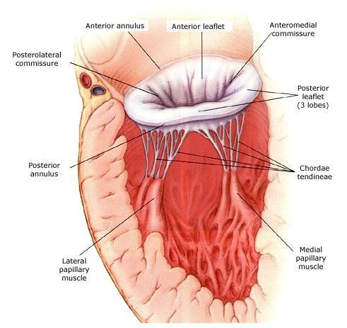
Annulus Fibrosus
Ringlike structure; the base of the heart valve that supports the leaflets of the 4 heart valves.
Right: Annulus Fibrosus Dexter Cordis
Left: Annulus Fibrosus Sinister Cordis
Contains collagen proteins within the rings which are impermeable to electrical propagation.
Serves as attachment of the atria and ventricles’ muscular fibers, as well as the bicuspid and tricuspid valves.

Slide 11
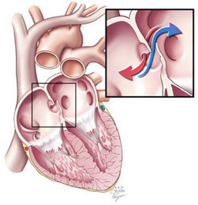
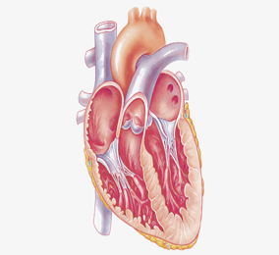
Fossa Ovalis
Foramen Ovale (opened)
Fetal Heart
Foramen Ovale
Foramen Ovale is a small hole that is present in the heart of a fetus but closes and becomes the Fossa Ovalis after birth.
Before a baby is born, it does not use its lungs to get blood rich in oxygen. Instead, this blood comes from the mother’s placenta and is delivered through the umbilical cord.
The foramen ovale makes it possible for the blood to go from the veins to the right side of the fetus’ heart, and then directly to the left side of the heart.
During the embryonic development, the blood must pass through the open Foramen Ovale from right to the left directly.
Fossa Ovalis
Depression of the right atrium of the heart.
After closing, it enables respiration and circulation independent from the mother.
Helps the body distribute the oxygenated blood in the body through lungs.
Fossa Ovalis
(closed)
Normal Heart

Slide 12
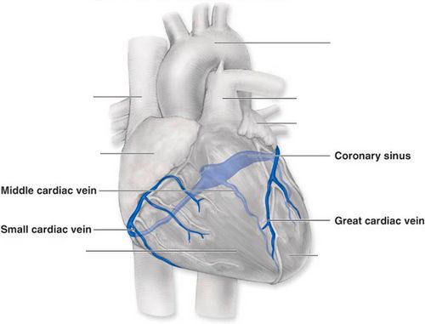
Coronary Sinus
The coronary sinus is a collection of veins joined together to form a large vessel that collects blood from the myocardium.
Receives blood mainly from the small, middle, and great cardiac vein.
It delivers less-oxygenated blood to the right atrium, as do the superior and inferior vena cavae.
Drains all blood inside the right atrium

Slide 13
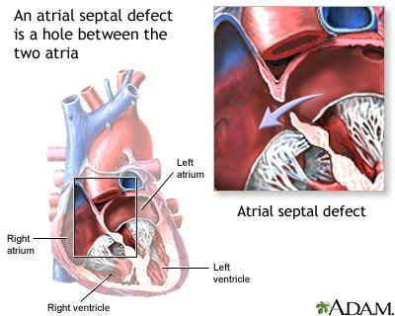
ATRIAL SEPTAL DEFECT:
An atrial septal defect (ASD) is an opening in one of several parts of the interatrial septum, causing a left-to-right shunt.
Oxygen-rich blood flows directly from the left side of the heart to mix with the oxygen-poor blood in the right side of the heart. Moderate-to-large ASDs result in large shunts, leading to right atrial and right ventricular volume overload. If unrepaired, these large shunts may lead to pulmonary artery hypertension, elevated pulmonary vascular resistance, and right ventricular hypertrophy.
ASDs can allow emboli from the veins to enter the systemic circulation, causing an arterial occlusion (eg, stroke).
Moderate to large ASDs should be closed, typically between ages 2 yr and 6 yr, using a transcatheter device when possible.

Slide 14
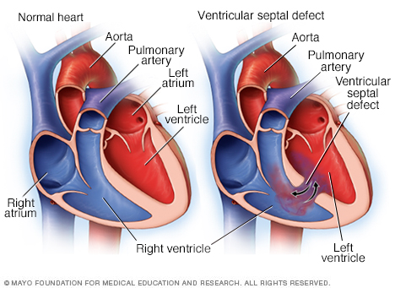
Ventricular Septal Defect
A common heart defect that involves a hole in the wall between both ventricular chambers
Possible causes include incomplete looping of the heart during first trimester and mechanical tearing of the heart due to myocardial infarction
Blood passes from the left ventricle to right ventricle which passes blood through the lungs to reenter the left ventricle
Symptoms include pulmonary hypertension, cyanosis, breathlessness, and poor feeding/weight gain

Slide 15
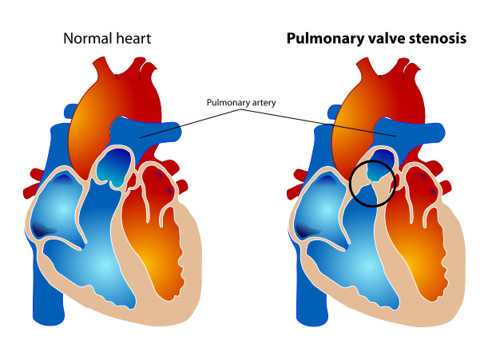
PULMONARY VALVE STENOSIS
What is pulmonary valve stenosis (also called PS)?
Pulmonary stenosis is a condition caused by a narrowing of the pulmonary valve opening. Pulmonary stenosis restricts blood flow from the lower right chamber (called the ventricle) to the pulmonary arteries, which delivers blood to the lungs. It is most commonly the result of a cpngenital heart defect. However, rarely PS can develop as a result of infections like rheumatic fever or carcinoid syndrome
If PS is mild, there probably won't be any noticeable symptoms. If it's moderate or severe, you may experience some of the following:
Heart murmur
Low tolerance for exercise
Fatigue
Fainting
Shortness of breath
Chest pain or palpitations

Slide 16
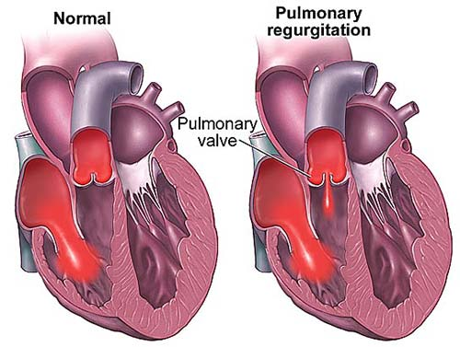
Pulmonary Valve Incompetence
Is a disorder in which the pulmonary valve, that directs the deoxygenated blood from the right atrium thru the pulmonary artery to the lungs to become oxygenated, is defective and doesn’t close tightly allowing the backflow of blood during diastole (Filling of blood in the ventricles at rest).
Symptoms: Murmurs, if more significant leakage: fatigue, chest pain, lightheadedness or fainting
Causes: Pulmonary Hypertension (High blood pressure in heart-lung system), Congenital heart defect (Tetralogy of Fallot), Infective Endocarditis (Bacteria enter bloodstream and remain in the heart), Rheumatic fever, Carcinoid Syndrome, etc.
Diagnosis: Chest X-rays, echocardiography, exercise test, CAT scan, MRI, Electrocardiogram
Treatment: Rarely severe enough to require treatment, maintain health and stress levels as well as diet, or if severe enough invasive pulmonary valve replacement.
Notes:
Congenital — Used to describe a condition or defect present at birth.
Endocarditis — Inflammation of the lining of the heart and valves.
Prophylaxis — Preventive. Antibiotic prophylaxis is the use of antibiotics to prevent a possible infection.
Pulmonary — Refers to the lungs and the breathingsystem and function.
Pulmonary hypertension — High blood pressure in theveins and arteries of the lungs.

Slide 17
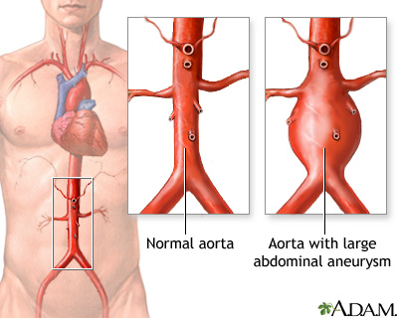
Abdominal Aortic Aneurysm
An abdominal aortic aneurysm (AAA) is an enlarged area in the lower part of the aorta.
Because the aorta is the body’s main supplier of blood, a ruptured abdominal aortic aneurysm can cause life-threatening bleeding.
Depending on the size and the rate at which the AAA is growing, treatment may vary from observing to emergency surgery.
AAAs are the most common form of aortic aneurysm
They usually cause no symptoms until they rupture, and not smoking is the best way to prevent them.

Slide 18
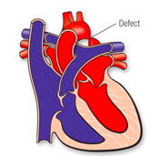
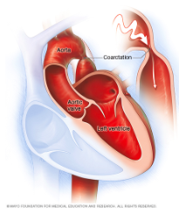
Coarctation of the Aorta
-Narrowing of the Aorta
-Congenital condition
-Affects blood flow where the arteries branch out to carry blood along separate vessels to the body.
-Heart must pump harder to force the blood through the narrow part of the Aorta
-High blood pressure, heart damage, chest pain, difficulty breathing

