Slide 1
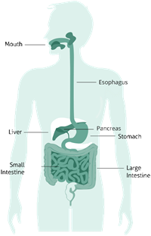
Digestion of Carbohydrates

Slide 2
Overview
Digestion and absorption
Mouth
Stomach
Small intestine
Large intestine
Liver
Pancreas
Metabolism
Use and abnormalities of carbohydrates in the body

Slide 3
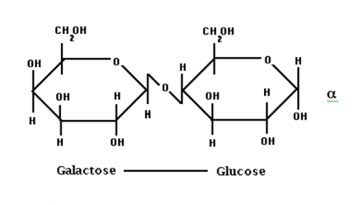
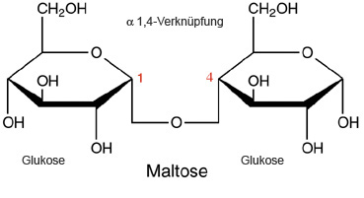
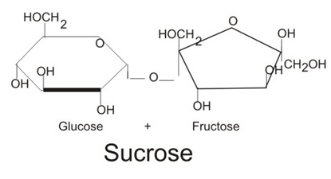
Disaccharides +
Monosaccharides
Lactose
Glucose + galactose
Maltose
Glucose + glucose
Sucrose
Glucose + fructose
Carbohydrates are ultimately broken down into 3 monosaccharides:
Fructose
Glucose
Galactose
Lactose

Slide 4
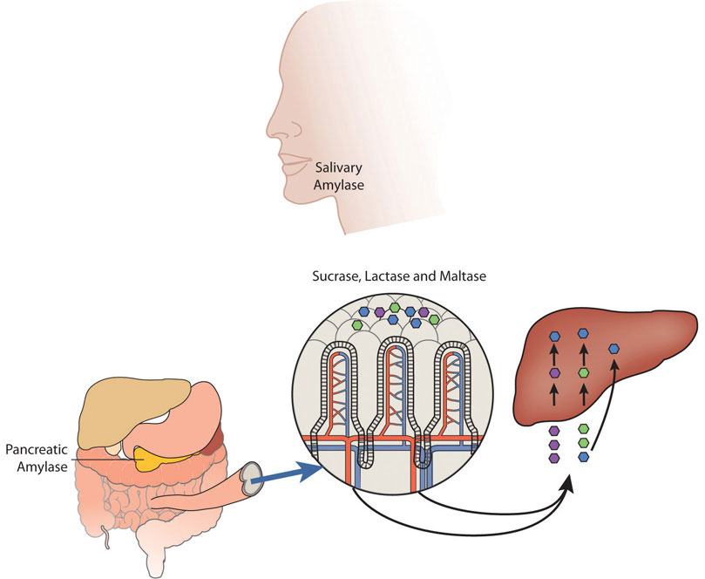
Digestion + Absorption: Mouth to small intestine
Starts in mouth; primarily takes place in small intestine
V
Notes:
Carbohydrate digestion begins in the mouth
Most extensive digestion occurs in the small intestine.
The monosaccharides produced are absorbed into the bloodstream and transported to the liver

Slide 5
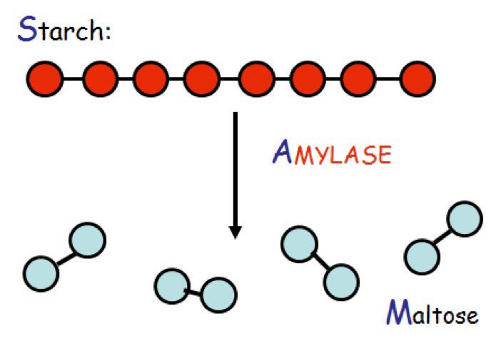
Mouth: Chemical + Mechanical digestion
Chemical digestion: Salivary α-amylase
Produced in salivary glands
Released during the process of chewing
Positive feedback loop: ↑carbohydrate intake, ↑amylase production
pH sensitive → inhibited by acidic environment in stomach
Starches → maltose + polysaccharides —> sweet taste
Salivary amylase breaks down only 5% of starch
Mechanical digestion: Chewing
Teeth and tongue break down food into physically smaller pieces
Notes:
MOUTH
Chemical digestion--Salivary amylase
Salivary amylase produced in salivary glands
Released during the process of chewing
Positive feedback loop resulting in increased oral amylase secretion in people consuming diets high in carbohydrates
Breaks the bonds between the monomeric sugar units of disaccharides, oligosaccharides, and starches.
Breaks starches (amylose and amylopectin) into maltose and polysaccharides —> sweet taste
pH sensitive —> inhibited by acidic environment in stomach
Salivary amylase breaks down only 5% of starch
Mechanical digestion
Chewing into smaller pieces
STOMACH
Mechanical digestion
Minimal carbohydrate digestion occurs in the stomach due to the inactivation of amylase in the acidic environment.
Peristalsis —> chyme
SMALL INTESTINE
Pancreatic amylase
Pancreatic juice, which contains pancreatic amylase, is released from acinar cells in pancreas into the small intestine along with other enzymes
Amylase (pancreatic and salivary) targets the α-1,4 bonds of complex carbohydrates
Carbs are digested (starch hydrolysis) into small components of branched amylopectin (maltose, maltotriose and α-limit dextrins). Oligosaccharides and disaccharides are digested by specific enzymes in the microvillus membrane (brush border).
These products are broken down by disaccharidase enzymes in the brush border of the small intestine
“Carbohydrates that aren’t digested in the small intestine pass into the large intestine. Here, they are digested by colonic bacteria, which results in the release of short chain fatty acids (SCFA) (propionate, butyrate and acetate) and methane.”--such is the case in lactose intolerance where lactose can’t be broken down, causing discomfort
*Brush border
Disaccharidases: exoenzymes that cleave one monosaccharide at a time from the oligosaccharides or convert disaccharides into monosaccharides
Isomaltase (limit dextrinase or debranching enzyme): hydrolyzes α-1,6 glycosidic bonds at the branch points in a number of limit dextrins and α-1,4 linkages in maltose and maltotriose
Maltase: maltose to glucose and glucose. Hydrolyzes only α-1,4 glycosidic linkages between glucose molecules in maltose
Trehalase: trehalose to glucose and glucose
Sucrase: hydrolyzes α-1,2 glycosidic linkages between glucose and fructose molecules (splits sucrose)
β-glycosidase complex = lactase and glucosyl-ceramidase
Glucosyl-ceramidase splits β-glycosidic bonds between glucose or galactose and hydrophobic residues such as those found in the glycolipids glucosylceramide and galatosylceramide.
Lactase splits β-1,4 bonds between glucose and galactose in milk sugar
Once chemically broken into single sugar units —> Monosaccharides are absorbed by cells in the small intestine

Slide 6
Mechanical digestion in the stomach
Salivary α-amylase inactivated
Minimal carbohydrate digestion occurs
Peristalsis → chyme
Notes:
https://www.youtube.com/watch?v=o18UycWRsaA

Slide 7
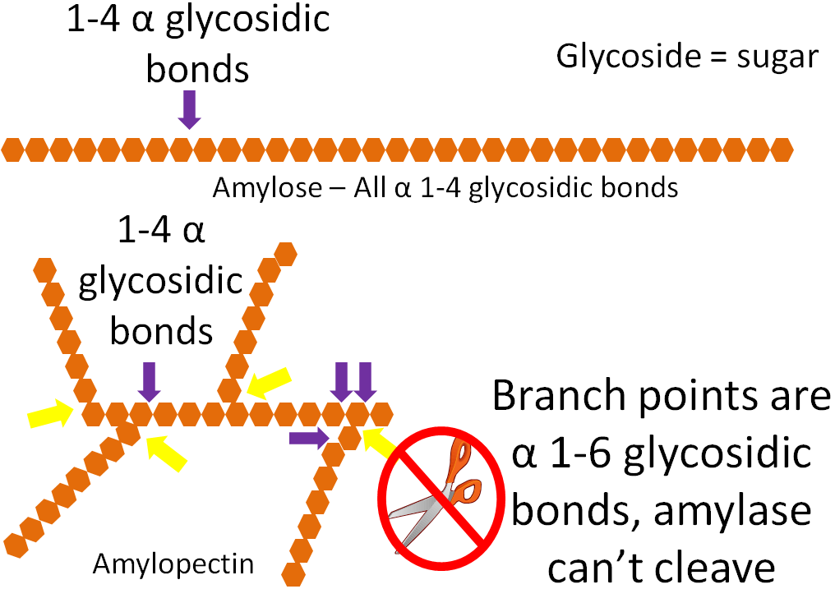
Small intestine: Primary site of absorption
Chemical digestion: Pancreatic α-amylase
Secreted from acinar cells of pancreas into small intestine as part of pancreatic juice
Catalyzes starch hydrolysis
Targets the α-1,4 bonds of complex carbohydrates
Starch hydrolysis: digest carbohydrates into shorter units
Further broken down into monosaccharides
Brush border
Disaccharidase enzymes: sucrase, maltase, + lactase
Secreted by the intestinal cells that line the villi
Break down disaccharides into their component monomers
Example: Sucrase: sucrose → glucose + fructose
Monosaccharides absorbed into intestinal cells

Slide 8
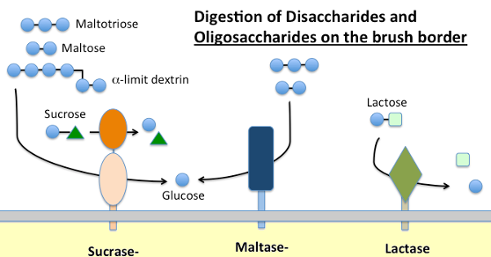
Small intestine: Brush border
Apical membrane of the small intestine
Lined with microvilli—nutrient absorption
Disaccharidase enzymes:
disaccharides → monosaccharides
Maltase → glucose + glucose
Lactase → glucose + galactose
Sucrase → glucose + fructose
Carbohydrates are digested into glucose, fructose, and galactose before absorption by the small intestine
These monomers are absorbed across the villi
Monosaccharides transported across the intestinal epithelium → bloodstream → liver and rest of body
Notes:
The apical membrane of the small intestine consists of microvilli extending from the cells = brush border

Slide 9
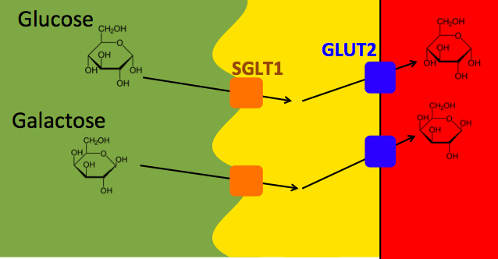
Absorption in the small intestine
Glucose and galactose: SGLT-1 transporter (sodium glucose co-transporter) in brush border of small intestine
Active transport via sodium gradient driven by Na+/K+ ATPase pump (co-transporter)
2 Na+ bind to outer face of SGLT-1 → conformation change → glucose can bind
Both Na+ and glucose (glucose first, then Na+ ions) are transported into cytoplasmic side of membrane following another conformation change
Na+ down concentration gradient; glucose against its concentration gradient
Na+ then released out via Na+/K+ ATPase pump to maintain the gradient
Fructose: GLUT-5 transporter (uniporter)
Facilitated diffusion via carrier protein and sodium-independent membrane protein
All 3 monosaccharides exit the basolateral membrane via passive transport (GLUT2 and GLUT5)
Notes:
Liver is first organ to receive glucose, fructose, and galactose. Stores as glycogen or exports back to blood

Slide 10
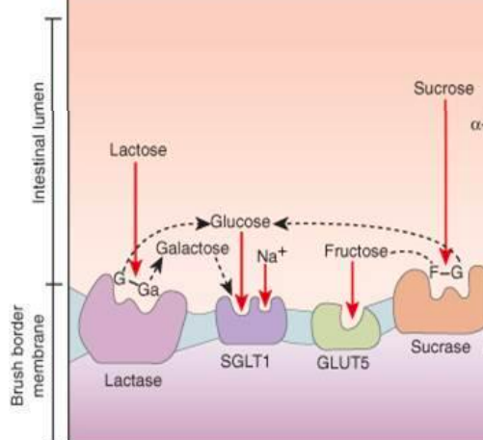
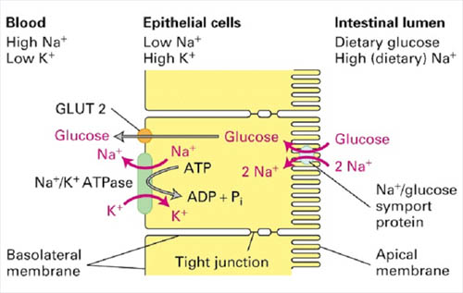

Slide 11
Carbohydrates in the large intestine
Almost all of the carbohydrates are digested and absorbed into body
Excludes dietary fiber and resistant starches
Dietary fiber and other complex carbohydrates are digested much less in the gastrointestinal tract than other simpler carbohydrate types
—> Rise in blood glucose after eating them is less and slower
High-fiber foods linked to a decrease in weight gain and reduced risk of chronic diseases, such as Type 2 diabetes and cardiovascular disease
Carbohydrates that aren’t digested in the small intestine pass into the large intestine
Digested by colonic bacteria
Release of short chain fatty acids (SCFA) (propionate, butyrate and acetate) and methane
SCFA are used as energy or growth source by bacteria, eliminated in feces, or absorbed into cells of colon
Example: Lactose intolerance—lactose can’t be broken down, causing discomfort

Slide 12
Lactose intolerance
Not milk allergy
Lactose malabsorption and deficiency
May or may not develop into lactose intolerance
Lack of lactase enzyme (breaks down lactose)
Inability to digest milk sugar lactose
Undigested lactose passes through to the colon, where bacteria ferment & digest it
Causes:
Genetic
Lactase nonpersistence
Congenital lactase deficiency
Symptoms:
Gas
Bloating
Diarrhea
Nausea
Varying thresholds of lactose intake (person-dependent) → tolerate different amounts of lactose before experiencing symptoms
68% globally
Non-genetic
Injury to the small intestine
Premature birth
Discomfort/pain in abdomen
Vomiting
Stomach rumbling/growling sounds
Notes:
Not the same as a milk allergy, which is an immune system disorder where there is an immune response to 1+ proteins in milk products
Lactose malabsorption
Not all with lactose malabsorption develop lactose intolerance
Only those with symptoms are lactose intolerant
Causes for lactase deficiency and malabsorprtion
Genetic
Lactase nonpersistence: lactase production decreases after infancy
Congenital lactase deficiency: rare. Lack of lactase production starting at birth
Non-genetic
Injury to the small intestine: cause small intestine to make less lactase (Crohn’s disease, celiac disease)
Premature birth: normal lactase levels do not appear until ~3rd trimester. Usually make sufficient lacatse levels later in life
Small intestine lacks sufficient amount of lactase enzyme —> cannot break down lactose in the foods/drinks you consume
Undigested lactose passes through to your colon
Varying thresholds of lactose intake (person-dependent) —> tolerate different amounts of lactose before experiencing symptoms
68% globally with varying prevalence/predisposition depending on where you are from

Slide 13
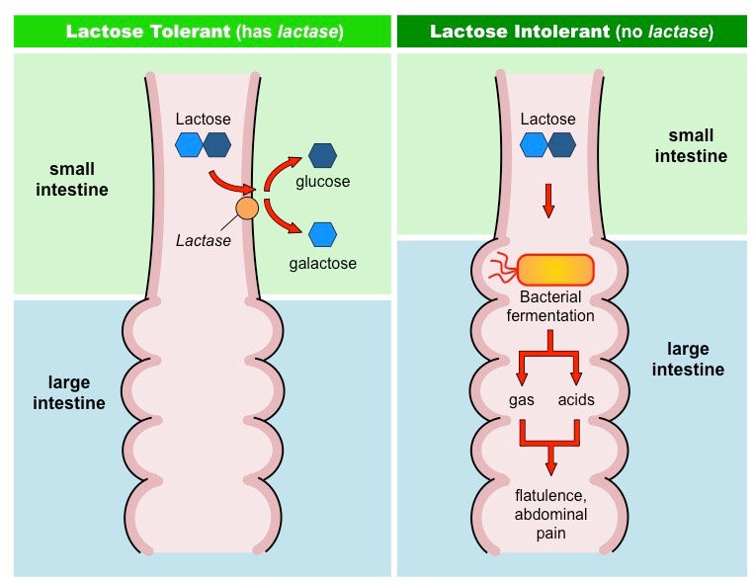

Slide 14
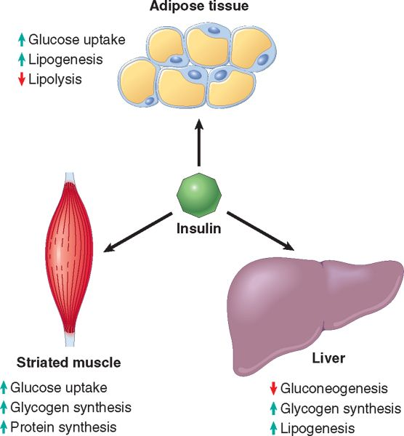
Blood Sugar Levels High
Pancreas secretes INSULIN to trigger glucose storage
Notes:
https://www.studyblue.com/notes/note/n/08-other-endocrine-glands/deck/1052523
Lots of glucose dissolved in the blood (more than cells could use at once) after a sugary meal triggers the release of insulin

Slide 15
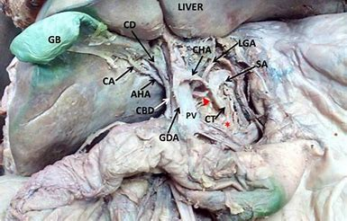
Glucose Through Blood to Liver
Glucose travels through the hepatic portal vein to the liver
Notes:
www.oapublishinglondon.com/article/1279
Too much glucose in the blood at once, we need some super hero molecules for glucose storage

Slide 16
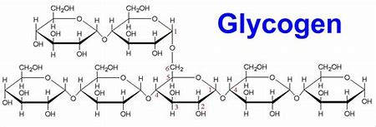
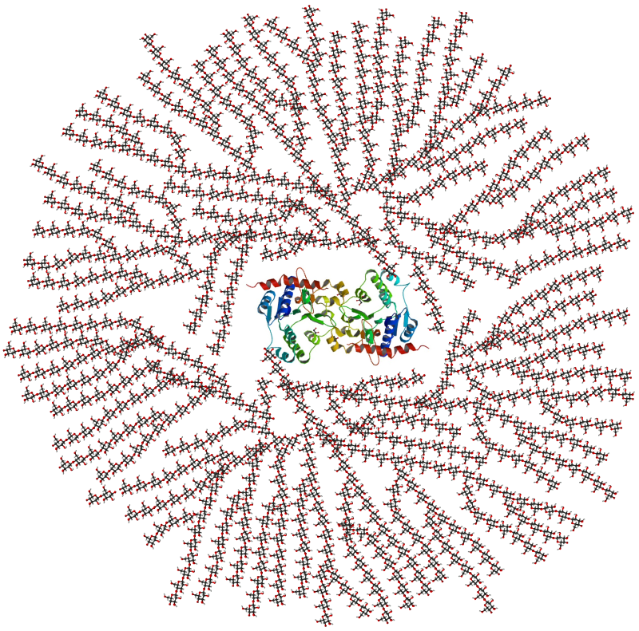
Glycogen
Glycogen is used to store energy from glucose
Essentially a bunch of glucose molecules linked together
Stored in the
Liver (higher concentration)
Skeletal muscles (lower concentration)
- Glycogen is composed of a core protein (glycogenin) surrounded by huge chains of glucose bonded together (polysaccharide)
- A glycogen granule contains around 300,000 glucose molecules!
Notes:
https://healthjade.com/types-of-carbohydrates/
https://en.wikipedia.org/wiki/Glycogen#/media/File:Glycogen_structure.svg

Slide 17
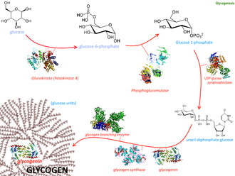
Glycogenesis
-The formation of glycogen in liver and muscle cells
-Occurs when blood glucose levels are high (lowers blood sugar levels a bit)
-Glycogen synthase is activated by insulin to link glucose subunits together

Slide 18
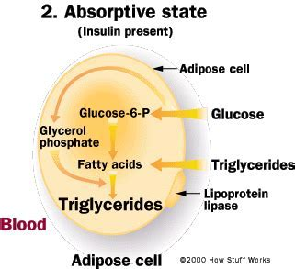
Glucose into fat
If there’s still a high concentration of glucose in the blood, insulin triggers glucose to be turned into fat for energy storage
Glucose enters lipocytes and is converted into glucose-6-P → Fatty Acids → triglycerides
Notes:
https://science.howstuffworks.com/life/cellular-microscopic/fat-cell2.htm

Slide 19
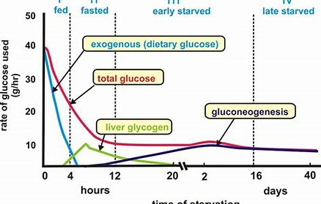
Blood Sugar Levels Low
Glycogenolysis: breakdown of glycogen
Gluconeogenesis: Formation of glucose from storage molecules:
-Fat: mostly glycerol
-Muscle: mostly alanine and glutamine amino acids
Triggered by glucagon
Notes:
http://usmle.biochemistryformedics.com/low-body-fat-mass-and-hormonal-levels/

Slide 20
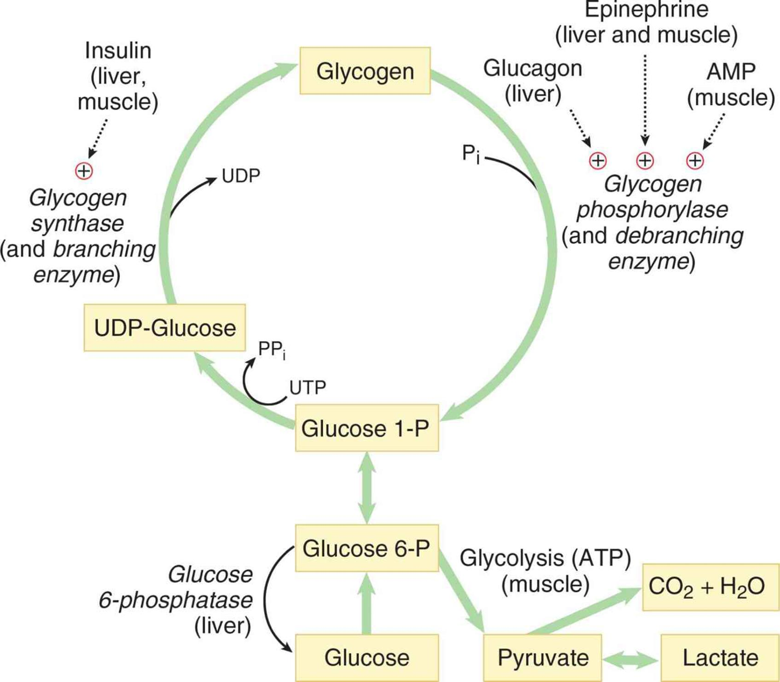
Glycogenolysis
Glycogen broken apart into glucose subunits by glycogen phosphorylase

Slide 21
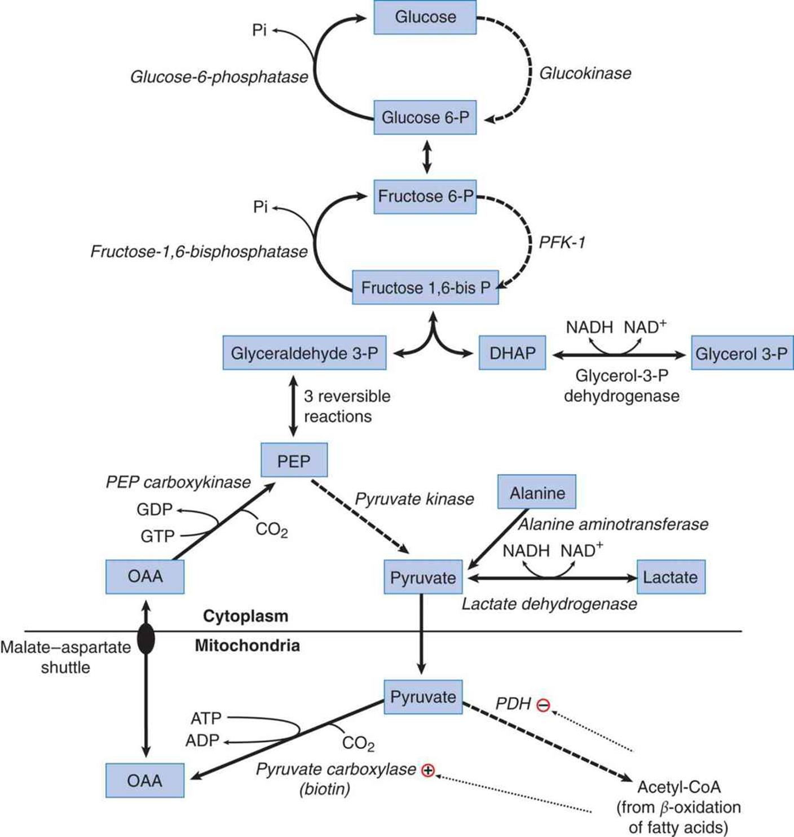
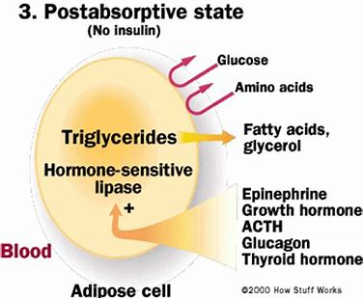
Lipolysis
Fat broken down by lipase enzyme
Glycerol and some fatty acids can be broken down into pyruvate then built into glucose (form of gluconeogenesis)
Notes:
After glycogen storage has been used up
https://schoolbag.info/chemistry/mcat_biochemistry/mcat_biochemistry.files/image205.jpg

Slide 22
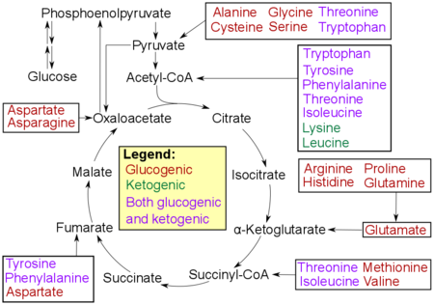
Protein Breakdown
Occurs when blood glucose levels are extremely low (starvation)
Glucogenic amino acids: broken down into glucose
Ketogenic amino acids: broken down into ketone bodies
Notes:
Glucogenic amino acids: Mostly alanine and glutamine
Ketogenic amino acids: just lysine and leucine

Slide 23
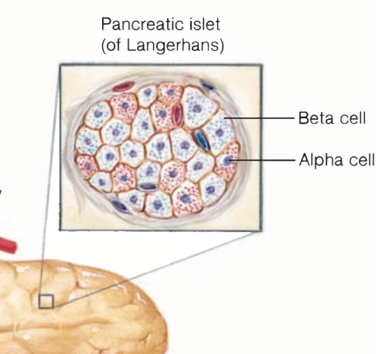
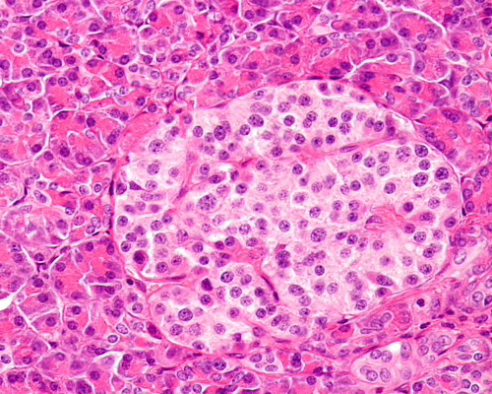
Islets of the Pancreas
The pancreas regulates blood glucose by secreting hormones into the bloodstream.
Islands of hormone-secreting cells (islets of Langerhans) secrete these hormones
Beta cells: Insulin
Alpha cells: Glucagon
Blood glucose homeostasis is achieved by the opposing and balanced actions of glucagon and insulin.

Slide 24
Blood Glucose Regulation
Blood glucose homeostasis is achieved by the opposing and balanced actions of glucagon and insulin.
Insulin
Stimulated by a rise in the plasma glucose concentration
Lowers blood glucose while it promotes the synthesis of glycogen and fat.
Glucagon
Stimulated by a fall in the plasma glucose concentration
Increases blood glucose due to hepatic glycogenolysis in the liver.

Slide 25
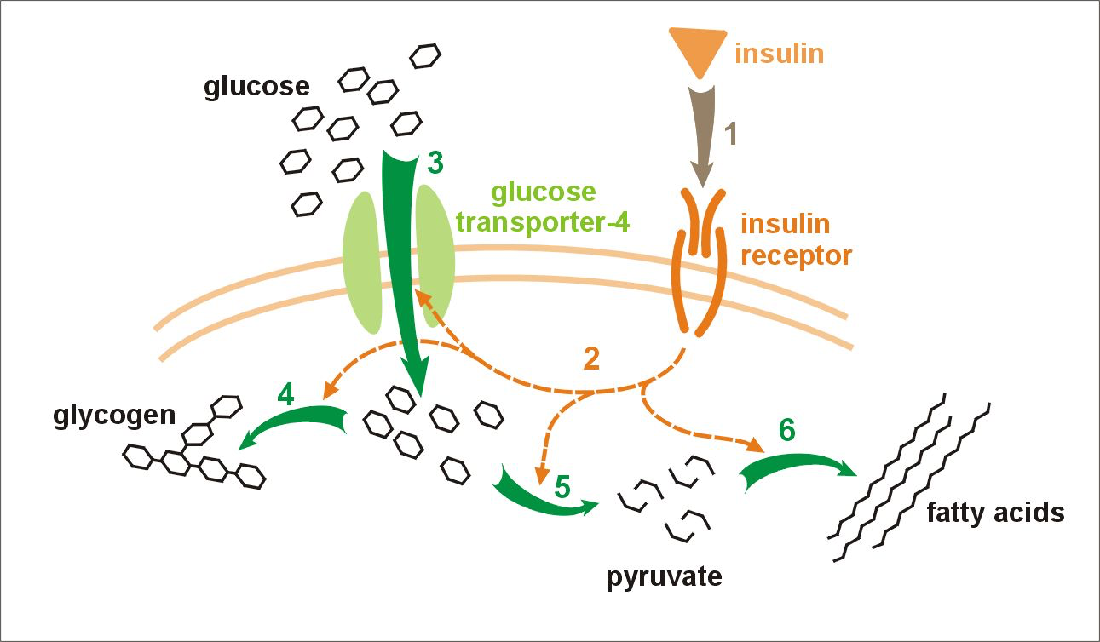
Insulin
An increase in blood glucose levels (post-meal) stimulates the beta cells to secrete vesicles containing insulin by exocytosis.
Insulin stimulates the insertion of GLUT4 carrier proteins into the plasma membrane of its target cells.
Skeletal and cardiac muscles, adipose tissue, and liver
Carrier proteins allow entry of glucose by facilitated diffusion.
→ Blood glucose decreases!

Slide 26
Insulin, continued
Insulin promotes glycogenesis, lipogenesis, and protein formation; thus, it is an anabolic hormone.
Insulin also inhibits the breakdown of fat and the breakdown of muscle proteins.

Slide 27
Glucagon
When blood glucose levels are low, alpha cells release glucagon.
Glucagon:
Stimulates liver cells to break down glycogen to glucose and release it into the blood (hepatic glycogenolysis)
Prevents the uptake of blood glucose into muscle, liver, and adipose tissue
Catabolic hormone
During prolonged fasting: Promotes gluconeogenesis (conversion of noncarbohydrate molecules into glucose), lipolysis (hydrolysis of stored fat) and ketogenesis (ketone bodies from free fatty acids in the liver)
→ Blood glucose increases!

Slide 28
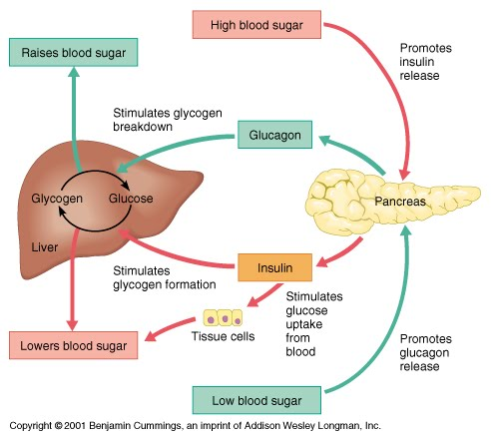

Slide 29
Blood Glucose Concentration
Normal blood glucose concentration:
Fasting: 65 to 105 mg/dl
Post-meal: 140 and 150 mg/dl
Hypoglycemia - Blood glucose levels are too low
Brain damage
Weakness, dizziness, personality changes, coma, and death
Reactive hypoglycemia: Exaggerated response of the beta cells to a rise in blood glucose. Occurs in type 2 diabetes.
Hyperglycemia - Blood glucose levels are too high
Tissue damage, nerve damage, eye problems, legs and feet
Fatigue. Hunger, blurry vision, frequent urination, dry skin

Slide 30
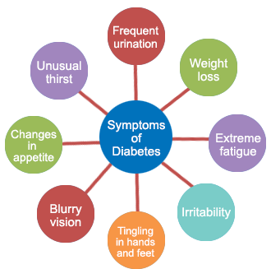
Development of Diabetes Mellitus
Chronic hyperglycemia → diabetes mellitus
Diabetes mellitus: Insufficient insulin or resistance to insulin
Glucose regulation falters
Type 1 or Type 2
Features:
Fasting hyperglycemia
Glucose in the urine
Metabolic changes

Slide 31
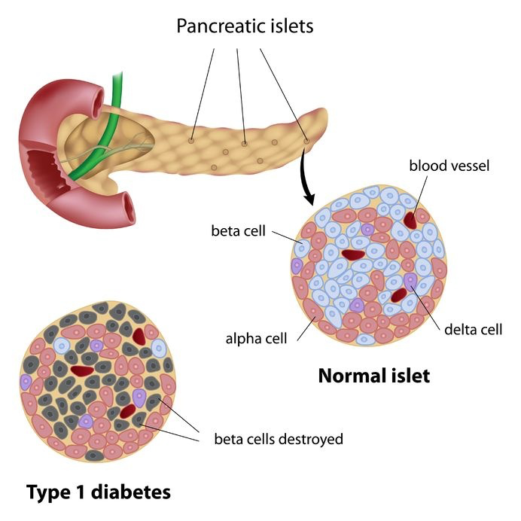
Type 1 Diabetes
Type 1 - Insulin-Dependent (IDDM)
5-10% of cases
Typically childhood onset
Cause: Destruction of beta cells in pancreas, leading to inability to produce adequate insulin and reduce blood sugar. Abnormally high secretion of glucagon from the alpha cells.
Treatment: Insulin injections, diet monitoring.

Slide 32
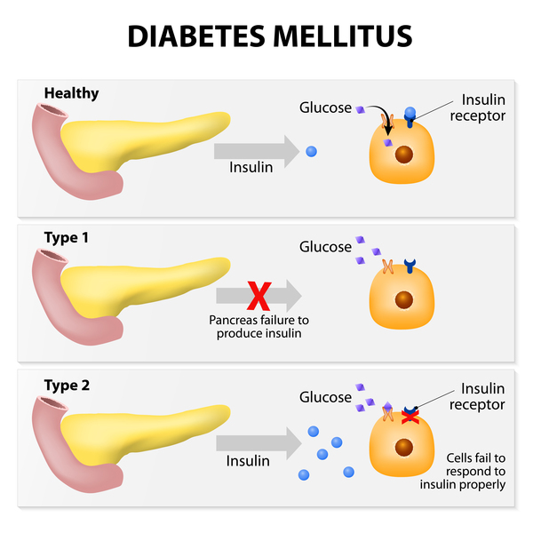
Type 2 Diabetes
Type 2 - Non-Insulin Dependent (NIDDM)
90-95% of cases
Usually adult onset, but increasingly found in children
Cause: Insulin insensitivity/resistance. Insulin resistance reduces the ability of insulin to stimulate skeletal muscle and adipose tissue to take glucose out of the blood. Also, insulin is less able to inhibit the liver from producing more blood glucose.
Treatment: Diet and exercise, possibly diabetes medications and/or insulin.

Slide 33
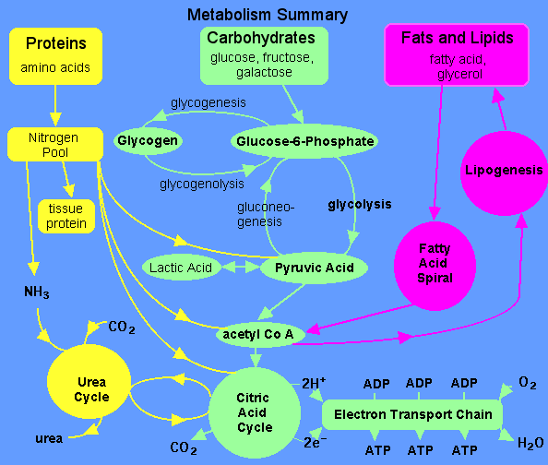
Cellular Metabolism
Cellular metabolism v.s. Cellular respiration
Catabolic reactions
Anabolic reactions
Co2 byproduct through the blood to be exhaled.

Slide 34
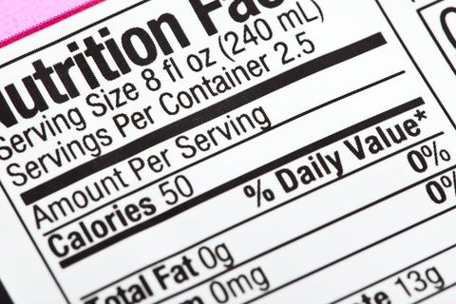
Calories
1 Calorie is equivalent to 1 _____.
UK labels vs US labels.
1,000 calories= 1 kilocalorie or kcal
Carbohydrates and Calories

Slide 35
Basal Metabolic Rate (BMR)
What is BMR?
BMR vs RMR
Harris-Benedict formula.
Women: BMR= 655.1+ (4.35 x weight in lbs) + (4.7x height in In) - (4.7 x age in years)
Men: BMR= 66.47 + (6.24 x weight in lbs) + (12.7 x height in In) - (6.755 x age in years)

Slide 36
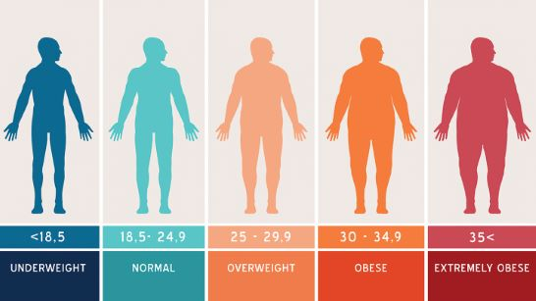
Body Mass Index (BMI)
Example: 19.8 BMI
If Carbs increase so does BMI.

Slide 37
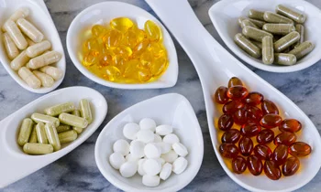
Vitamins/Minerals
Water soluble B Vitamins
Coenzymes that assists in glucose metabolism.
1) B1 Thiamine
ATP synthesis
2) B2 Riboflavin
Other B vitamins are depend on this vitamin
3) B3 Niacin
Electron carrier.
4) B5 Pantothenic acid
5) B6 Pyridoxine
Assists in glycogenolysis.
Breakdown of glycogen to glucose.
6) Biotin
7) Folate
RNA and DNA synthesis.
Minerals
Zinc
Copper
Chromium

Slide 38
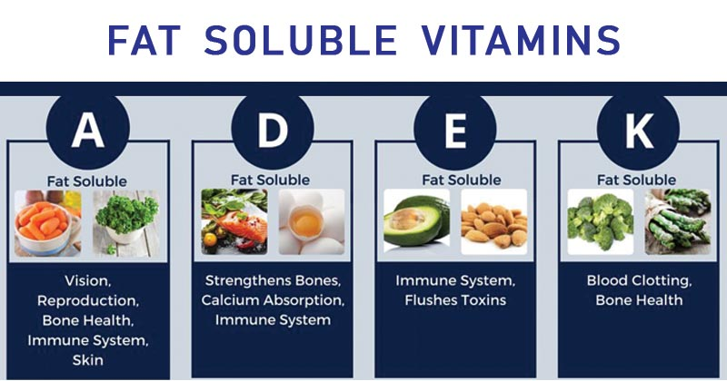
A vitamin that can dissolve in fats and oils. Fat-soluble vitamins are absorbed along with fats in the diet and can be stored in the body's fatty tissue.

Slide 39
The End.

Slide 40
Works Cited:
Carbohydrate Digestion and Absorption NASPGHAN Physiology Series
https://www.niddk.nih.gov/health-information/digestive-diseases/lactose-intolerance/definition-facts
http://www.vivo.colostate.edu/hbooks/pathphys/digestion/smallgut/bbenzymes.html
https://opentextbc.ca/biology/chapter/15-3-digestive-system-processes/
https://www.ncbi.nlm.nih.gov/pubmed/8116552
https://www.ncbi.nlm.nih.gov/pubmed/14642859
https://www.healthline.com/health/carbohydrate-digestion#digestion-process
https://schoolbag.info/chemistry/mcat_biochemistry/mcat_biochemistry.files/image205.jpg
http://usmle.biochemistryformedics.com/low-body-fat-mass-and-hormonal-levels/
https://science.howstuffworks.com/life/cellular-microscopic/fat-cell2.htm
https://healthjade.com/types-of-carbohydrates/
https://en.wikipedia.org/wiki/Glycogen#/media/File:Glycogen_structure.svg
www.oapublishinglondon.com/article/1279
https://www.medicalnewstoday.com/articles/288177.php#cautions_about_supplements
https://www.ncbi.nlm.nih.gov/pmc/articles/PMC3093919/
https://courses.lumenlearning.com/suny-ap2/chapter/carbohydrate-metabolism-no-content/
https://courses.lumenlearning.com/wm-biology2/chapter/transport-of-carbon-dioxide-in-the-blood/

