Slide 1
Digestion of Nucleic Acids

Slide 2
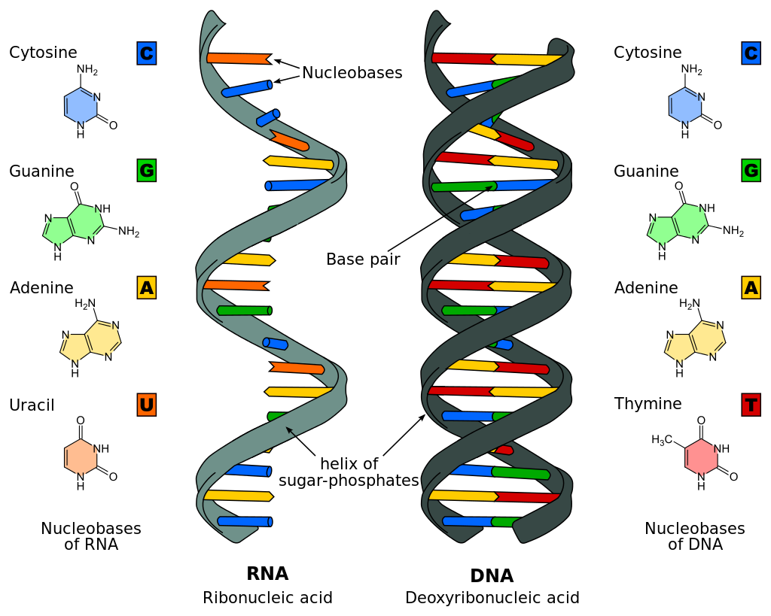
Review of Nucleic Acids Structure
DNA - double stranded
RNA - single stranded
Polymer made up of nucleotides
Nucleotides
Phosphate Group
Deoxyribose/Ribose Sugar
Nitrogenous Base
Nucleoside + Phosphate Group
Nucleoside
Nitrogenous Base + Deoxyribose/Ribose Sugar

Slide 3
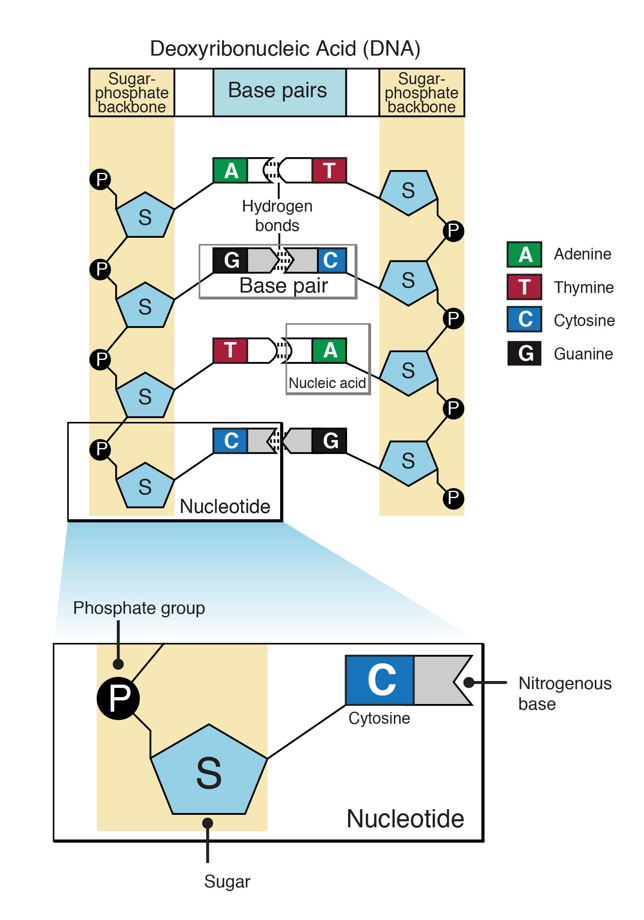
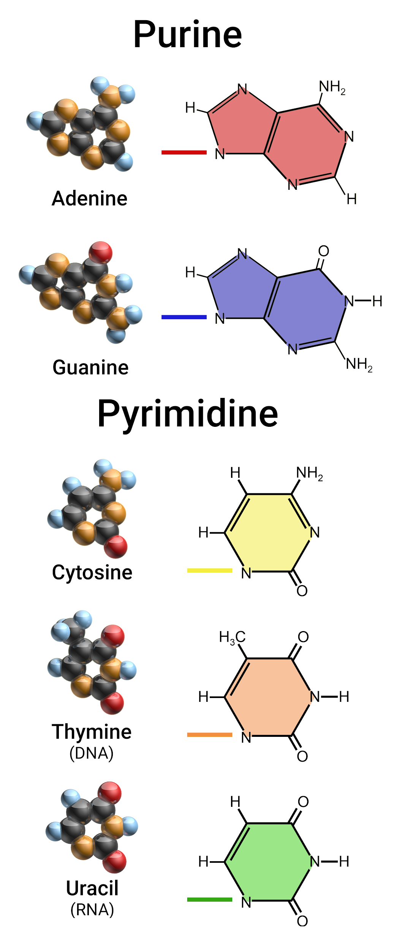
Nitrogenous Bases
Purine
2 Carbon Nitrogen Ring
Pyrimidine
1 Carbon Nitrogen Ring
In RNA, Uracil instead of Thymine
Base Pairings:
DNA: A-T, G-C
RNA: A-U, G-C

Slide 4
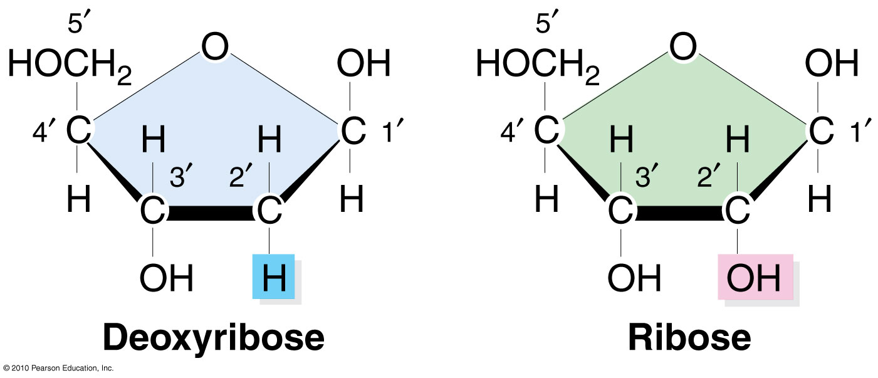
DNA
Stores genetic information
Stable in alkaline conditions
Sources of Nucleic Acids
Meat
Vegetables
Yeast, Yeast Extracts and Alcoholic Beverages
RNA
transfer of genetic code from DNA used for protein synthesis
Unstable in alkaline conditions

Slide 5
Mouth to Stomach
Mouth: Mechanical Digestion (Mastication and Deglutition)
Esophagus: Transports food to the stomach (Deglutition to Peristalsis)
Stomach: Denaturation of Nucleic Acids and the beginning of chemical digestion

Slide 6
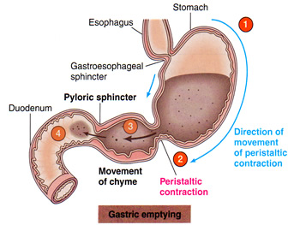
Stomach to Small Intestine
Peristalsis: Wave-like involuntary muscle contractions that move food to different processing stations in the digestive tract.
Small Intestine: Completion of chemical digestion by way of enzymes in the Pancreatic juice

Slide 7
Nucleic acids ingested
In order for these complex structures to be absorbed, they must be broken down into smaller bits (e.g. sugars, phosphates, and nitrogenous bases)

Slide 8
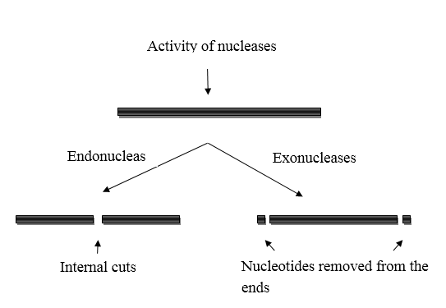
Review: Exonucleases & Endonucleases
Exonucleases: Enzymes that cleave nucleotides individually from either 5’ or 3’ end of RNA or DNA
Endonucleases: hydrolyze internal phosphodiester bonds to break them

Slide 9
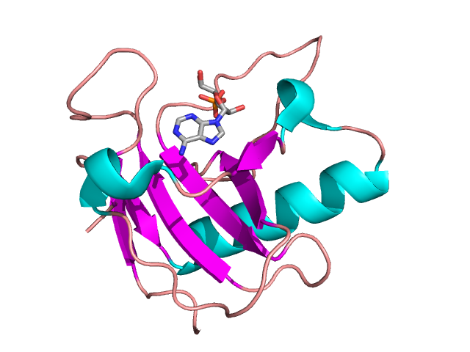
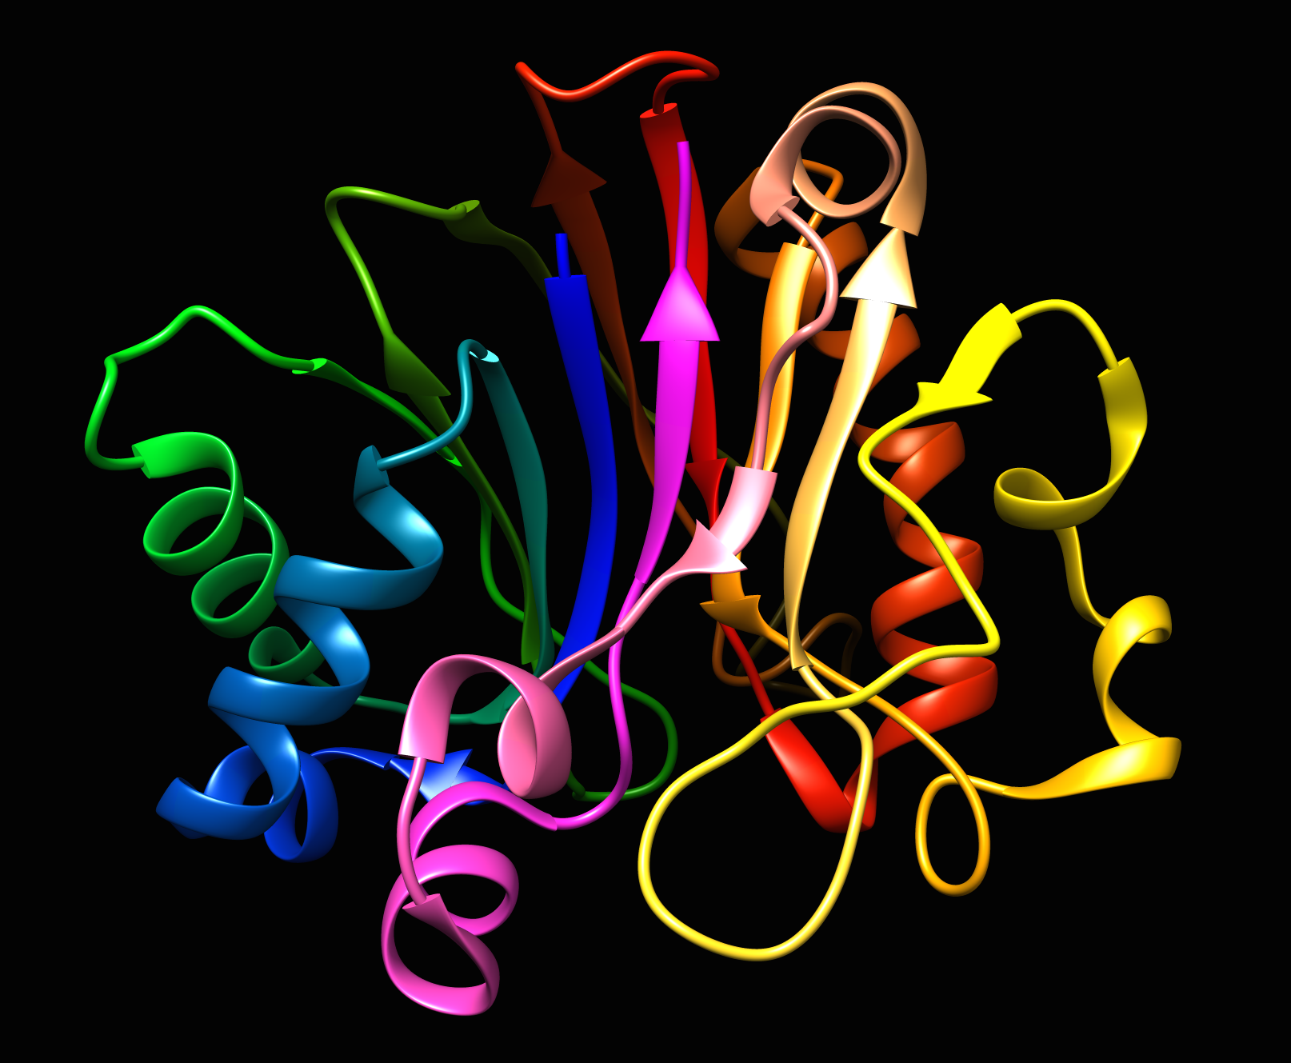
Pancreatic Enzymes
Two main ones: ribonuclease and deoxyribonuclease, are produced by the pancreas & enter the duodenum.
Ribonuclease
Deoxyribonuclease

Slide 10
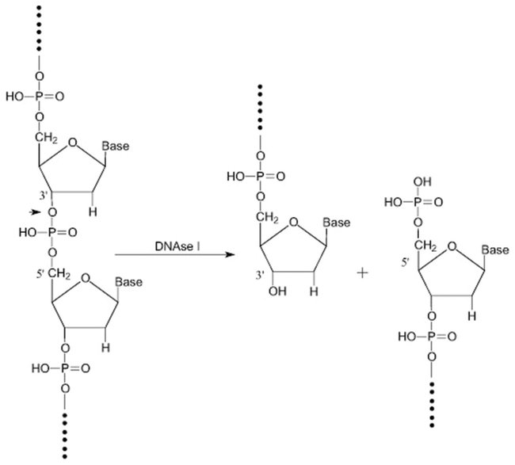
Digestion by pancreatic enzymes
During digestion, DNA and RNA undergoing hydrolysis to yield individual nucleotides
DNA
Deoxyribonucleotides
deoxyribonuclease
RNA
Ribonucleotides
ribonuclease

Slide 11
Brush Border Enzymes
In the intestines, the nucleotides are digested by phosphatase and nucleosidase, two intestinal brush border enzymes.
Phosphatase cleaves phosphate groups off substrates
Nucleosidase cleave nucleosides off substrates
The product is pentoses, phosphates, and nitrogenous bases.
Phosphatase reaction
Nucleosidase reaction

Slide 12
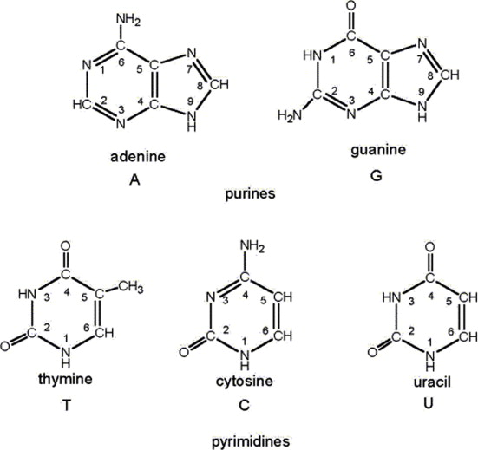
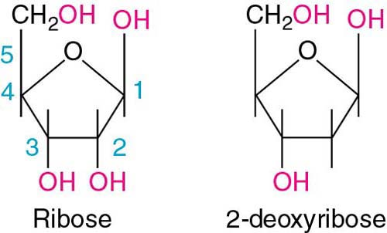
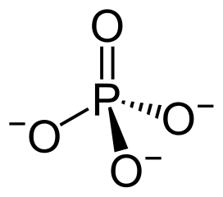
Phosphates
Pentose
Nitrogenous bases
These are now able to be absorbed into the alimentary canal’s wall

Slide 13
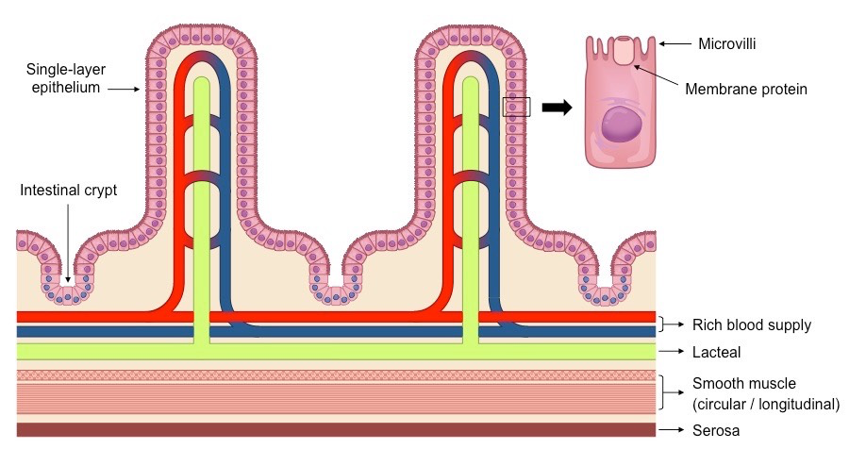
Membrane Transport Proteins use Active Transport
Pentose sugars, phosphates, and nitrogenous bases are transported across the villus epithelium to enter the bloodstream

Slide 14
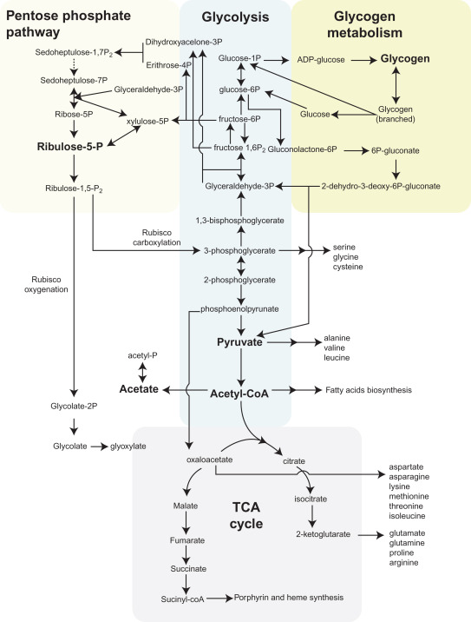
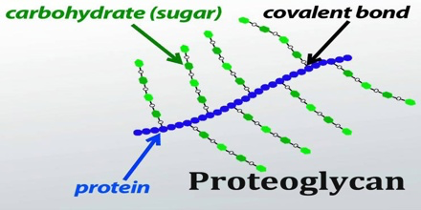
Pathway of Pentose Sugars
D-Ribose sugars may be utilized in pentose-phosphate pathway (anabolic)
May be used in proteoglycans

Slide 15
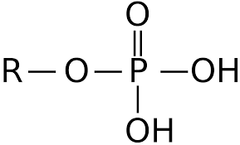
Pathway of Phosphates
Multiple uses: repair bone (85%), muscle contraction, nerve functioning, and some stored in tissues
Phosphate levels regulated by the kidneys and excreted in urine

Slide 16
Pathway of Nitrogenous bases
De-Novo Synthesis Vs. Salvage Pathway
Synthesis of complex molecules from simple molecules such as sugars or amino acids
Happens in Cytosol of liver, small intestine, and thymus
Readily available in cells
Do not use free bases
Used to recover bases and nucleosides that are formed during degradation of RNA and DNA.
Purine and pyrimidine bases are salvaged and recycled to make nucleotides from degradation of DNA and RNA.
Consume less energy
preferred source of nucleotides for nucleic synthesis
Occurs primarily in Liver

Slide 17
De-Novo Synthesis
P-Ribose
Turns into PRPP (Phosphoribosyl pyrophosphate)
Purine Route
PRPP is turned into IMP(inosine monophosphate)
broken down to AMP(adenosine Monophosphate) and GMP(guanosine Monophosphate
Synthesised to either DNA or RNA
Xanthine Oxidase enzyme breaks AMP and GMP into Uric Acid
Pyrimidine Route
PRPP and Orotic Acid combine to form UMP(uridine Monophosphate)
UMP turns to UDP(uridine diphosphate and is converted to CTP(cytosine triphosphate)
UDP to dUDP(deoxy-uridine Diphosphate) to dUMP(deoxy-uridine monophosphate) until finally converted to dTMP(deoxy-thymine monophosphate)
Ribonucleotide Reductase turns Ribose(RNA) to Deoxyribose(DNA)

Slide 18
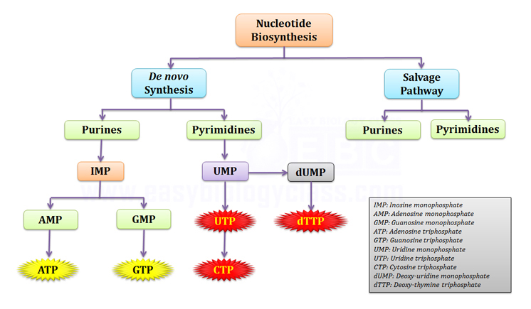

Slide 19
Salvage Pathway
DNA or RNA is broken down
Release GMP (Guanosine Monophosphate) or AMP (Adenosine Monophosphate)
Sugar and phosphate groups removed to form Adenosine and Guanine.
Adenosine goes through extra step to become Inosine
Inosine and Guanine are recycled by enzyme HGPRT back to Purines

Slide 20
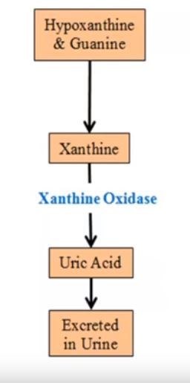
Salvage Pathway
If there is an excess, Hypoxanthine and Guanine are converted to xanthine
Acted on by Xanthine Oxidase to Uric Acid (excess forms crystals an causes Gout)
Excreted in our urine.

Slide 21
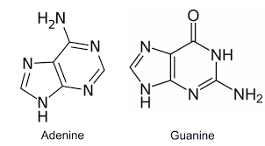
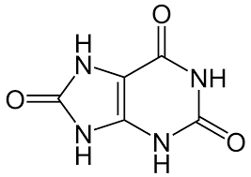
Purine Degradation into Uric Acid
Purines are nitrogen-containing compounds, which are made inside the cells of your body (endogenous) or come from outside the body (exogenous).
Purine breaks down into Uric Acid
High Levels of uric acid from excess purines may accumulate in your tissues which can form different diseases and complications
Purines
Uric Acid

Slide 22
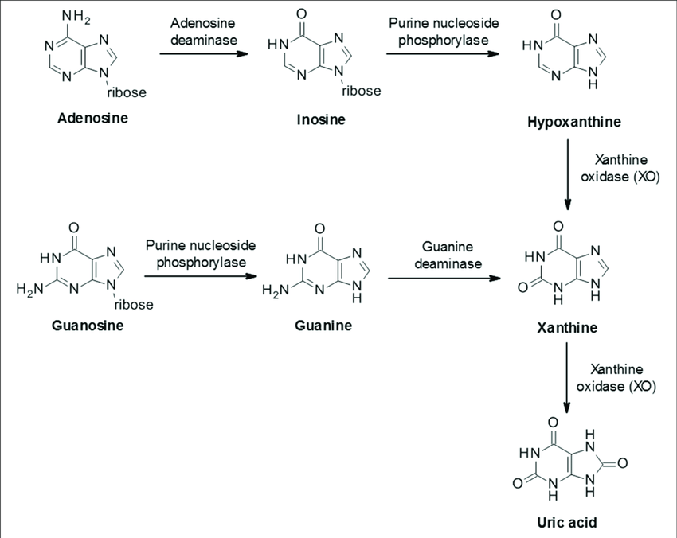
Purine Degradation into Uric Acid
Nucleotide monophosphates, AMP and GMP, are converted to Adenosine and Guanosine by nucleotidase
AMP → Adenosine → Xanthine
GMP → Guanosine → Xanthine
Xanthine formed from these two steps are converted to Uric Acid using Xanthine Oxidase

Slide 23
Hyperuricemia
Hyperuricemia results from excess uric acid in the blood.
Normal uric acid levels:
Females: 2.4-6.0 mg/dL
Males: 3.4-7.0 mg/dL
Primary Causes:
Increased production of uric acid levels from purine
Secondary causes:
High uric acid levels due to another disease or condition
Foods High in Purine
All organ meats such as the liver
Yeasts, and yeast extracts
Asparagus, spinach, beans, peas, lentils
Symptoms
Kidney problems caused by formation of kidney stones, or problems with urination
You may notice an inflammation of a joint (gout), if the uric acid crystals deposit in your joints

Slide 24
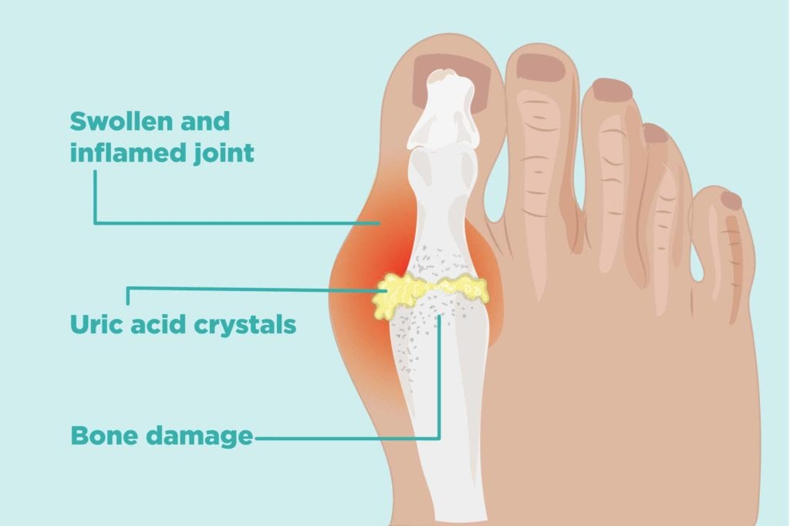
Gout
Is a disease resulting from deposition of monosodium urate crystals in tissues from excess uric acid levels
White blood cells may attack the crystals, causing inflammation and pain
Occurs in about 20% of people with hyperuricemia

Slide 25
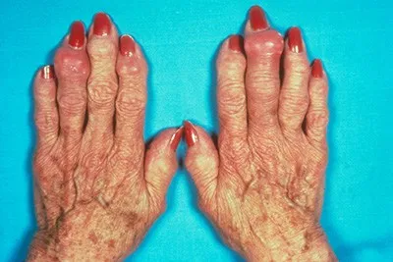
Gout
Symptoms:
Severe pain in your joints
Joint stiffness
Difficulty moving affected joints
Redness and Swelling
Treatment:
Allopurinol: is a Xanthine Oxidase Inhibitor
Non-Steroidal anti-inflammatory (NSAID) agents and Tylenol may relieve the pain
Uricosuric Drugs - block the reabsorption of urate

Slide 26
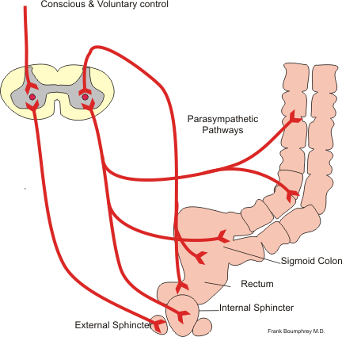
Defecation Reflex
Voluntary and involuntary processes
Fecal matter expands rectal walls
Stretch receptors cause contraction of rectal muscles
Internal anal sphincter relaxes
Urge to defecate
Contraction of external sphincter muscle
Contract abdominal muscles and anorectal angle decreases
Peristaltic waves of rectum and sphincters allow feces to pass

Slide 27
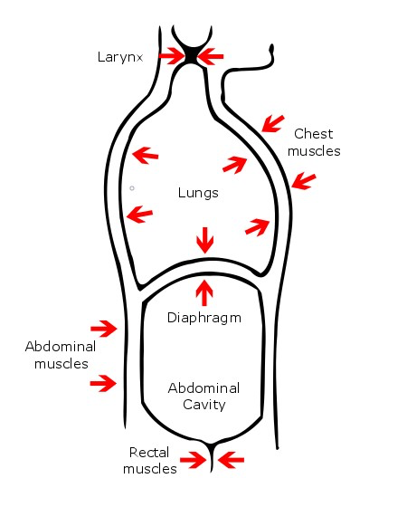
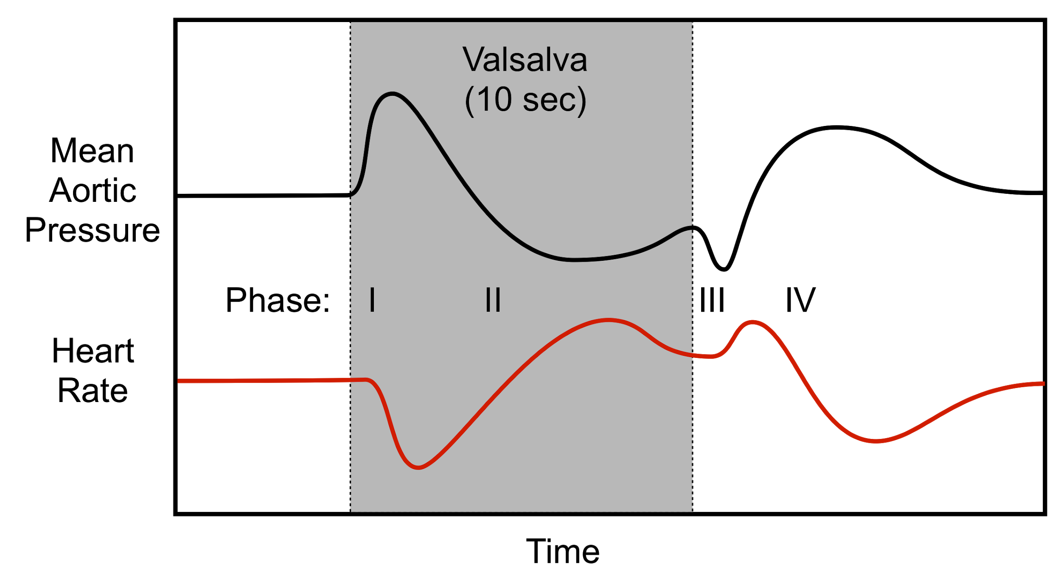
Valsalva Maneuver
Act of exhaling forcefully while closing one’s glottis.. “Bearing down”
Increases intrathoracic pressure and parasympathetic stimulation to the heart
Preload (filling) decreased
Lower cardiac output
Deviation = abnormal heart functioning
Notes:
Bearing down while exhaling
Ventricular filling
Diagnose e.g. valve stenosis or hypertrophy

Slide 28
Acknowledgements
Dr. Wissmann for his instruction of the course
Class for being an attentive audience
SMC Department of Life Sciences for the

Slide 29
References
“Hemodynamics of a Valsalva Maneuver.” Image for Cardiovascular Physiology Concepts, Richard E Klabunde PhD, www.cvphysiology.com/Hemodynamics/H014.
Libretexts. “22.11F: Defecation Reflex.” Medicine LibreTexts, Libretexts, 9 Sept. 2019, med.libretexts.org/Bookshelves/Anatomy_and_Physiology/Book%3A_Anatomy_and_Physiology_(Boundless)/22%3A_Digestive_System/22.11%3A_The_Large_Intestine/22.11F%3A_Defecation_Reflex.
OpenStax, Lumen Learning &. “Anatomy and Physiology II.” Chemical Digestion and Absorption: A Closer Look | Anatomy and Physiology II, courses.lumenlearning.com/suny-ap2/chapter/chemical-digestion-and-absorption-a-closer-look/.
“Phosphate in Blood.” Phosphate in Blood | Michigan Medicine, www.uofmhealth.org/health-library/hw202265.
Chemical Digestion and Absorption: A Closer Look https://courses.lumenlearning.com/suny-ap2/chapter/chemical-digestion-and-absorption-a-closer-look/
Structural Biochemistry/Nucleic Acid/Difference between DNA and RNA https://en.wikibooks.org/wiki/Structural_Biochemistry/Nucleic_Acid/Difference_between_DNA_and_RNA

