Slide 1
Digestion of Fats
Jordan Buencamino
Khaliah Sanders
Samantha Hernandez
Yeji Lee

Slide 2
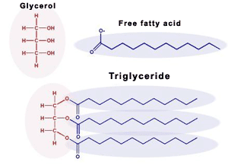
What is a fat? Triglyceride?Lipid?
Lipids
Organic compound
Functions
Store Energy
Structural support
Triglycerides
Most common type of fat
Glycerol + three fatty acid chains
Notes:
Discuss chemical structures and functions in the body

Slide 3
Long vs. Short Chain Fatty Acids
Short Chain Fatty Acids
Less than 6 Carbons
Produced by friendly gut bacteria
Main source of energy for epithelial cells in colon
Rapidly metabolized by intestinal cells
Long Chain Fatty Acids
12 or more Carbons
Can be in dietary food but are mainly produced in the liver
Turned into triglycerides
Taken up by cells and are stored or used for energy
Saturated and unsaturated fats

Slide 4
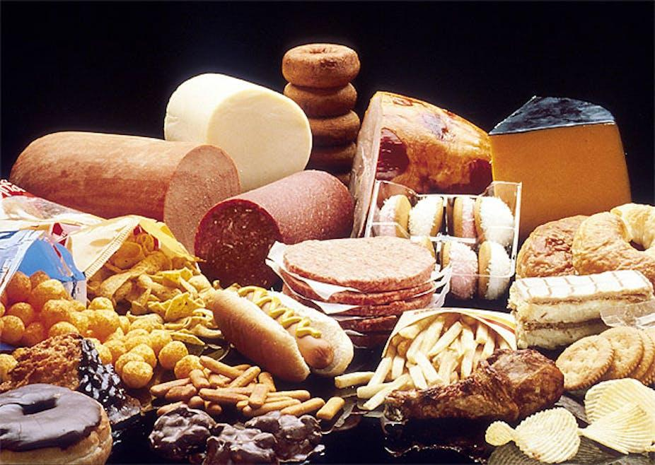
Saturated Fats
No double bonds in fatty acid chain
Saturated with hydrogen atoms
Typically solid at room temperature
Increases risk for heart disease and LDL
Dairy products, Red Meat, Coconut Oil, etc.

Slide 5
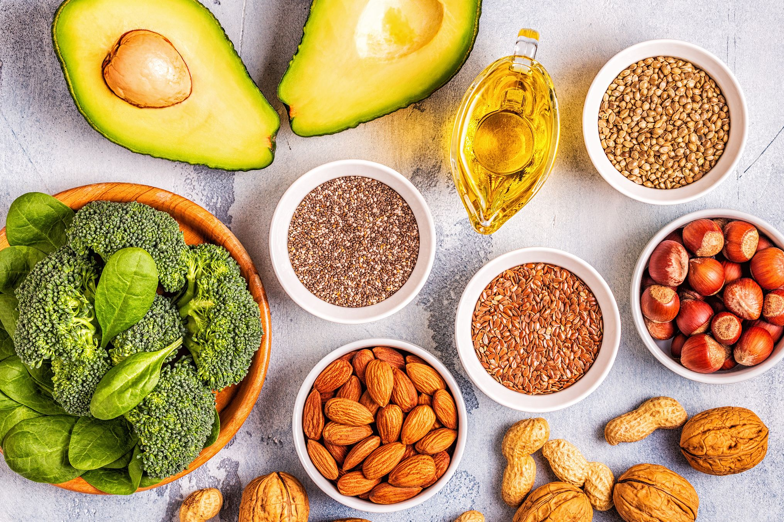
Unsaturated Fats
At least one double bond in a fatty acid chain
Liquid at room temperature
Avocados, Olives, Almonds, etc.
Monounsaturated fats
One double bond
Polyunsaturated fats
Two or more double bonds

Slide 6
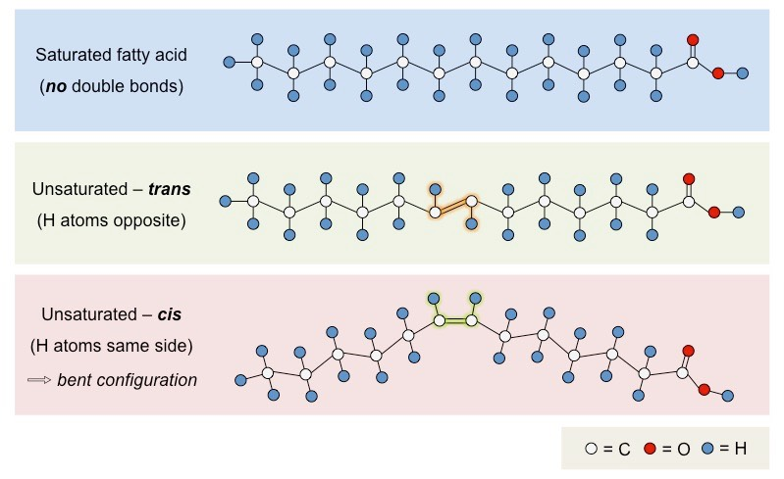
Cis vs. Trans Configuration
Cis Configuration
Double bonds on the same side
Prevents tight packaging
Trans Configuration
Double bonds on opposite side
Increase shelf life of a product
Creates a more solid product

Slide 7
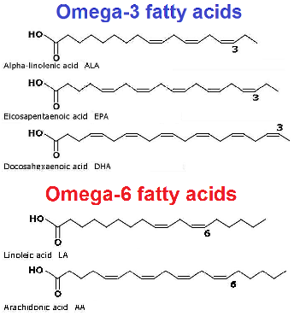
Essential Fatty Acids
Polyunsaturated Fats
Omega-6: Linoleic Acid
84-89% total amount of polyunsaturated calories
Eggs, Tofu, Vegetable oils: Sunflower oil, Corn oil, etc.
Protection against heart disease
Omega-3: Alpha-Linoleic Acid
9-11% total amount of polyunsaturated calories
Sardines, walnuts, flax seeds, soybeans, canola oil, etc.
Reduces blood pressure, increases HDL, decreases triglycerides

Slide 8
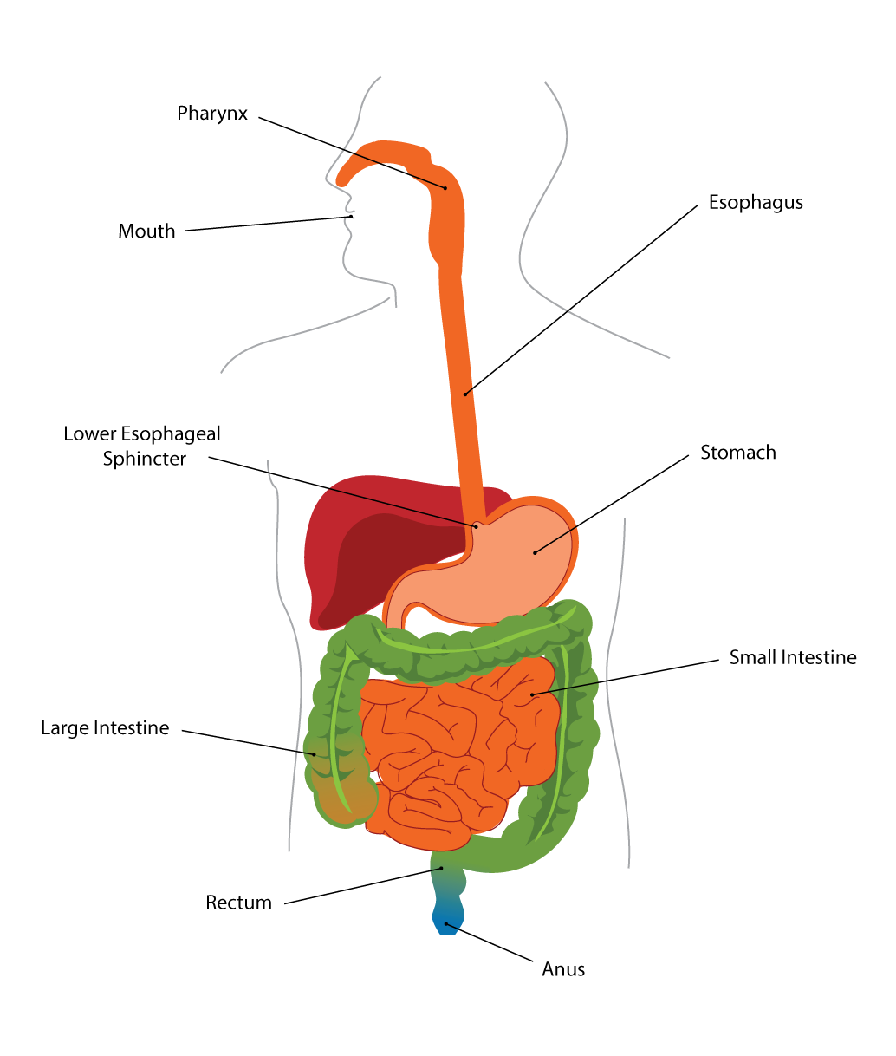
Mouth and Esophagus
Mechanical Digestion
Secretion of Acidic Lipases: Lingual Lipase
Esophagus contracts to move bolus toward the stomach
Notes:
Function and what part they play? Once introduced
Samantha

Slide 9
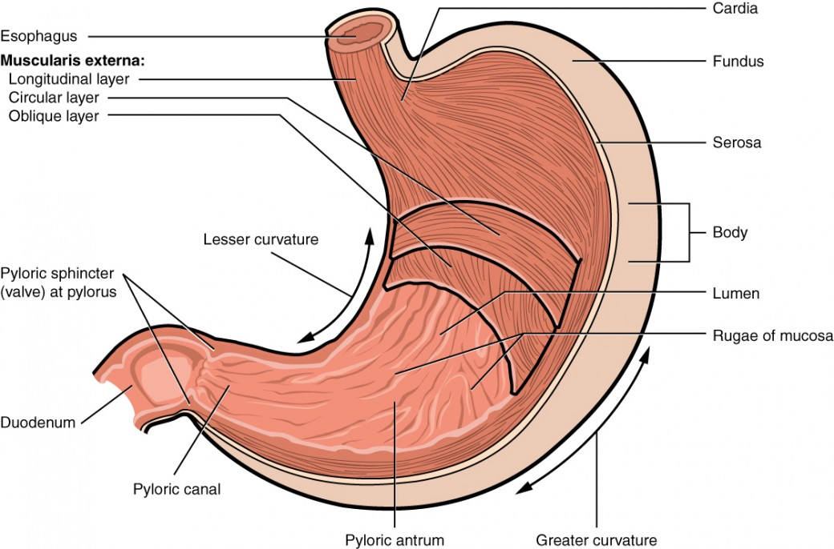
Stomach
Mix & Churn food with gastric juice
Gastric lipase breaks down
triglycerides → diglycerides + fatty acids
Notes:
Function and what part they play Yeji

Slide 10
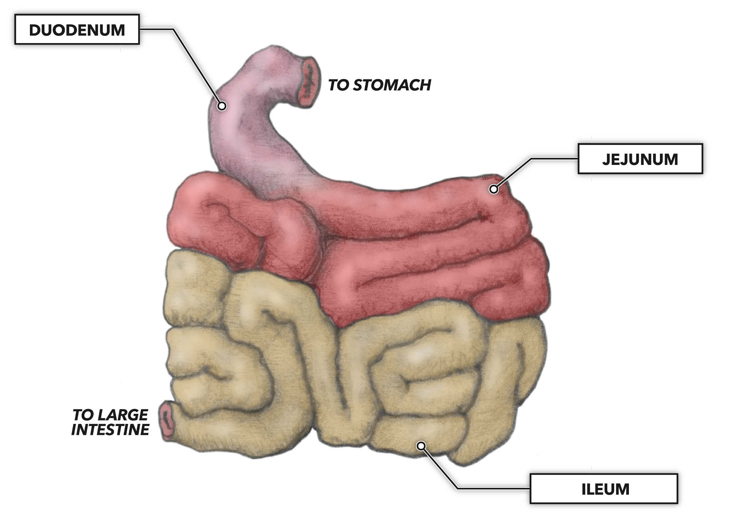
Small Intestine
In the duodenum, triglycerides interact with
bile salts (emulsifier of lipids) and
pancreatic lipase (fat-digesting enzyme)
Triglycerides are packaged into chylomicrons
in the cells of the small intestine → Lacteals → Blood stream via thoracic duct

Slide 11
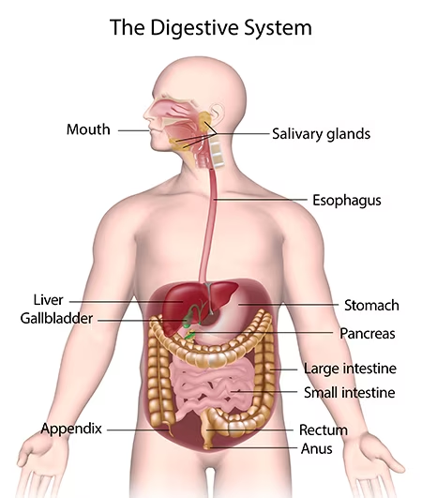
Absorption of Fats in the Digestive system
Mouth
Esophagus
Stomach
Duodenum
Small intestine
Lymphatic System
Blood
Notes:
Jordan
As we’ve seen so far, fats must go through several steps of processing before they can be digested and absorbed by our bodies.
I have whole pathway here but the majority of absorption occurs in the small intestine. For the next few slides, I’ll be focusing from here (duodenum) down
Mouth - mastication
Esophagus - movement via peristalsis
Duodenum - emulsification (pancreas - pancreatic lipase, liver - bile)
Small intestine - digestion & absorption
Lymphatic system - transportation of chylomicrons to blood
Blood - transportation of chylomicrons VLDLs (containing fats) to tissues of body
Most of digestion/absorption happens in small intestine
Absorption: where? specifically how? all enzymes? fate?

Slide 12
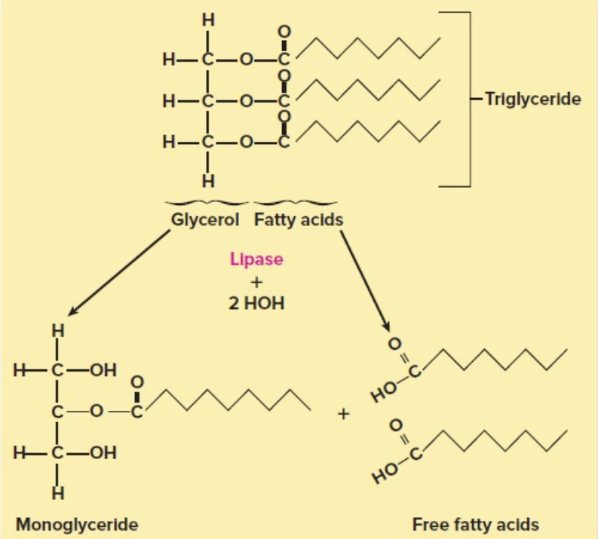
Absorption of Fats in the Digestive system
Arrival of lipids in duodenum triggers secretion of bile → emulsification*
Through hydrolysis, pancreatic lipase liberates 2 fatty acid tails and a monoglyceride from each triglyceride
Free fatty acids and monoglycerides associate with micelles of bile salts, cholesterol, and lecithin and are absorbed into the epithelial cells of the small intestine
Synthesized intracellularly into triglycerides
*Emulsification ≠ digestion
Notes:
Jordan
Before digestion can begin, fats need to be emulsified, or broken down into smaller particles for absorption. This happens in the duodenum, where bile and pancreatic lipase do their work to break down dietary fats.
First, pancreatic lipase catalyzes a hydrolysis reaction yielding a monoglyceride and 2 free fatty acids from each triglyceride.
Now, one of two things will happen from here: short chain fatty acids will be absorbed directly from the small intestine into the hepatic portal veins. Long chain fatty acids follow a different pathway, which I’ll go over now.

Slide 13
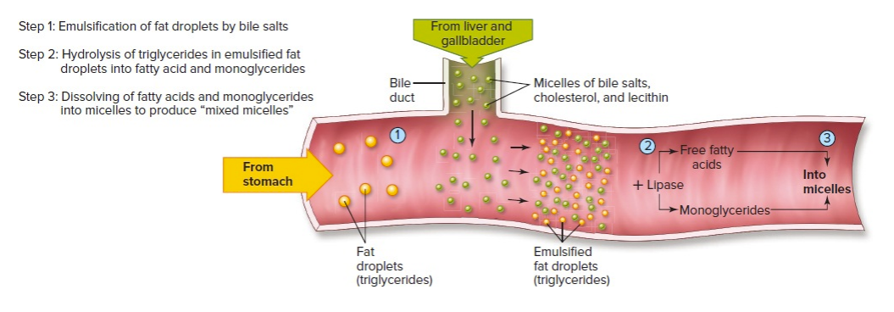
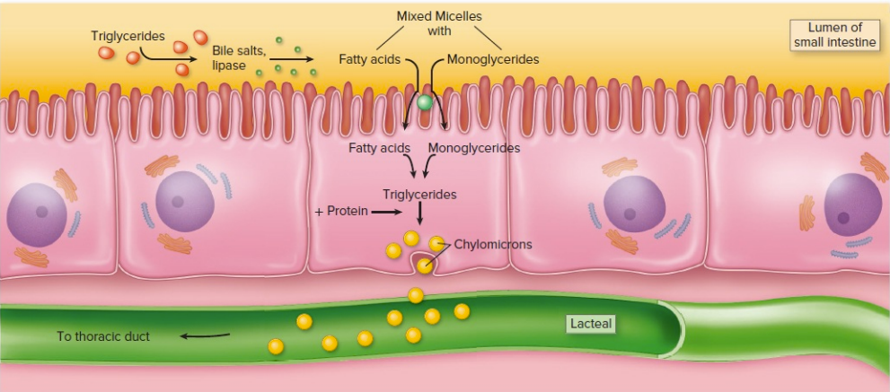
Absorption of Fats in the Digestive system
Notes:
Jordan
Here we can see the whole pathway: fats enter the small intestine from the stomach, get emulsified by lipase and bile salts, then mix with the cholesterol and lecithin to form mixed micelles (essentially a group of different molecules)
These mixed micelles then enter the villi of the small intestine, after which they are resynthesized into triglycerides.
The triglycerides then acquire a protein element (which I’ll touch on later) to form chylomicrons

Slide 14
Absorption of Fats in the Digestive system
From the small intestine to the lymphatic system
Triglycerides are combined with phospholipids, cholesterol, and protein inside epithelial cells to form chylomicrons
Chylomicrons are exocytosed into central lacteals (lymphatic capillaries) of intestinal villi
Lacteals transport chylomicrons to thoracic duct, which dumps them into left subclavian vein
Small intestine
Lymphatic system
Blood
Notes:
Jordan
Chylomicrons are essentially bags of fat, consisting of triglycerides, phospholipids, cholesterol, and protein.
These bags of fat are exocytosed into a lymphatic capillary, known as a lacteal.
Lacteals then bring the chylomicrons to the thoracic duct, which eventually dumps them into the left subclavian vein.

Slide 15
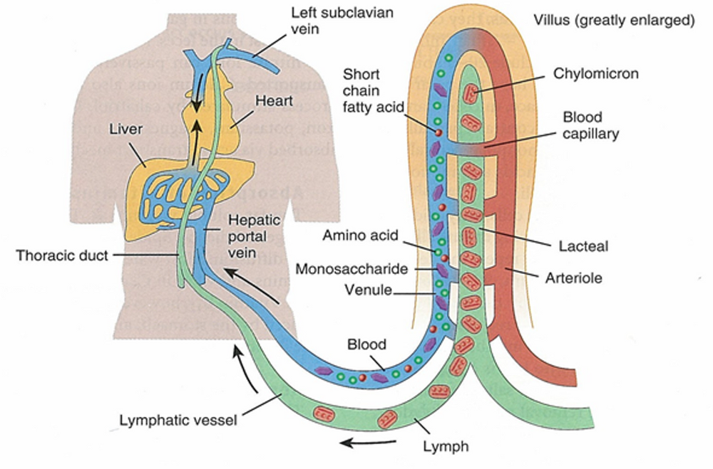
Absorption of Fats in the Digestive system
Notes:
Jordan
Here we can see all of that in action. You’ve got the chylomicrons traveling up the lymphatic vessel to the left subclavian vein, through the heart, and to the liver.
You can also see how the short chain fatty acids skip the process we were just talking about. They take a shortcut through the hepatic portal vein straight to the liver.

Slide 16
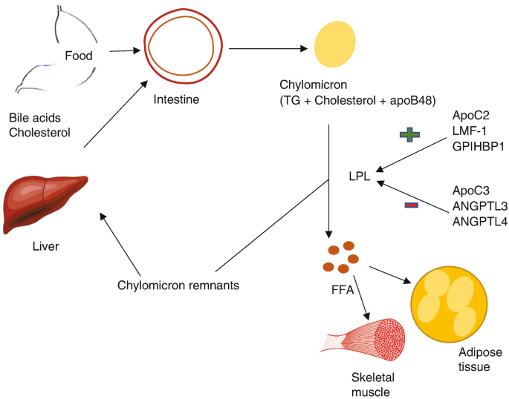
Absorption of Fats in the Digestive system
In blood
Once chylomicrons enter the bloodstream, they acquire apolipoprotein which allows them to bind to receptor proteins on the plasma membrane of the endothelial cells of muscle and adipose tissue.
The endothelial cell plasma membrane also contains lipoprotein lipase (LPL), which is used to free triglycerides from chylomicrons and VLDLs.
The free fatty acids can then enter the tissue cells to be used for energy, cell repair, and growth.
Once the triglycerides have been removed from the chylomicrons, the remaining remnant particle containing cholesterol is released into the blood and eventually makes its way back to the liver.
Notes:
Jordan
Now for some complicated stuff. Once chylomicrons enter the blood, they interact with apoliprotein, which allows them to bind to receptor proteins in non-hepatic tissues.
When this happens, they encounter an enzyme called lipoprotein lipase which frees triglycerides from chylomicrons and VLDLs for use and storage by the muscle or tissue.
With the triglycerides removed, the remnants of the chylomicrons make their way back to the liver to be recycled/broken down.

Slide 17
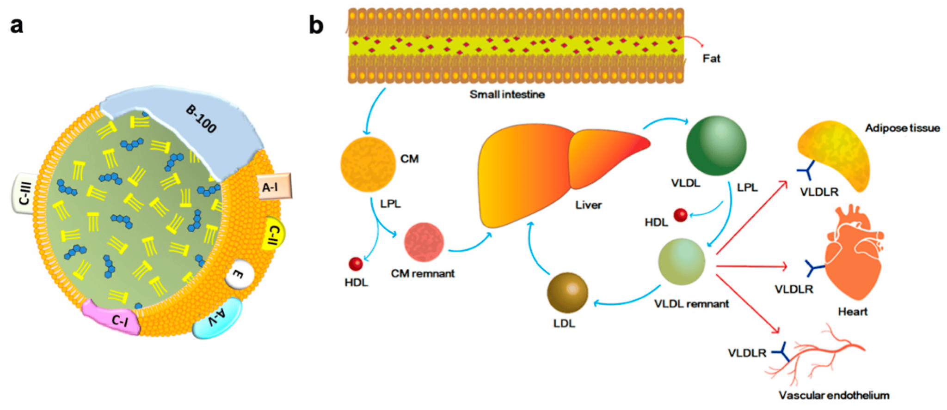
Absorption of Fats in the Digestive system
Similar to chylomicrons, the liver produces very low density lipoproteins (VLDLs) containing cholesterol and triglycerides
LPL removes triglycerides from VLDLs to deliver to organs, converting VLDLs to low density lipoproteins (LDLs) containing only cholesterol.
LDLs transport cholesterol to organs, including blood vessels
Excess cholesterol is returned from the organs to the liver via high density lipoproteins (HDLs)
Notes:
Jordan
I mentioned VLDLs in the last slide but what are they?
The liver produces these very low density lipoproteins (VLDLs) which are similar in structure and function to chylomicrons— they are chock full of fats and cholesterol and are circulated throughout the body to deliver their contents to our organs.
Like with the chylomicrons, LPL removes fats from VLDLs, converting them into low density lipoproteins, or LDLs.
LDLs transport cholesterol throughout the body, including the blood vessels. This is why high levels of LDLs are associated with atherosclerosis: all that cholesterol in the blood vessels can cause narrowing and blockage, which leads to a whole slew of other issues.
In contrast, excess cholesterol is bound to high density lipoproteins, or HDLs, and returned to the liver for processing.

Slide 18
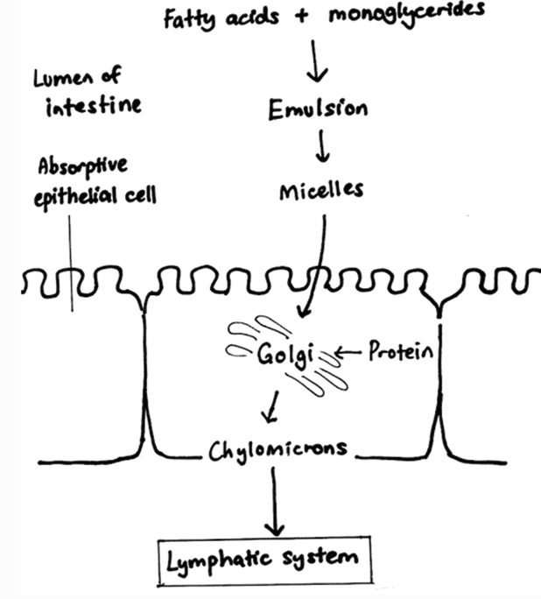
Emulsification
The breakdown of fat globules in the duodenum into tiny droplets, which provides a larger surface area on which the enzyme pancreatic lipase can act to digest the fats into fatty acids and glycerol. Emulsification is assisted by the action of the bile salts!

Slide 19
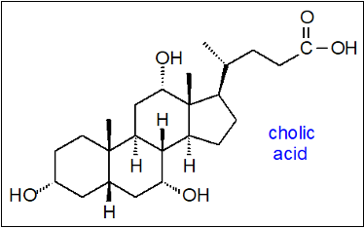
Bile Salts
Synthesized and conjugated in the liver, secreted into bile, stored temporarily in the gallbladder,
polar and water soluble, function as detergents whereby they emulsifies larger fats into smaller droplets
passed from the gallbladder into the duodenum, absorbed throughout the small intestine but especially in the ileum, and returned to the liver via the portal vein.
This cycling of bile acids between the liver and the intestine is referred to as the enterohepatic circulation.
Bile acid synthesis generates bile flow which is important for biliary secretion of free cholesterol.

Slide 20
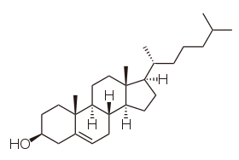
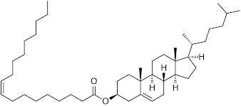
Cholesterol
Cholesterol is an insoluble lipid molecule that plays a critical role in the structure and function of membrane bilayers.
The digestive system is largely responsible for the maintenance of cholesterol balance in the body.
Notes:
What is cholesterol?
Show structure
Khaliah

Slide 21
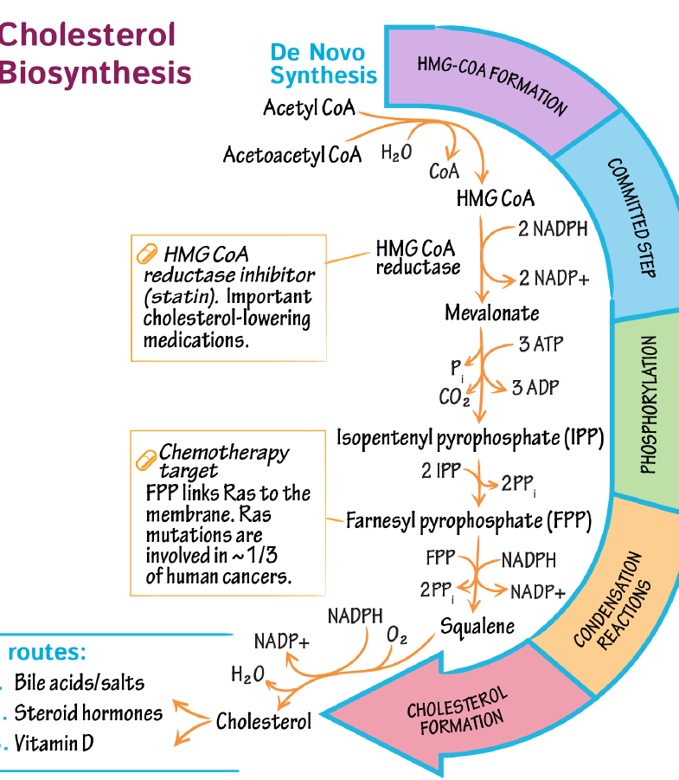
Cholesterol
Synthesis
pathway
Notes:
Maybe a diagram here that demonstrates the pathway?
Acetyl coa and statin no need for extra details
Khaliah

Slide 22
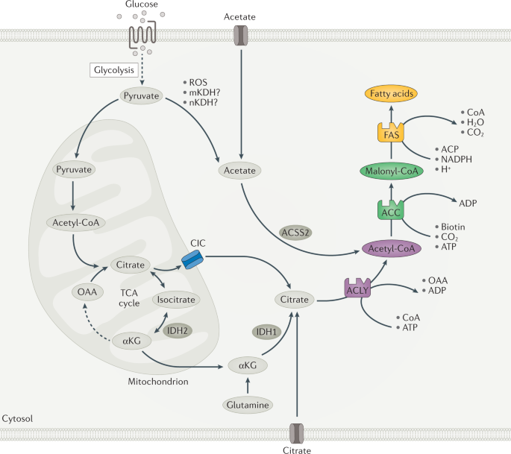
Lipogenesis
The process in which acetyl-coa is stored as triglycerides for storage. The triglycerides are stored in adipose tissue until needed for further use.

Slide 23
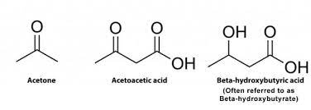
Ketogenesis
metabolic pathway that produces ketone bodies, which provide an alternative form of energy for the body. The body is constantly producing small amounts of ketone bodies that can make 22 ATP each in normal circumstances, and it is regulated mainly by insulin.
occurs primarily in the mitochondria of liver cells

Slide 24
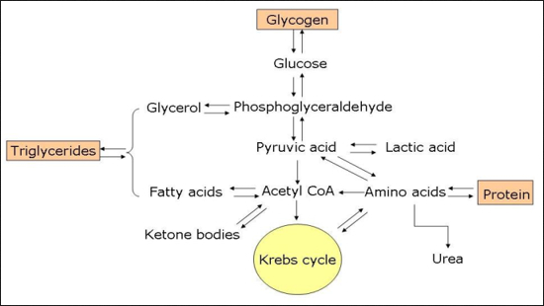
Amino acids to Fats
Occurs when there is an excessive amount of proteins in the body. The protein breaks down into amino acids and ketones. The amino acids are urinated away and ketone are able to be stored by the body as fatty acids.

Slide 25
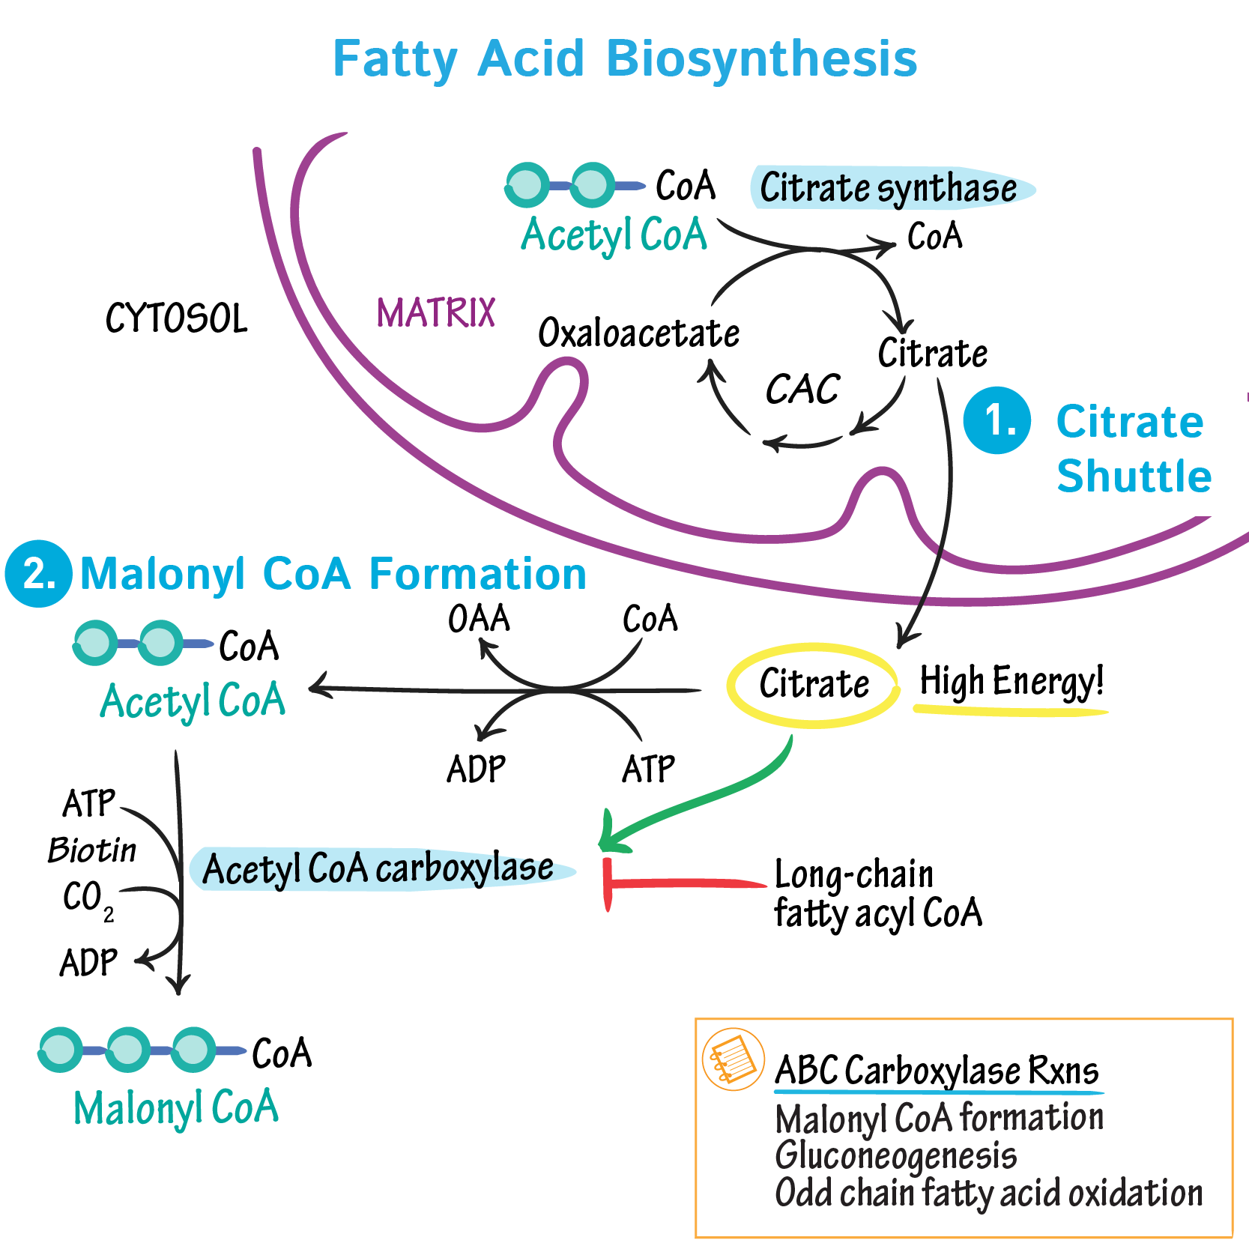
Glucose to Fats
Glucose is broken down into pyruvate by glycolysis and pyruvate is broken down into acetyl-coa to produce fatty acids to form triglycerides by fatty acid synthesis

Slide 26
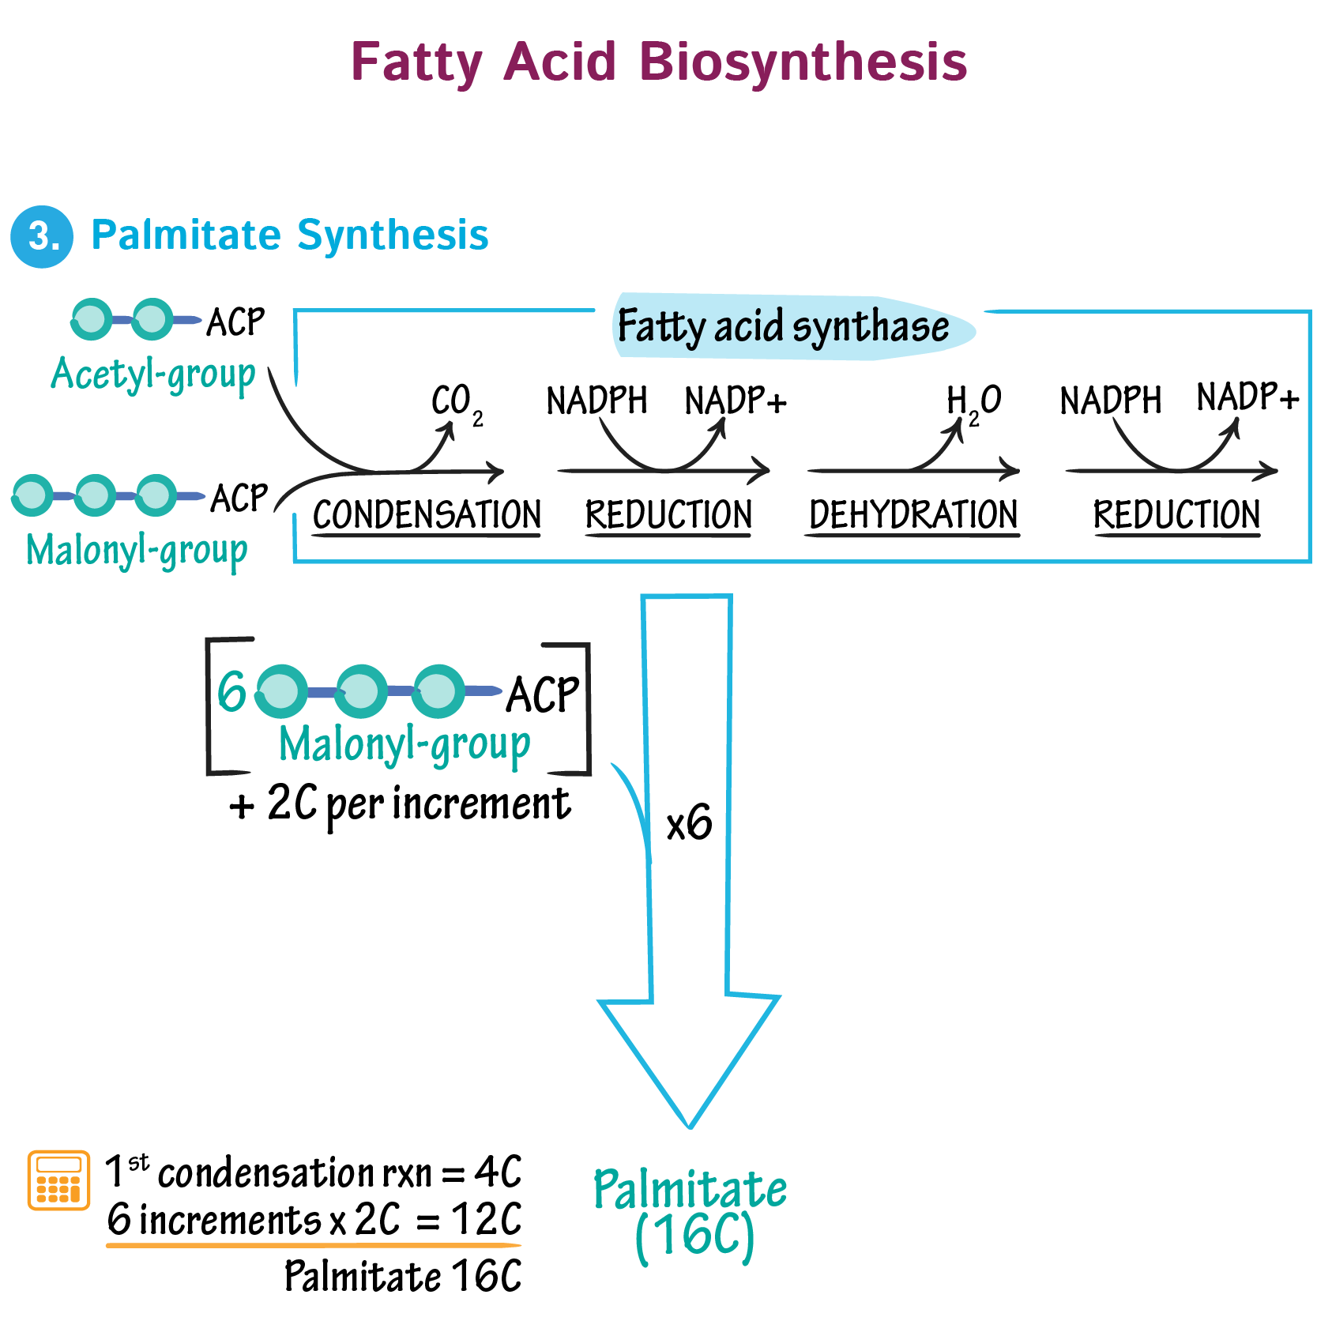
Glucose to Fats
Glucose is broken down into pyruvate by glycolysis and pyruvate is broken down into acetyl-coa to produce fatty acids to form triglycerides by fatty acid synthesis

Slide 27
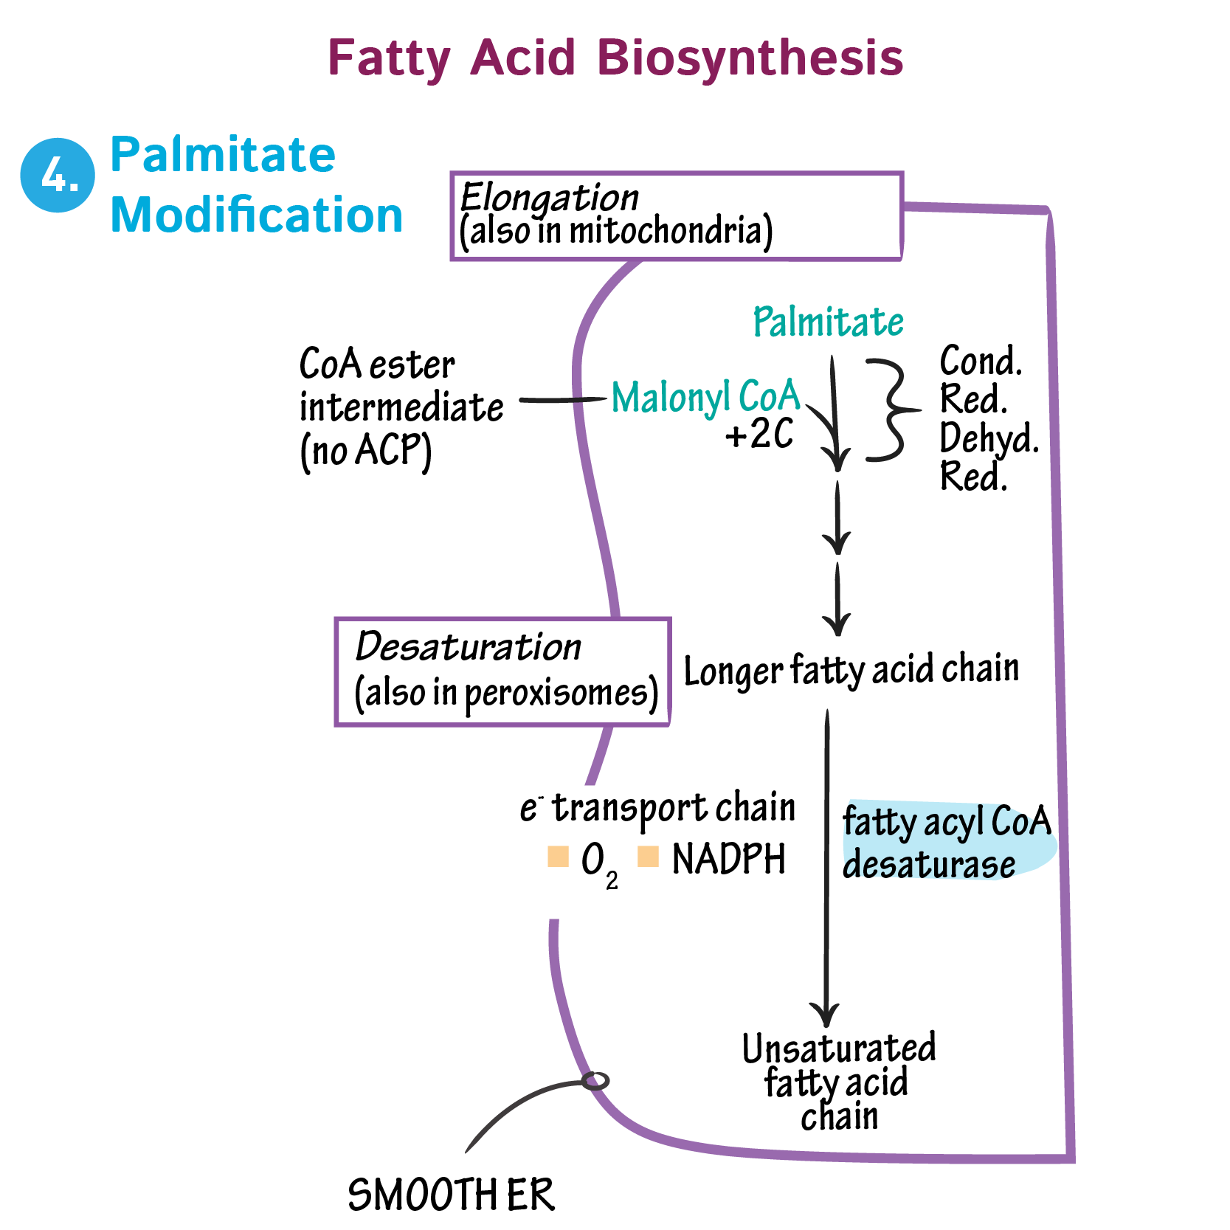
Glucose to Fats
Glucose is broken down into pyruvate by glycolysis and pyruvate is broken down into acetyl-coa to produce fatty acids to form triglycerides by fatty acid synthesis

Slide 28
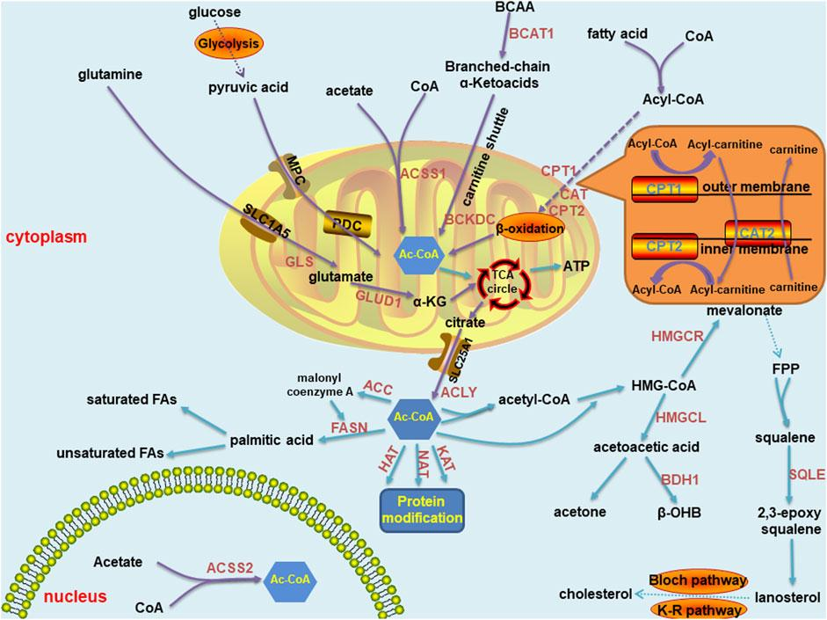
Review

Slide 29
Thank you!

