Slide 1
Digestion of Fats
By Brenda, Katrina, and Julia
Notes:
Maybe we can divide the slides into four sections? I’ve based it off the digestion of fats slides on paul’s site and grouped together the key terms for each topic - Kat
The chemical structure of fats, the differences between types of fats
Define what a triglyceride is and its main function within the body.
Key Terms: Long v Short Fatty Acid Chains, Saturated Fats, Unsaturated Fats, Polyunsaturated Fats, Omega-6 and Omega-3 fats
Digestion in the Mouth, Esophagus. Stomach, and Small Intestine
Discuss the mechanical and chemical digestion of fats in the following structures.
Key Terms: Gastric Lipase, Pancreatic Lipase + Colipase, Bile Salts, Chylomicron, Emulsification
Absorption of Fats in the Digestive System
Explain how fats are absorbed in the digestive system
Key Terms: Chylomicrons, Lacteals, LDL, HDL, VLDL, lipoprotein lipase
-> The same key terms can be used as a good way to transition into cholesterol synthesis due to similarity
Explain how other cellular molecules turn into fat + explain cholesterol synthesis
Key terms: HMG-CoA Synthase, fat for storage, fat for ATP, glucose into fat, amino acids into fat. Structure of cholesterol. Lipogenesis and ketogenesis, Cholesterol Ester
-> Lipogenesis uses Acetyl-coA from glycolysis in order to store fat, so glucose ATP and amino acids into fat can be mentioned in the same explanation.

Slide 2
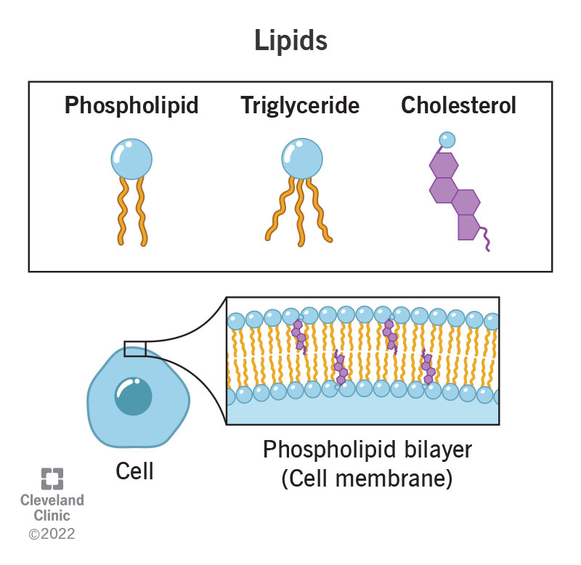
What are lipids?
Lipids are macromolecules made of fatty acid monomers
Lipids are nonpolar and do not interact with water
Function: Structural support for cells, energy storage, and cell signaling
Notes:
Lipids are nonpolar macromolecules that cannot dissolve in water
Types of lipids are phospholipids, triglycerides, and cholesterol
Phospholipids are composed of a glycerol molecules with two fatty acids and a phosphate group
Triglycerides are composed of three fatty acid units joined to glycerol
Called a fat if solid at 25 degrees Celsius and called and oil if liquid at that temp
Cholesterol mentioned later

Slide 3
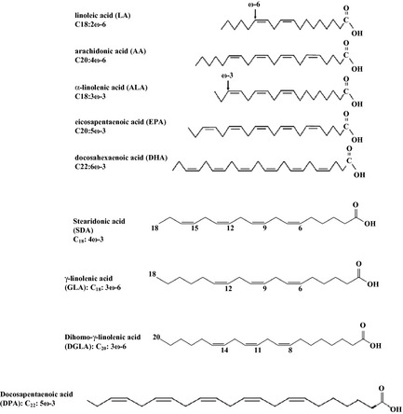
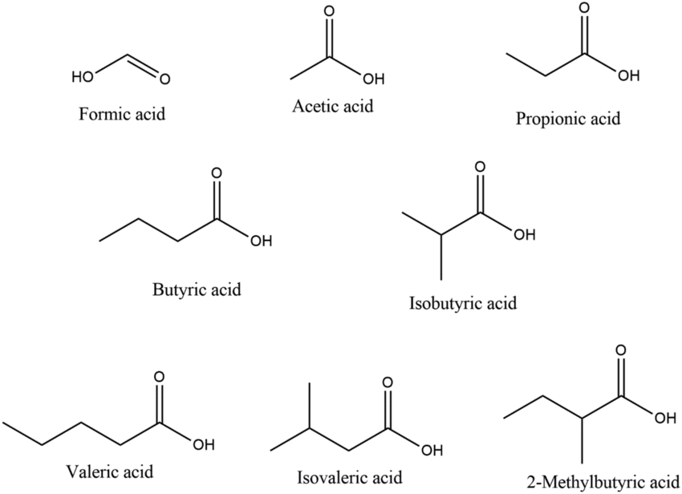
Short-chain vs. Long-chain Fatty Acids
Notes:
Short-chain fatty acids are less than 6 carbons long and can be produced by microbiota and secreted into the portal vein blood during absorption
Enter portal blood directly from enterocytes
Long chain fatty acids are 12 or more carbons long and used within intestinal epithelial cells to synthesize triglycerides
Help form chylomicrons
Majority of our dietary fats contain long-chain fatty acids

Slide 4
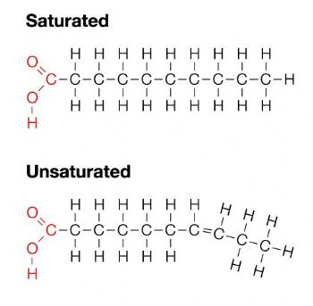
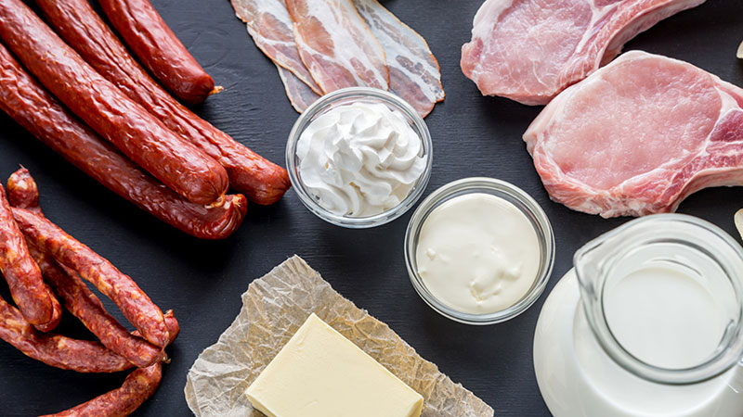
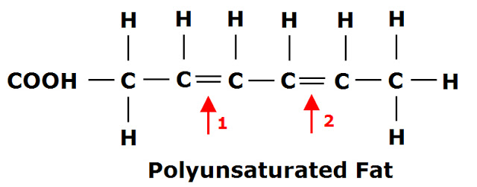
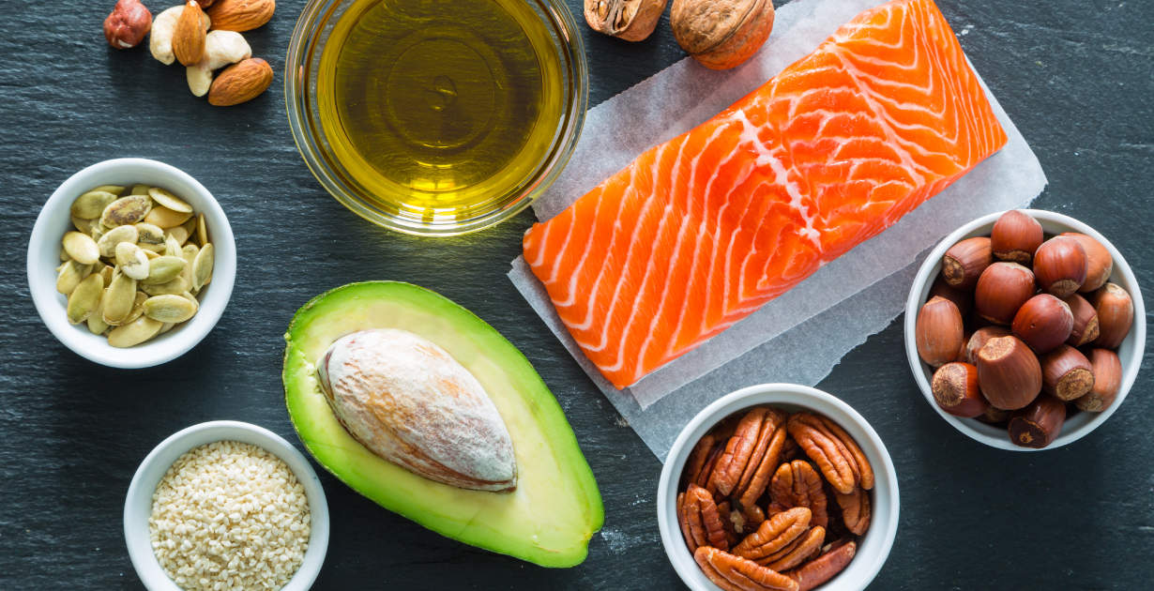
Saturated vs Unsaturated vs Polyunsaturated Fats
Notes:
A saturated fat is a fatty acid with a carbon chain containing all of the hydrogens it can hold
Can be found in butter, beef, and coconut oil
An unsaturated or monounsaturated fat is a fatty acid with a carbon chain that contains one double bond
Can be found in olive oil, canola oil, and peanut oil
A polyunsaturated fat is a fatty acid that contains two or more double bonds
Can be found in soybean oil, corn oil, fatty fish
Recommend less than 20g of saturated fats per day and a moderate intake of unsaturated fats

Slide 5
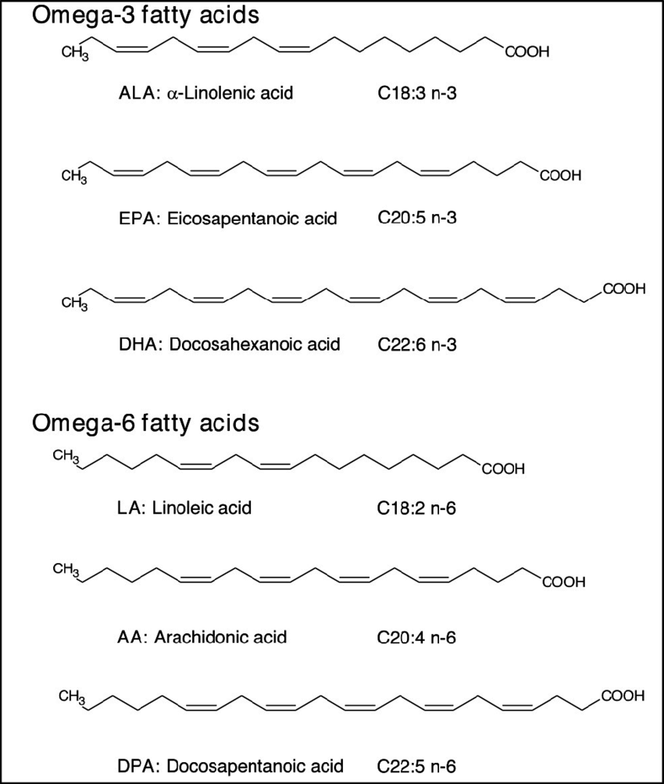
Omega-3 and Omega-6 Fats
Omega-3 and Omega-6 fats are types of polyunsaturated fatty acids (PUFAs)
Linoleic acid accounts for 84-89% of total amount of PUFA calories and alpha linolenic acid contributes 9-11%
Notes:
Differences are based on their chemical structure
ω-3 fatty acids (FAs) have in common a terminal carbon-carbon double bond in the omega three-position, the third bond from the methyl end of the acid, whereas, ω-6 acids have it in the omega six-position, the sixth bond from the methyl end of the fatty acid, respectively.
Ideal ratio of omega-6 to omega-3 fats is 2.3:1, but the current American avg is 9.8:1 (this shows a need for increased omega-3 fats in our diets)
Can find high amounts of DHA and EPA in fish oils and fish
Can find ALA in vegetable oils (flaxseed, soybean, canola)

Slide 6
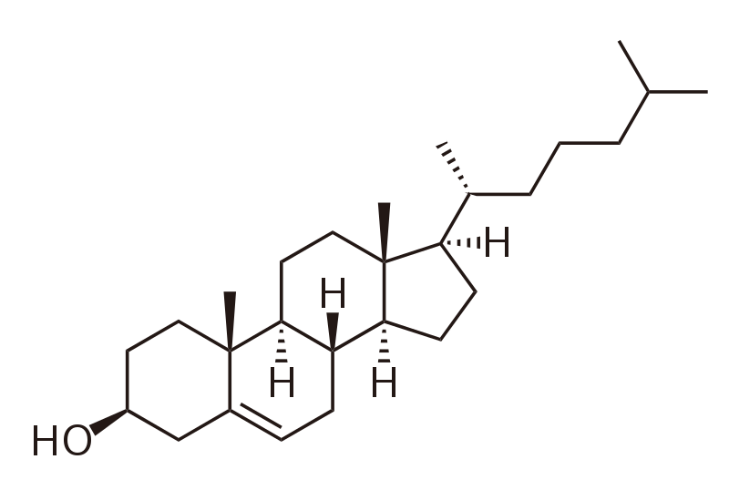
Structure of Cholesterol
Important lipid in building all animal cell membranes
Maintain integrity and fluidity between phospholipids
4 non-aromatic rings, 1 carbon double bond, 1 side chain, and 1 hydroxyl group
Notes:
Cholesterol is an important type of hydrophobic lipid in building all animal cell membranes.
The structure of a cholesterol molecule involves 4 non-aromatic rings, 1 carbon double bond, 1 side chain, and 1 hydroxyl group.
They help maintain structural integrity and regulate fluidity between phospholipids.
They also act as the precursor to the synthesis of bile, hormones, and vitamin D.
There are many sources of cholesterol found in foods, such as meat, eggs, and cheese. But cholesterol can also be synthesized in the human body.
Once synthesized, cholesterol is transported into the blood plasma through large molecules of lipoproteins in order to act as energy and building components to tissue cells.

Slide 7
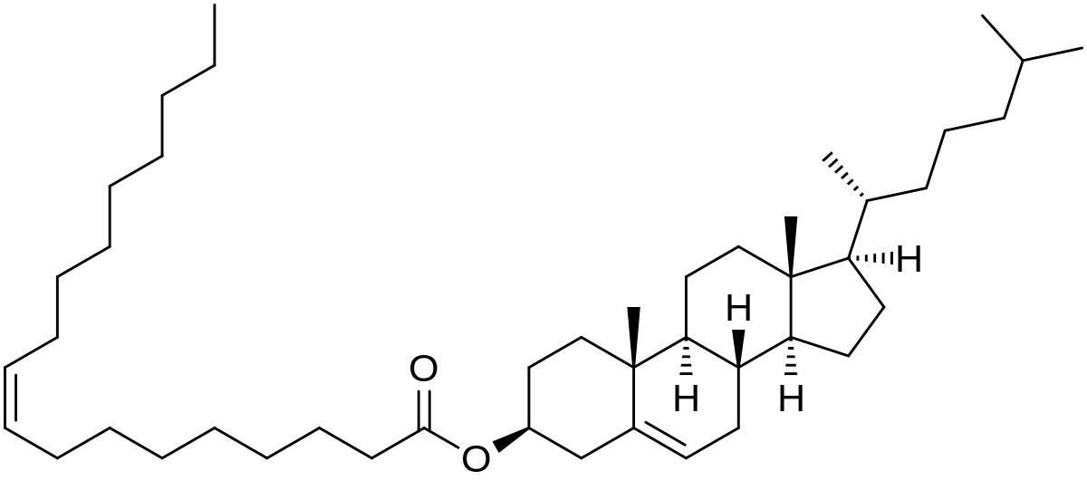
Structure of Cholesterol Ester
Excessive cholesterol can either be flushed away through the liver or be stored as energy as cholesterol ester
An enzyme ACAT catalyzes cholesterol into cholesterol ester.
This makes an ester bond between the hydroxyl group and a fatty acid
Notes:
Excessive cholesterol can either be flushed away through the liver or be stored as energy.
An enzyme ACAT reduces Acetyl-coA to CoA from a fatty acid and combines the Acetyl chain to Cholesterol.
ACAT -> Cholesterol Acyltransferases
This catalyzes the cholesterol into cholesterol ester where an ester bond is formed between the hydroxyl group and the fatty acid.
Cholesterol ester can also be converted to back into cholesterol through an enzyme called Cholesterol Esterase, which removes the acetyl chain.

Slide 8
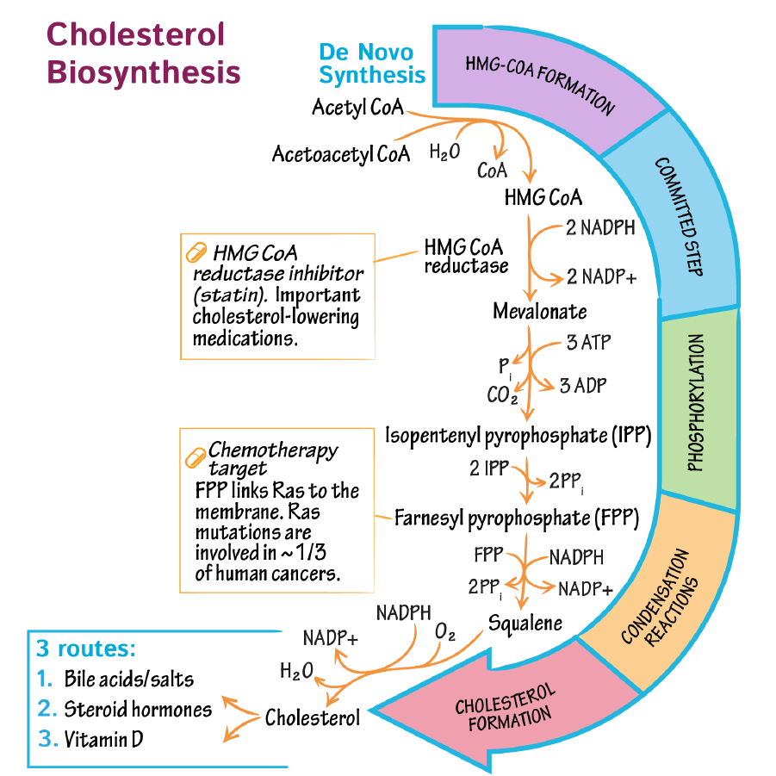
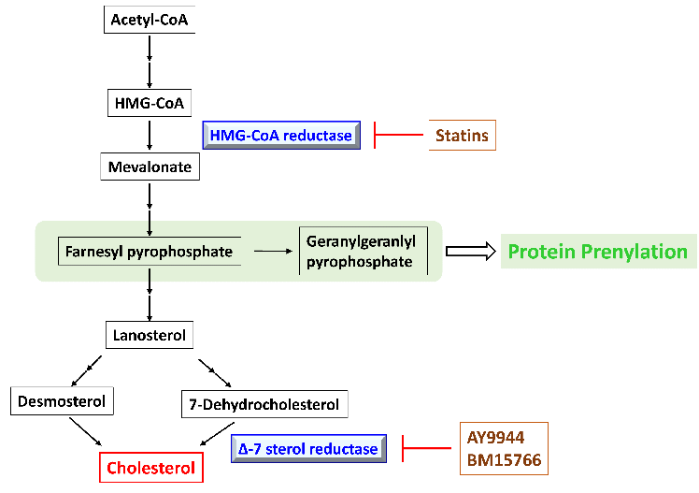
Cholesterol Synthesis Pathway
Notes:
Cholesterol Synthesis can take place in the cytoplasm or the endoplasmic reticulum of a cell.
Follow the pathway as described in the following diagram. Make note of how much NADPH, NADP+, ATP, and other molecules either used or produced.
Precursors: Acetyl CoA and Acetoacetyl CoA
Precursors come together by the enzyme HMG-CoA synthase to create mevalonate
This process requires 2 NADPH, converting into 2 NADP+
Between HMG-CoA and Mevalonate, HMG-CoA reductase acts to inhibit HMG-CoA synthase to regulate cholesterol production.
Statins are a inhibitory medication to reduce excessive levels of triglycerides and cholesterol. It works by acting on HMG-CoA reductase.
Mevalonate converts through a series of pyrophosphates.
First mevalonate uses 3 ATP to become isopentenyl pyrophosphate. This also produces 3 ADP, 1 phosphate and 1 CO2.
Farnesyl pyrophosphate is then made from two isopentenyl pyrophosphate.
Farnesyl pyrophosphate uses NADPH into NADP+ to produce Squalene.
Squalene is the main oily and organic compound that's used to create cholesterol. It uses NADPH and oxygen, turning into NADP and water from condensation, to form cholesterol.
Cut out by products
Simplify
Precursor Acetyl Coa and Acetoacetyl CoA
Catalyzes together by enzyme HMG CoA synthase -> Mevalonate
In between, HMG CoA reductase inhibits this process to regulate the production of cholesterol
Mevalonate goes through a series of pyrophosphates -> Farnesyl Pyrophosphate -> Squalene
Squalene is one of the last precursors necessary to produce cholesterol

Slide 9
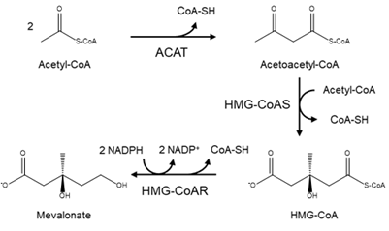
HMG-CoA-Reductase
The enzyme HMG-CoA Reductase has two significant roles:
Catalyzes HMG-CoA into Mevalonate
Rate-Limiting enzyme for cholesterol synthesis
Notes:
This is a diagram that showcases how HMG-CoA Reductase works in Cholesterol Synthesis.
HMG-CoA-Reductase is an enzyme that catalyzes HMG CoA into Mevalonate. This requires the energy conversion of 2 NADPH into 2 NADP+
HMG-CoA-Reductase is also a rate-limiting enzyme for cholesterol synthesis.
The conversion of HMG CoA to Mevalonate is regulated, where Glucogen and AMP inhibit HMG-CoA-Reductase while Insulin activates HMG-CoA-Reductase.

Slide 10
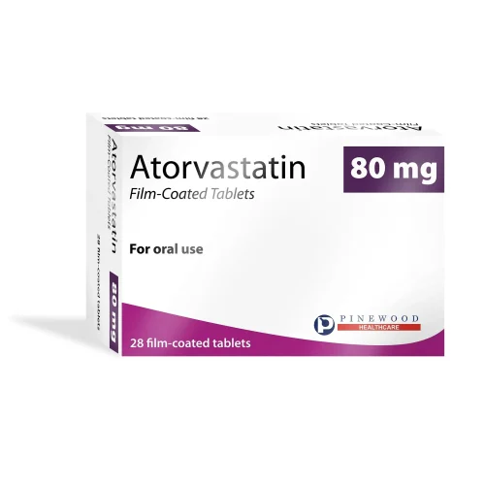
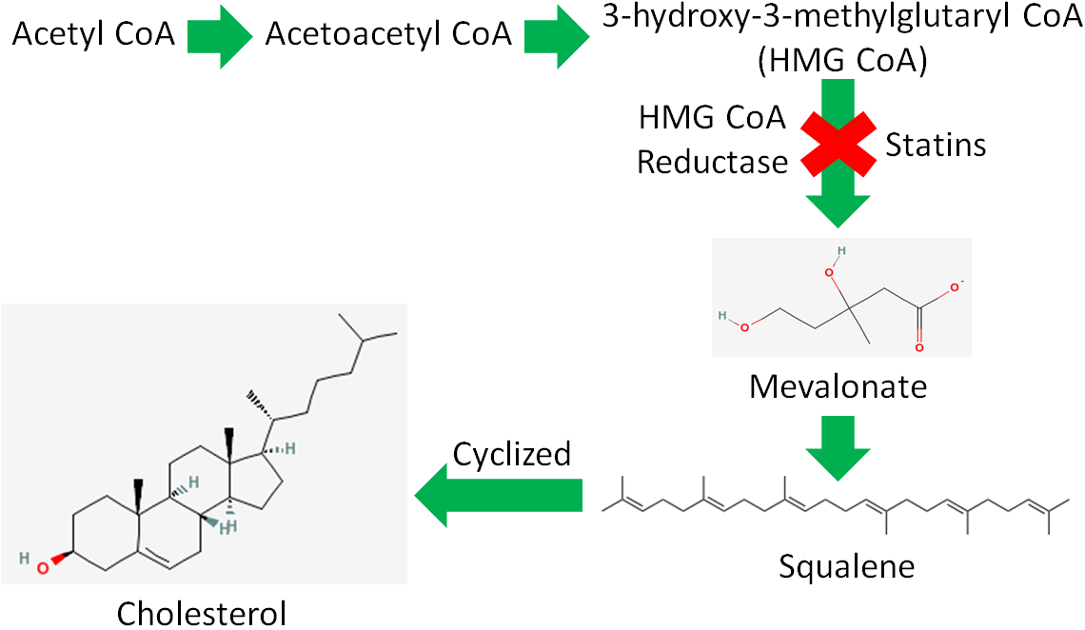
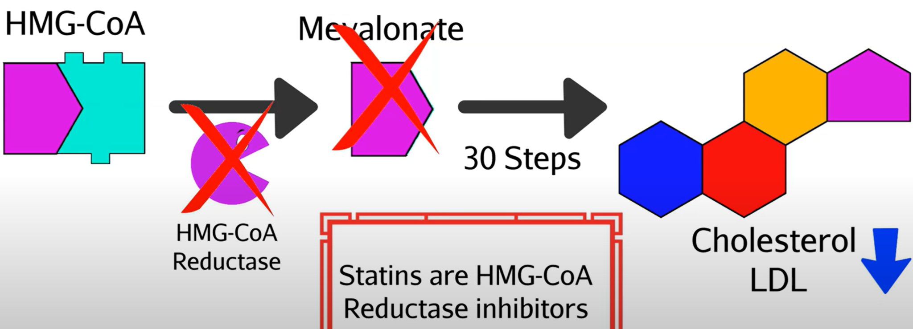
Statins
Statins help to reduce the ability of liver cells to produce cholesterol and lower LDL-cholesterol concentrations
Mechanism: Blocks the enzyme HMG-coenzyme A reductase, the rate limiting step in cholesterol synthesis
Used to treat atherosclerosis and hypercholesterolemia
Notes:
Drugs that help lower LDL-cholesterol concentrations to reduce the risk of atherosclerosis
They can be inhibitors of HMG-coenzyme A reductase, the enzyme that catalyzes the rate-limiting step in cholesterol synthesis, and as a result, the statins reduce the ability of liver cells to produce cholesterol
The lowered intracellular cholesterol then stimulates the production of more LDL receptors in the plasma membrane, allowing the liver cells to engulf more LDL-cholesterol from the blood to make bile with
Lowers the blood-LDL cholesterol concentration so that less will enter the endothelial cells of the arteries
Statins can also slightly increase HDL levels and reduce inflammation

Slide 11
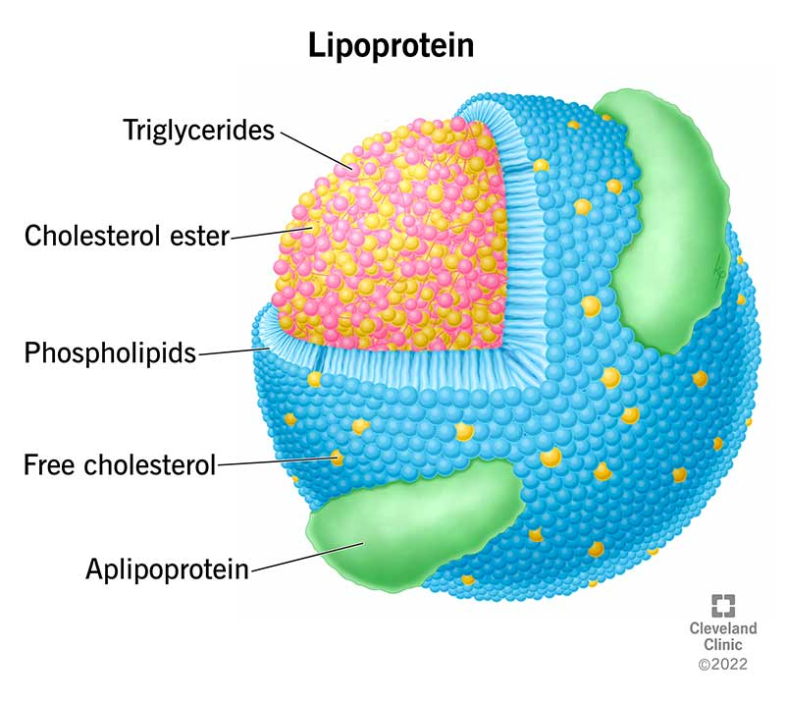
What are lipoproteins?
Lipoproteins are circular packages that can transport lipids and cholesterol throughout the body
Outer layer: Hydrophilic phospholipid heads with cholesterols and apolipoproteins on the surface
Inner contents: triglycerides and esterified cholesterol
Notes:
Lipoproteins are not molecules but particles comprised of several thousand molecules
Help solve the problem of lipids being hydrophobic (lipid / water incompatibility) due to the amphipathic nature of phospholipids
Outer layer composed of a single layer of phospholipid molecules on the outside surrounding a central core
Hydrophilic region of phospholipid head faces outward and hydrophobic tails face inward
Compatible with surrounding molecules
Outer layer also contains cholesterol and apolipoproteins
Help stabilize the particle and serves to identify the specific lipoprotein
Inside the lipoproteins are triglycerides and esterified cholesterols (cholesterol esters)

Slide 12
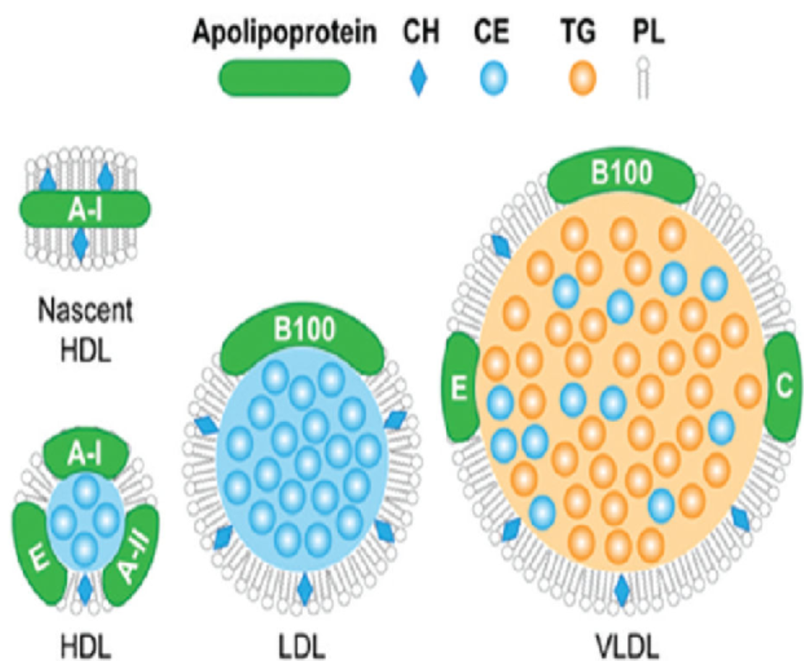
Lipoproteins: LDL, HDL, VLDL
Lipoproteins are classified by their density
VLDL are made in the liver and transport triglycerides to the body.
As the # of triglycerides decrease, VLDL converts to LDL
LDL transport cholesterol to the body and returns to the liver
HDL performs the process of reverse cholesterol transport
Notes:
Notes:
Lipoproteins are classified by their density.
HDL are high density lipoproteins that transport excess cholesterol from the bloodstream and into the liver to be removed.
LDL are low density lipoproteins that transports cholesterol from the liver to different body tissues via the bloodstream.
VLDL are very low density lipoproteins who perform the similar functions of LDL. However, VLDL and LDL have a reputation of being called “bad” cholesterol due to excessive cholesterol building up in arteries.
The liver packages a combination of endogenous and dietary cholesterol along with triglycerides into VLDL
VLDL travels in the blood stream to other body tissues. Muscles and adipose tissue extract triglycerides in order to store energy, which in the process turns VLDL into LDL. Peripheral cells in body tissues then use up the cholesterol in order to build cell membrane and perform other cellular functions.
Excess cholesterol is delivered to HDL in order to return to the liver

Slide 13
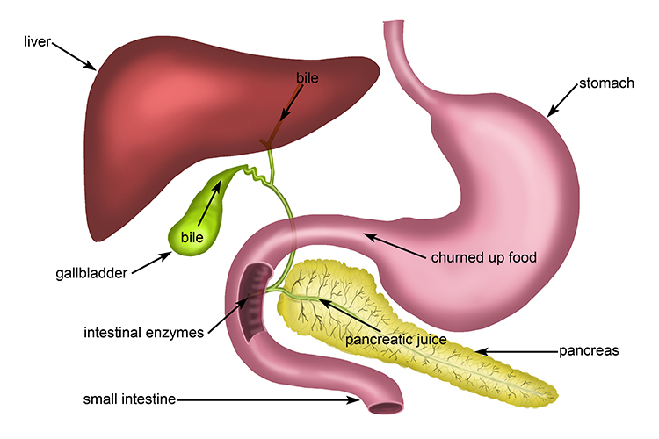
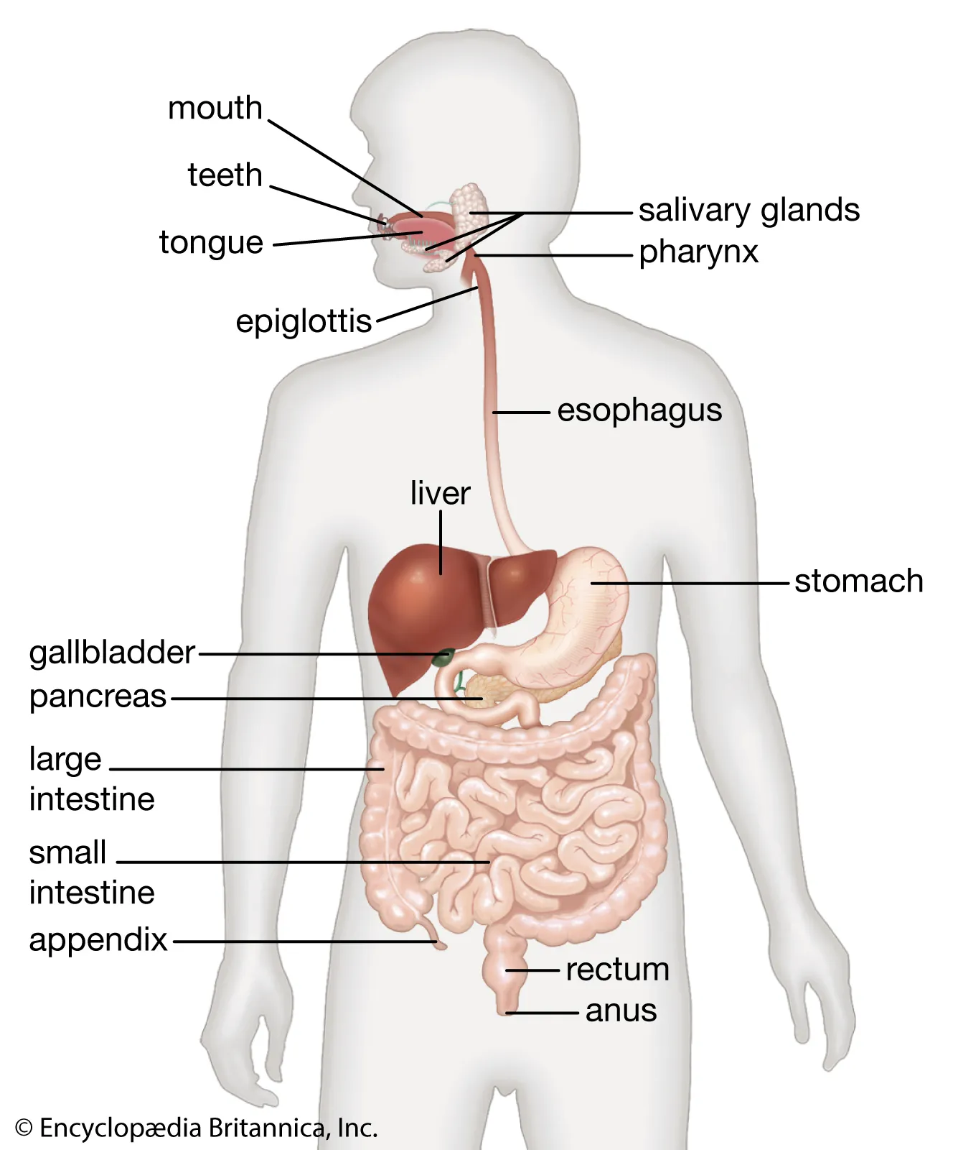
Digestion and Absorption Pathway
Mouth → Esophagus → Stomach → Duodenum → Small Intestine → Lymphatic System → Blood
Notes:
Digestion of triglycerides occurs in the digestive tube and the three fatty acid chains and glycerol backbone are absorbed by the absorptive cells lining the small intestine
The triglyceride is reassembled in the smooth endoplasmic reticulum within the absorptive cells

Slide 14
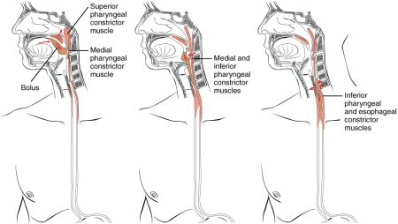
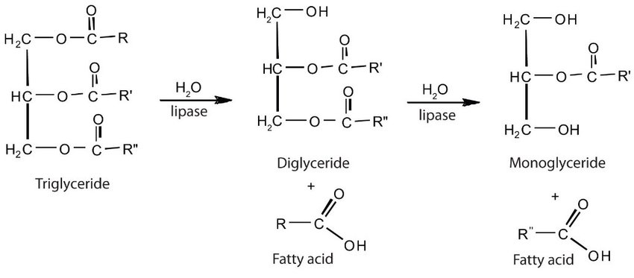
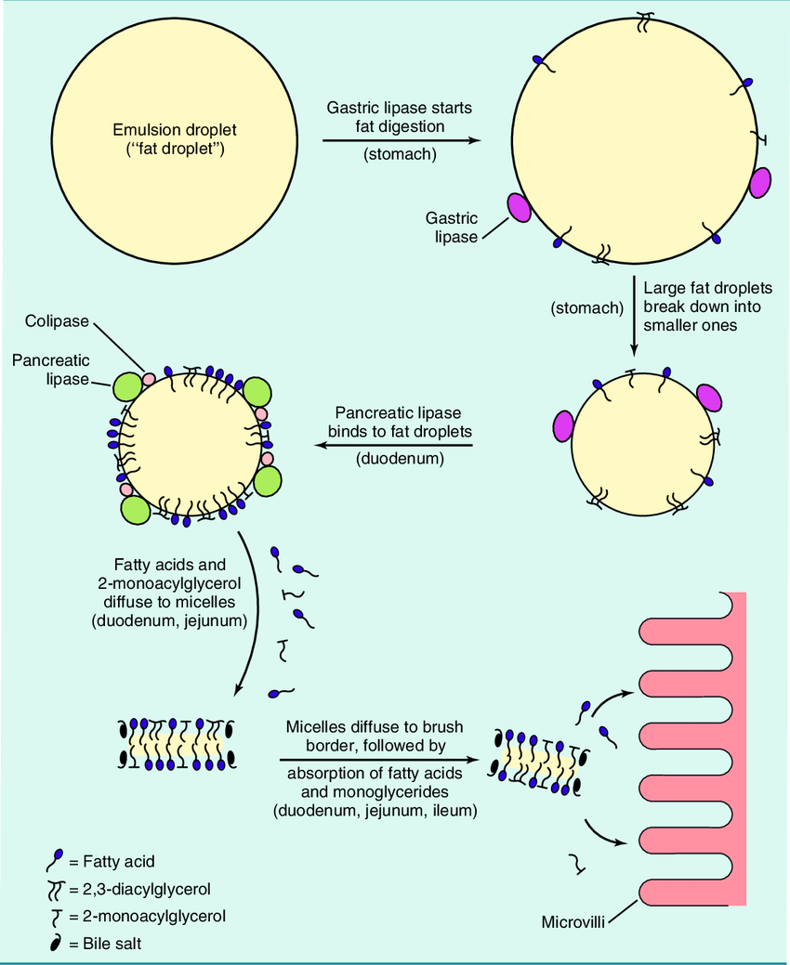
From Mouth to Stomach
Mastication of fats with lingual lipase breaks down fat into smaller droplets separated from water
In the stomach, HCl with gastric lipase partially breaks down triglycerides into diglycerides and fatty acids
Notes:
Physical digestion occurs with mastication (chewing). Enzymes like lingual lipase with some phospholipids that act as emulsifiers initiate the process of digestion
Fats become tiny droplets separated from watery components
The swallowed fats move from the stomach to the stomach through the esophagus by peristalsis (muscular contractions)
In the stomach, hydrochloric acid mixed with gastric lipase during a hydrolysis reaction begins to break down triglycerides into diglycerides and one fatty acid
The stomach’s churning and contractions help to further emulsify the diglycerides

Slide 15
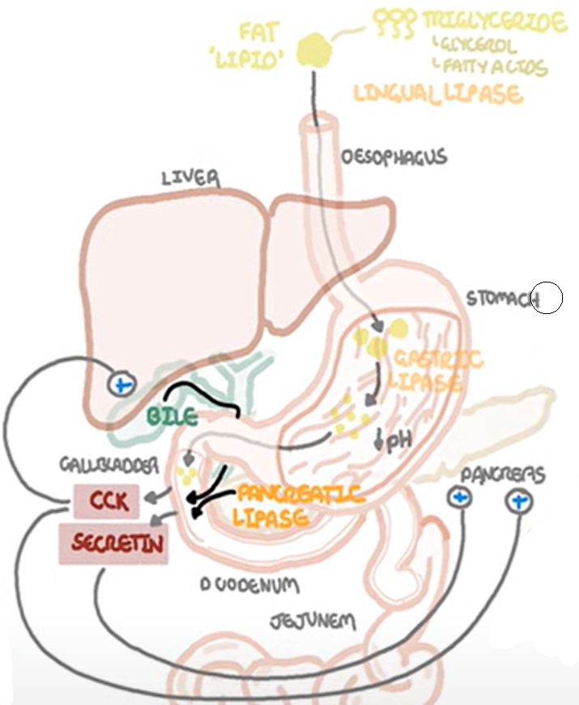
Digestion and Absorption at the Small intestine
Majority of digestion and absorption of fat occurs in the duodenum
The fat droplets & acidity of the gastric acid stimulates the production of cholecystokinin and secretin.
Stimulates bile production and secretion
Stimulates pancreatic juice secretion
Stimulates bicarbonate secretion
Increases ph to 6.5 (optimal for fat digestion)

Slide 16
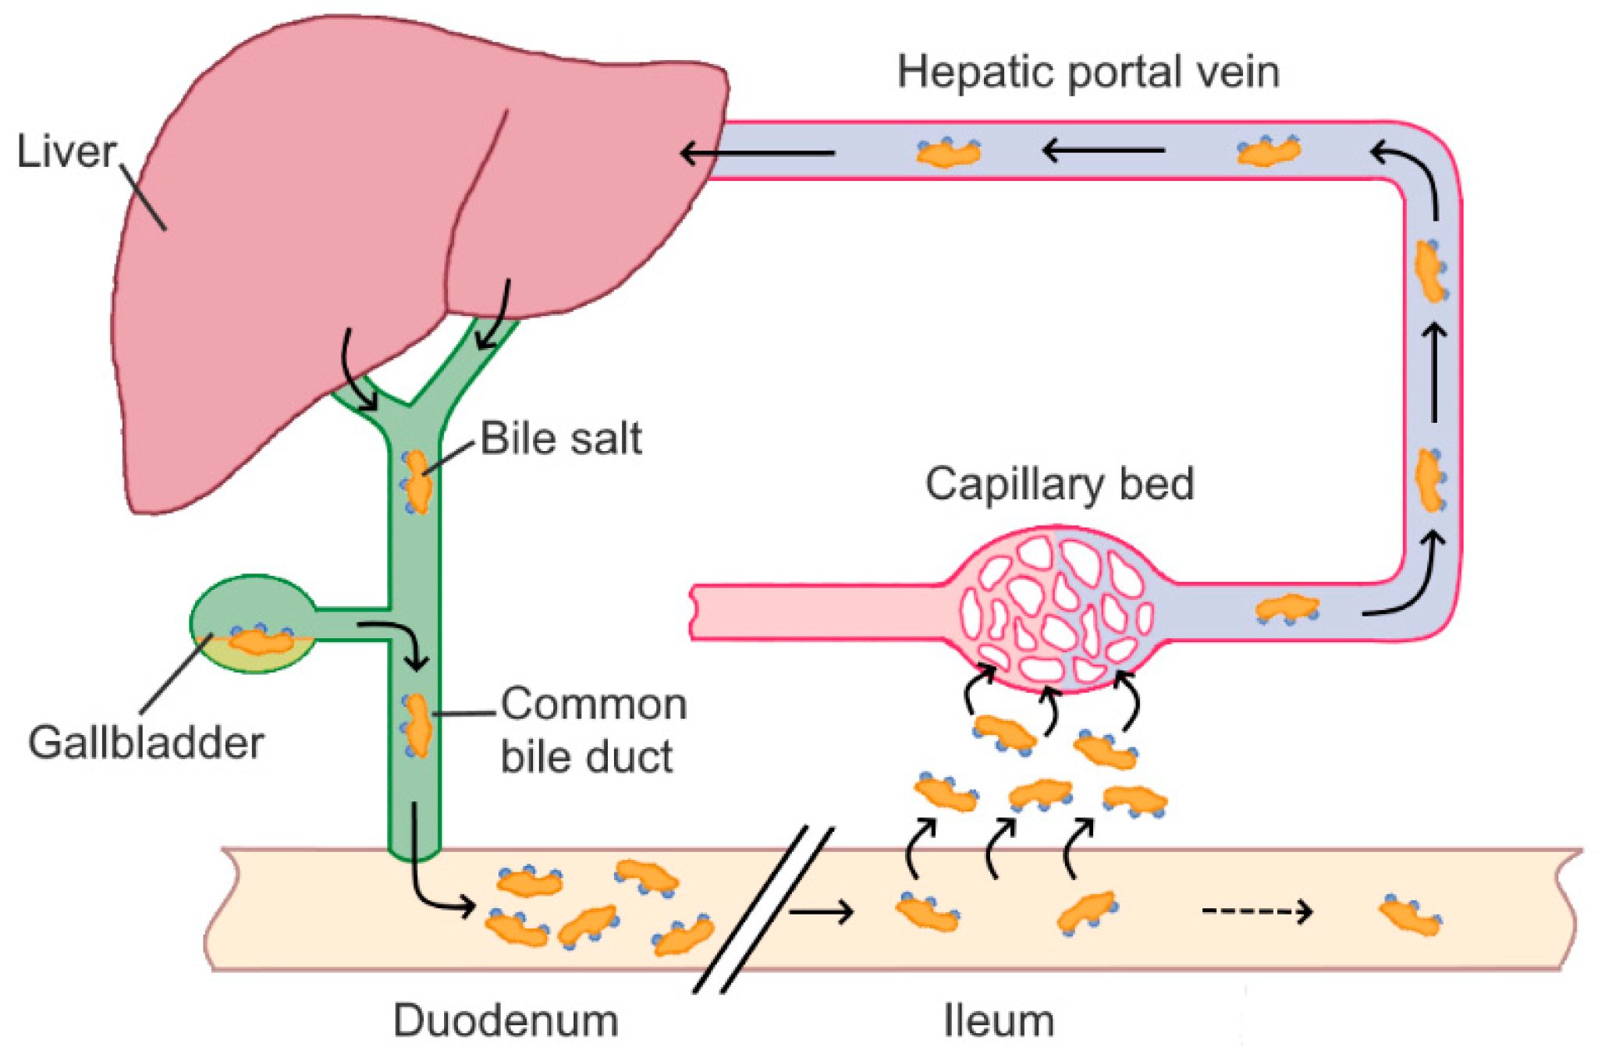
Bile
Synthesized by the liver
Composed of cholesterol, phospholipid, bile pigment, bile acid, and bile salt
Liver to gallbladder to small intestine
Bile salt is a major component of bile
Emulsify fat which aids in absorption
Notes:
- consist of cholic acid or chenodeoxycholic acid added with amino acids such as glycine or taurine

Slide 17
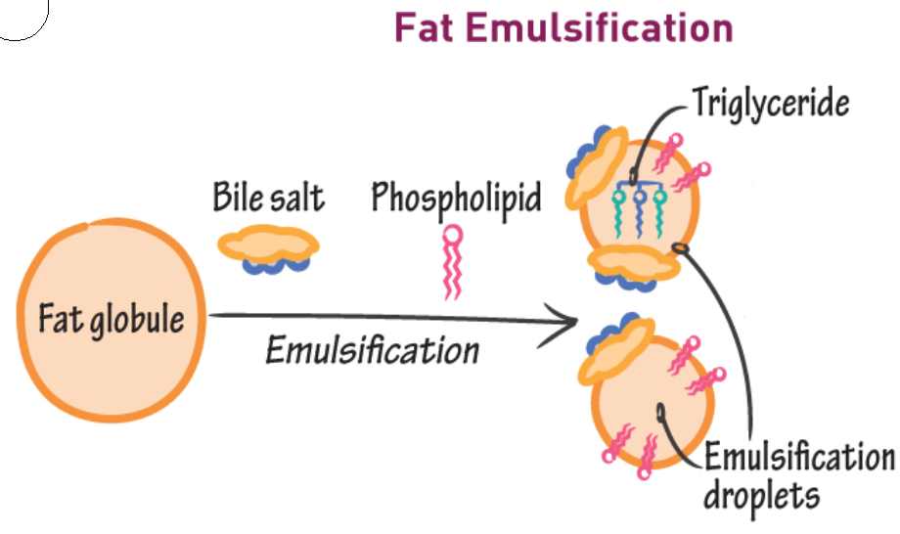
Emulsification
⤷ the breakdown of large fat droplets into small emulsified droplets of triglyceride
is not chemical digestion
provides a greater surface area

Slide 18
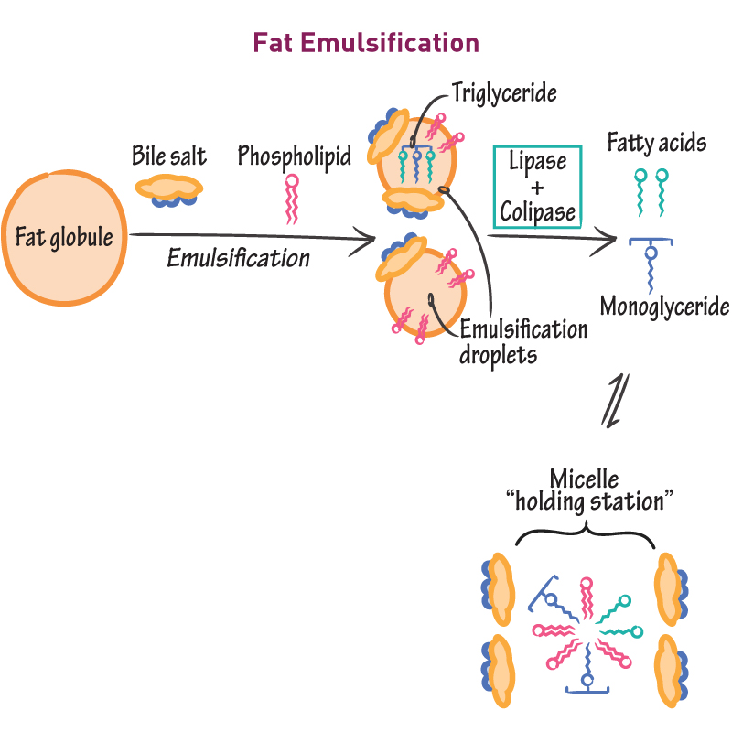
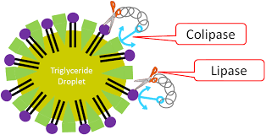
Pancreatic Juice
⤷contains pancreatic colipase
a protein
coats the emulsification droplets
anchors pancreatic lipase to the droplet
⤷ contains pancreatic lipase
an enzyme
hydrolyze the triglyceride into fatty acids & monoglycerides

Slide 19
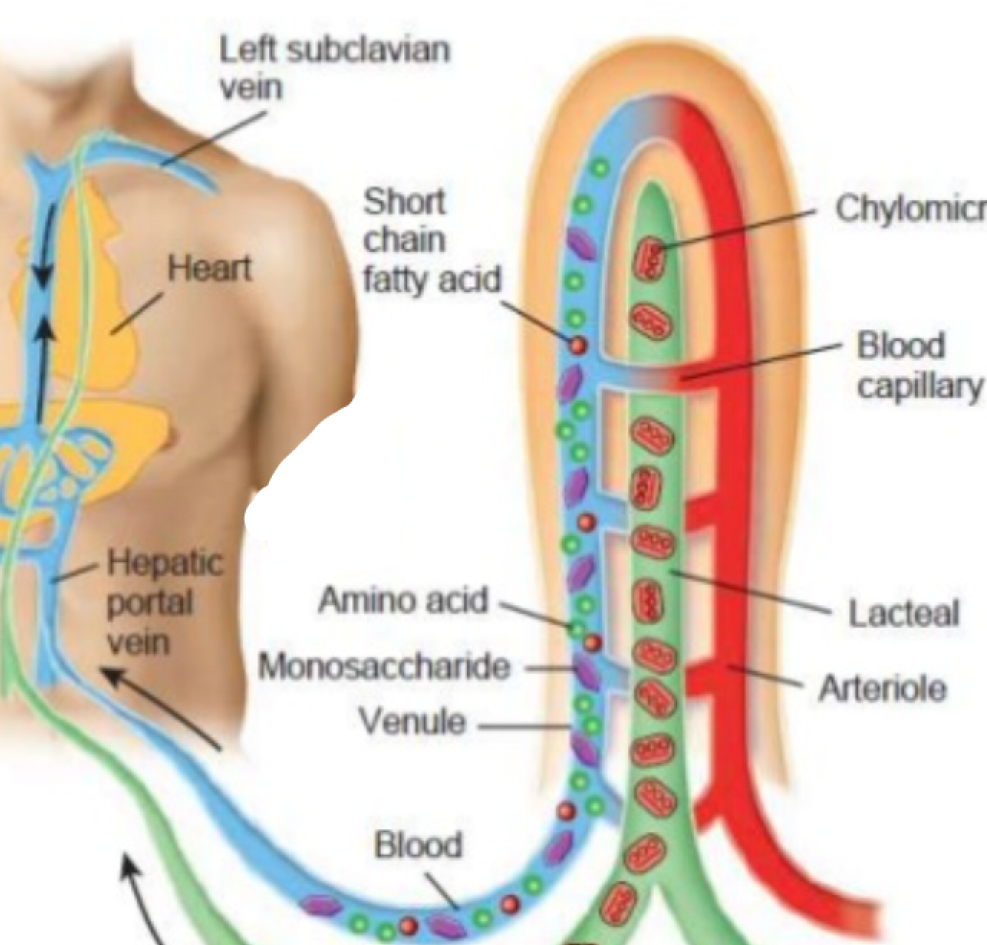
Entering the small intestine cells
Free fatty acids & monoglycerides enter into the epithelial cells of small intestine
Via micelles ( an aggregate of bile salt)
Short-fatty acids are secreted into the blood
Long-fatty acids are resynthesized into triglycerides

Slide 20
Chylomicron
⤷ transport triglycerides out of the cell
formed in the Golgi body
has a sphere with an outer membrane made up of phospholipids
made up of triglycerides, phospholipids, cholesterol, and protein
a type of lipoprotein
Notes:
Chylomicron are ultra-low density lipoproteins found in the blood and lymphatic fluid
They transport fat from the interstitial lumen to the liver.
They’re very high in triglycerides but also consist of phospholipids and cholesterol.
Ultra-Low Density lipoproteins
Transport fat from the interstitial lumen to the liver
Very high in triglycerides and consist of phospholipids and cholesterol

Slide 21
Lacteals
are specialized lymphatic vessels
Chylomicrons leaves cells by exocytosis and enters the lacteals found in the villi of the small intestine
Lymph within the lacteal takes chylomicrons through to the thoracic duct and into the blood circulation system

Slide 22
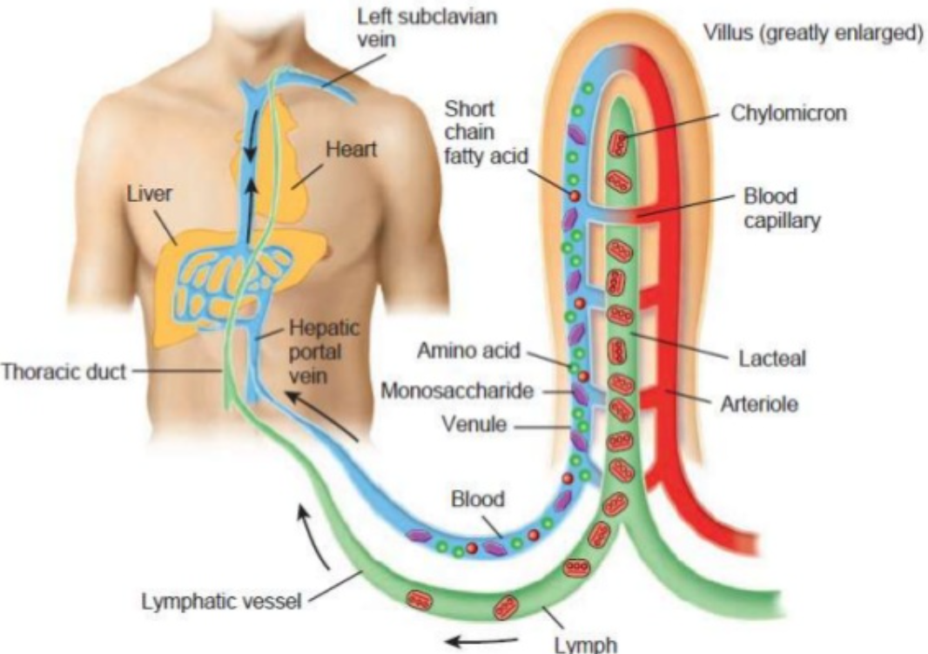
Bloodstream to the body and liver
Apolipoproteins are found on the membrane of chylomicrons
Allows chylomicrons to bind to capillary endothelial cells of muscle and adipose tissue
Binds to ApoE receptor on the cells
Lipoprotein lipase hydrolyzes triglycerides into free fatty acids that enter the cell
Remaining chylomicrons is released & taken up by the liver

Slide 23
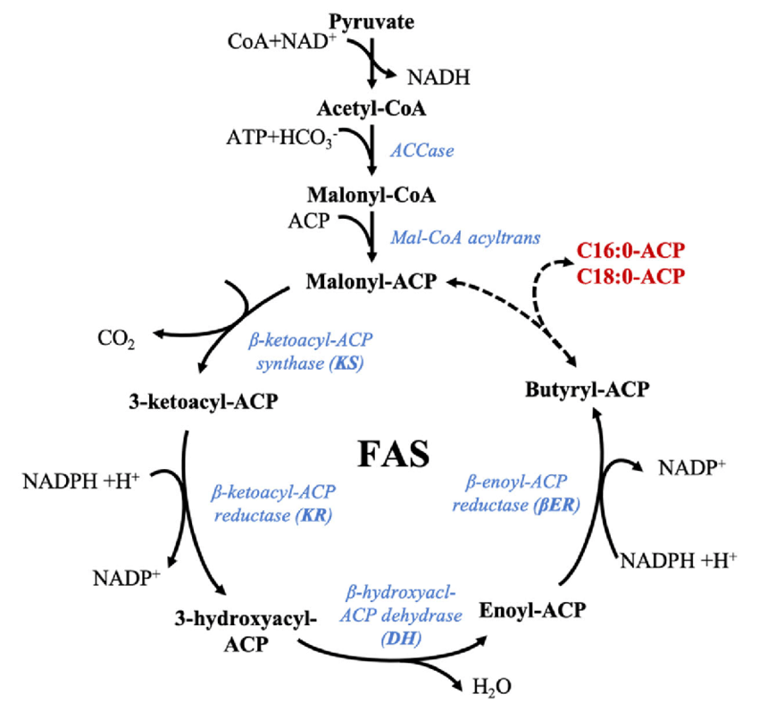
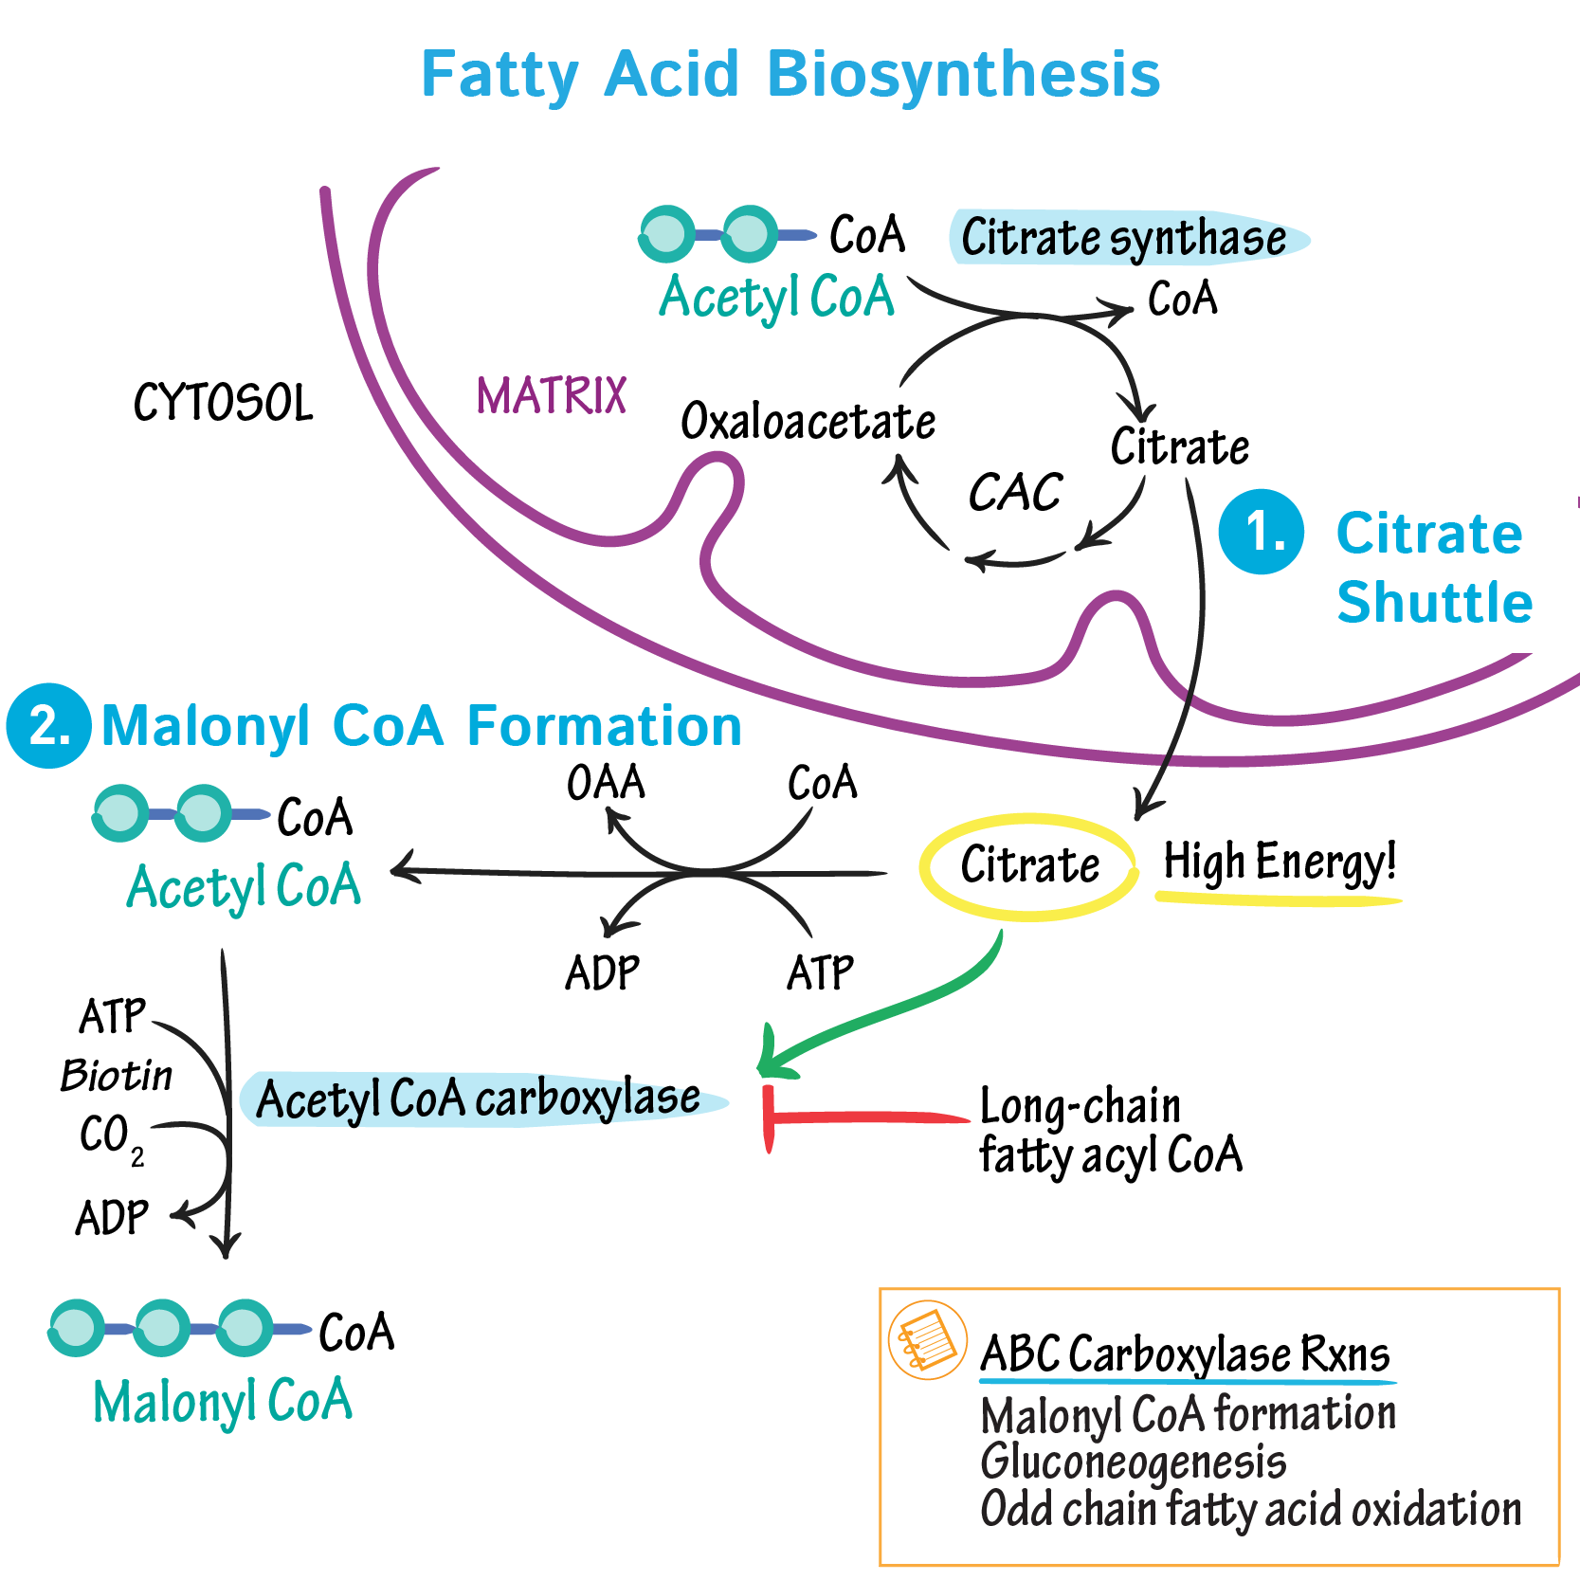
Lipogenesis
Notes:
Lipogenesis is the formation of fat by turning glycerol and fatty acids into triglycerides.
Glucose to Fat:
In glycolysis, glucose is converted into pyruvate. Pyruvate molecules convert into Acetyl-CoA.
Acetyl-CoA typically enters the Krebs cycle to produce citrate. Citrate can also be reconverted back into Acetyl-CoA.
However, Acetyl-CoA can be converted by Acetyl-CoA carboxylase into a rate limiting enzyme known as Malonyl CoA
As we’ve covered before, a rate limiting enzyme helps regulate the production of fat and cholesterol.
Malonyl CoA turns into Palmitate by the fatty acid synthase and start the fatty acid synthesis
This process allows Acetyl-CoA to turn into fatty acids, which will be stored for later in adipose cells for when energy is needed.
Amino Acids to Fat:
Excessive protein in the human body can be broken down into amino acids and ketones.
Amino acids can be deaminated in order to enter the Krebs cycle to become Pyruvate or acetyl-CoA.
They can then follow the same pathways as Acetyl-CoA turning into fatty acids.
Fat for ATP:
Sometimes if glucose levels are too low to create pyruvate and produce acetyl-CoA, then fatty acid oxidation can turn fat into ATP.

Slide 24
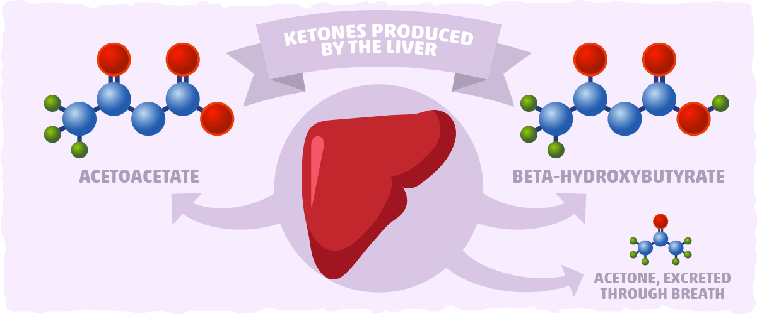
Ketogenesis
Ketogenesis is the production of ketone bodies by breaking down fatty acids.
Alternative energy source when there isn’t enough glucose
Acetoacetate, Acetone, and Beta-Hydroxybutyric Acid are the three main ketone bodies
Notes:
Ketogenesis is the production of ketone bodies through breaking down fatty acids.
Ketone bodies are used when there isn’t enough glucose to provide energy to the body.
They work as an alternative energy source, especially during fasting or diabetics.
Ketone bodies follow the same pathways as the synthesis of cholesterol, except they diverge at HMG-CoA and begin Ketone synthesis
HMG-CoA is catalyzed by the enzyme, HMG-CoA lyase, to convert into Acetoacetate
Acetoacetate can go through a spontaneous degradation to become Acetone
Acetoacetate can also be catalyzed by the enzyme beta-hydroxybutyrate to become Beta-Hydroxybutyric Acid
These three are all classified as ketone bodies.
This all happens in the mitochondria of liver cells.

Slide 25
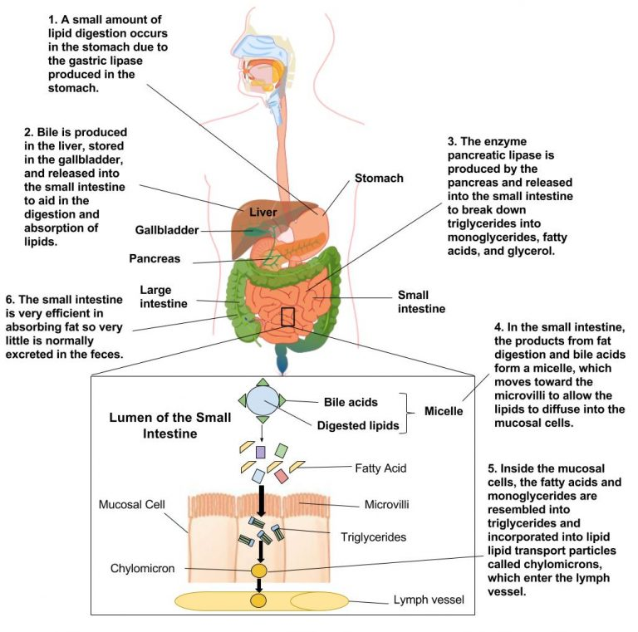
Digestion review

Slide 26
Thank you!

