Slide 1
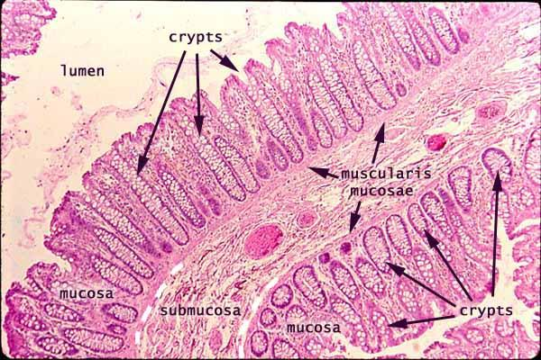
Digestion of Fats

Slide 2
Why do we need fats? What are they for?
Fats Serve Many Functions in the Body:
Essential for the formation of the phospholipid bilayer and sheaths surrounding nerves
Major source of energy
Helps you absorb some vitamins and minerals
Essential for blood clotting, muscle movement and inflammation

Slide 3
Let’s Start with Some Definitions:

Slide 4
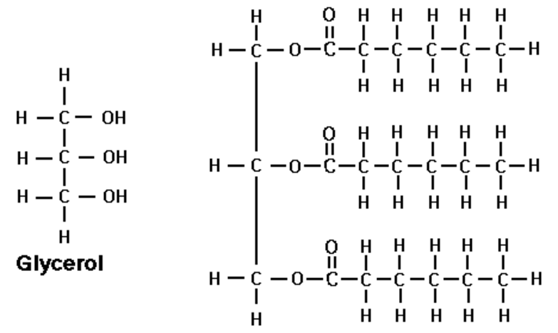
Lipids -> Triglycerides:
Not water-soluble
Formed from glycerol backbone and fatty acids. FAs are hydrocarbon chains strung on a carboxyl group.

Slide 5
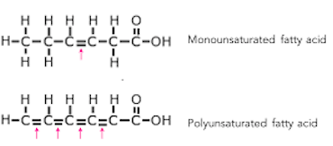
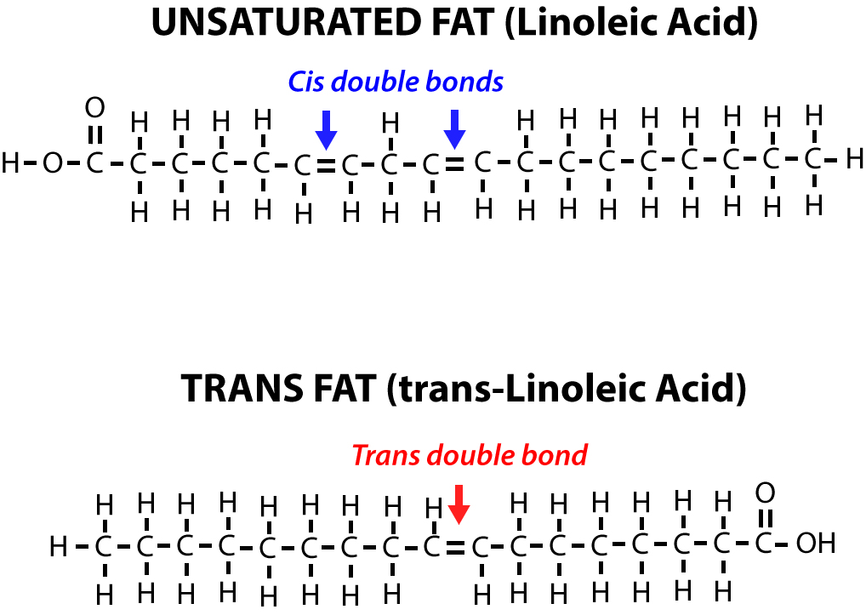
Unsaturated Fats
Fat in which there is at least one double bond within the fatty acid chain
Liquid at room temperature
Monounsaturated if it contains one double bond
i.e. Olive oil, peanut oil, canola oil, avocados, most nuts
Polyunsaturated if it contains two or more double bonds
Essential fatty acids: required for critical body functions but must be consumed from diet
Omega-3 (from alpha linoleic acid): i.e. salmon, mackerel, sardines, flaxseeds, tofu, walnuts, soybean oil, green leafy vegetables
Raises HDL, lowers triglycerides, help prevent and even treat heart disease and stroke, and reduce blood pressure
Omega-6 ( from linoleic acid): i.e. vegetable oils such as safflower, sunflower and corn oils
Linked to protection against heart disease
Cis configuration
Trans configuration

Slide 6
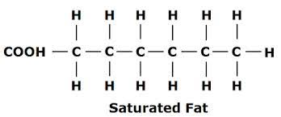
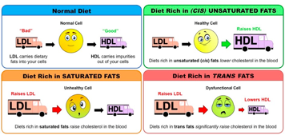
Saturated Fats and Trans Fats
Saturated Fats
Fat in which there are no double bonds in fatty acid chain
Saturated with hydrogen atoms
Typically solid at room temperature
I.e. red meat and dairy products,commercial foods, palm kernel oil, coconut oil
Increase LDL and risk for heart disease
Trans Fats:
Artificial: byproduct of a process called hydrogenation that is used to turn healthy oils into solid and prevent them from becoming rancid
I.e. margarine, fried foods, baked goods and fast food
Increases LDL and reduces the amount of beneficial HDL cholesterol, increases triglycerides
When incorporated into cell membranes, membrane fluidity is reduced and cells don’t function as well.

Slide 7
Long-chain and Short-chain Fatty Acids:
SCFAs: Fewer than six carbons
LCFAs: More than 14 carbon atoms
Production -->
SCFAs are produced when the friendly gut bacteria ferment fiber in the colon, and are the main source of energy for the epithelial cells lining the colon. For this reason, they play an important role in colon health.
LCFAs can be dietary in origin (oils and animals fats), or can be produced by the body, primarily in the liver
SCFAs and medium-chain fatty acids are primarily absorbed through the portal vein during lipid digestion, while LCFAs are packed into chylomicrons and enter lymphatic capillaries, and enter the blood first at the subclavian vein.

Slide 8
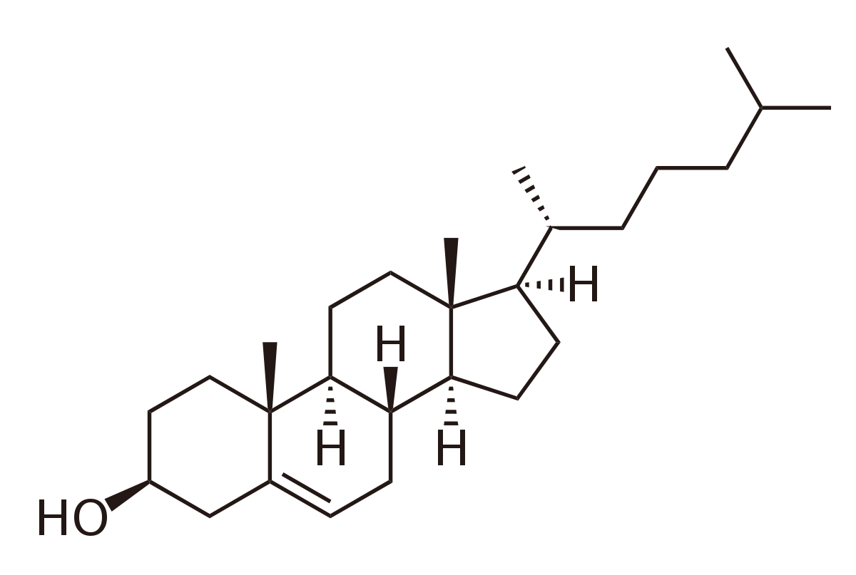
Cholesterol:
Not a fat, but acts like one
Most cholesterol is synthesized by liver hepatocytes, a process which combines molecules of acetyl-CoA with HMG-CoA reductase (the beginning of 37 step process).
Important part of the phospholipid bilayer (30%), and myelin sheaths for nerve cells.
(27 Carbons!)

Slide 9
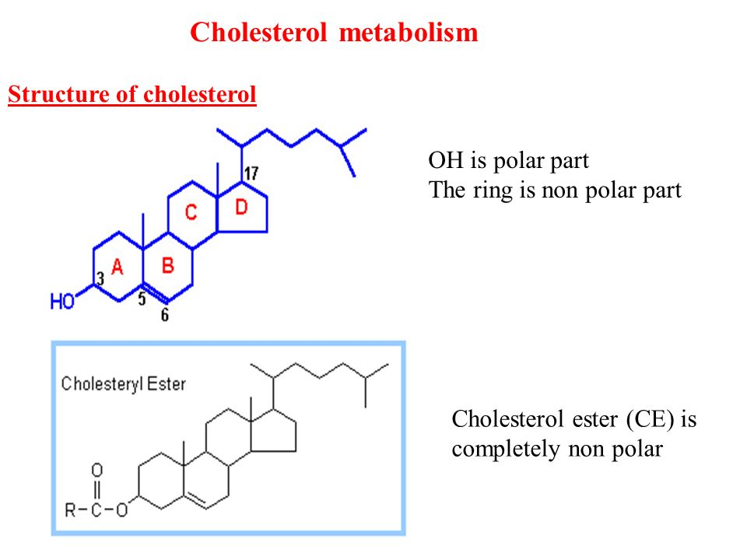
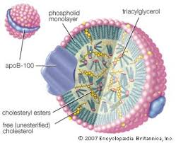
Cholesteryl Esters
Ester of cholesterol that is formed between the carboxylate group of a fatty acid and hydroxyl group of cholesterol
Makes molecule more nonpolar
Allows more cholesterol to be packaged into the interior of a lipoprotein to facilitate its transportation.
Prevents the spontaneous back exchange of cholesterol from HDL to cells.
May accumulate in fatty lesions of atherosclerotic plaques.

Slide 10
Digestion:
As with most nutrients, the breakdown and digestion of fats is distributed across the entire GI, from mouth to colon.
However, the small intestine is the most important location for lipid digestion.

Slide 11
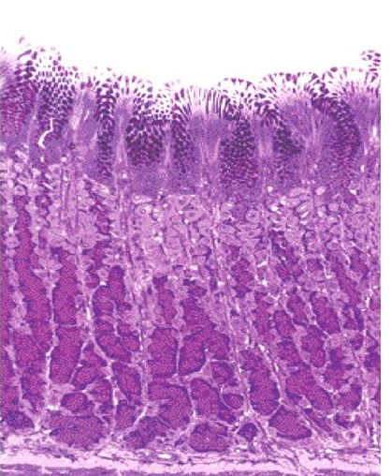
Mouth & Stomach:
Preliminary mechanical break down
Secretion of Acidic Lipases: Lingual Lipase from the mouth and Gastric Lipase via Chief Cells in stomach.
These do not need bile salts or colipase, and account for approximately the first 30% of lipid hydrolysis.
Stomach Gastric Glands

Slide 12
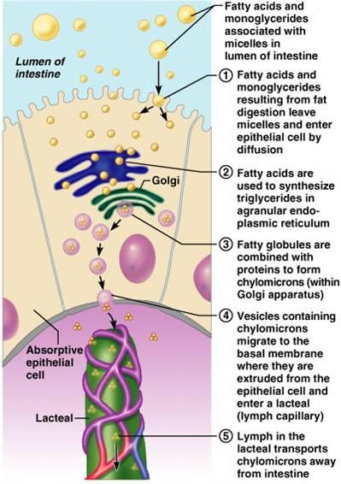
Small Intestine:
Emulsification via Bile Salts
Digestion via Pancreatic Lipase/ Colipase
Emulsion droplets of fat --> smaller Micelles
Absorption of FFAs and monoglycerides via enterocytes.
LCFAs and Cholesterol reconstructed and packed into Chylomicrons --> Lacteal

Slide 13
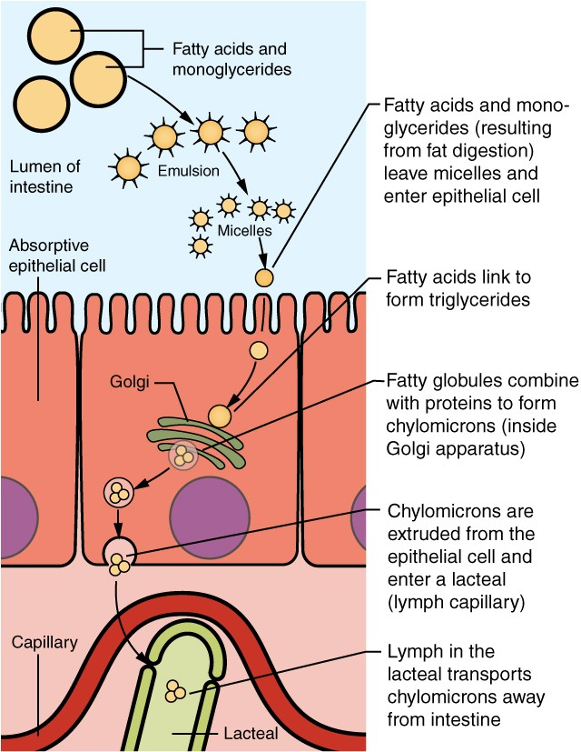
Emulsification via Bile Salts
Digestion via Pancreatic Lipase/ Colipase
Emulsion droplets of fat --> smaller Micelles

Slide 14
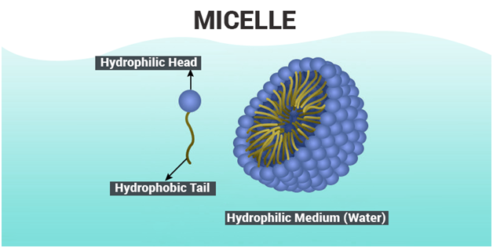
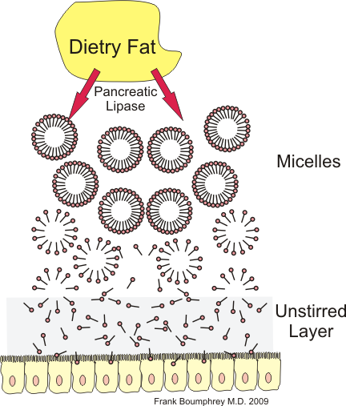
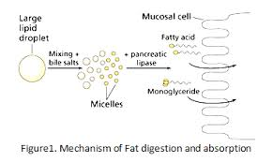

Slide 15
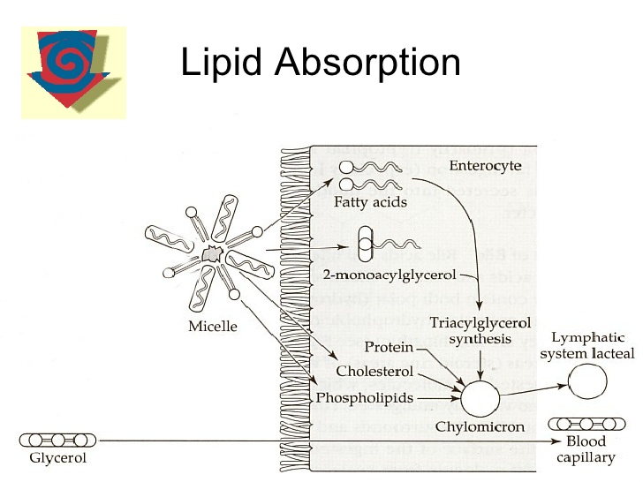
Micelles are essentially small aggregates of mixed lipids and bile acids suspended within the ingesta. As the ingesta is mixed, micelles bump into the brush border of small intestinal enterocytes, and the lipids, including monoglyceride and fatty acids, are taken up into the epithelial cells.
They also carry complex lipids such as lecithin and lipid soluble vitamins (A, D, E and K) to the brush border (Microvilli) of the absorptive cells for absorption.

Slide 16
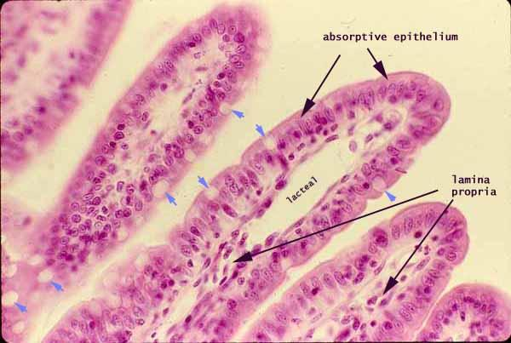
Lymphatic Absorption from the Small Intestine
Dense bed of capillaries pack each villus, as well as a central lacteal, a lymphatic capillary running through the core of each villus that absorbs dietary fats from the small intestine.

Slide 17
Transportation of fats: Chylomicrons and Lipoproteins:
Important Enzyme:
Lipoprotein Lipase (LPL)
Once in circulation, VLDL will come in contact with LPL in the capillary beds in the body (adipose, cardiac, and skeletal muscle). LPL will remove triglycerides from VLDL for storage or energy production.

Slide 18
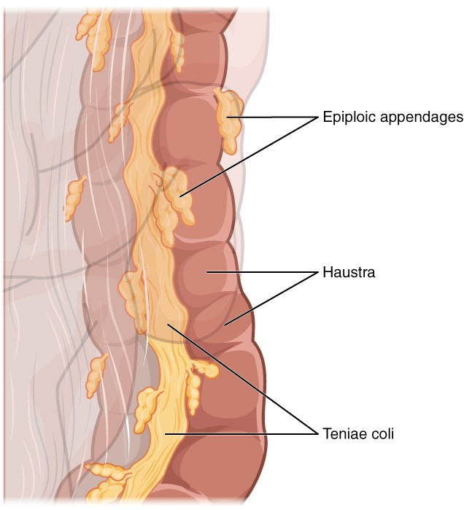
But wait, you say, what about the colon?
Sadly, not much activity
Short-chain fatty acids are created by gut bacteria consuming dietary fiber, these SCFAs are then absorbed by the colon’s inner epithelium.

Slide 19
Lipogenesis & Ketogenesis:
Physiology of fat storage in the body.

Slide 20
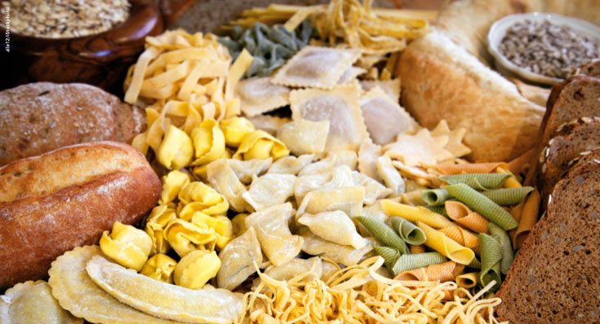
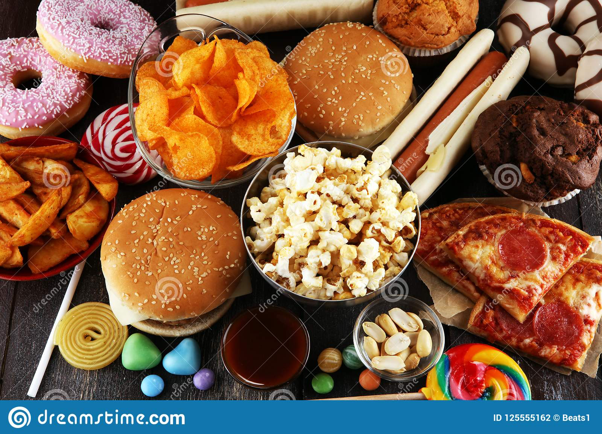
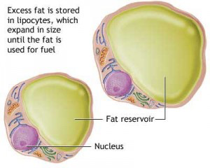
Lipogenesis: Overview
The synthesis of fatty acids
Comes from non-lipid sources
EXCESS Carbohydrates
Occurs when the body has used the needed amount of glucose and there is still some left over
Glucose will be stored
Starvation
Stimulated by insulin and citrate
Inhibited by glucagon

Slide 21
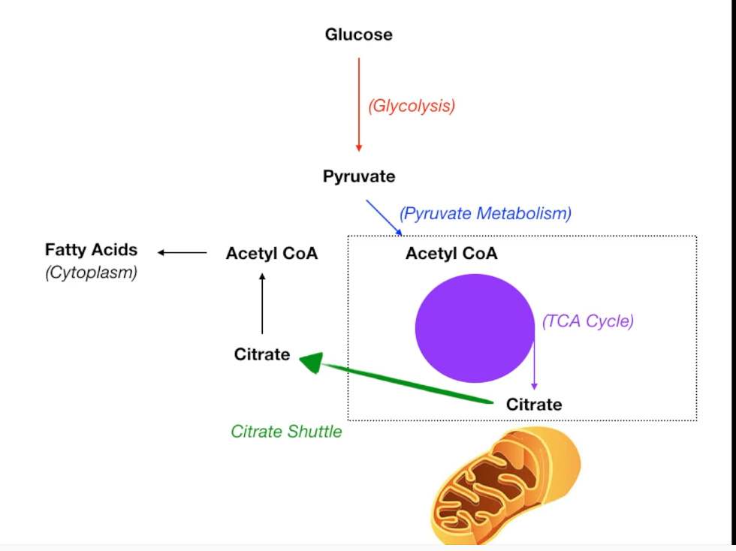
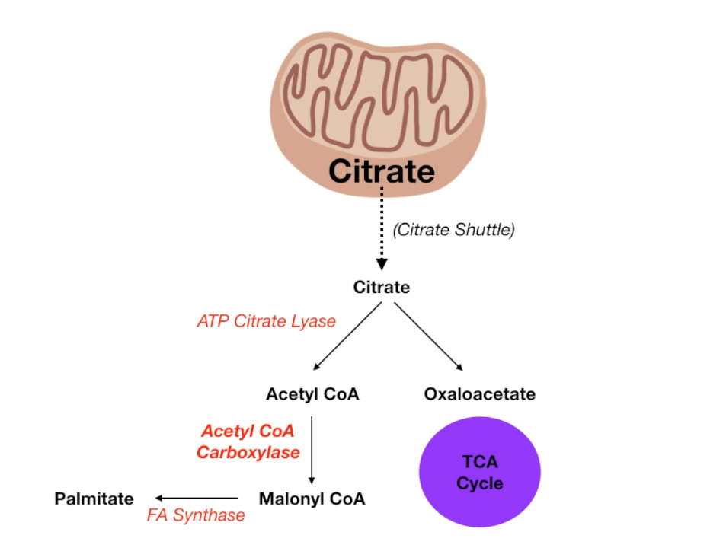
Lipogenesis: The process
Krebs
Glucose will travel through the bloodstream into the liver
Acetyl CoA combines with oxaloacetate
Citrate is produced
Citrate is moved out of the mitochondria into the cytoplasm via a citrate shuttle
Acetyl CoA can not leave the mitochondria
Re-converted as Acetyl CoA
Acetyl CoA carboxylase converts Acetyl CoA into Malonyl CoA
the rate limiting enzyme
Malonyl CoA is converted into Palmitate by the fatty acid synthase
Krebs cycle
Notes:
Palmitate is the final product

Slide 22
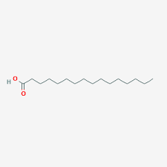
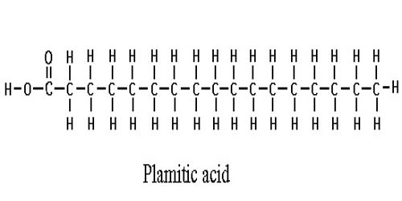
Palmitate is the same thing as palmitic acid in your human body. Palmitic acid is the first fatty acid produced during lipogenesis (fatty acid synthesis) and from which longer fatty acids can be produced.

Slide 23
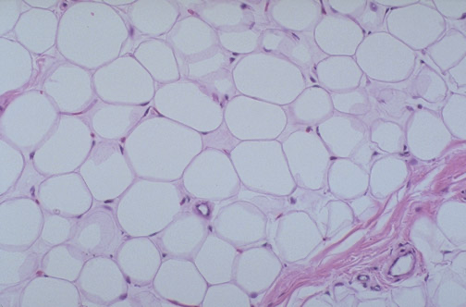
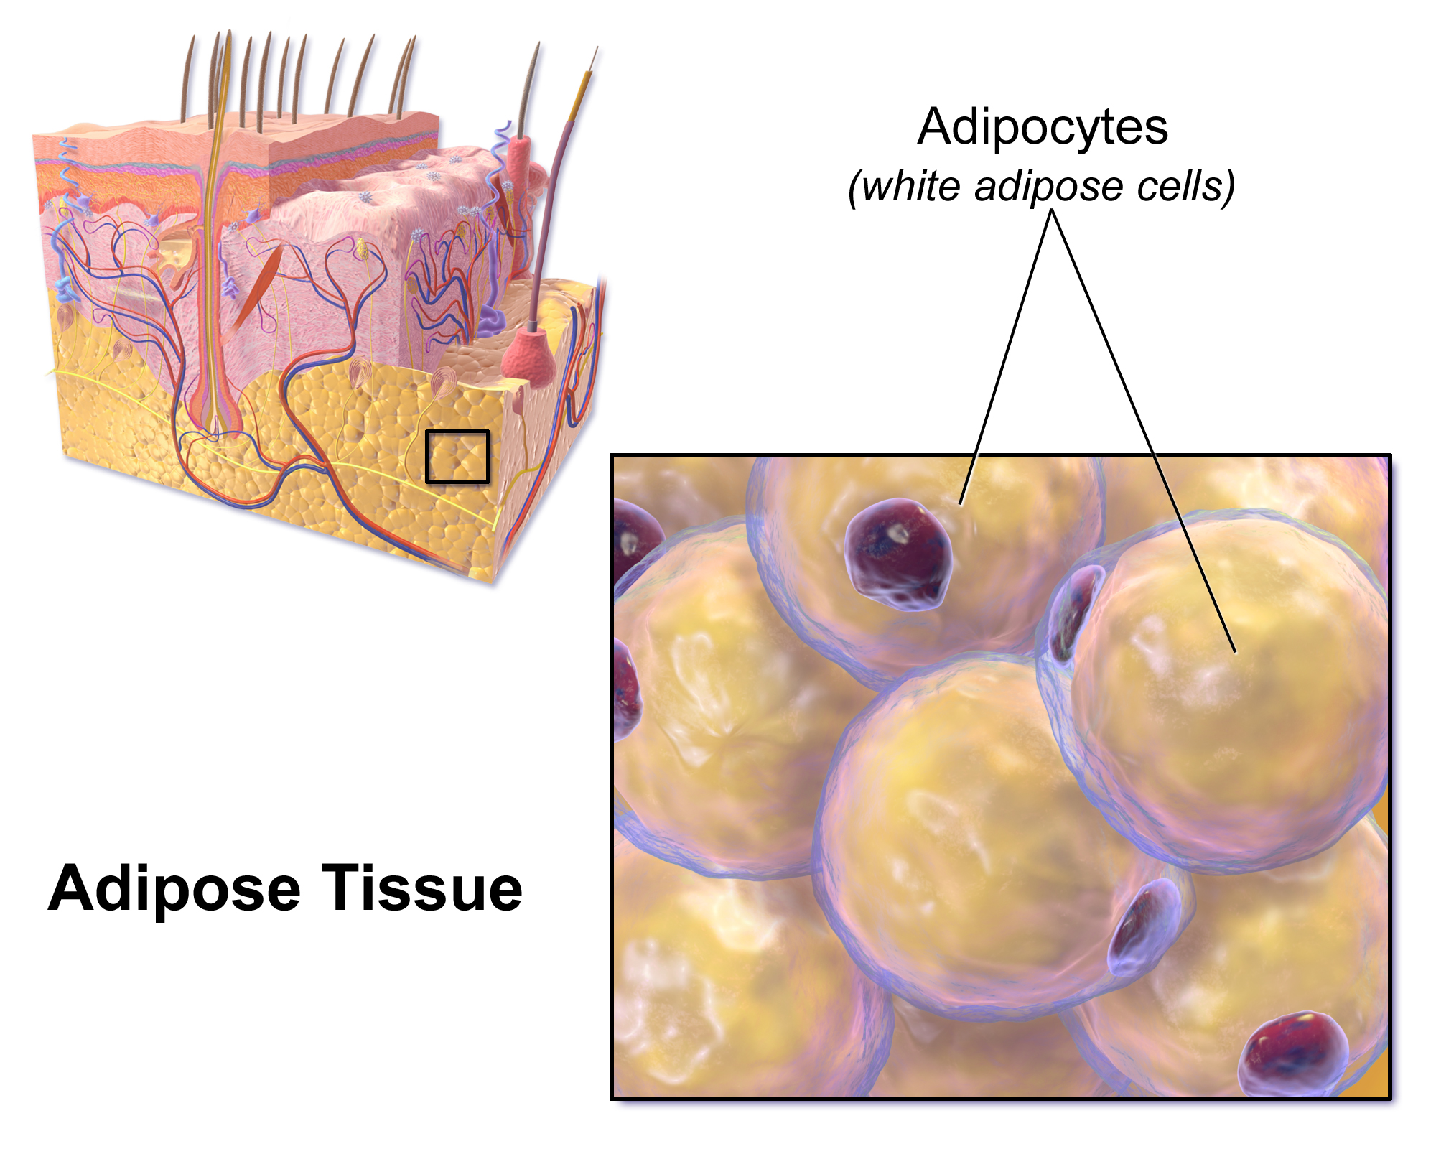
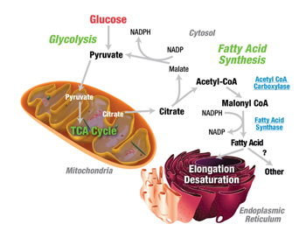
Lipogenesis: the results
Acetyl-CoA will be converted into fatty acids
It will be stored as adipose cells
Those that are not used for immediate energy use
Excess fat build up can lead to:
Atherosclerosis

Slide 24
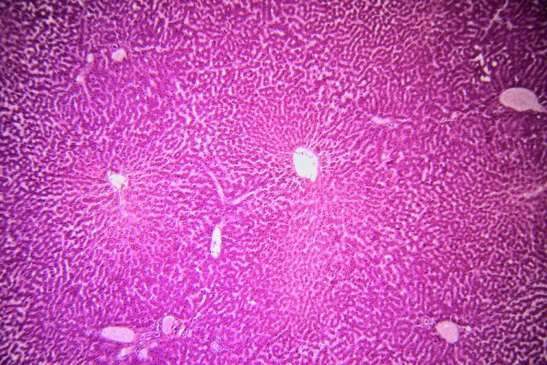
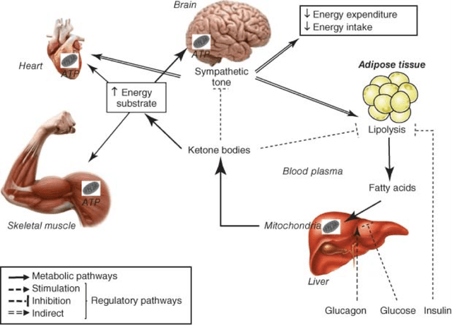
Ketogenesis:Overview
Liver converts some of the Acetyl CoA molecules into substances know as ketone bodies.
An energy source to substitute glucose
Occurs mainly in liver hepatocytes
Also in the kidney epithelia and astrocytes in the brain
Triggered by low levels of oxaloacetate and high levels of Acetyl CoA
It's a way to store Acetyl CoA
This is only used in extreme dire situations
fasting

Slide 25
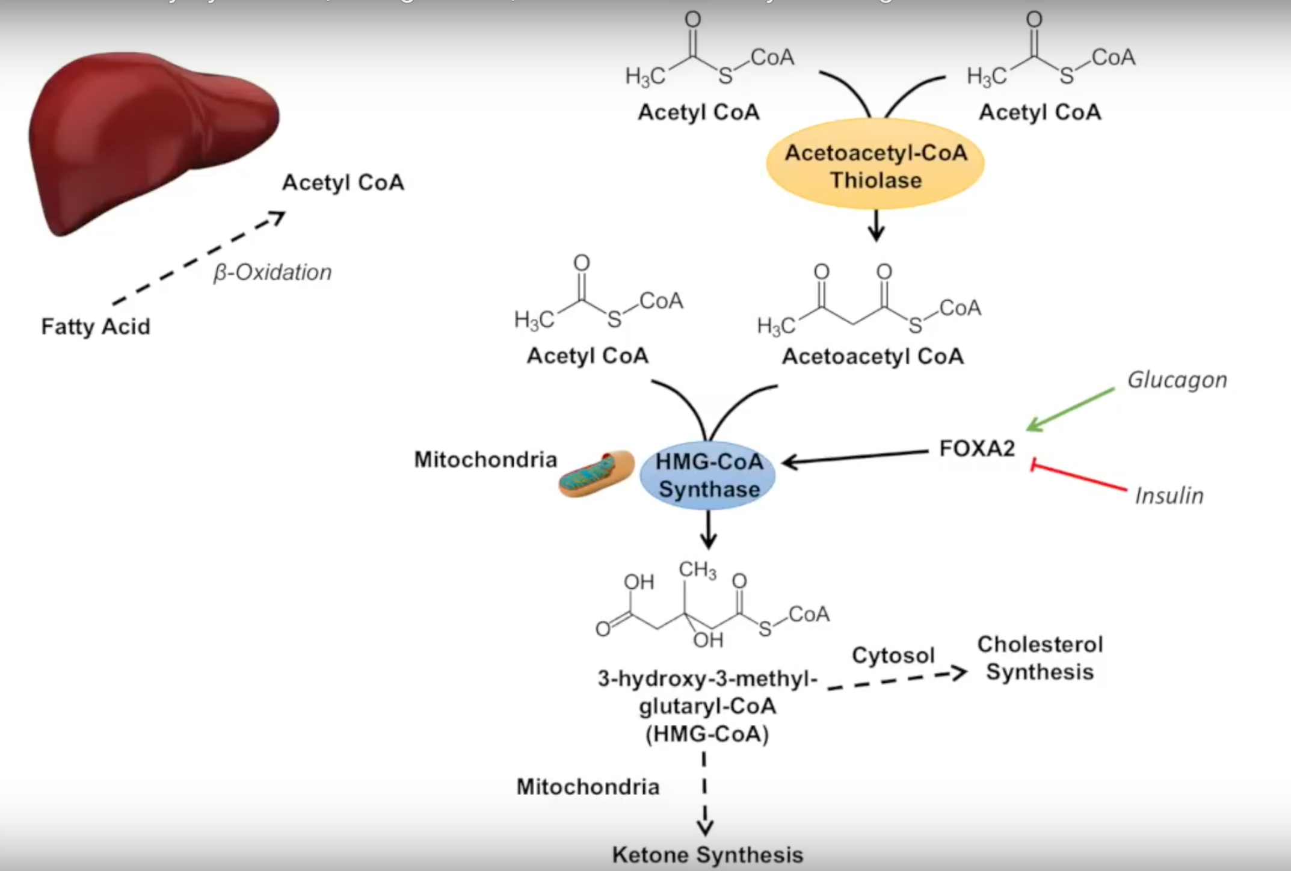
Ketogenesis: the process
Acetyl CoA is produced through beta oxidation of fatty acids
𝛽-oxidation: Catabolism of fatty acids.Two carbon ions from the long chain are removed at a time and attached to coenzyme A.
2 Acetyl CoA will be converted into acetoacetyl CoA by acetoacetyl-CoA thiolase
With another Acetyl CoA and HMG-CoA synthase
HMG-CoA is produced which then leads to ketone synthesis in the mitochondria

Slide 26
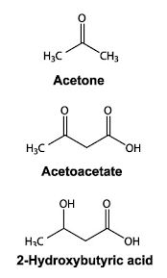
Ketogenesis: the results
The creation of ketone bodies
Used when
Fasting
Low glucose levels
Example of ketone bodies:
Acetone
Acetoacetate
Beta-hydroxybutyrate
What if there is too much ketone bodies in the bloodstream?
Ketoacidosis

Slide 27
Summary
Fats are lipids, essential nutrients
Breakdown via Digestive Lipases
Mainly in Small Intestine
Circulation via Lipoproteins
Storage of energy

Slide 28
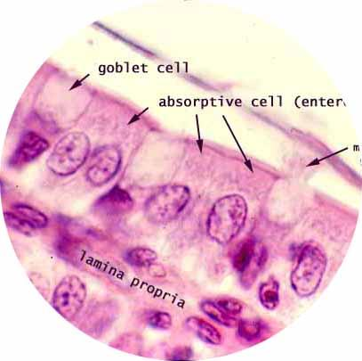
Thanks!
Any questions?

