Slide 1
Mitosis, Mitosis, Mitosis.
How come every Biology class always has to talk about Mitosis?
What is Mitosis anyway?
What’s the big deal?

Slide 2
Cells divide.
Cells have the ability to duplicate themselves.
They can make two identical copies of themselves.
The most exciting thing you can do is to watch a cell divide.
Watch a cell go through cell division, watching the process of cell division. You can see the changes that occur in the cell while it is in the active process of dividing. You can see ‘stuff’ going on inside the cell and see the cell actually get squiggly and wiggly and split into two identical cells (what are commonly called the two daughter cells).

Slide 3
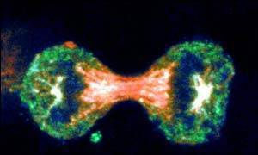
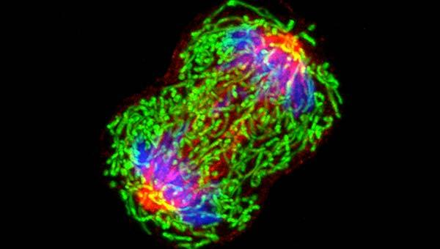
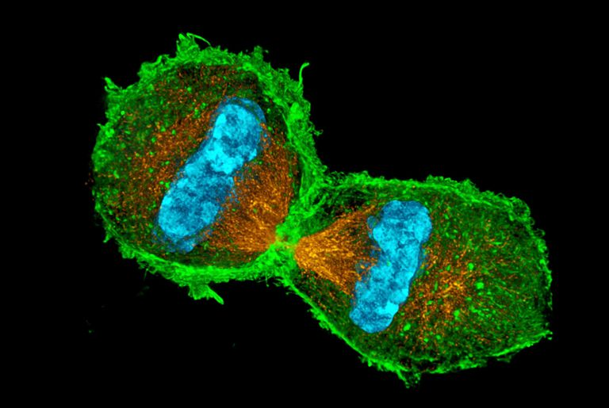

Slide 4

Isn’t cell division (mitosis) ….

Slide 5
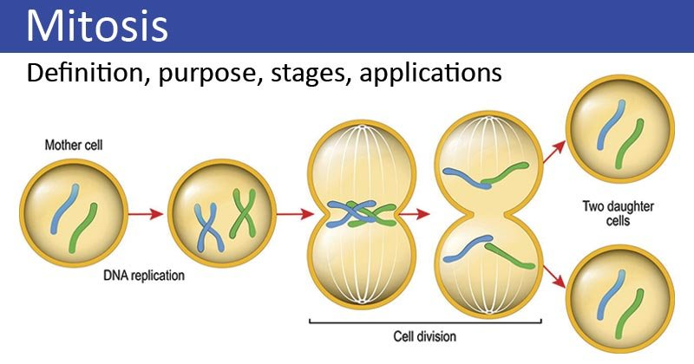
So to explain what one is seeing during cell division is “Mitosis”.
Mitosis is the scientific way to explain cell division.
Mitosis is a process where a single cell divides into two identical daughter cells (cell division). During mitosis one cell divides once to form two identical cells.

Slide 6
Take a moment and study this slide. The ‘Mother cell’ has two chromosomes or one pair of chromosomes. Our human cells have 46 chromosomes or 23 pairs of chromosomes. Notice that before this cell pinches in the middle and divides into two daughter cells, each of the two chromosomes has to duplicate itself so that each of the daughter cells ends up with two chromosomes just like the original mother cell.
What is ‘weird’ is that when these chromosomes duplicate, the new copy stays attached to the original chromosome toward the middle. So lining up in the middle of the cell are these ‘double chromosomes’, they then separate so each daughter cell gets the correct number of chromosomes.

Slide 7
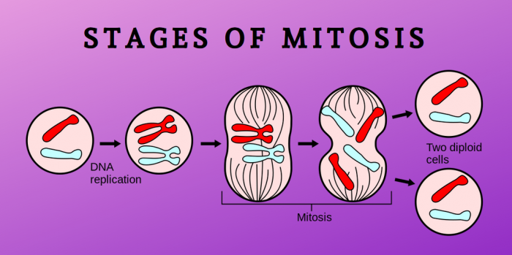
So for a cell to divide, first you need to duplicate (replicate) each chromosome, then the cell can pinch in the middle and split into two daughter cells.
Notice the thin, black lines are protein fibers constructed by this dividing cell to pull and push the chromosomes both to the middle of the cell and to move the separated single chromosomes to where they eventually belong at either end of the cell before it finally splits in two.

Slide 8
How do you watch all this happening?
Well, with a microscope of course! Cells are after all microscopically small.
The microscope was only recently invented.
Robert Hook refined the design of the compound microscope around 1665 and published a book titled Micrographia which illustrated his findings using the instrument.
Once folks started to actually see cell division in action, someone eventually would start to try to ‘scientifically’ describe the changes that you could see happening. To give descriptive names to the visible changes that were always seen in a dividing cell.
These visible changes were named ‘Mitosis’. Mitosis is cell division.

Slide 9
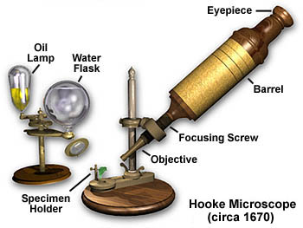
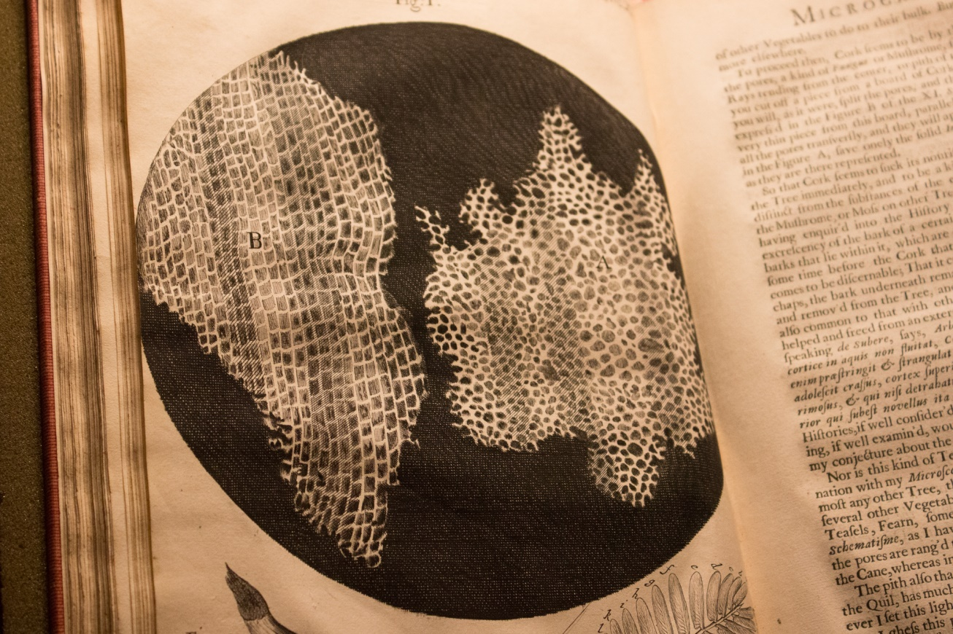
The Origins Of The Word 'Cell’: In the 1660s, Robert Hooke looked through a primitive microscope at a thinly cut piece of cork. He saw a series of walled boxes that reminded him of the tiny rooms, or cellula, occupied by monks.

Slide 10
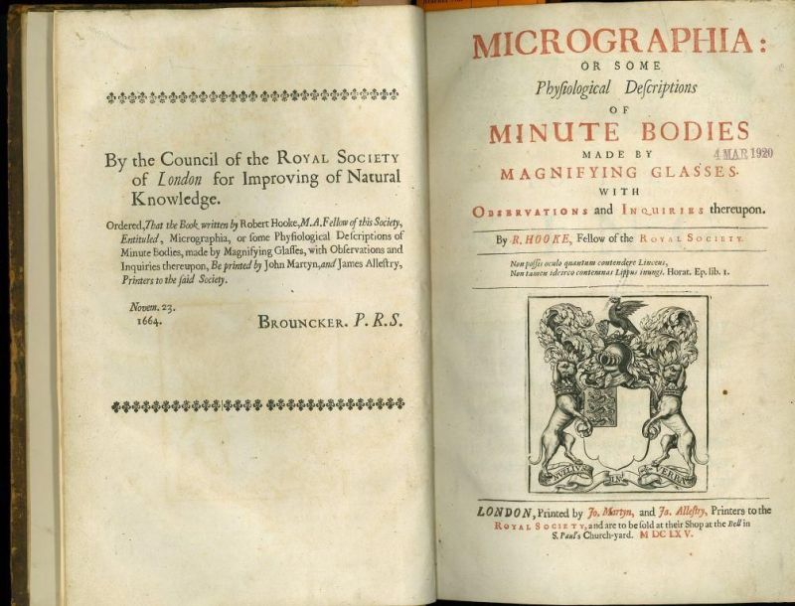

Slide 11
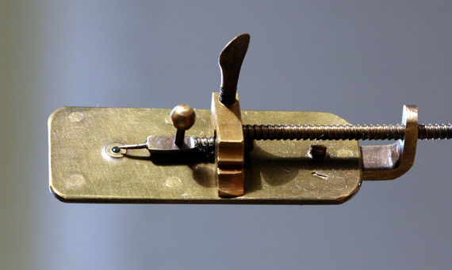
Anton van Leeuwenhoek, a Dutch merchant without university studies discovered microscopic life at the end of the 17th century. Leeuwenhoek was the first person to see unicellular animals, bacteria, red blood cells and sperm, and all with his homemade microscopes. He did not invent the microscope, he perfected its use.

Slide 12
The German anatomist Walther Flemming began his pioneering studies of mitosis almost 150 years ago. Flemming was one of the first cytologists and the first to detail how chromosomes move during mitosis, or cell division. Flemming observed cell division in salamander embryos, where cells divide at fixed intervals. He developed a way to stain chromosomes to observe them clearly.
Ultimately, Flemming described the whole process of mitosis, from chromosome doubling to their even partitioning into the two resulting cells, in a book published in 1882. His terms, like prophase, metaphase and anaphase, are still used to describe the steps of cell division. His work helped form the basis of the chromosome theory of inheritance.

Slide 13
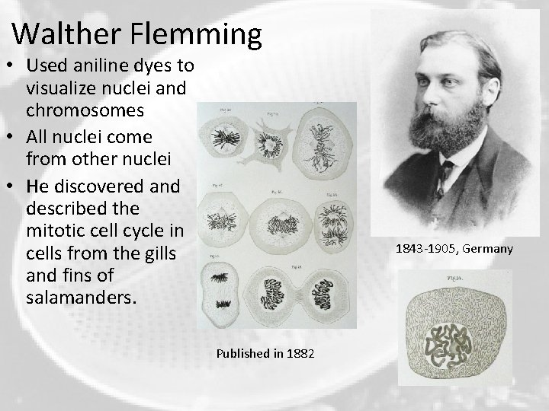
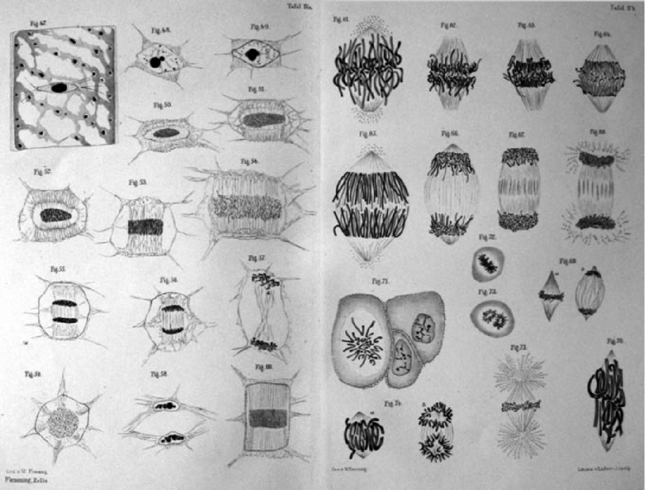

Slide 14
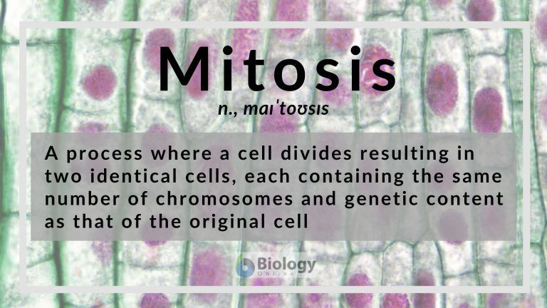

Slide 15
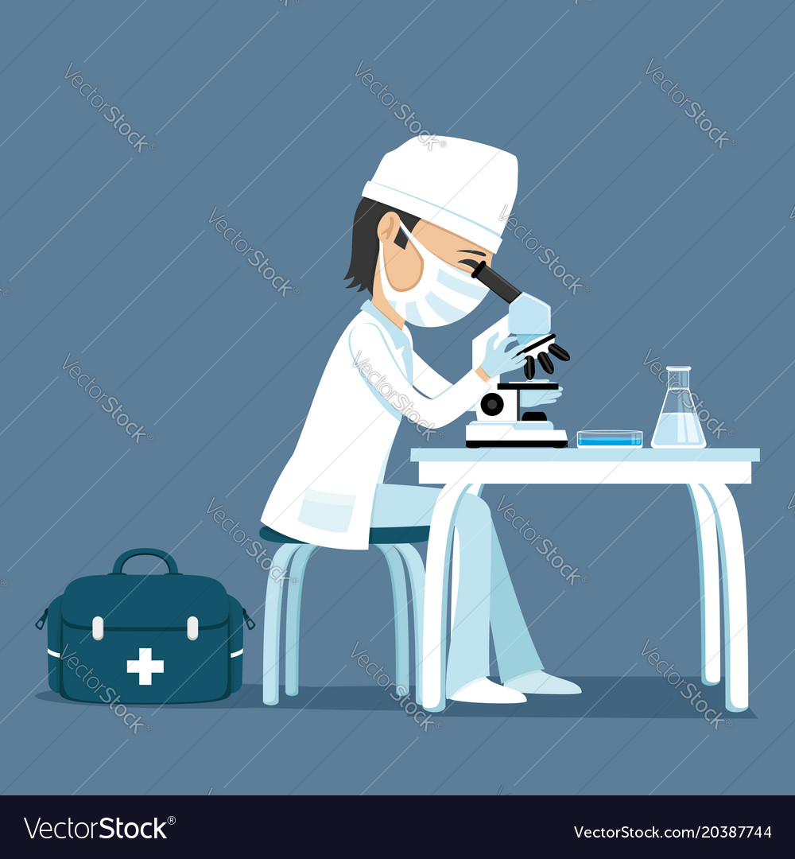
Let’s look at cells under the microscope.
The cells have had a colored dye poured onto them, then this dye is washed away. Another color dye is pour onto the cells and it too is washed away. So all the cells we look at under the microscope are ‘stained’ this way. Generally, but not always, a pink and purple colored dye is used.
It turns out to be easier to dip a clear, glass slide into a small jar full of the colored dyes. The cells have been attached to the clear glass slide.
Commonly the two dyes are hematoxylin and eosin (H & E Staining).

Slide 16
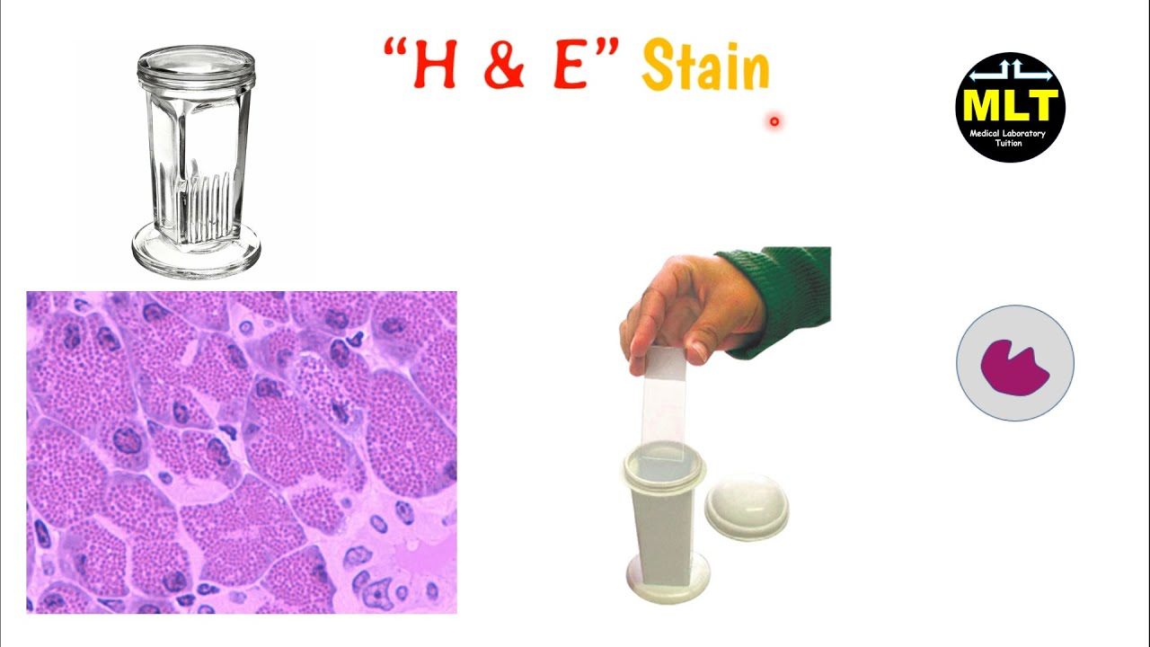
The nuclei look purple and the cell’s cytoplasm looks pink.

Slide 17
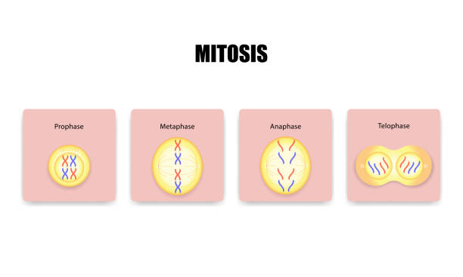
The most exciting thing you could ever look at when looking at cells microscopically is when they divide. That step by step process is called ‘mitosis’.
As you can imagine, before the cell gets all squiggly and wiggly and pinches into two daughter cells all the chromosomes must be duplicated. The duplicating of all of the chromosomes and then moving one complete set to one end of the cell and the other complete set of newly copied chromosomes to the other end of the cell can be seen with the microscope. This has been divided into four parts, the first, second, third and fourth part: the 4 stages of Mitosis. All 4 stages are determined by how the nucleus looks right before the cell actually splits onto two daughter cells.
These four stages are famous: Prophase / Metaphase / Anaphase / Telophase !

Slide 18
Mitosis: Let's Split!
Mitosis is the most dramatic event in a cell's life. Cellular structures that have always been there suddenly disintegrate, new structures are constructed, and it all culminates in the cell splitting in half. Imagine quietly going about your business one day, when you suddenly feel the bones of your skeleton rearranging themselves. Then, you find yourself being pinched apart from your midline, and before you know it, someone who looks just like you is sitting beside you. That's akin to what happens to a cell during mitosis.
Mitosis is divided into four phases: prophase, metaphase, anaphase, telophase. They are concerned with what the nucleus looks like and what is happening to the chromosomes right before the cell actually splits into two daughter cells. We’ll learn that the process of pinching in and splitting the cell into two daughter cells is called ‘cytokinesis’.

Slide 19
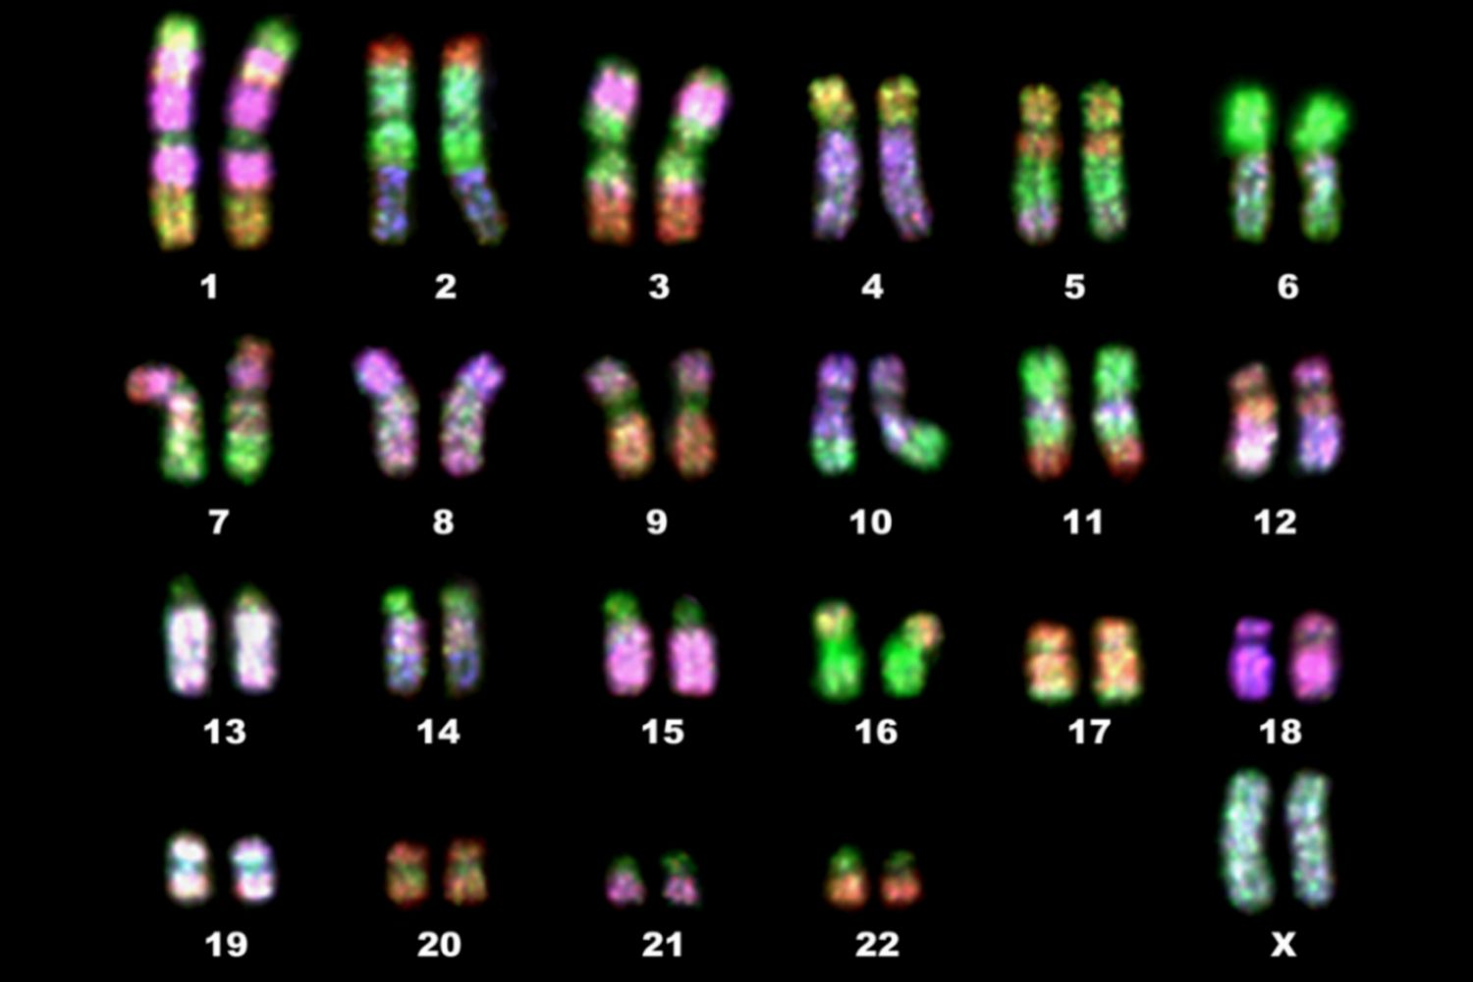
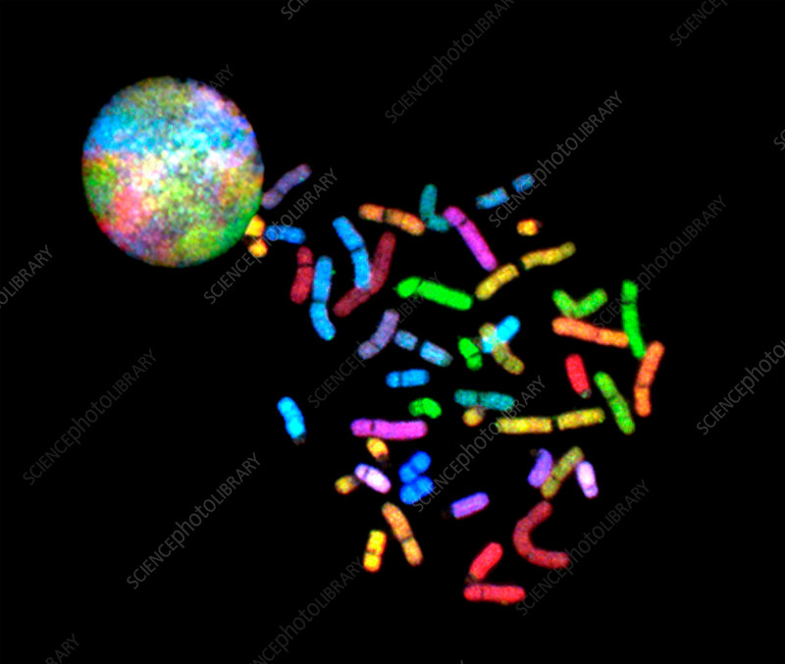
Human cells have 46 chromosomes. For each chromosome, there is one almost identical to it. So the 46 chromosomes are actually 23 pairs of chromosomes. If you were to burst open a human cell and burst open that cell’s nucleus you’d find all of these 46 chromosomes. A picture of them is taken and they are arranged with the longest ones first and the shortest pair last. This is called a Karyotype:

Slide 20
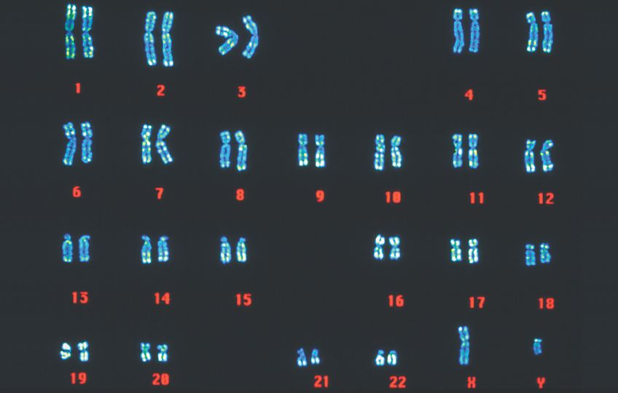
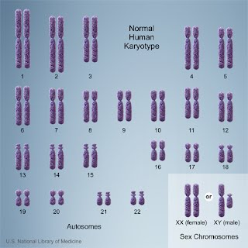
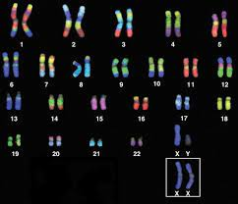
So the shortest chromosome pair is #23. This shortest chromosome is the Y-Chromosome and it turns on testosterone production to produce a male. Any cell can only have one single Y-Chromosome. The other chromosome that works to determine sex (male or female) is the X-Chromosome. However, the X-Chromosome is quite long and does not pair up with the short Y-Chromosome by size. But since the short Y-Chromosome is a sex determining chromosome it is paired with the long X-Chromosome in the Karyotype as pair #23. So a genetic male has at chromosome pair #23 a Y-Chromosome and a X-Chromosome (on the left below). A genetic female has two X-Chromosomes (which are long) placed as chromosome pair #23 (on the right below).

Slide 21
Why talk so much about chromosomes during Mitosis? Well, each cell has 46 chromosomes, yes? So if a cell goes through Mitosis, each of the two daughter cells must end up with 46 identical chromosomes…..yes! How can the original cell with 46 chromosomes produce two daughter cells each with 46 chromosomes?
So prior to the cell getting squiggly and wiggly and spitting into two daughter cells, all of the original chromosomes must be duplicated. Then there will be two complete sets of 46 chromosomes and in that way each daughter cell can get its full set of 46 chromosomes. So for a short period of time, right before the cell splits into two daughter cells, that original cell has 46 + 46 = 92 chromosomes. So prior to splitting apart into two, all the chromosomes must undergo DNA replication and then these 92 chromosomes have to be moved into position so when the cell splits, each daughter cells gets 46 chromosomes.
Interestingly (can be confusing), this period of DNA replication occurs before Mitosis.

Slide 22
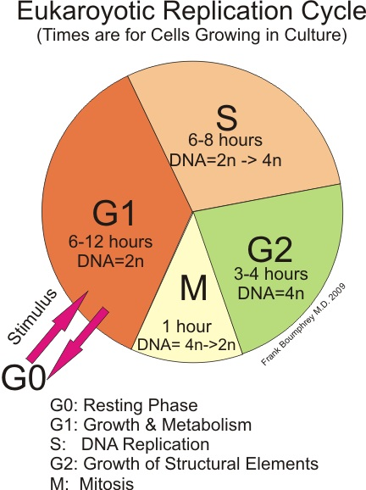
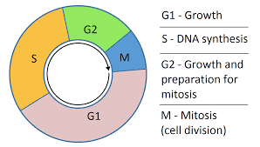
Notice the four stages of Mitosis (Prophase, Metaphase, Anaphase, Telophase) all have to do with watching these 92 chromosomes being pulled around inside the cells before it splits apart. The duplicating of the original 46 chromosomes happens prior to Mitosis in a phase called the “S-phase”.
If you were like Walther and watched cells divide (undergo Mitosis), you’d notice quickly that you could see the “S-phase” where the nucleus looked busy and then the nucleus would go back to looking normal. And then you might have to wait several hours before Mitosis finally began and finished. There would be a sizable gap in time between the “S-phase” and “Mitosis”. This is called “Gap-2” or “G-2 phase”.
Gap-1 is the long period of time between the end of Mitosis and the “S-phase”.
These four phases are called the Cell-Cycle.

Slide 23
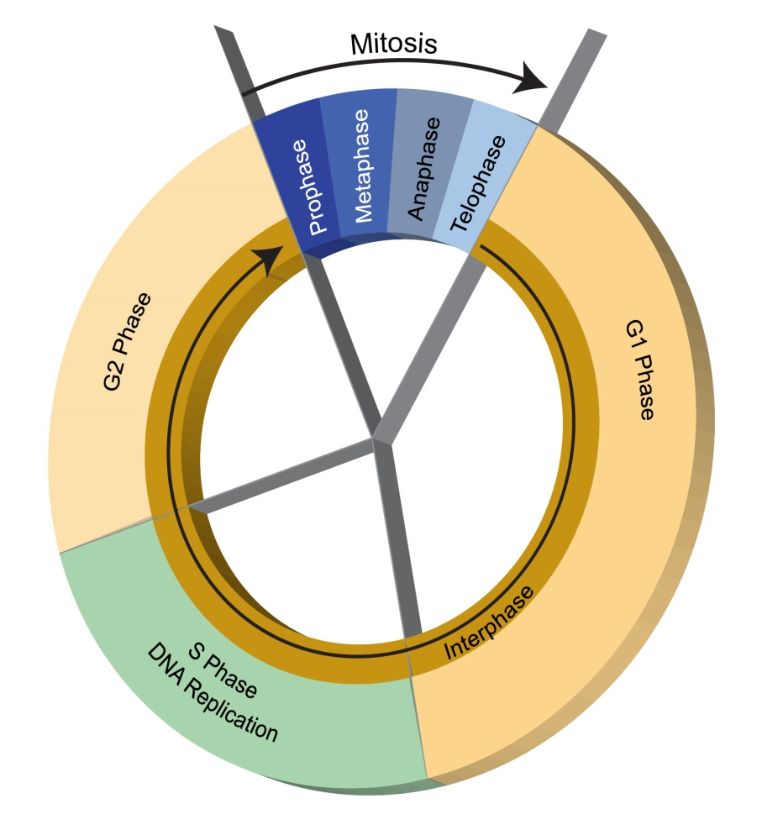
Do not be confused.
There are 4 parts to the Cell Cycle: G1 – S – G2 – M, and the around again.
The “M” represents Mitosis. So, G1 – S – G2 – Mitosis and the back to G1 – S – G2 – M ….
For “M”, Mitosis, there are 4 phases: Prophase, Metaphase, Anaphase, Telophase.

Slide 24
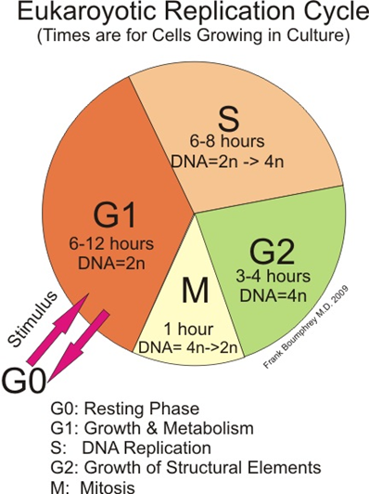
So as we saw in this previous diagram, if you got your microscope out and started to watch these cells divide, you’d spend maybe 6-8 hours watching the nucleus look busy (we now know that the nucleus looks busy since the chromosomes are being copied), then the nucleus would go back to normal. Then maybe 3-4 hours of nothing would appear (G2 / Gap-2). Then “M” (Mitosis) with its four phases for about an hour. Then 6 or more hours of nothing (G1). The early biologists would spend all their time watching the cell split into two daughter cells during “Mitosis” and not bother watching during G1 or S or G2. So that interval between Mitosis is called “interphase” = G1 + S + G2. (You can ignore G0 for now.)

Slide 25
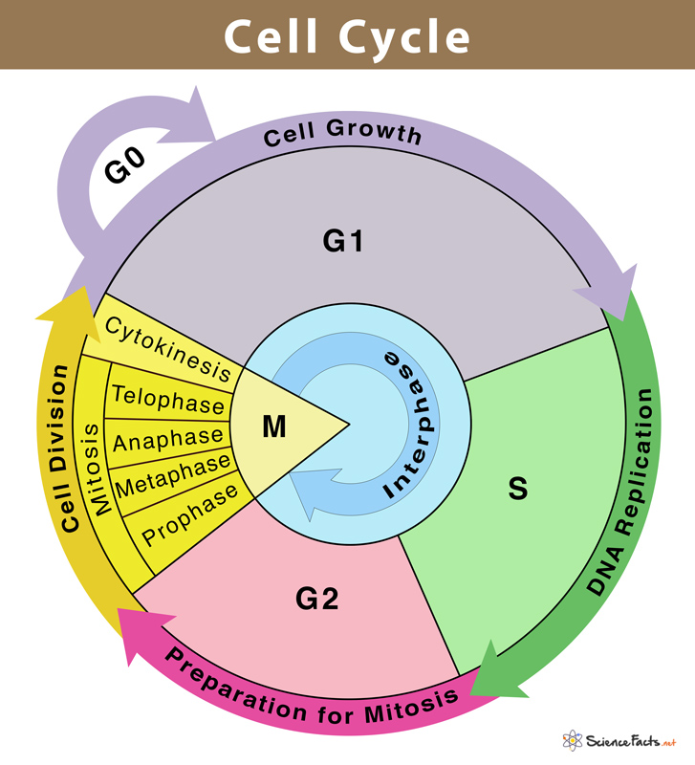
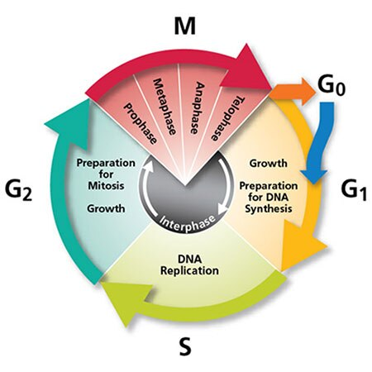
Notice the diagram on the right has “Cytokinesis”. Cytokinesis is the part of the cell division process during which the cytoplasm of a single eukaryotic cell divides into two daughter cells. Cytoplasmic division.

Slide 26
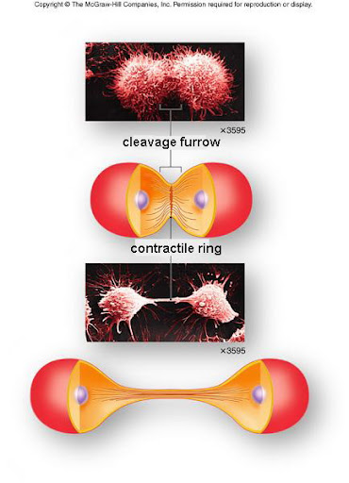
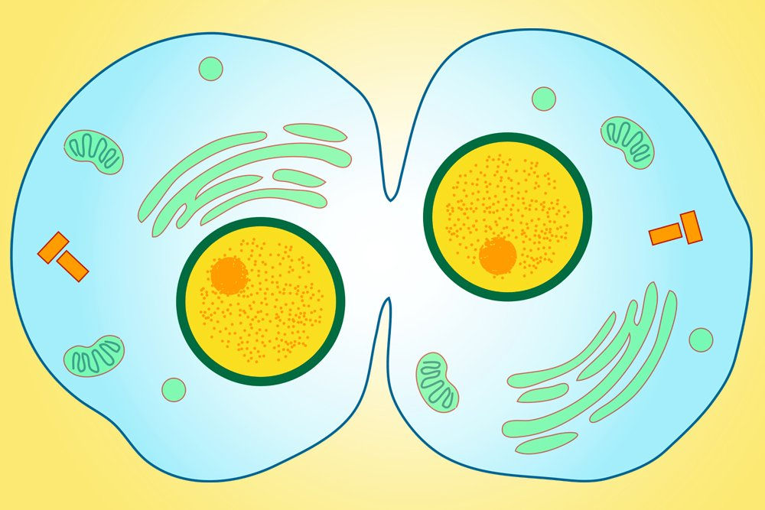
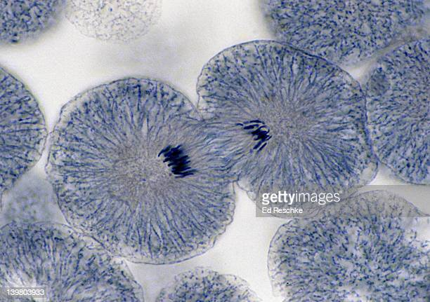
Mitosis consists of Prophase, Metaphase, Anaphase and Telophase. All of these four phases have to do with what is happening with the chromosomes in the nucleus and eventually sending a complete set of 46 chromosomes into their own nuclei and having each of these two new nuclei move to the opposite sides of the cell before it splits into two daughter cells.
But what about the rest of the cell when it is splitting into two daughter cells. What about everything going on in this dividing cell that isn’t related to the chromosomes and nucleus? Well, all those ‘cytoplasmic’ events is referred to as ‘cytokinesis’.
The most noticeable event in cytokinesis is the pinching in at the center of the cell (the cleavage furrow) until the cell splits into two daughter cells.

Slide 27
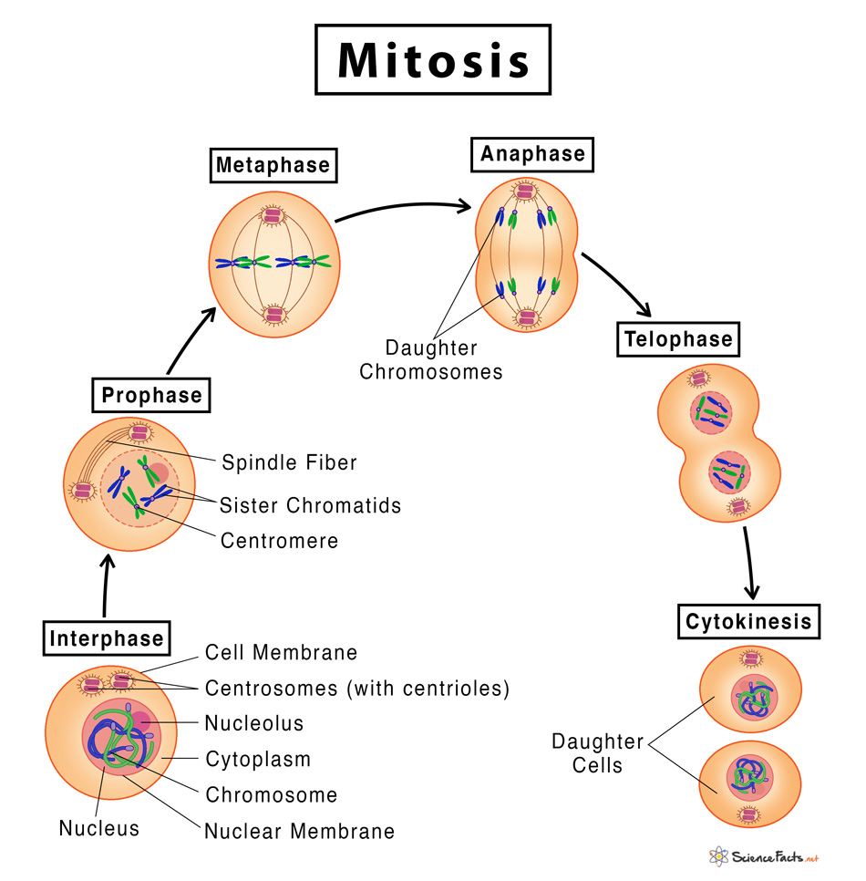
Now we can interpret this diagram. “Interphase” at the bottom left is G1 + S + G2 of the cell cycle. OK.
The diagram then shows “M” (Mitosis) and its four phases. Those 4 phases all have to do with nuclear changes right before the cell actually splits into two daughter cells. So after Telophase, the cell does actually split into two daughter cell and this is called “Cytokinesis”. What happens after Cytokinesis is done? The cell enters G1 since the cell has now ended “M”.

Slide 28
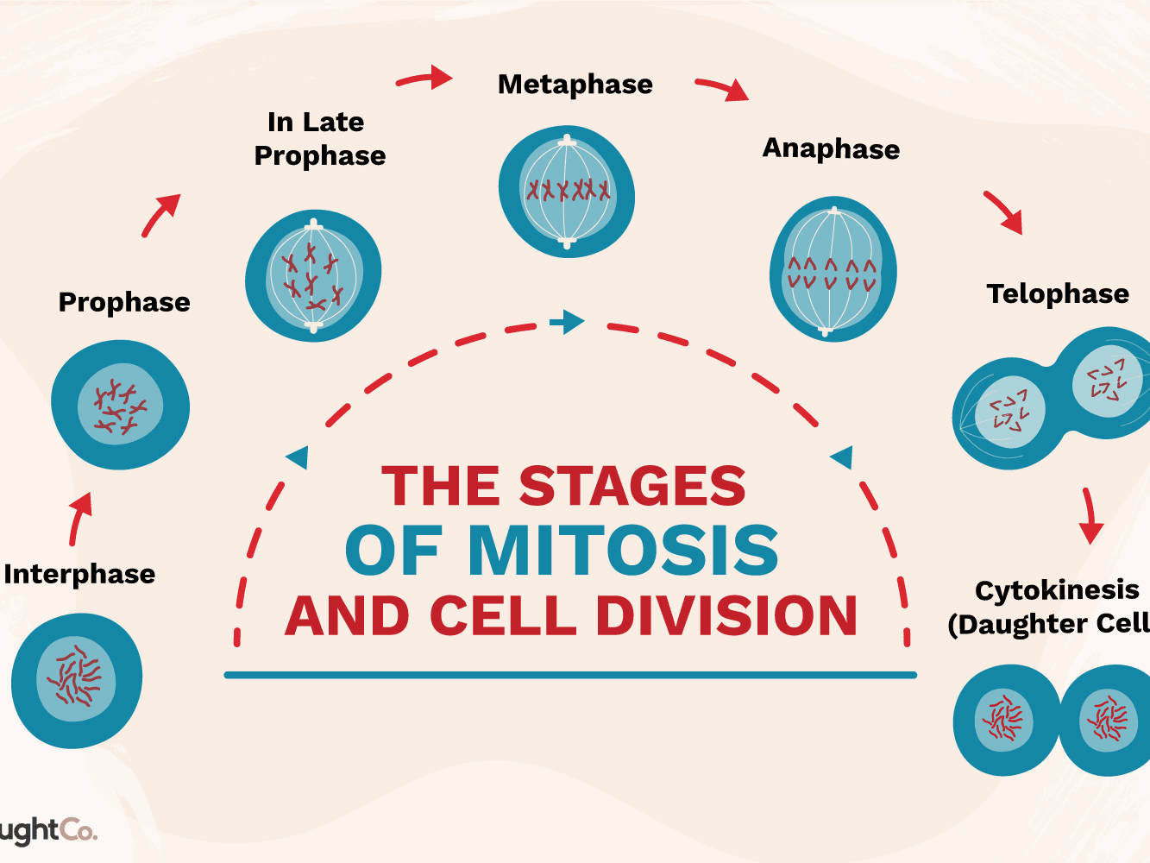

Slide 29
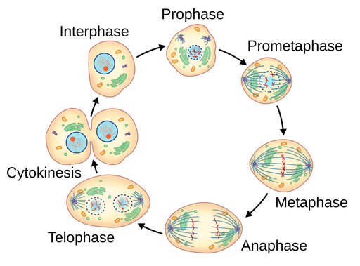
So a diagram such as this one is no longer confusing. “Interphase” represents “G1 + S + G2”. After G2 begins “M”, which is broken down into its specific phases is shown (Prophase / Metaphase / Anaphase / Telophase). After P/M/A/T, which applies to the nuclear changes, the cell splits into two daughter cells and this splitting event is called ‘Cytokinesis’.

Slide 30
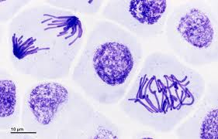
Mitosis:

Slide 31

Wait, before we jump into the 4 phases of Mitosis (Prophase, Metaphase, Anaphase, Telophase), let me remind you that before this “M-phase” (Mitosis), there was the S-phase of the cell cycle. And what happens during the S-phase of the cell cycle? The chromosomes are duplicated. All 23 pairs of them.
These next slides explain that in detail…..

Slide 35
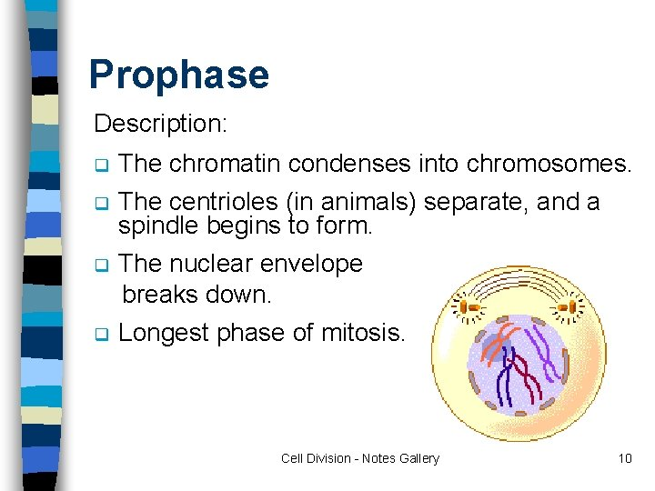
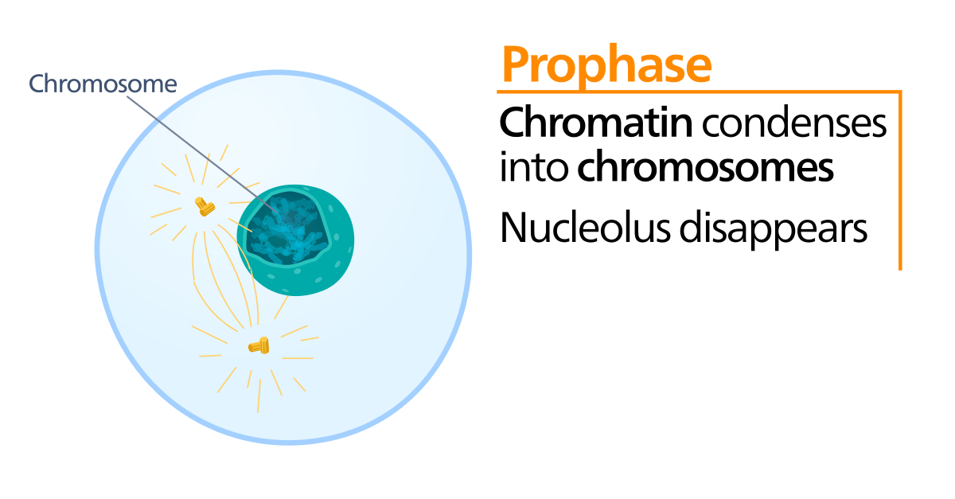
Prophase: the first stage of cell division, before metaphase, during which the chromosomes become visible as paired chromatids and the nuclear envelope disappears.

Slide 36
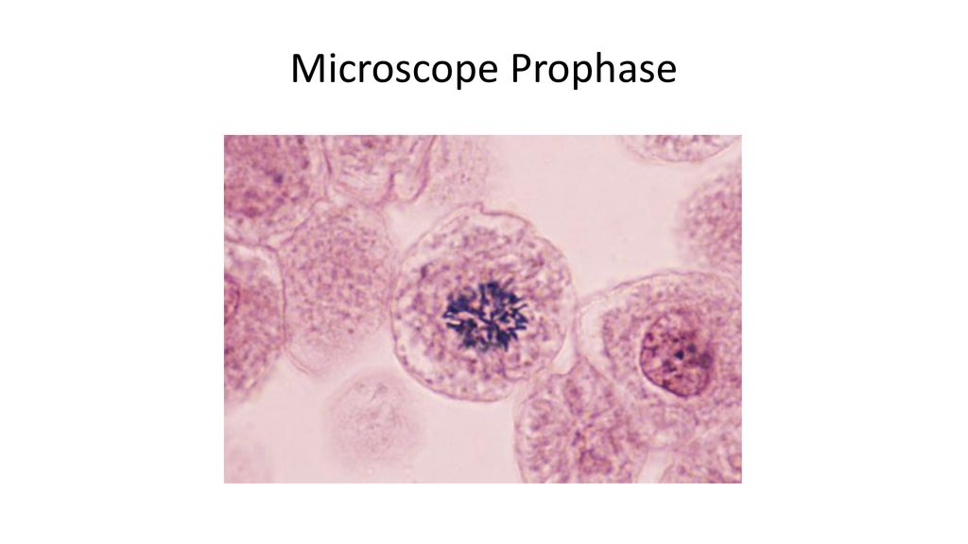

Slide 37
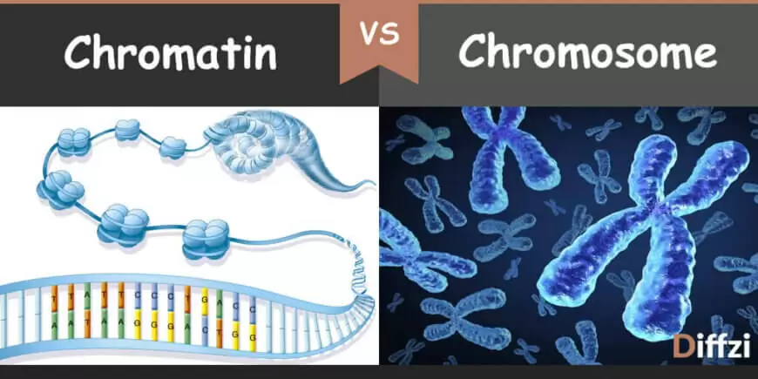
Wait, what’s chromatin? How is it different from a chromosome? Well, Chromatin is the term to describe the long, stringy, uncoiled Double Stranded DNA. It winds all over the nucleus. It is the ‘unraveled’ version of a chromosome. If a cell is going to divide, all the unraveled chromosomes must we wound up into a tidy bundle of DS-DNA … a chromosome. Now go back to the previous 2 slides and read them again.

Slide 38
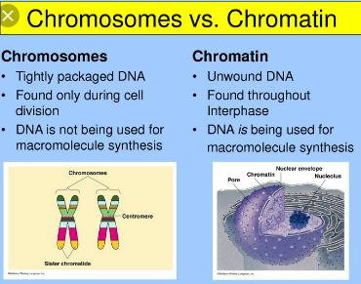
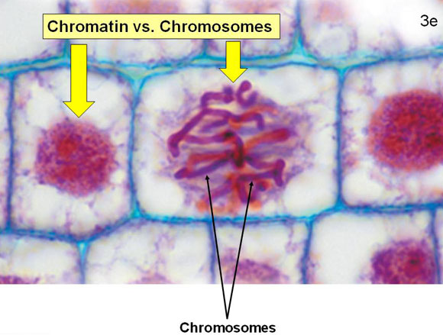
In order for Double-Stranded DNA to work, to do its job, it must be unraveled and free to unzip. That is how DS-DNA is most often found in a cell’s nucleus. However, if that cell is going to undergo Mitosis, all that unraveled DS-DNA (an unwound Chromosome) has to be wound up, condensed, into a manageable bundle. That tightly packed DS-DNA is visiable under the microscope and is called the Chromosome.

Slide 39
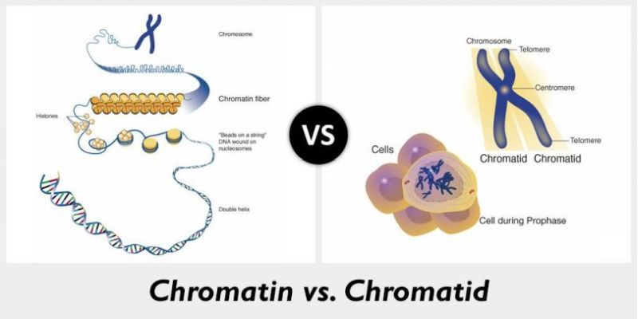
This is not confusing. We know all about sister chromatids. They are very different from the unraveled DS-DNA called chromatin. Chromatin is the unraveled chromosome. After a chromosome has duplicated itself (replicated) these two complete copies of that chromosome are still attached and each complete identical chromosome is called a sister chromatid. Got it? Good. Remember from earlier, these sister chromatids are connected at the centromere.

Slide 40
OK, can you now put all of these terms into one sentence? If you can, you’ve mastered these terms: chromatin / chromosome / chromatids / centromere.
As the cell prepared to divide, the chromatin condensed into visible chromosomes that underwent replication during the S-phase into two identical sister chromatids that were attached near their middles at the centromere.
How’s that for bonus points!

Slide 41
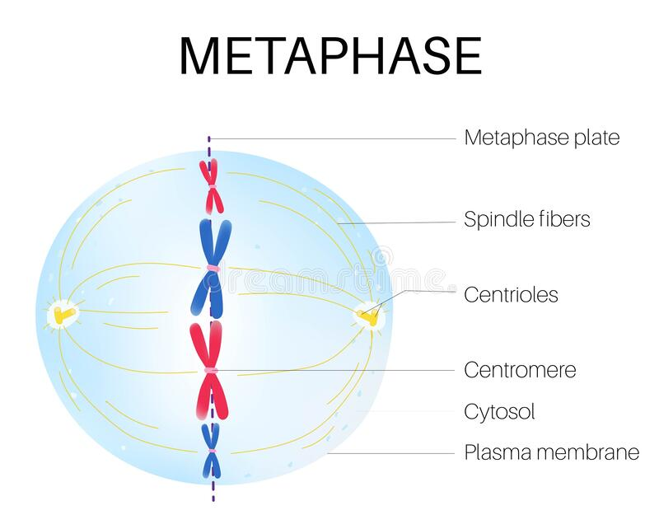
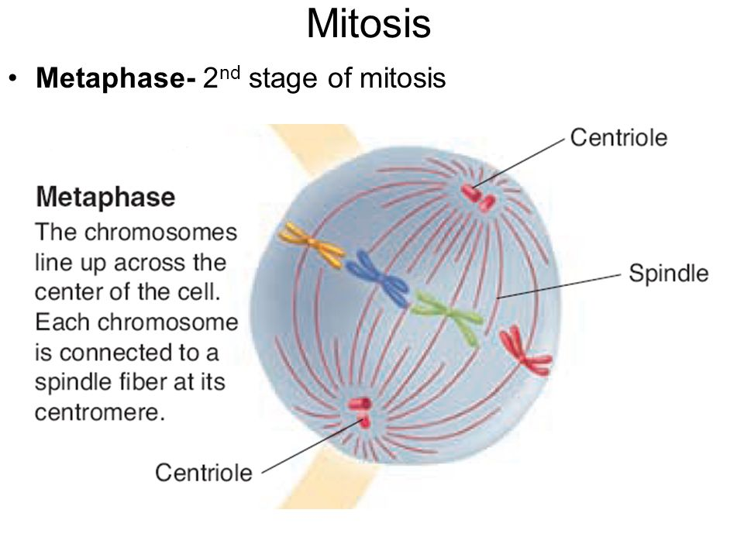
Metaphase: the second stage of cell division, between prophase and anaphase, during which the chromosomes become attached to the spindle fibers. The chromosomes are lined up along the metaphase plate. These spindle fibers pull and push the separated sister chromatids to opposite sides of the cell.

Slide 42
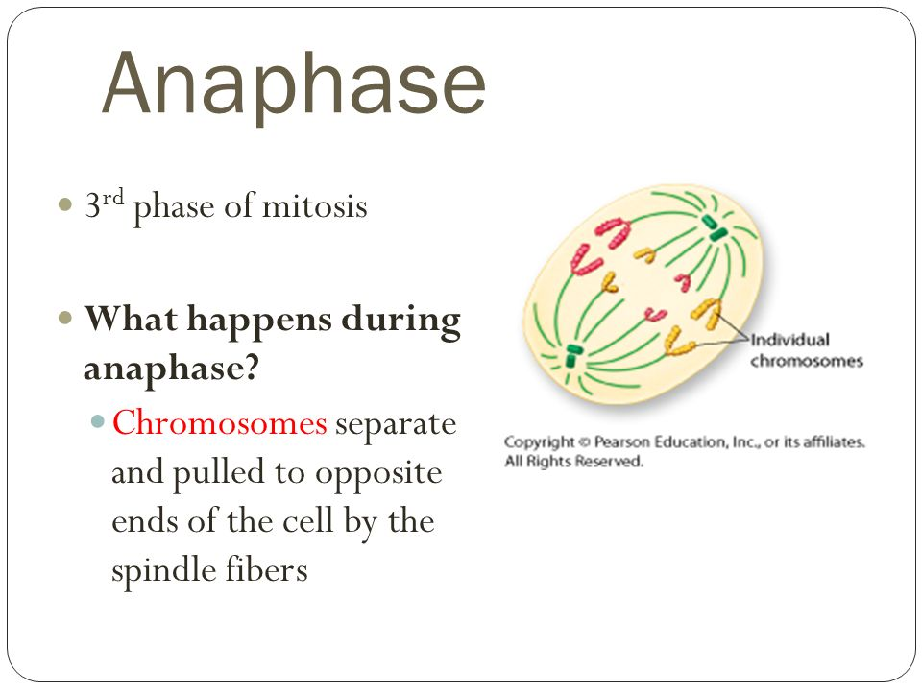
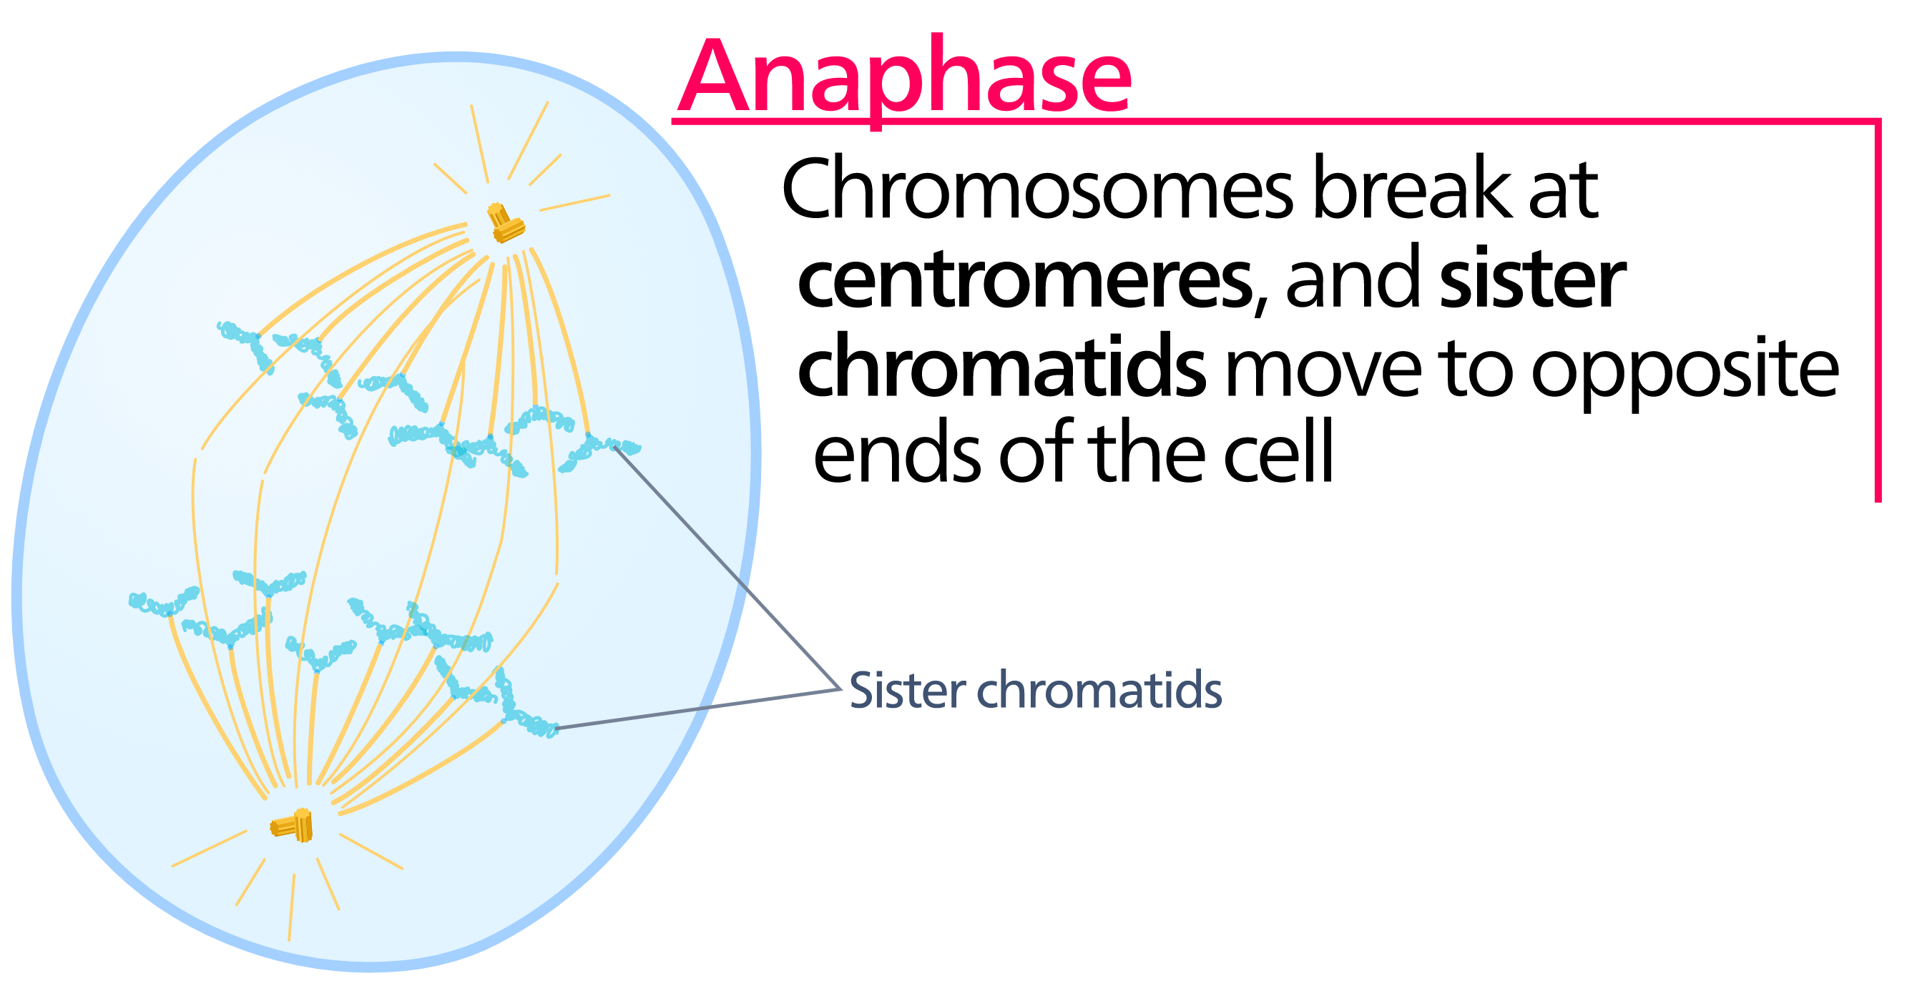
Anaphase: mitotic cell division in which the chromosomes move away from one another to opposite poles of the spindle. Everyone remembers “Anaphase …. Away”.

Slide 43
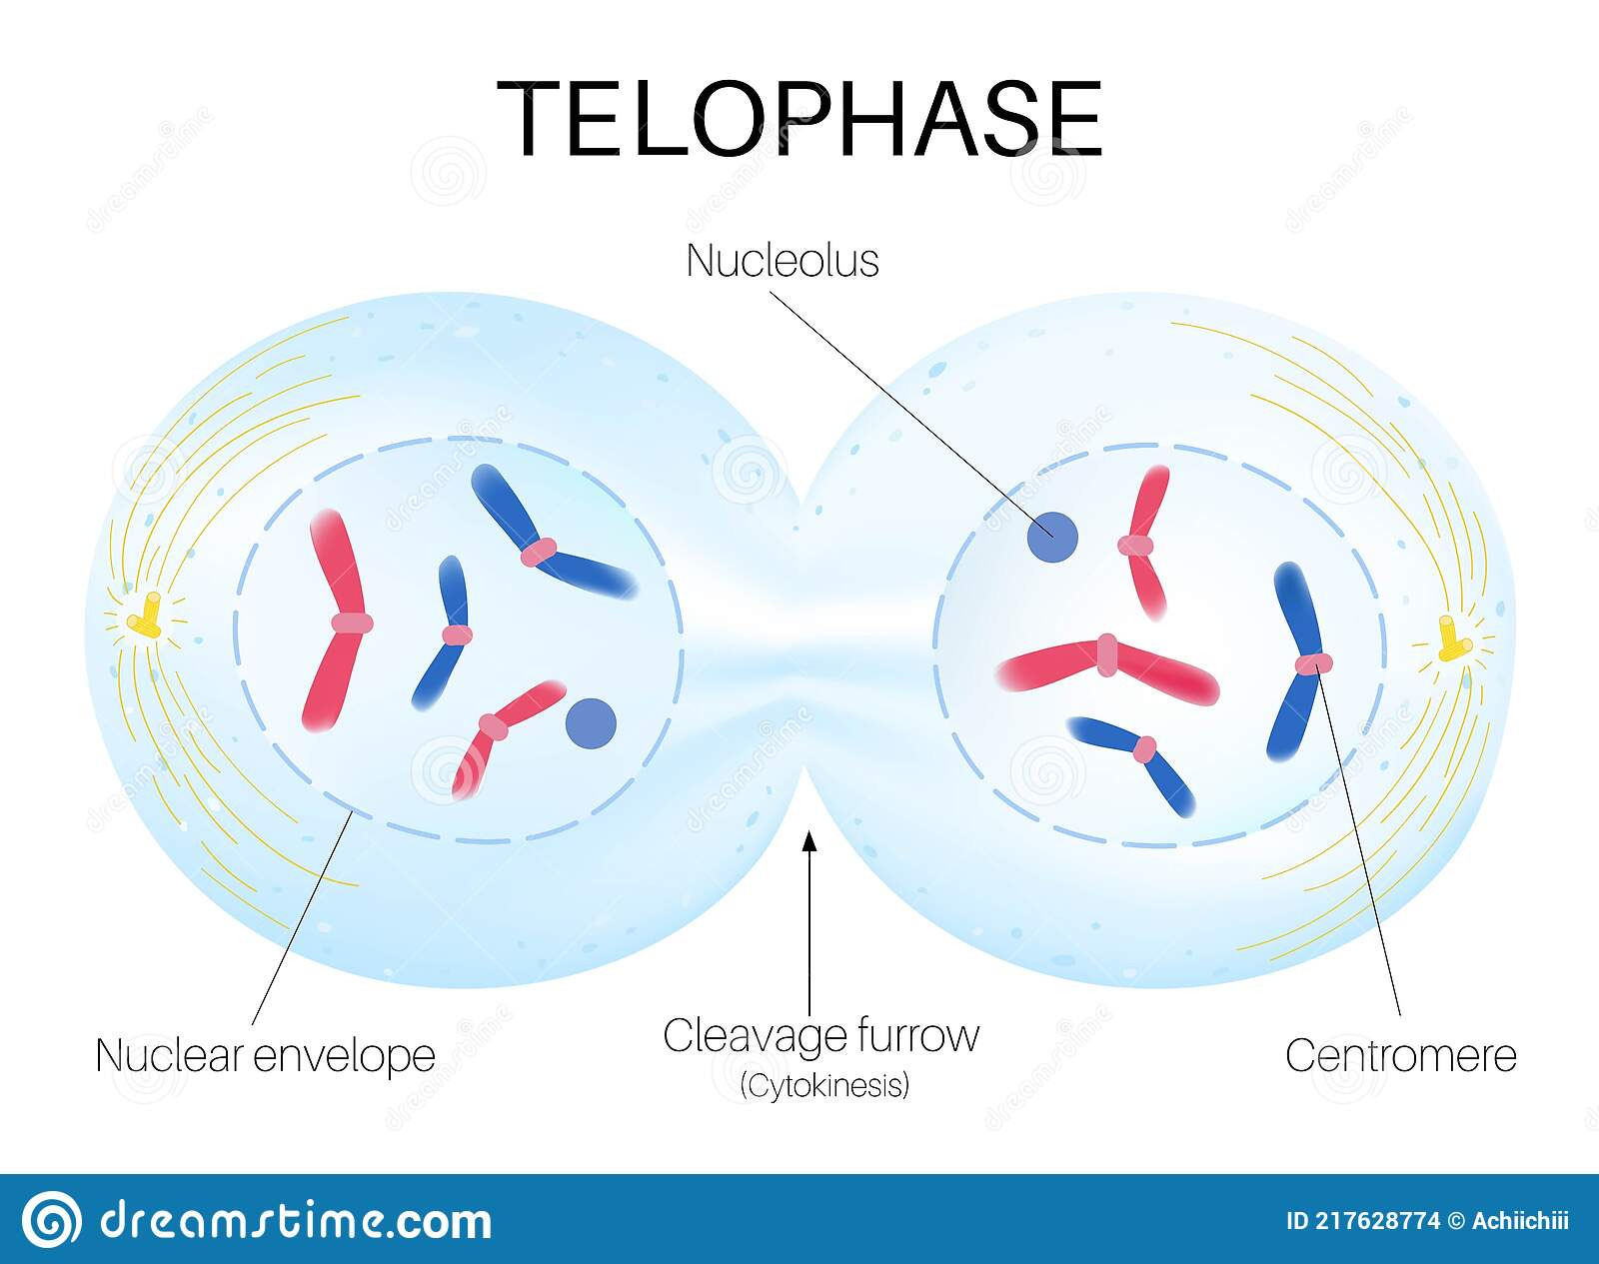
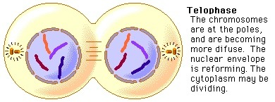
Telophase: the final phase of cell division, between anaphase and interphase, in which the chromatids or chromosomes move to opposite ends of the cell and two nuclei are formed.

Slide 44
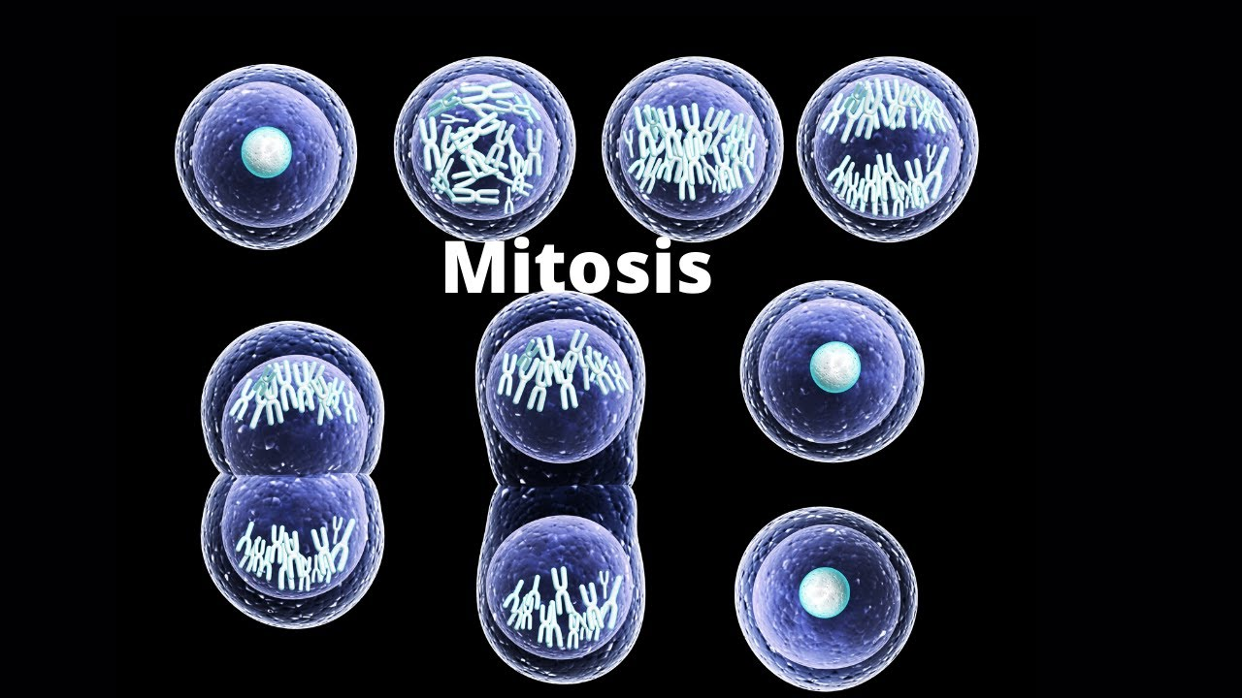

Slide 45
So to review, Mitosis has to do with what you see happening to the DNA/Chromosomes when a cell in dividing. Prophase / Metaphase / Anaphase / Telophase.
After the chromosomes have been moved around, two complete sets at opposite ends of the cell, now the cell itself is ready to split into two daughter cells. That process that follows Telophase is “Cytokinesis”…the dividing of the cytoplasm and the cell itself.
But we also mentioned that these chromosomes have to have been duplicated (replicated) before we begin Mitosis. That replication of all of the chromosomes happens during what is called the “S-phase” of the cell cycle. G1 – S – G2 – M --→ and all around again, it is a cycle that repeats as long as the cell is dividing. So we also introduced the ‘cell cycle’.
Do you know the difference between: chromatids vs. chromosomes vs. chromatin? Sure, easy.
Can you tell the difference visually between: Prophase / Metaphase / Anaphase / Telophase?
Sure, easy.

Slide 46
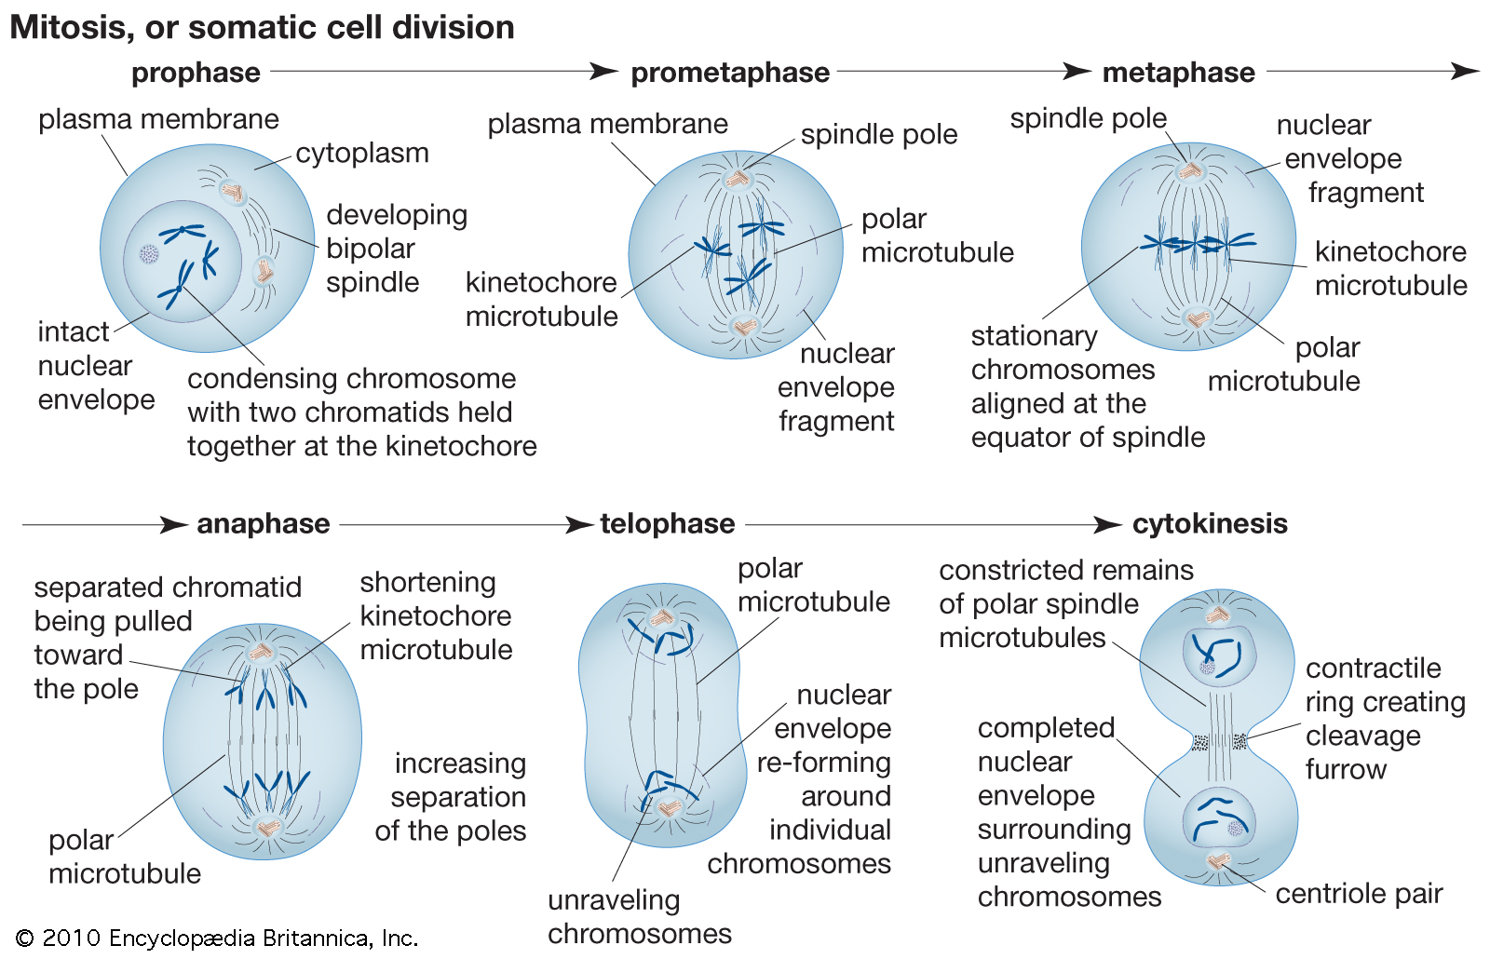
Ok, did you have a question? Good question. Let me repeat it here for the entire class to hear/read:
“Many of the diagrams of mitosis show a ‘prometaphase’ phase between prophase and metaphase, what’s that all about, this thing called ‘prometaphase’? Well, as in all science, the more exact, the better.
Prophase is distinguished by an intact nucleus (the nuclear membrane is still there). When transitioning to the next phase, Metaphase, the nuclear membrane has to disappear so all the duplicated chromosomes can line up in the middle of the cell (the metaphase plate). To me more exact, you could consider the stage where the nuclear membrane is gone but the chromosomes are not lined up in the middle yet. That would be ‘prometaphase’. But we won’t be responsible for that.

Slide 47
The term that refers to division of the cytoplasm is:
A)cytokinesis
B)anaphase
C)fission
D)S-phase
E)endocytosis

Slide 48
What structure is responsible for moving the chromosomes during mitosis?
A)spindle fibers
B)nucleus
C)nucleolus
D)cytoplasm
E)collagen fibers

Slide 49
During which phase does the DNA make a copy of itself?
A)prophase
B)interphase
C)cytokinesis
D)metaphase
E)dinophase

Slide 50
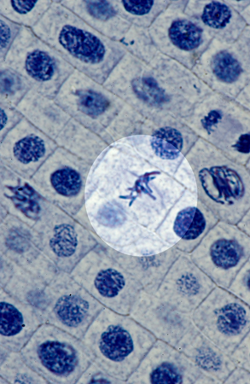
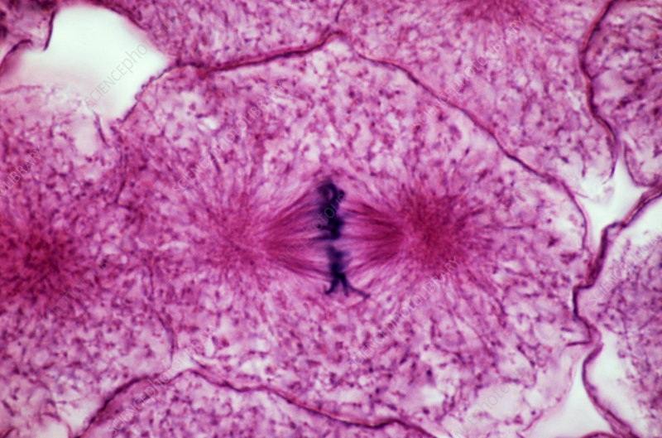
What stage or phase of mitosis is shown?

Slide 51


What stage or phase of mitosis is shown below?

Slide 52


What stage or phase of mitosis is shown?

Slide 53


What stage or phase of mitosis is shown below?

Slide 54


What do the images below show?
(a) cytokinesis (b)S-phase of the cell cycle (c)prophase (d)metaphase

Slide 55


The images below show:
(a)sister chromatids (b)chromatin (c)spindle fibers (d)chromosomes in G1 phase of the cell cycle

Slide 56

The specific cell shown in interphase is in:
(a)S-phase (b)prophase (c)cytokinesis (D)telophase

Slide 57
Thanks for joining me on our trip to ‘Mitosis’.

