Slide 1
Transcription and Translation

Slide 2
At the top is double stranded DNA, a chromosome. The middle drawing shows the base-pairing. Notice in the third drawing the double stranded chromosome is unzipped exposing unpaired bases.

Slide 3
Looking at the bottom drawing, notice the distance where the double stranded DNA is unzipped is called a ‘gene’. There are on the left red colored bases pairing up with the exposed bases on the top strand of the chromosome. This is the beginning of the messenger RNA (mRNA).

Slide 4
Notice that all the unpaired bases on the top strand of the chromosome are now paired up with individual, complementary red bases. Now all that is needed is to connect all the red bases now that they are all lined up next to each other.

Slide 5
All that is needed to connect the individual red bases is to put a ‘phosphate group’ in between them. You can see a complete strand of nucleic acid in red. It is 16 bases long: TCGATCGATCGATCGA. The next slide will show this red strand of nucleic acid unzip from the top strand of the chromosome.

Slide 6
So we unzipped the original chromosome from the beginning and the end of the ‘gene’. With the top strand of the chromosome’s bases now unpaired, we floated in individual bases (in red) and paired them up: A with T and C with G. We connected all these individual red bases by adding ‘phosphate groups’, making a complete strand of red nucleic acid. Now that newly constructed red strand of nucleic acid is itself unzipped and moved from the nucleus where this is all happening, out to the cytoplasm to have it enter a ribosome. This process of making the red nucleic acid strand is called ‘transcription’. We made a copy off of the chromosome, like a transcriber (transcriptionist?)

Slide 7
A better drawing showing transcription in the nucleus. Notice the red strand of nucleic acid in this drawing is called RNA. Why? You may have noticed that in my previous drawings and text explanations I was calling the newly constructed red strand ‘nucleic acid’. Well, it is a strand of RNA. Why? If you were to isolate the red strand out of your nucleus and examine it biochemically, you’d find it is nucleic acid: Sugar – Phosphate – Sugar – Phosphate – Sugar – Phosphate ………. We know the phosphate group. In the chromosome, the sugar was ribose that was actually missing an oxygen, so it was called deoxyribose, hence the name DNA (deoxyribo-nucleic acid). In the red strand, the sugar is regular ribose. Don’t ask me why. That just what we find. So the red strand is a nucleic acid that uses ribose as its sugar, so it is a ribonucleic acid (RNA). The messenger RNA, mRNA.

Slide 8
Don’t worry about the ‘nontemplate strand’ and ‘template strand’ or ‘direction of synthesis’. Just look at how the mRNA is made from the chromosome template. AND NOTICE the letter “U”. What’s that all about? What’s a “U” doing here. We learned the four bases: A, G, C and T. Well, only in RNA is the “U” used instead of “T”. Since this mRNA is RNA, instead of the “T” base, the “U” base is used. What is the “U” base? It is a molecule called uracil. Get it: “U” for uracil. So when making mRNA, you will pair the “U” base with the “A” base in the DNA. DNA has A, G, C and T. RNA has A, G, C and U.

Slide 11
Let’s go to the next step, using the mRNA to make a protein: translation. As we already know, proteins are made up of a string of amino acids. Translation will be the ‘translation’ of bases in the mRNA into amino acids in the protein. Translation is the translation of nucleic acid into protein.

Slide 12
Let me impress upon you how simple this is. There are only three ‘players’ in this game: (1) ribosome; (2) mRNA; (3) tRNA (transfer RNA). These odd tRNA molecules are only 3 bases long with an amino acid attached to the other end. The mRNA travels through the ribosome. Only three bases fit at a time. The three bases on the mRNA that are inside of the ribosome are compared to the three bases on the transfer RNAs (tRNA molecules) to see if they all three base pair. For example, if the three bases of the mRNA inside the ribosome are CGA, the matching tRNA would have to be GCT. Once that matching tRNA is found by the ribosome, the ribosome steals the amino acid off of that tRNA and the ribosome keeps that amino acid.

Slide 13
Once those three bases of the mRNA that are inside the ribosome are matched with a specific tRNA, those three bases exit the ribosome and three new bases enter the ribosome and the ribosome goes back to work pulling in tRNAs looking to find the one tRNA that will match. In the middle drawing, the GAT inside the ribosome is finally matched with the tRNA that has CTA and that amino acid is taken off of that tRNA and placed with the first amino acid the ribosome took off of the first matching tRNA. In this way, three bases at a time the mRNA travels through the ribosome and the ribosome is collecting the amino acids off of the complementary tRNA’s. A string of amino acids is what the ribosome is left when after the entire mRNA has traveled through the ribosome. That sting of amino acids is a protein, a polypeptide. This process that occurs on the ribosome is called translation.

Slide 14
Oh Dear, I forgot, the mRNA and the tRNA do not use ‘T’, but Uracil.

Slide 15
The mRNA is the orange line at the top. The tRNAs are the big, blue ‘T’s. Nice and simple but a confusing diagram since it does not show the ribosome.

Slide 16
This diagram shows the interesting shape of the tRNAs.

Slide 17
As you get more comfortable understanding what is going on during translation, the diagram below makes sense.

Slide 20
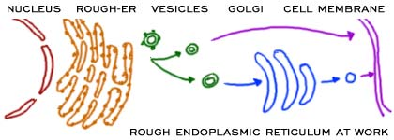

Slide 21
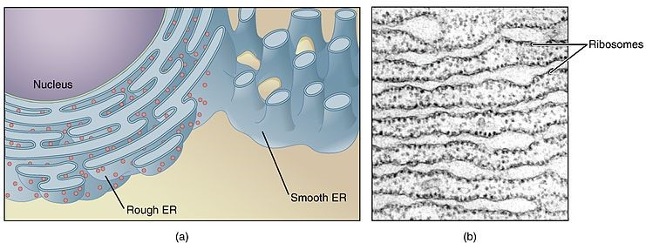

Slide 23
From DNA to PROTEIN
https://www.youtube.com/watch?v=gG7uCskUOrA

Slide 24
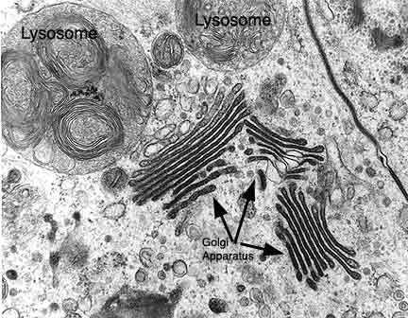
Amazingly, we’ve covered almost all of the organelles inside of a cell. We’ve mentioned the nucleus, mitochondria, endoplasmic reticulum (both rough and smooth) and the Golgi apparatus. So let’s finish off the list of organelles by mentioning the lysosomes and peroxisomes. Lysosomes first.

Slide 25
Lysosome: An organelle in the cytoplasm of eukaryotic cells containing degradative enzymes enclosed in a membrane.

Slide 26
What is a peroxisome? What does it do?

Slide 27
The Cell:
https://www.youtube.com/watch?v=iNeO330QBS0&list=PLQka5tMa901J3NTb5kQp4dONp4rVMxCQ2&index=5
https://www.youtube.com/watch?v=URUJD5NEXC8

Slide 28
The end.

