Slide 1
Carbohydrates (sugars) C_{n}H_{2n}O_{n}

Slide 2
Sugars, GLUCOSE, is used to make ATP. ATP fuels all the reactions in a cell. Low energy ADP is converted to the high energy ATP in the mitochondria. Oxygen is also required. Carbon dioxide is a waste that is eliminated from the cell into the blood.

Slide 4
down, down, up, down. C_{n}H_{2n}O_{n} = C₆H₁₂O₆

Slide 5
dehydration synthesis

Slide 7
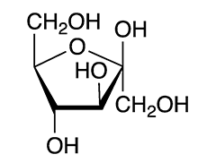
Fructose

Slide 14
hydrolysis reaction

Slide 15
The end.

