Slide 1
Digestion of proteins and amino acids
By: Alex, Ana, Evelyn, Kay, and Lorraine
Notes:
Ana

Slide 2
Proteins and amino acids
overview
Chemical structures
Function/digestion
absorption
terms (throughout)
Notes:
Ana

Slide 3
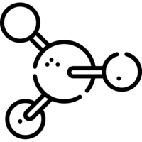
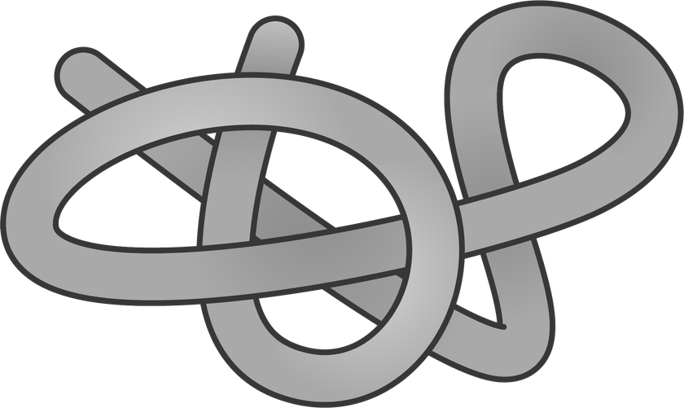
amino acids vs. proteins
Amino acid
protein
Simple organic molecule that is made up of:
Central carbon atom
Amino group
Carboxyl group
Hydrogen atom
R-group
Building blocks of proteins
There are 20 amino acids
Large, nitrogenous, organic compound composed of chain(s) of amino acids
Amino acids are linked together by peptide bonds
Serve as structural, functional, and regulatory molecule in the body
Notes:
lorraine
AMINO ACIDS
-amino group: NH2
-carboxyl group: COOH
-the R-group determines the type of AA
PROTEINS
-Peptide bond: bond between carboxyl group and amine group
-The AAs determine the function of the protein

Slide 4
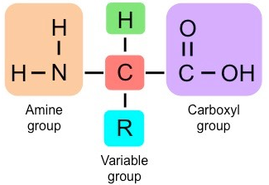
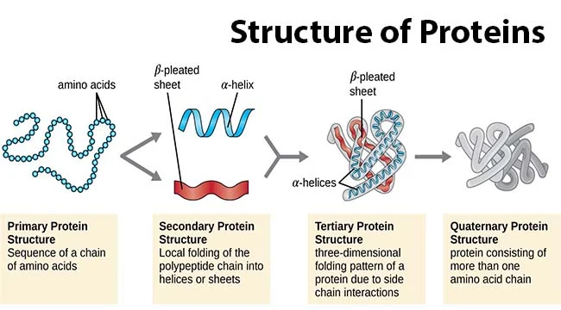
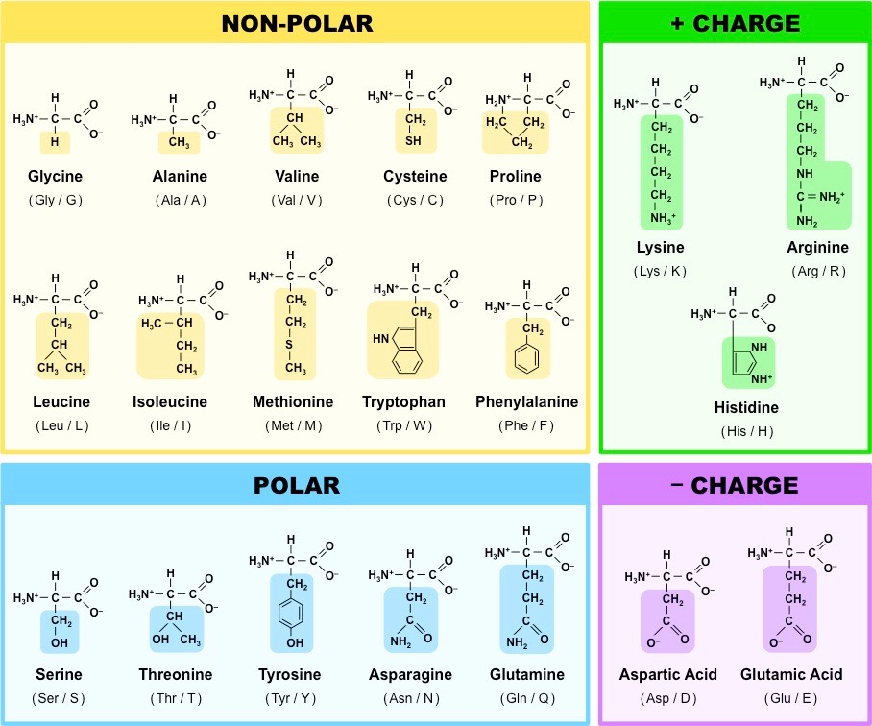
Chemical structures
Amino
acid
protein
Notes:
lorraine
As i said, amino acids are made up of
Central carbon atom
Amino group
Carboxyl group
Hydrogen atom
R-group
Proteins, however, have 4 different structures:
Primary: sequence of amino acids → polypeptide chain
Secondary: the polypeptide chain begins to fold into alpha helices or beta-pleated sheets due to Hydrogen bonding
denatured
Tertiary: 3D structure with big curves and twists due to interactions with AA side chains
denatured
Quaternary: two or more amino acids are bonded
denatured

Slide 5
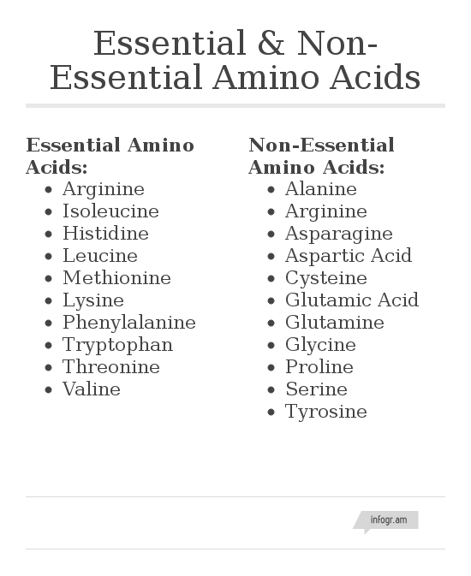
Essential and non-essential amino acids
Essential amino acids:
Not produced by the body, thus must be acquired through diet
Non-essential amino acids:
Produced by the body
Notes:
lorraine
A amino acid being classified as essential or non-essential depends on if it’s synthesized in the body. In this case, there are 9 essential amino acids thatt are not synthesized in the body, meaning in order to get them, you have to obtain them through your diet. On the other hand, there are 11 non-essential amino acids that are produced by the body
Both essential and non-essential amino acids have many of the same functions in the human body. These include the production of proteins, enzymes, and hormones, as well as the regulation of gene expression and digestion.

Slide 6
Function and digestion
In the mouth, esophagus, stomach, and small intestine
Notes:
Ana

Slide 7
Function and digestion:
mouth & esophagus
Mechanical digestion: process of mastication that breaks down substances into smaller particles to more efficiently undergo chemical digestion, saliva aids in swallowing and allowing the passage through the esophagus
No digestive enzymes released in the mouth to break down protein
Proteins do not undergo chemical digestion in the mouth or esophagus
Salivary amylase only aids chemical digestion of carbohydrates into sugars
Protein chemical digestion doesn’t begin until it reaches the stomach and small intestine
Notes:
ana

Slide 8
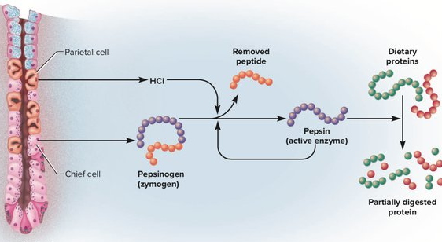
Function and digestion: stomach
Chemical
Vagus nerve and hormone gastrin stimulate secretion of hydrochloric acid (HCl) by parietal cells and pepsinogen by chief cells
HCl acidity (2.0) denatures protein
HCl+ pepsinogen ⇒ pepsin
Pepsin= an enzyme that breaks down the peptide bonds in polypeptide chains making smaller peptides
Mechanical
-Peristalsis churns the partially digested protein converting it into chyme, and moves it into the small intestine
Notes:
Evelyn

Slide 9
Function and digestion: small intestine
Digestion
Enzymatic break down of protein
Absorption
How protein enters the blood stream
Notes:
Kay

Slide 10
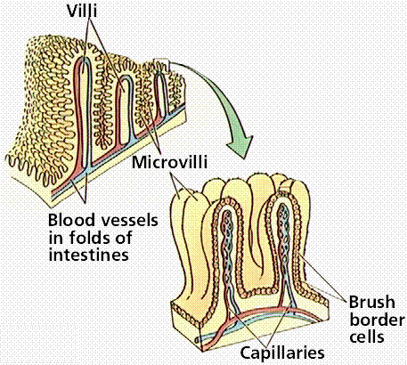
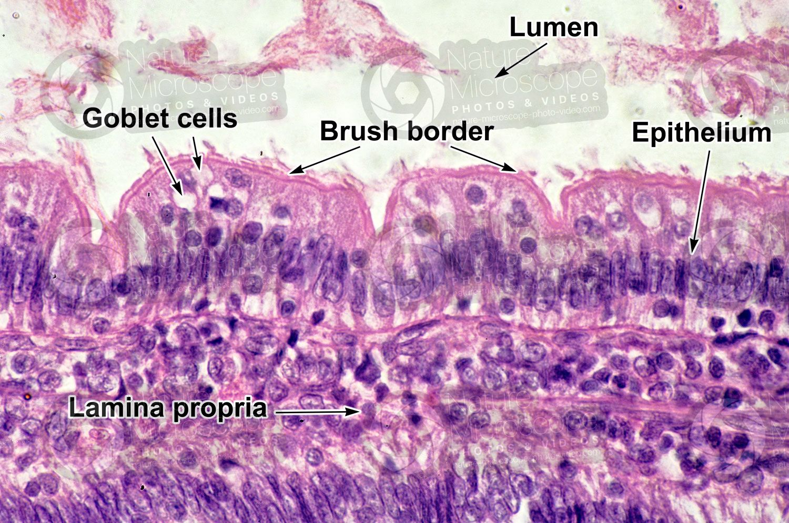
Brush border
Microvilli: small intestine and proximal tubule of the kidney
Increases surface area
Notes:
Kay

Slide 11
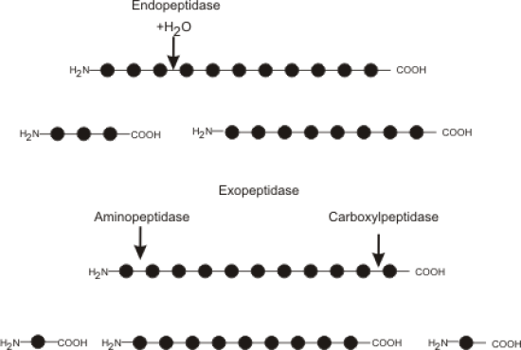
Digestive Enzymes
Zymogens
Inactive enzymes
Trypsinogen
Enterokinase:
Trypsin → Trypsinogen
Enterokinase embedded in the brush border
Activates trypsinogen into trypsin
Trypsin activates other pancreatic enzymes
Endopeptidases
Cleave interior peptide bonds
Trypsin, chymotrypsin, elastase
Exopeptidases
Remove amino acids from end of polypeptide chains
Carboxypeptidase, aminopeptidase
Notes:
Kay

Slide 12
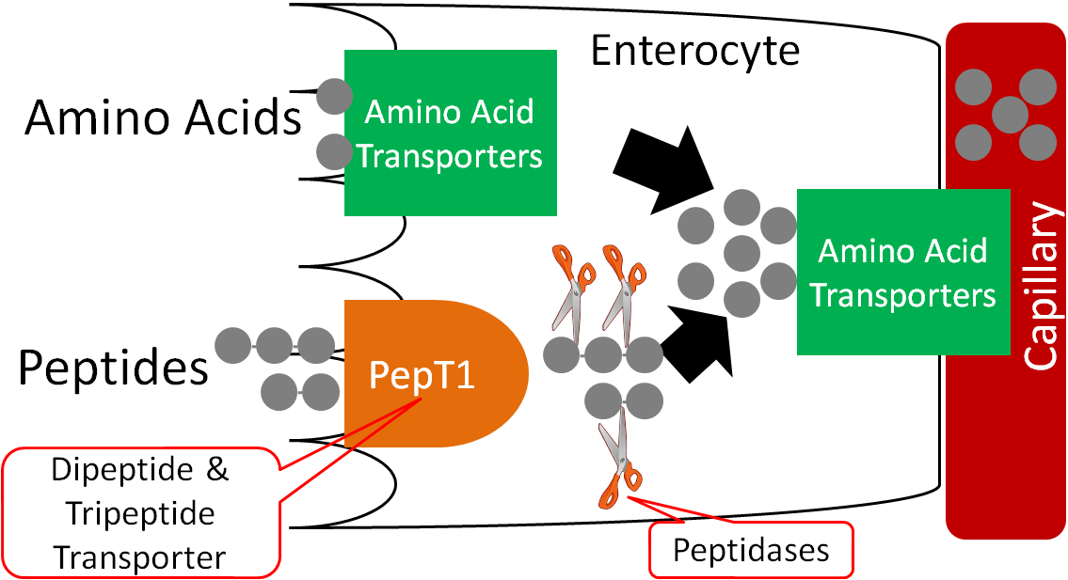
Absorption
Polypeptide chains are digested into free amino acids, dipeptides, tripeptides
Free Amino Acids
Co-transport across brush border with Na⁺
Dipeptides and tripeptides
Enter epithelial cells by single membrane carrier
Hydrolyzed into free amino acids within cell cytoplasm
Facilitated diffusion: basolateral membrane → interstitial fluid → hepatic portal vein → liver
Notes:
Kay

Slide 13
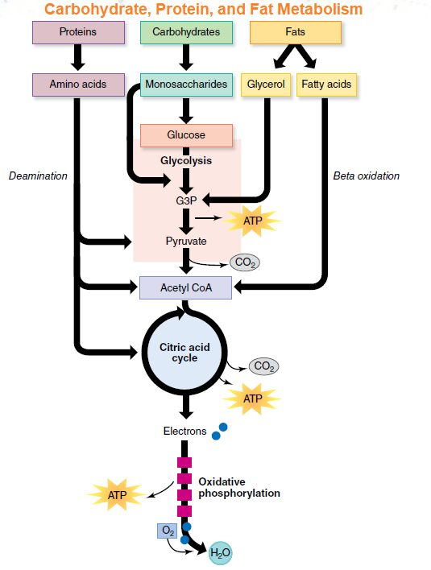
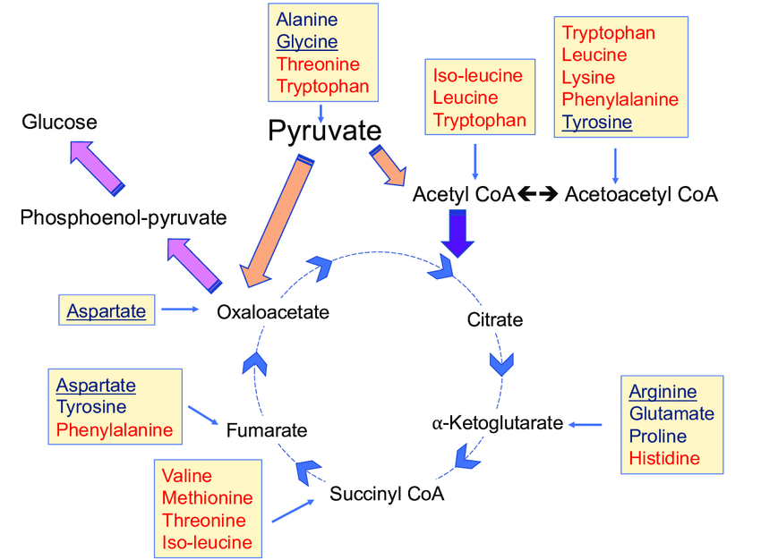
AMINO ACIDS FOR ATP PRODUCTION
Amino acids enter the Krebs cycle to produce ATP. Depending on the type of amino acid, they can enter through different parts of the TCA cycle, such as through pyruvate and acetyl CoA, among others. As the amino acids go through the Krebs cycle, ATP is produced.
Notes:
Evelyn
Amino acids can enter the Krebs cycle at the beginning, as Acetyl CoA and Pyruvate, or depending on the R group, as other components.

Slide 14
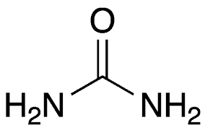
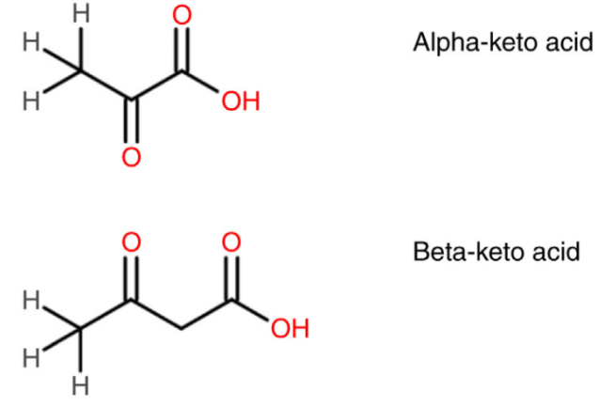
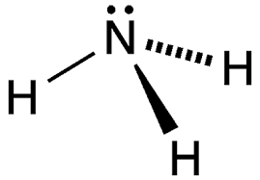
AMMONIA, UREA, KETO ACIDS
AMMONIA (NH₃)
Chemical made by the intestines as protein is processed in the body. Toxic to the body → neutralized by the liver.
Keto Acids (CH₄N₂O)
Organic compounds that contain a carboxylic acid group (−COOH) and a ketone group ( >C=O).
Urea (CH₄N₂O)
Waste product of amino acid metabolism that is produced by the liver and excreted by the kidneys as urine.
Notes:
Alex
AMMONIA: produced when you cleave off the amine group in an amino acid, but it’s toxic so the liver neutralizes it
UREA: after ammonia is neutralized, it becomes urea, which is not toxic to the body and then excreted as urine
KETO ACID: Both amino and keto acids contain a carboxylic acid group. However keto acids have a double bonded Oxygen molecule where an amine group would be present in an amino acid

Slide 15
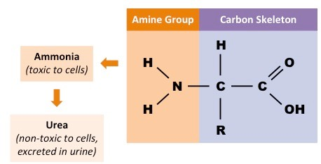
Deamination vs. transamination
Deamination
Transamination
Removal of an amine group, which then is converted into ammonia, then urea, before being expelled as urine
Occurs in liver
Removal of amine group from an amino acid and transferred to a keto acid
Creates a new amino acid and keto acid → synthesizes non-essential amino acids
Notes:
Alex
DEAMINATION
-occurs when there is an excess of protein
-amine group is removed from the AA → it becomes ammonia which is really toxic to the body → liver converts ammonia (NH3) into urea → pee
TRANSAMINATION
-Transfer of the amine group turns the ketone acid into an amino acid, sacrificing itself in the process and becoming a ketone acid. Our body uses this process during the creation of non-essential amino acids

Slide 16
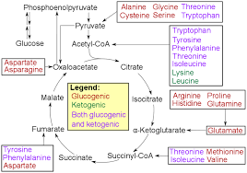
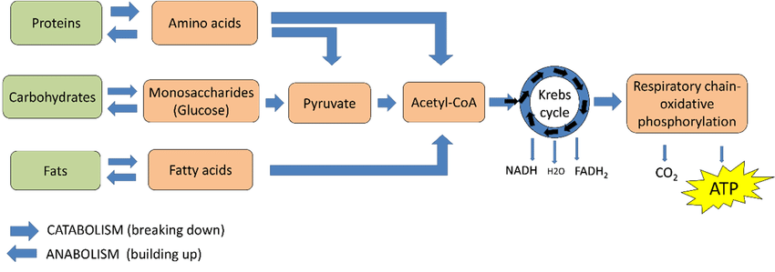
AMINO ACIDS into…
Glucose
Amino acids can be converted into glucose in the Krebs cycle
When deaminated, amino acids can enter the pathways of glucose metabolism as pyruvate, acetyl CoA, or several components of the citric acid cycle
Fats
Proteins, which are composed of amino acids, can be converted to fat (lipogenesis) and used for energy
Notes:
alex
GLUCOSE
-they can be subsequently metabolized to CO2 and H2O releasing ATP
-Certain amino acids are glucogenic and yield glucose after circling through the citric acid cycle. This all depends on where and how the carbon skeletons enter the citric acid cycle in the liver
FAT
-lipogenesis (formation of fat) can occur when the excess proteins that are made up of AA are converted to fat

Slide 17
conclusion
Chemical Structure
Function
Digestion and Absorption

Slide 18
Sources
Fox, S. I. (2016). Human Physiology (Fourteenth). McGraw Hill Education.
‌

Slide 19
Thank you!

