Slide 1
Protein Digestion

Slide 2
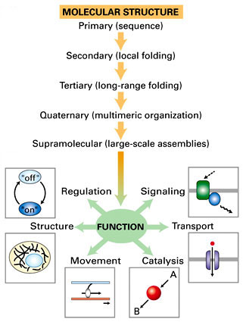
Function of Proteins
Proteins are class of macromolecules with a diverse range of functions:
Aid in digestion of food
Carry substances in the blood or lymph
Construct different structures, like the cytoskeleton
Coordinate activity of different body systems
Protect the body from foreign pathogens
Effect muscle contraction
Notes:
Digestive enzymes act as catalysts in biochemical reaction. Usually complex proteins.
Ex. amylase, lipase
Used for transport
Ex. Hemoglobin, albumin
Structural proteins
Ex. actin, tubulin
Hormones: chemical signaling molecules-small proteins or steroids
Ex. insulin- protein hormone that helps regulate blood glucose level
Defense proteins
Ex. immunoglobulins
Contractile Proteins
Ex. Actin and Myosin

Slide 3
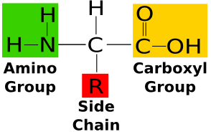
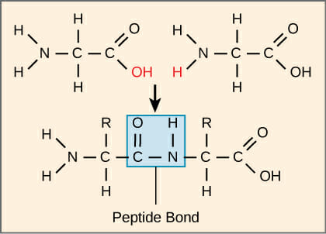
Protein Structure
Linear string of amino acids
20 different types
Amino Acid structure:
Central Carbon
Amino Group
Carboxyl Group
Hydrogen atom
R-group/side chain
Amino acids linked by peptide bonds
Notes:
Keto Acid:
Contain carboxylic group (-COOH) and a ketone group(-CO-)

Slide 4
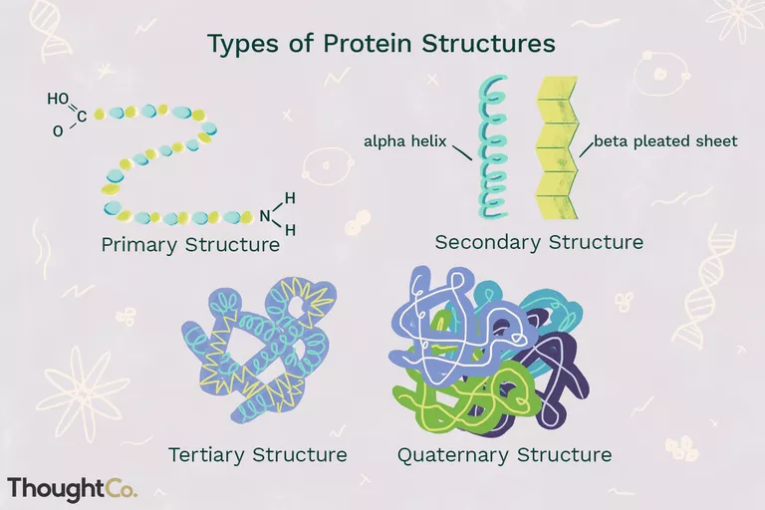
Protein Structure
Each protein has a 3-Dimensional Shape
Primary Structure
Amino Acid Sequence
Secondary Structure
Alpha-helix
Beta-pleated sheet
Tertiary Structure
Folded individual peptide
Quaternary Structure
Aggregation of two or more peptides

Slide 5
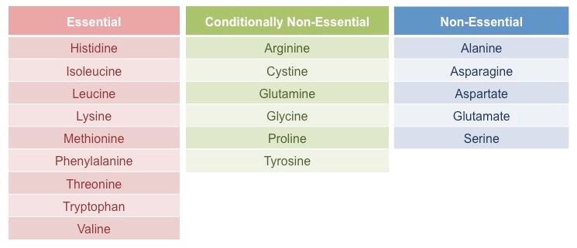
Essential/Non-Essential Protein
Of the 20 different amino acids, 9 are classified as being essential.
“Essential” as they can’t be synthesized by the body and must be obtained through diet.
Non- Essential amino acids, in contrast, can be synthesized by most cells in the human body.
A third category, Conditionally Non- Essential, refers to 6 amino acids that may come across limitations in the rate that they synthesize.
Their limitation may occur during illness and stressful situations.
It is also at the time of illness and stressful situation when the Conditional Non- Essential amino acids become essential for the body.
Notes:
Further synthesis limitations of Conditionally non essential AA
-availability of its AA precursor
-Can be synthesized in only limited amount of tissue

Slide 6
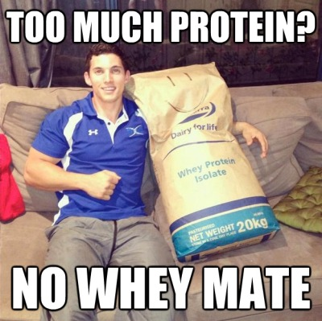
Dietary Sources Of Proteins
Pairing proteins (such as beans with rice) and eating all the essential amino acids at one meal is not necessary.
It is more important to have a well rounded diet throughout the day.
All the essential amino acids can be obtained from the following food groups: Meat: Red meat, beef, turkey, chicken, poultry Fish: Salmon, fish of all type Dairy: cottage cheese, low fat cheese, greek yogurt Eggs: One egg contains all 9 essential amino acids Beans: peas, chickpeas, lentils, soybeans, peanuts, edamame Grains: Quinoa Nuts and Seeds: Almonds, walnuts, macadamia, cashews, pumpkin

Slide 7
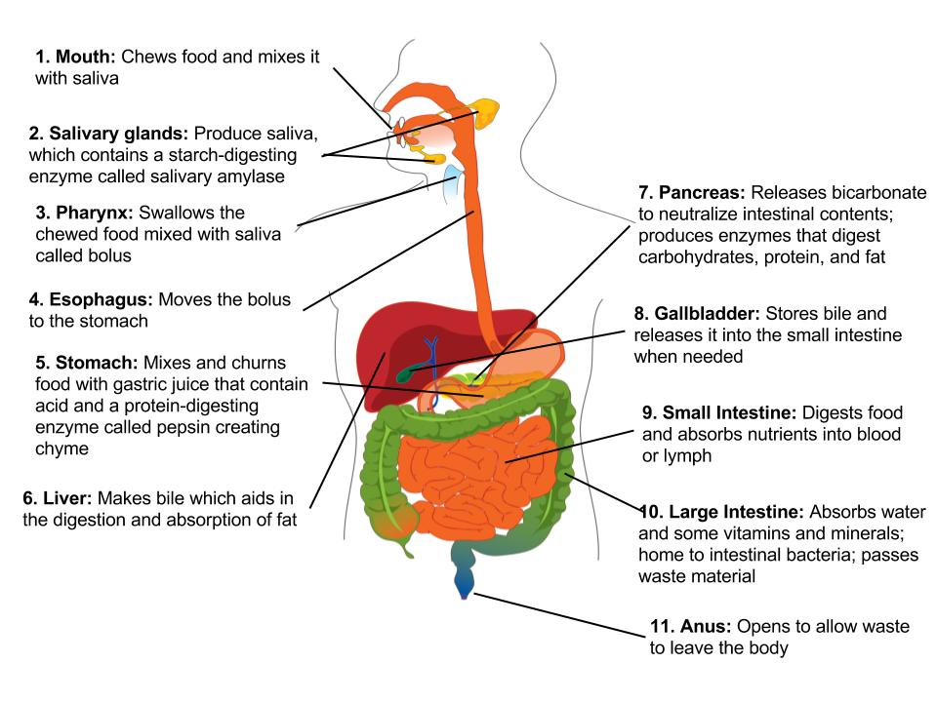
Protein Digestion
2 types of protein digestions are there..
Mechanical digestion which starts in the mouth and continues in the stomach and then small intestine.
Chemical digestion which begins in the stomach and ends in the small intestine and recycles amino acids to generate more protein.

Slide 8
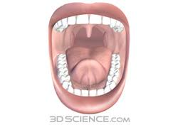
Break Down of Proteins In Mouth and Salivary Glands*
No digestion of proteins in mouth
The mouth is involved in the mechanical break down of food. The teeth begin the mechanical breakdown the large pieces into smaller pieces that can be swallowed.
The salivary glands then provide some saliva (lubricate the food this helps in making food soule) to aid swallowing and the passage of the food through the esophagus. There are two enzymes in your saliva called amylase and lipase. But they mostly break down carbohydrates and fats.
After mastication and chewing the food enters the stomach

Slide 9
Protein Digestion In Stomach: Start of protein Digestion
Digestion of protein start in stomach
When proteins enters the stomach, it stimulates the secretion of the hormone gastrin
This gatrin, stimulates the release of gastric juice which contain…
Hydrochloric acid (HCL)
Pepsinogen (zymogen)
Renin ( In infants)
The pH In gastric juice is 1.5-2.5 (very acidic)

Slide 10
Protein Digestion in In Stomach: Start of protein Digestion
Gastrin: Stimulates Parietal cells that secrete HCL; Chief cells of the gastric glands to secrete pepsinogen
Hydrochloric acid:Denatures protein structure and Activates pepsinogen (zymogen) to pepsin
Pepsin:Hydrolyzes proteins to smaller polypeptides and some free amino acids

Slide 11
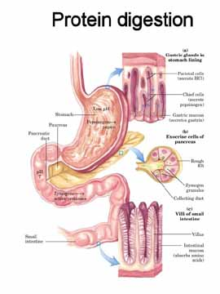
Break down of proteins in Pancreas and Small intestines
Digestion of proteins is initiated by pepsin in the stomach.
Digestion of protein is completed in the small intestine by pancreatic enzymes trypsin, chymotrypsin, and carboxypeptidase. These enzymes also get some help from the brush border enzymes found in the small intestine.
The small intestine is the major site of protein digestion by proteases.The pancreas secretes a number of proteases as zymogens into the duodenum where they must be activated before they can cleave peptide bonds.
Notes:
Pancreas secretes trypsin into small intestines
Trypsin and others senzymes secreted by small intestines digest protein into amino acids

Slide 12
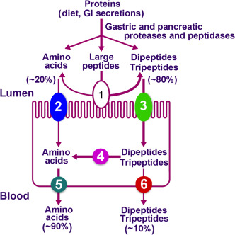
Absorption of Peptides & Amino Acids
Pancreatic protease break down large peptides into medium and small amino acids
Oligopeptides
Peptides and Amino Acids are absorbed in the lumen of the small intestine
Brush border cells of small intestine contain peptidase (integral membrane protein) to hydrolyze peptides and amino acids in the lumen
Break down into free amino acids and very small peptides
Dipeptides and Tripeptides are absorbed through the cotransport of H+ ions via transport molecule called PepT1
Amino Acids absorbed through cotransport of Na+ ions
Cytoplasmic peptidase digest Di/Tripeptides into amino acids and exported to blood
Notes:
gastric and pancreatic proteases hydrolyze dietary proteins within the lumen of the small intestine predominantly into medium and small peptides (oligopeptides).
The brush border of the small intestine is equipped with a family of peptidases.
Peptidases are integral membrane proteins rather than soluble enzymes. They function to further the hydrolysis of lumenal peptides, converting them to free amino acids and very small peptides. These end products of digestion, formed on the surface of the enterocyte, are ready for absorption.
There is virtually no absorption of peptides longer than four amino acids.
abundant absorption of di- and tripeptides in the small intestine. These small peptides are absorbed into the small intestinal epithelial cell by cotransport with H⁺ ions via a transporter called PepT1.
Once inside the enterocyte, the vast bulk of absorbed di- and tripeptides are digested into amino acids by cytoplasmic peptidases and exported from the cell into blood. Only a very small number of these small peptides enter blood intact.
The lumenal plasma membrane of the absorptive cell bears at least four sodium-dependent amino acid transporters - one each for acidic, basic, neutral and amino acids.
These transporters bind amino acids only after binding sodium. The fully loaded transporter then undergoes a conformational change that dumps sodium and the amino acid into the cytoplasm, followed by its reorientation back to the original form.
Thus, absorption of amino acids is also absolutely dependent on the electrochemical gradient of sodium across the epithelium. Further, absorption of amino acids, like that of monosaccharides, contributes to generating the osmotic gradient that drives water absorption
absorption of intact proteins occurs only in a few circumstances. In the first place, very few proteins get through the gauntlet of soluble and membrane-bound proteases intact. Second, "normal" enterocytes do not have transporters to carry proteins across the plasma membrane and they certainly cannot permeate tight junctions.

Slide 13
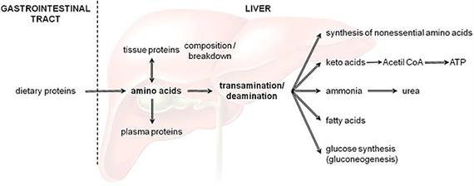
Protein Metabolism
Protein produce ~4 calories per gram/~10-15% of total energy production
Protein is broken down into its amino acid components via:
Catabolization - in small intestine
Deamination - in liver
Liver uses amino acids to synthesize proteins
Excess converted to glucose (glycogen) and fatty acids (triacylglycerol) for storage
Send amino acids to the muscle so muscle can synthesize protein
Notes:
Protein contains 4 calories of energy and accounts for approximately 10-15 percent of total energy production
Protein is broken down into its constituent amino acids in the small intestine via catabolization and hydrolysis of peptides into free amino acids, and deamination in the liver
The liver uses these free amino acids to synthesize proteins
The excess is converted to glucose or glucagon which is how glucose is stored in the liver and triacylglycerides or fatty acids in adipose tissue
The liver can also send amino acids to the muscle where it can be used to synthsize new proteins

Slide 14
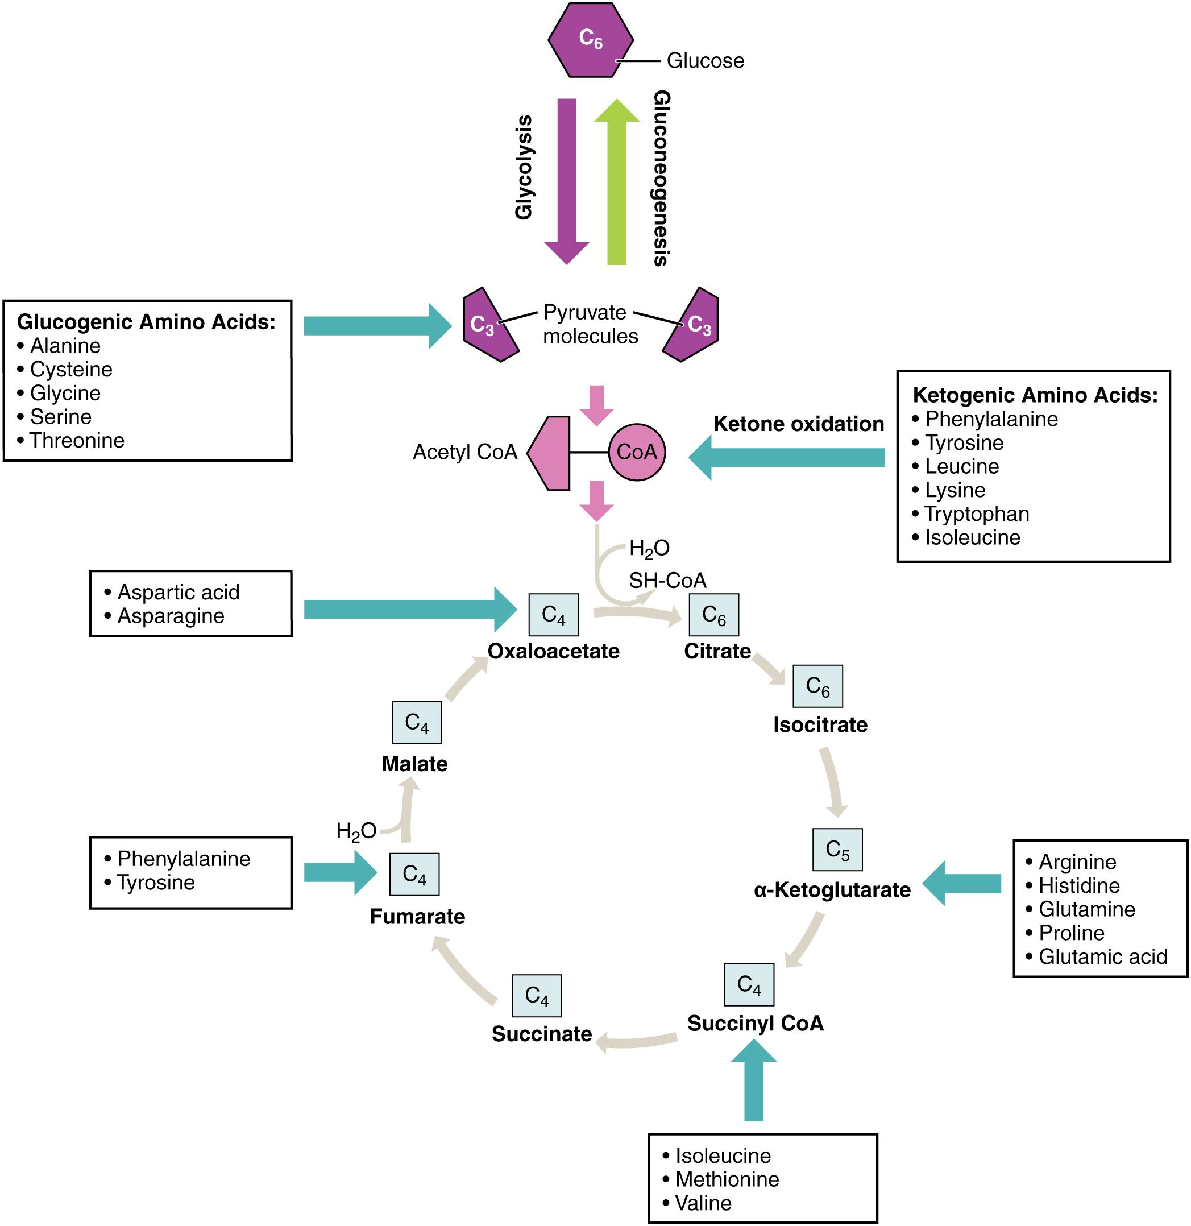
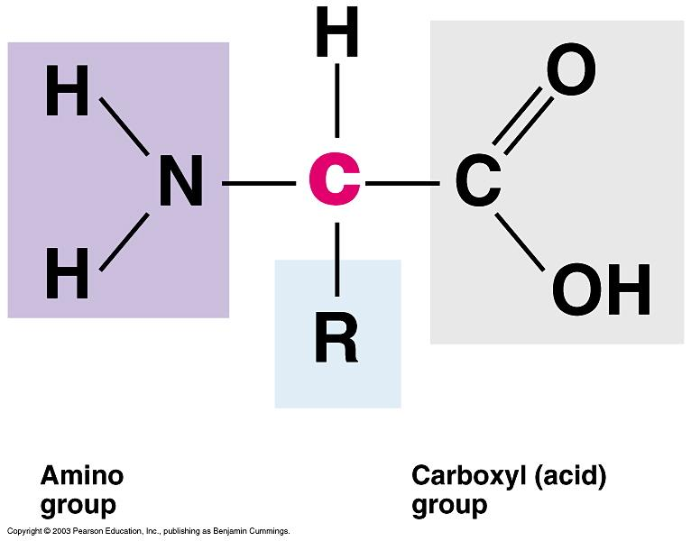
Ketogenic vs. Glucogenic Amino Acids
Ketogenic Amino Acids
Converted to Acetyl-coA or Acetoacetyl coA
Lysine and Leucine are exclusively ketogenic
Glucogenic Amino Acids
Converted to Pyruvate or Oxaloacetate or intermediates of the Krebs Cycle
In times of fasting:
When there is not enough glucose being ingested from food consumption, protein is metabolized for energy
Glucogenic amino acids can contribute to precursors of gluconeogenesis and can help support the synthesis of glucose in times of fasting
Ketogenic amino acids make more acetyl-coA
Notes:
This conversion happens by cleaving off the carbon backbone of the amino acid and sending it to the Krebs Cycle
For glucose, it would then be converted into Pyruvate or Oxaloacetate or other intermediates of the krebs cycle like acetyl-co-a
In the fasted state, fatty acids are being released from adipose tissue and sent to the liver where they are being oxidized and used for ATP production
Amino acids are also released during this fasted state from our tissues (mostly muscle) and sent to the liver where they can enter a diverse array of metabolic pathways.
Glucogenic amino acids can help during this fasting time by contributing to the precursors of gluconeogenesis and can hep support the synthsis of glucose as a source of fuel for the body

Slide 15
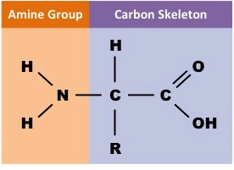
Deamination
Occurs in the liver.
The removal of an amine group from an amino acid.
Deaminases
The removed amine group becomes ammonia.
The remaining parts can be metabolized.
Excess protein intake.
Notes:
Deaminases- enzymes that catlyze the removal of the amine group.
Excess protein intake causes body to deanimate amino acids for energy.
Amine group can enter urea cycle, or be used in transanimation.

Slide 16
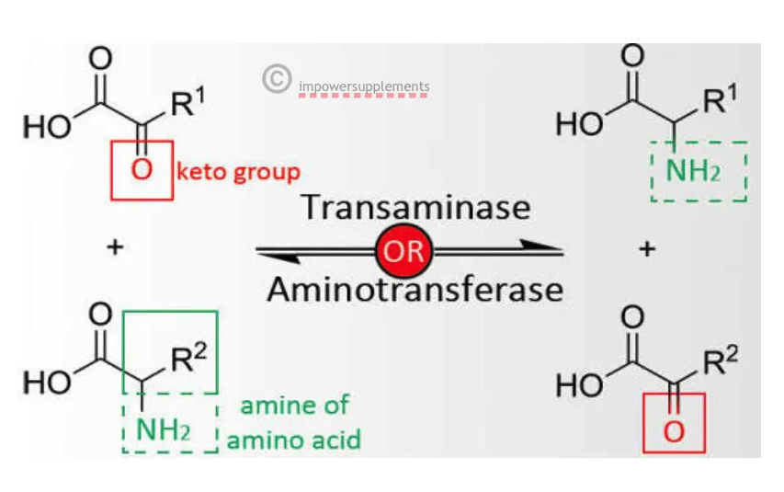
Transamination
Transfer of amine group from an amino acid to a keto acid.
Transaminases
Converts essential amino acids to non-essential amino acids
Notes:
Transamination is the deamination of an amino acid and the amination of a keto acid
Keto Acids formed can be used in krebs cycle (alpha-keto glutarate)

Slide 17
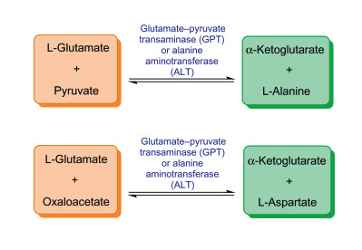
Transamination
Notes:
L-glutamate is amino acid

Slide 18
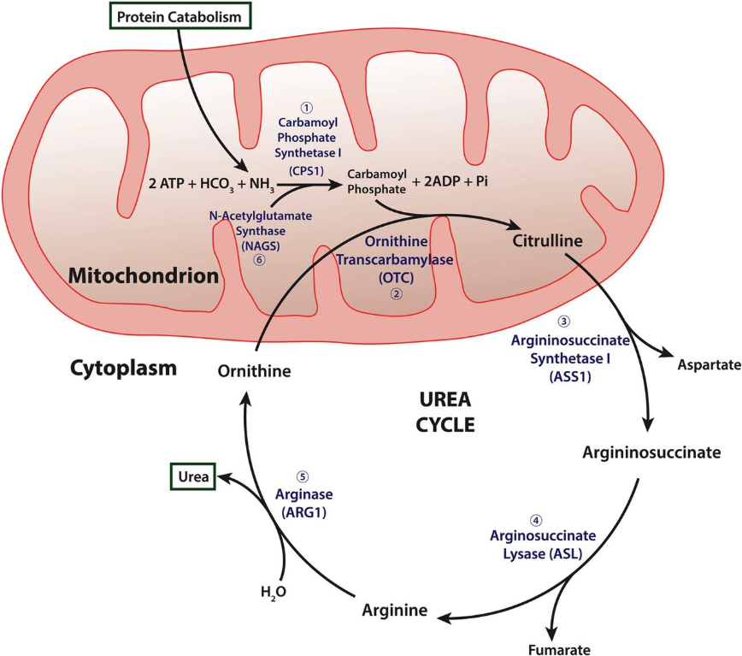
Urea Cycle
Ammonia (NH₃) —> Urea (NH₂)₂
Liver and Kidneys
Removal of toxic deamination byproduct
Once converted to urea, travels in bloodstream to kidneys to be excreted in urine.

Slide 19
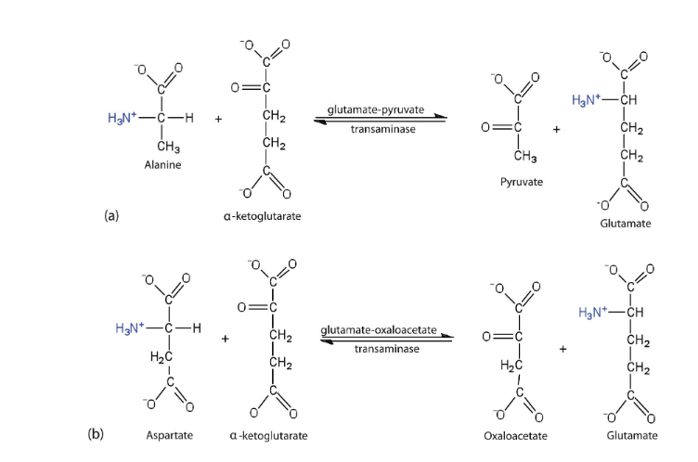
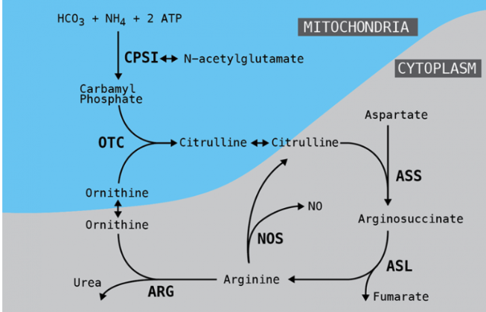
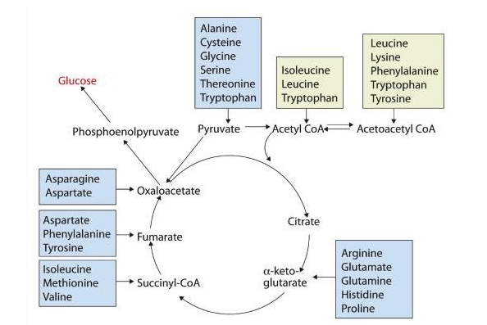
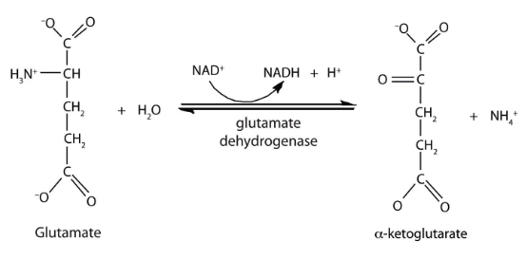

Slide 20
Thank you!

