Slide 1
Digestion of Sugars
By: Hailey, Kevin, Marvin, and Rachel

Slide 2
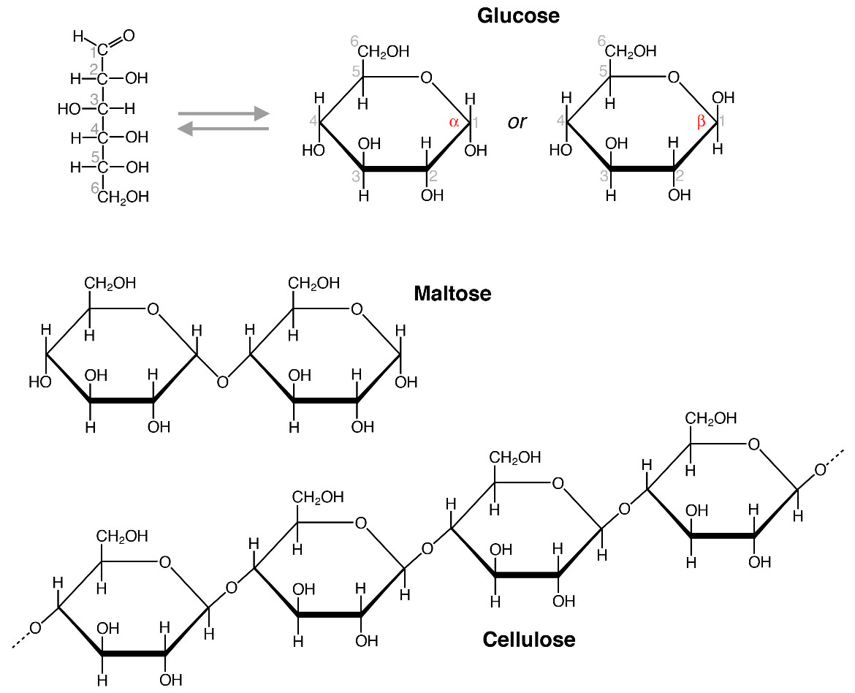
Chemical structures
Carbohydrates contain carbon, hydrogen, and oxygen.
The general formula for a carbohydrate is CnH2nOn
Monosaccharides are simple sugars, some examples are glucose, galactose, and fructose.
Disaccharides are formed when two monosaccharides are covalently bonded.
Polysaccharides are multiple monosaccharides that are joined together. One example is cellulose, which is a common polysaccharide composed of glucose. It has β-1,4 glycosidic linkages.

Slide 3
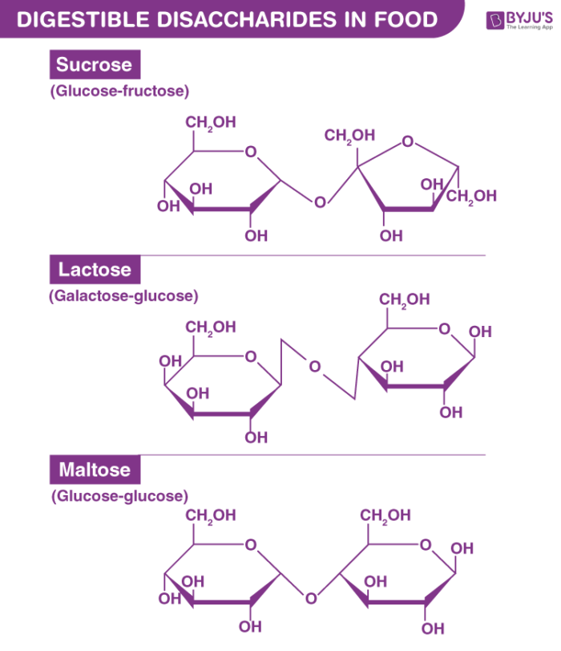
Disaccharides and their enzymes
There are three famous disaccharides.
The first is sucrose, its corresponding enzyme is sucrase which hydrolyzes it into glucose and fructose.
The second one is lactose. The corresponding enzyme is lactase which catalyzes the hydrolysis of lactose into glucose and galactose.
The third one is maltose. It’s corresponding enzyme is maltase which catalyzes the hydrolysis of maltose into two molecules of glucose.

Slide 4
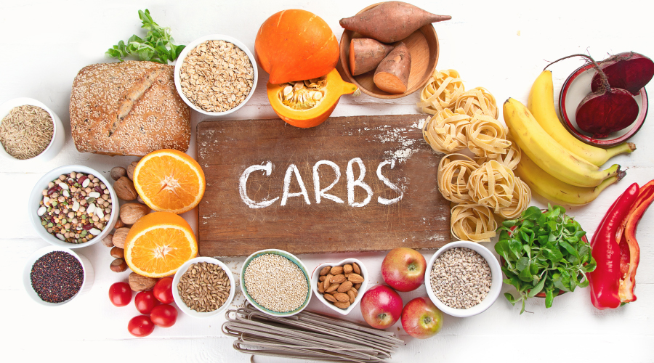
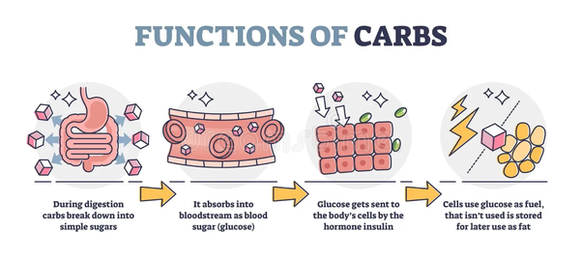
Functions of carbohydrates
Energy production: dietary glucose is used to make atp through cellular respiration. Carbohydrates are broken down into ATP through glycolysis, Krebs cycle, and electron transport chain.
Energy storage: They are stored as glycogen in the liver and muscles, so that when energy is needed, they are able to be broken down easily into glucose. Glucose is converted to glycogen through glycogenesis.

Slide 5
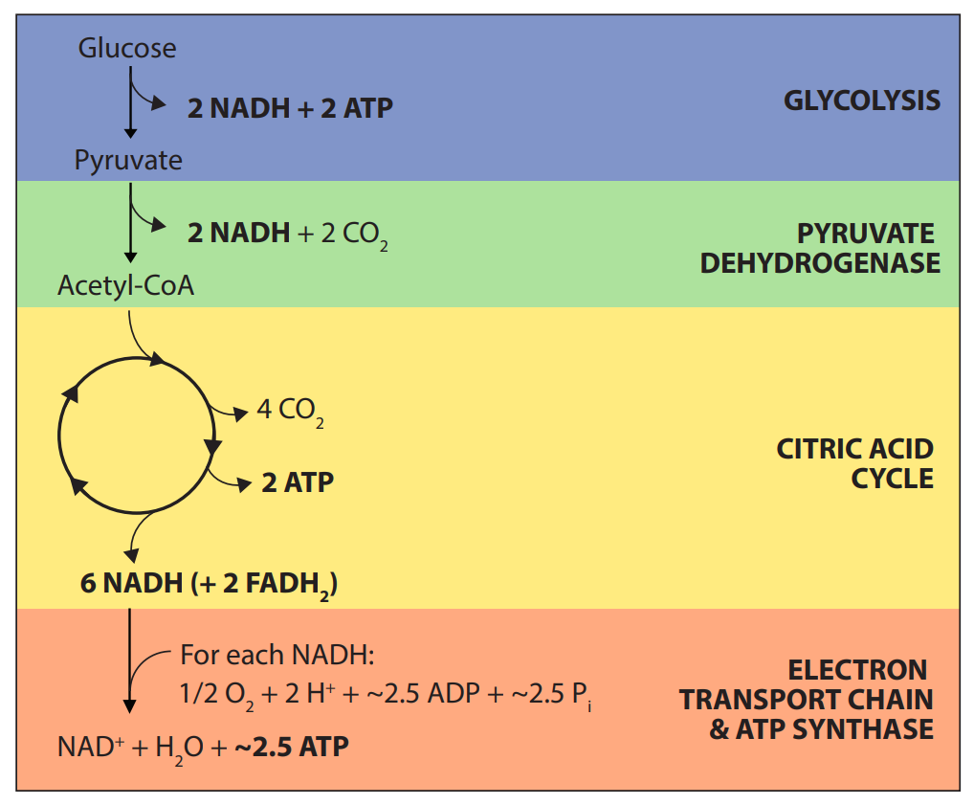
Cellular Respiration:
Glycolysis: first stage of cellular respiration that takes place in the cytoplasm. It involves one molecule of glucose and ends with two molecules of pyruvate.
Krebs cycle: the second phase of cellular respiration takes place in the mitochondria. Acetyl-Coa, which can be derived from carbohydrates, produces energy in the form of ATP.
Electron Transport Chain: third step, happens in the mitochondria. NADH and FADH2 carry electrons that will go through a chain of reactions. The electrons release energy which is used to pump H+ ions, creating an electrochemical gradient.

Slide 6
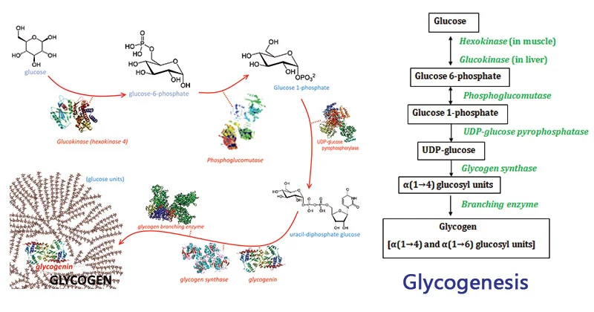

Slide 7
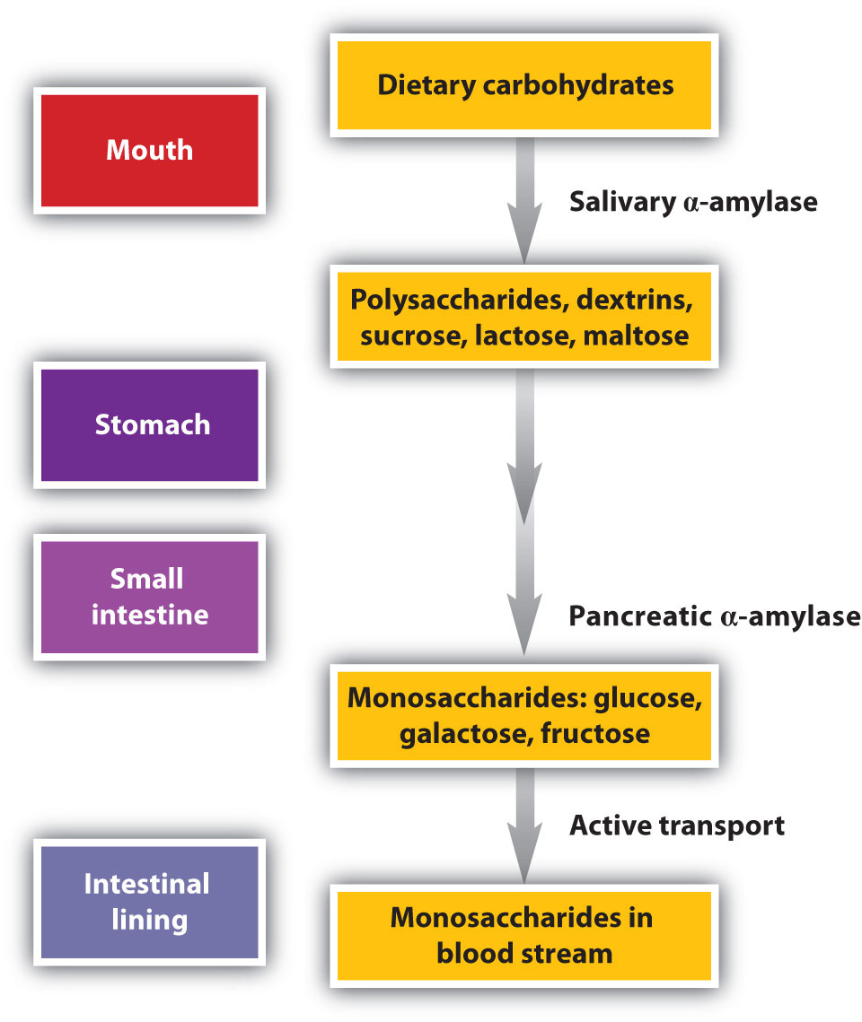
Digestion (mouth)
Chemical vs Mechanical
Chemical digestion involves specific enzymes that help break down the complex carbohydrates into simple sugars
Mechanical digestion is physically chewing up the food with your mouth, tongue, and teeth.
It all starts in the mouth with salivary amylase which breaks down starch into glycogen and maltose.
Role of salivary amylase is to digest and eliminate any sugars that are left in between meals to prevent gum disease and gingivitis.
Overall, mechanical digestion is the part where you chew your carbs into smaller pieces, and chemical digestion is when your salivary glands release amylase to break starch into simpler sugars.

Slide 8
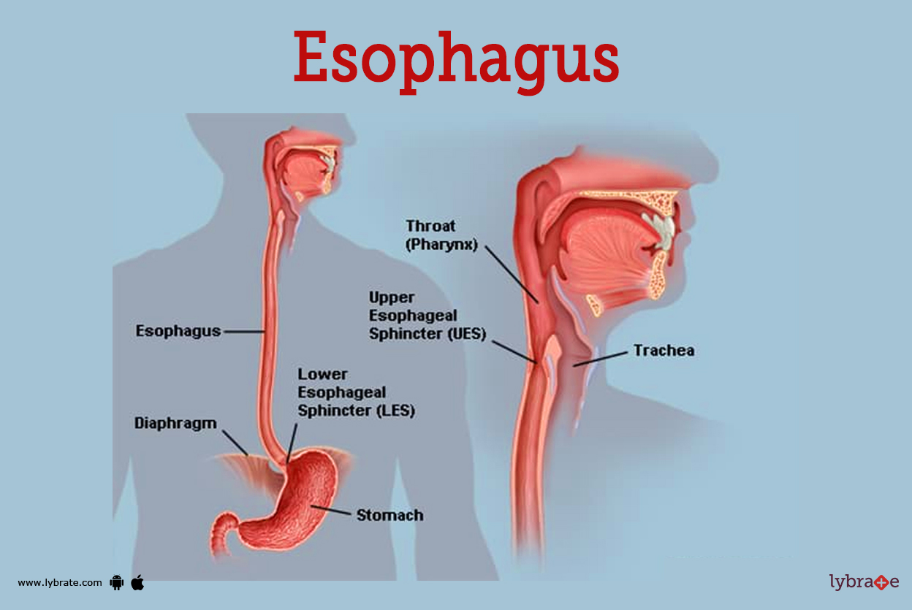
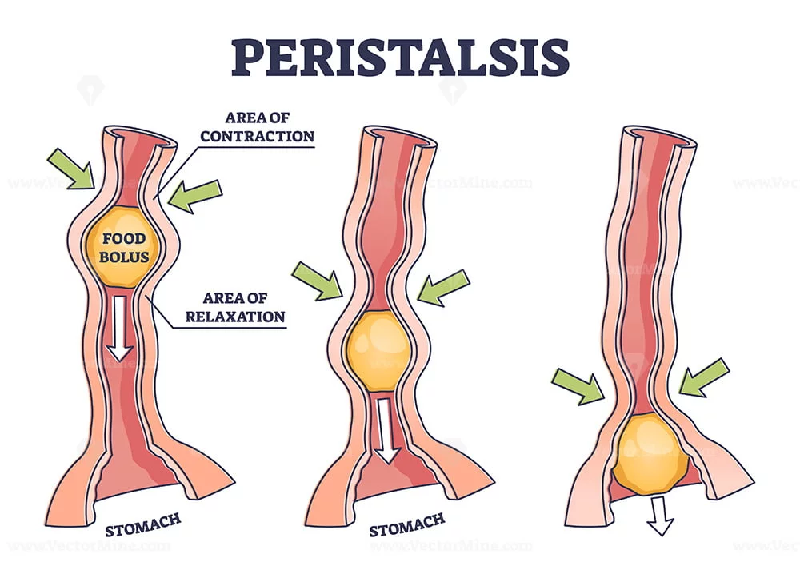
Digestion (esophagus to stomach)
The esophagus and stomach does not play a major role in digesting carbohydrates. The esophagus main function is to move the bolus down in wavelike contractions called peristalsis.
The lower esophageal sphincter allows the bolus to enter the stomach, and also prevents the nonkeratinized stratified squamous epithelial cells of the esophagus from being destroyed by the acidity of the stomach.
The stomach’s main functions in digestion are to turn the bolus into chyme by way of the gastric juices.
The pH of the stomach is 2.0, which is really acidic! This allows the food to be further broken down. The hcl does not chemically digest the food, the enzymes do all the digestion. HCl destroys the function of salivary amylase in the stomach.

Slide 9
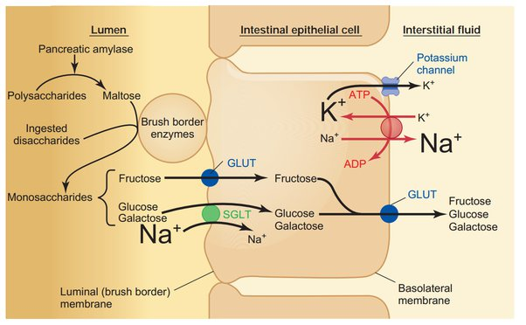
Digestion (small intestine)
Once in the small intestine, pancreatic amylase breaks down the polysaccharides into disaccharides. The most common disaccharides are maltose, sucrose, and lactose. These disaccharides are then broken down into monosaccharides by the digestive enzymes found at the brush border of the enterocytes (intestinal absorptive cells).
Sucrase, breaks down sucrose into the monosaccharides fructose and glucose.
Maltase, breaks down maltose into two glucose monosaccharides.
Lactase, breaks down lactose into the monosaccharides glucose and galactose.
The enterocytes can only absorb these sugars in their simplest form. Therefore, they absorb glucose, galactose, and fructose.
Absorption of carbohydrates (sugars) can happen in two different ways, through active transport (energy dependent) and through facilitated diffusion (energy independent).
Fructose is absorbed through facilitated diffusion, it does not need ATP energy because fructose moves down its concentration gradient into the enterocytes with the help of the carrier protein GLUT-5. While inside a majority of the fructose is converted into glucose.

Slide 10
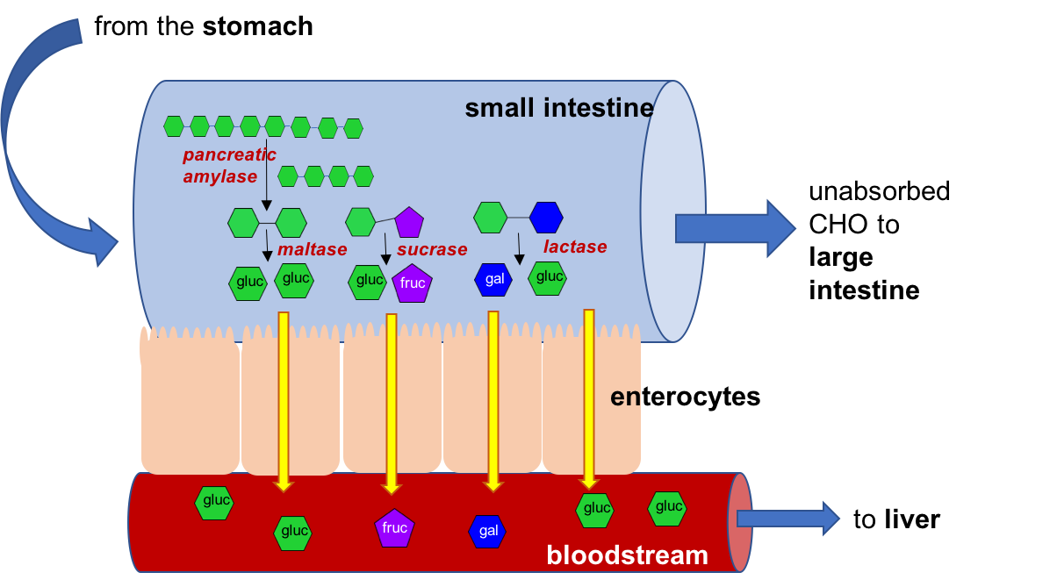
Digestion (small intestine)
Glucose and galactose is absorbed through active transport, which uses ATP energy. The Na+/K+ ATPase found on the basolateral side use the ATP to pump three sodium out and two potassium into the cell. This creates an electrochemical gradient that with a lower concentration of sodium inside the cell.
SGLT1, a cotransporter protein found on the apical side of the moves sodium down against its electrochemical gradient into the cell, pulling glucose and galactose with it.
Fructose, glucose, and galactose, leave the cell via passive transport on the basolateral side and enter the blood and travel to the liver.

Slide 11
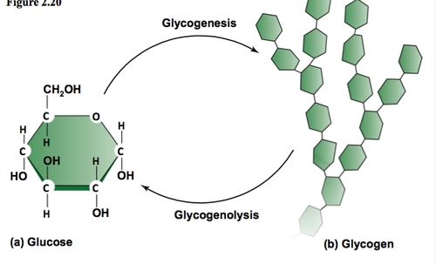
Glucose into glycogen
“Glycogenesis”
Glucose is absorbed from the intestine and that causes our blood sugar to go up, in response to the high blood sugar level, the pancreas releases insulin.
Insulin acts on glucose transporters on the cell membrane, which are GLUTs. GLUTs make insulin to bring more glucose into all cells in our body.
Inside the cell, an enzyme called hexokinase adds a phosphate group to six carbon creating glucose-6 phosphate. Which ends up being broken down during glycolysis making ATP as a byproduct. Overtime, ATP levels starts to rise and that inhibits certain enzymes in glycolysis. When that happens, the extra glucose 6 phosphate can be used to make glycogen. that usually takes place in the liver and muscle cells.

Slide 12
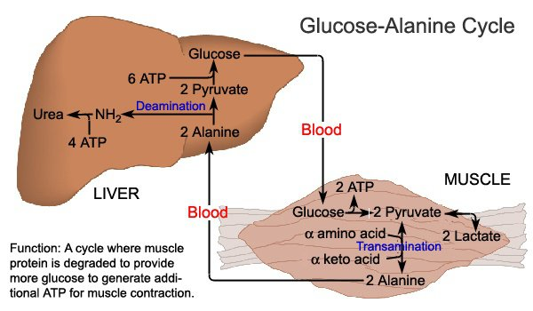
Glucose into amino acids “Glucose-Alanine Cycle”
Unfortunately, our body doesn’t have mechanism to store excess amino acids in its form, so it breaks down into glucose or fat.
Glucose is converted into pyruvate after glycolysis, and that pyruvate molecule is turned into alanine. and that alanine is transported into liver, and gets converted into glucose again. The converted glucose goes to muscle to provide energy for muscle contraction!

Slide 13
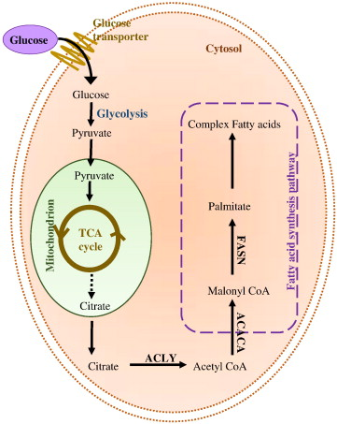
Glucose into fat
“Lipogenesis”
there's high concentration of glucose in the blood, insulin triggers excess glucose to be turned into fat for energy storage.
once glucose is transported to liver from blood, glucose is converted into glucose-6-phosphate which in the process insulin is used to produce glycogen thru the glycogenesis. but when the glycogen storage capacity
has been maxed out liver converts it into fatty acids via lipogenesis.
any excess glucose is converted into acetyl-CoA, which acts as the input for lipogenesis and the formation of fatty acids, under the influence of insulin. fatty acids are combined with glycerol to form tri-acyl glycerols commonly abbreviated to tags. the liver usually stores only a small amount of fatty acids as tags, with the rest being transported to adipose tissue by special carrier proteins termed VLDL (very low density lipoprotein)

Slide 14
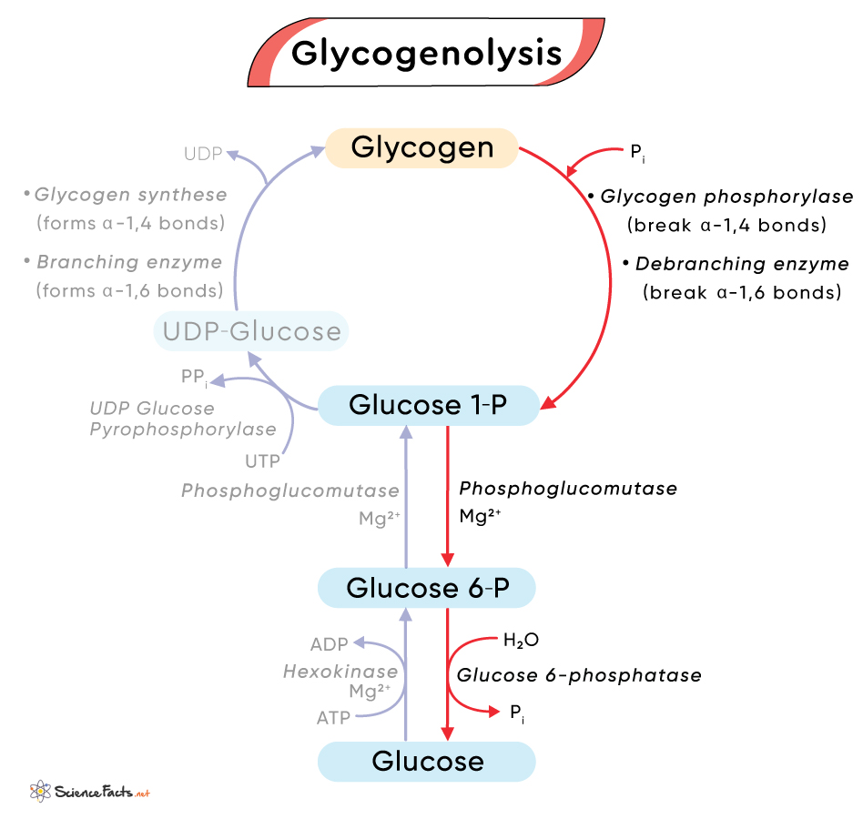
Glycogenolysis
When the body does not have enough fat to convert into glucose it resorts to Glycogenolysis.
Glycogen is taken from the muscles and liver for glycogenolysis.
This is a process in which glycogen is broken down into glucose which will be used as an energy source.
This process is regulated by two enzymes Glycogen phosphorylase and phosphorylase kinase

Slide 15
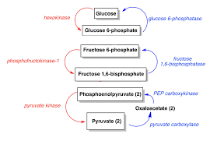
Gluconeogenesis
If the body continues to be in a state where glucose is not available it will resort to gluconeogenesis.
In this process a glucose is produce from noncarbohydrates such as glycerol, lactate, propionate and certain amino acids.

Slide 16
Energy
A calorie is a unit of energy.
It is the equivalent of 4.184 Joules
A Kcal or kilocalorie is the equivalent of 1000 calories.
Kilocalories are what we refer to as food calories.

Slide 17
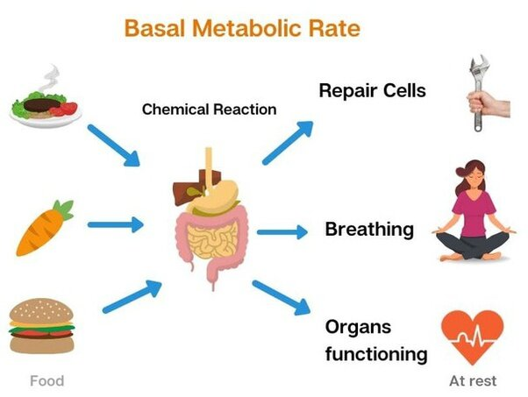
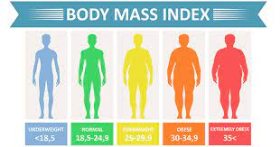
Metabolic rate and BMI
The basal metabolic system is equal to the minimum amount of calorie the body is burning in order to sustain life.
The basal metabolic rate accounts up to 70% calories burn in a day.
BMI stands for body mass Index.
BMI is a person's weight in kilograms (or pounds) divided by the square of height in meters (or feet).

Slide 18
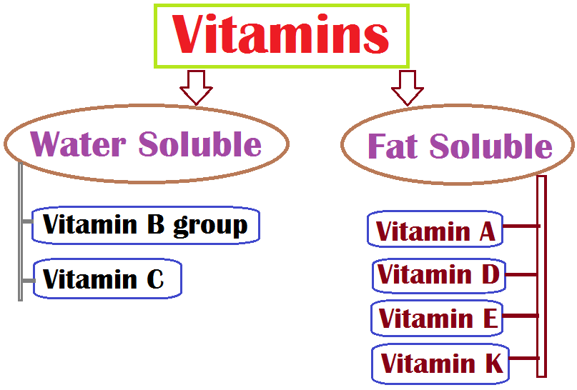
Water Soluble vs fat soluble vitamins
Vitamins are an important part of the diet as they help in multiple process throughout the body.
There two types of Vitamins, water soluble and fat soluble.
Water soluble vitamins enter the bloodstream and are eventually discarded and must be frequently replenished.
Fat soluble vitamins are stored in the body with fats and can last in the body for up tp 6 months.

