Slide 1
SUGARS
By: Naomi Dooley & Sharon Jimenez

Slide 2
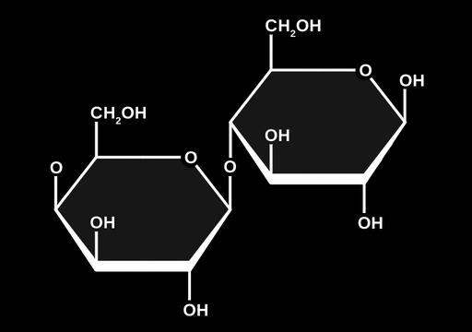
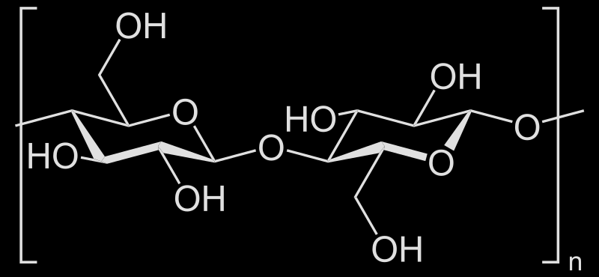
Chemical Structure
Sugar is a group of Carbohydrates
Bread, sweets, fruits, starches (from plants) in our body
Organic molecules that contain carbon, hydrogen, & oxygen in a 1:2:1 ratio
General Formula: CₙH₂ₙOₙ-
⇨ Monosaccharides are simple sugars - ex: glucose, fructose, galactose
⇨ Disaccharide are two monosaccharides joined by a covalent bond - ex: sucrose, maltose, lactose
⇨ Polysaccharide are several monosaccharides joined together - ex: cellulose

Slide 3
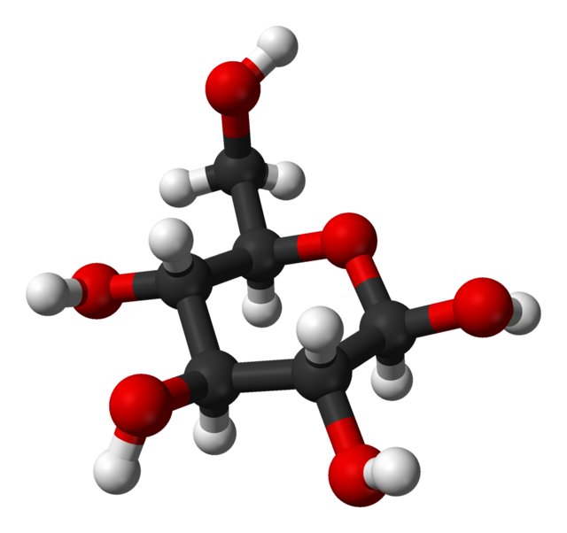
What makes Glucose important?
Source of energy
Essential for brain function (ATP) - thinking, memory, teaching
Converted into glycogen for storage of energy
Treats low blood sugar; helps maintain blood sugar level

Slide 4
Formation & Dissociation of Carbohydrates
In the formation of disaccharides and polysaccharides, monosaccharides are covalently bonded together by a reaction called Dehydration Synthesis
A hydrogen atom is removed from one molecule and a hydroxyl group is removed from another, pulling out water (dehydrates) from the two molecules.
When disaccharides or polysaccharides are consumed, the covalent bonds that join monosaccharides to form disaccharides and polysaccharides must be broken. This occurs by Hydrolysis
Breaks bonds between monosaccharides by adding water to split the molecule

Slide 5
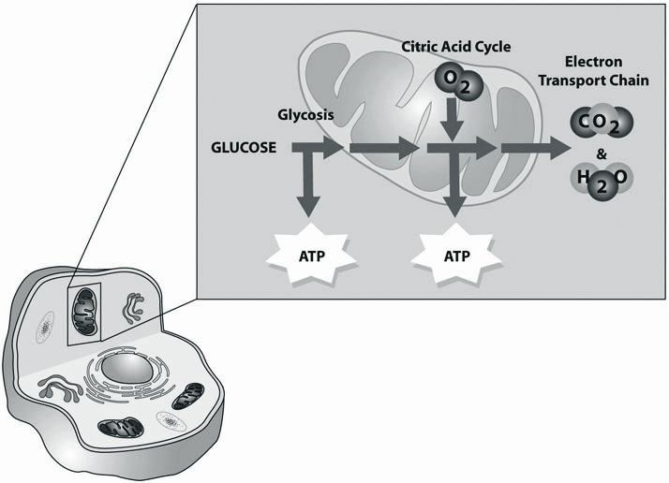
Functions of Carbohydrates
Production of Energy
Most carbohydrates in food consumed are broken down into glucose entering the bloodstream. Glucose then travels cells which then produces adenosine triphosphate (ATP) through a series of complex processes called cellular respiration.
Provide Stored Energy
Stored form of glucose - glycogen; found in muscle/liver
Stored glucose can be released into blood to provide energy throughout the body/maintain blood sugar levels
Helps Preserve Muscle
When glucose from carbohydrates is low, muscle is broken down into AA and transformed into glucose to produce energy

Slide 6
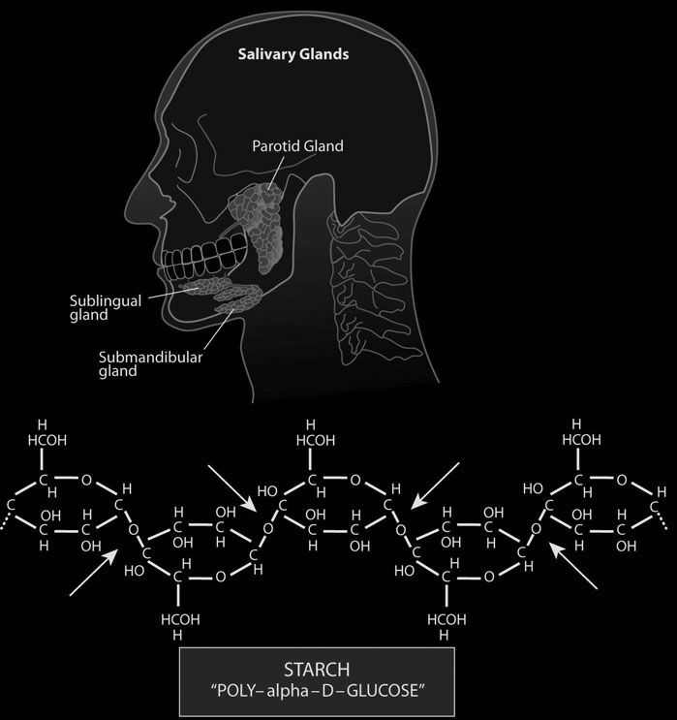
Digestion of Carbohydrates in Mouth
Mastication breaks down carbohydrate food into smaller pieces
Salivary glands produce saliva which contains the enzyme ‘amylase’ that coats the food
Enzyme breaks down amylose and amylopectin into smaller pieces of glucose called dextrins and maltose
Increased concentration of maltose in oral cavity results in chemical/mechanical breakdown of starches which causes a more sweetful taste
Only 5% of starches are broken down

Slide 7
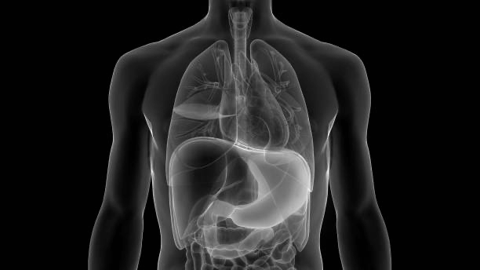
Digestion in Esophagus & Stomach
Swallowed food is pushed from the oral cavity to the anal end of the esophagus by a wavelike muscular contraction called peristalsis
Contractions of stomach churn the chyme therefore mixing food with gastric secretions.

Slide 8
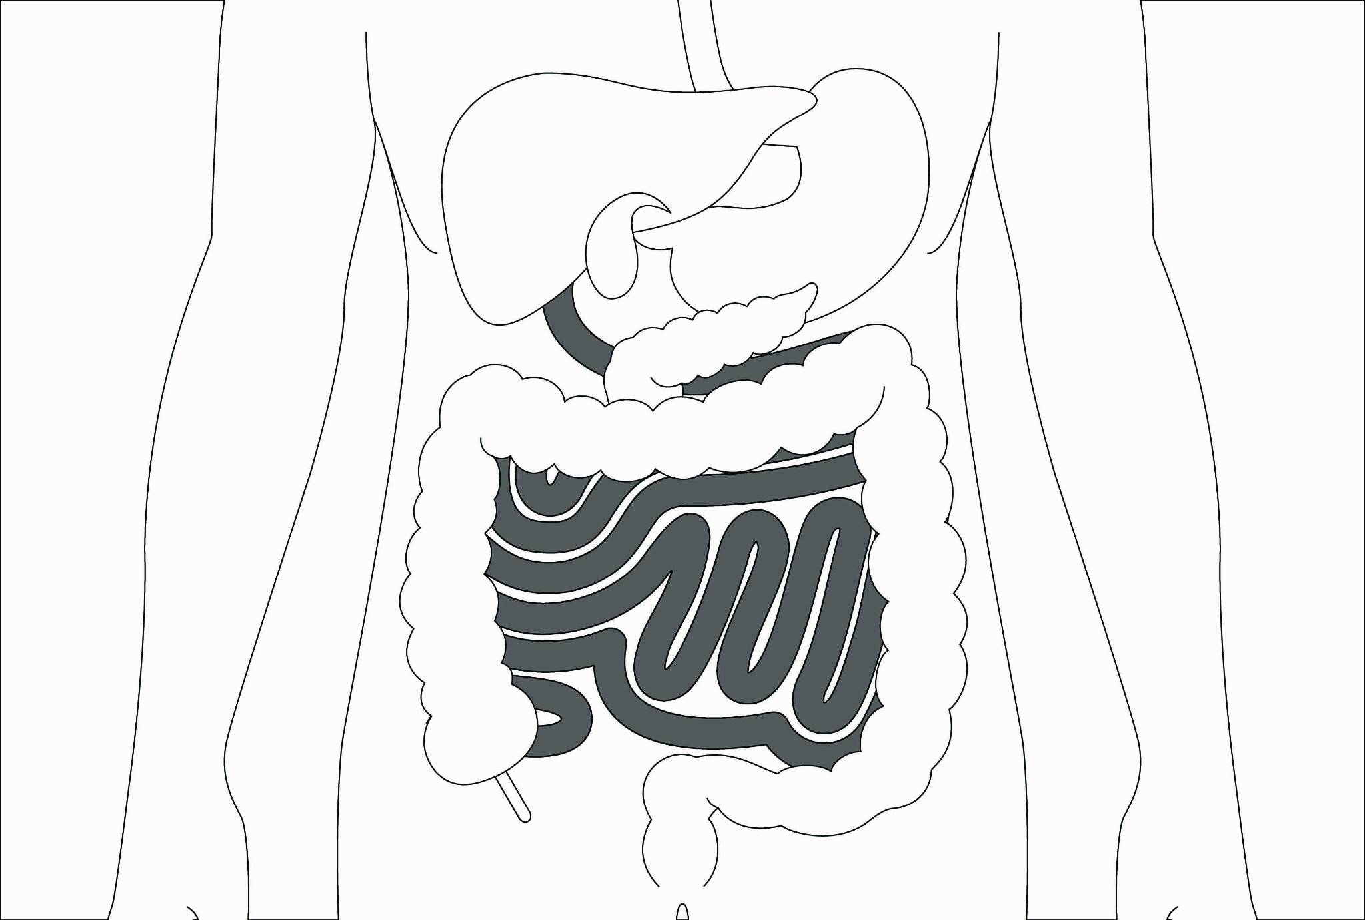
Digestion in Small Intestine
Food entering the chyme into the small intestine releases pancreatic juice containing ‘pancreatic amylase’ - breaks down sugar into starches
Brush border enzymes are embedded within the plasma membrane of microvilli; active sites of these enzymes help complete the digestion of food
Peristalsis - causes force of food to move toward anal end
Segmentation - muscular constrictions of lumen; mixes chyme more thoroughly; occurs frequently in proximal end than distal end causing pressure difference to allow the movement of chyme

Slide 9
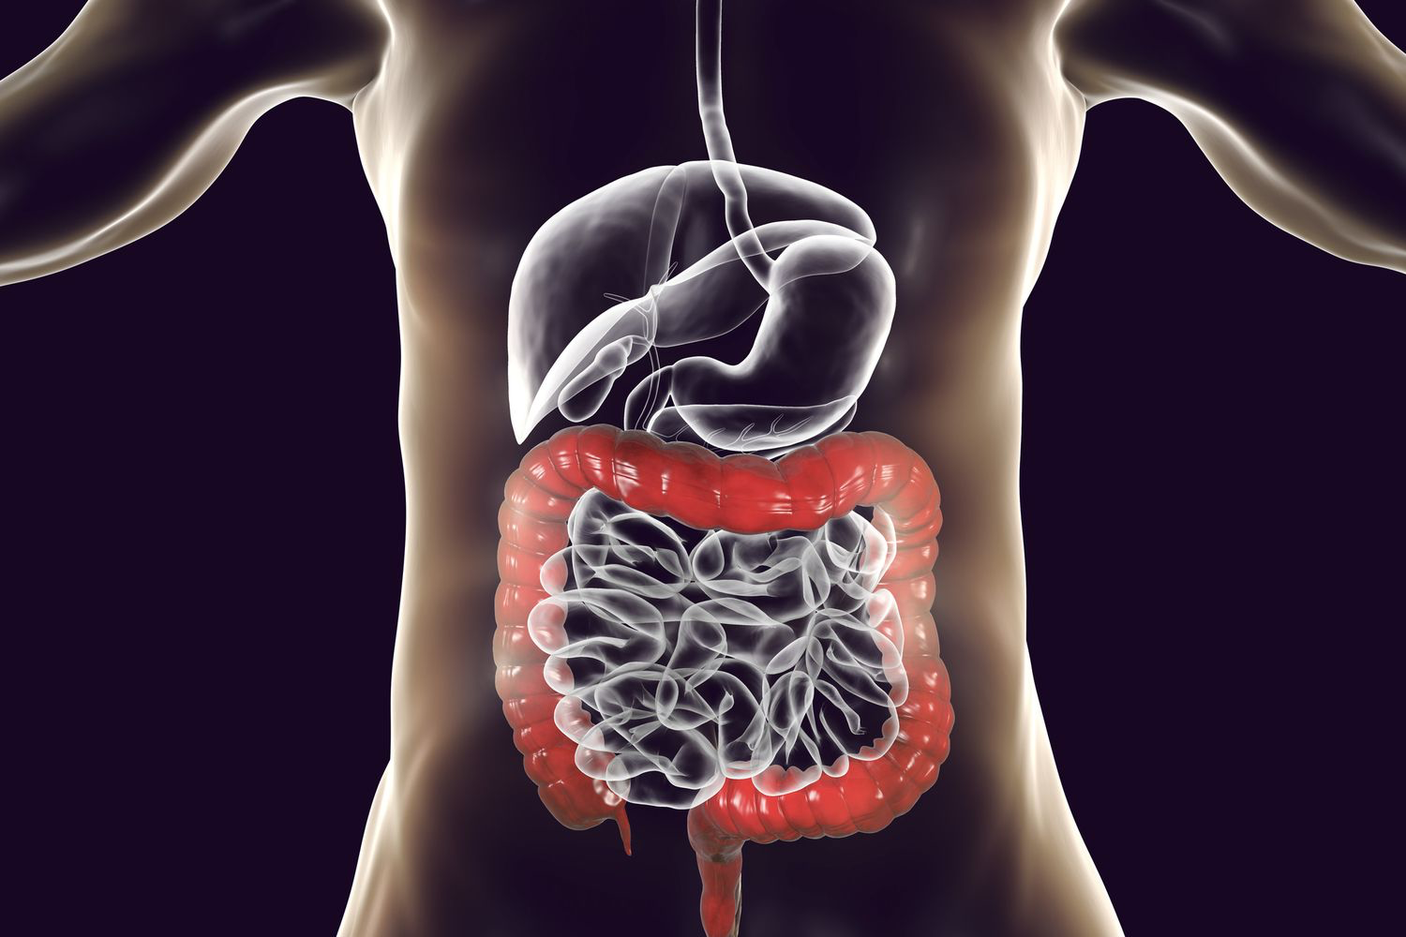
Digestion in Large Intestine
Chyme from small intestine enters the cecum;waste products digest water and are excreted through the anal canal
Bacteria ferments sugars into short-chain fatty acids - used by bacteria to produce energy/absorbed in cells of colon
Liver → metabolize scfa into cellular energy

Slide 10
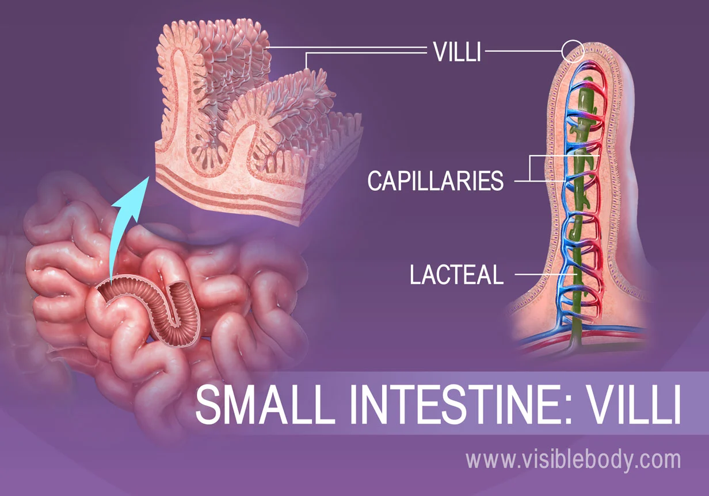
Absorption of Carbohydrates
Small intestine
After being digested by pancreatic amylase into smaller malitrose, maltose, and oligosaccharides, starch is further hydrolyzed to become individual monosaccharides. This process is executed by brush border enzymes found on microvilli in the small intestine.

Slide 11
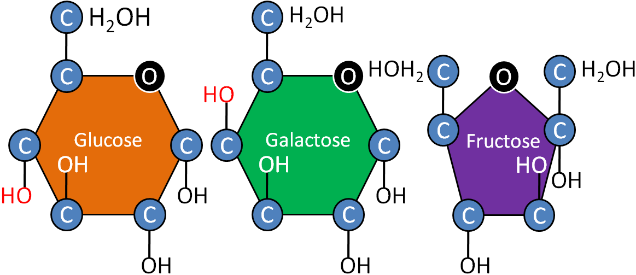

Slide 12
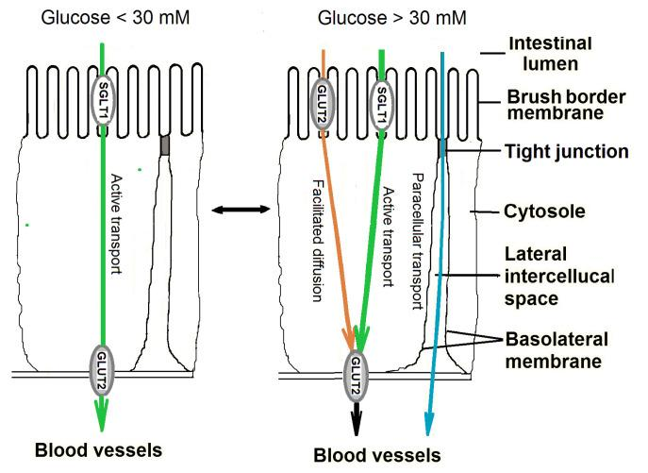
Glucose and Galactose Absorption
One individual monosaccharide molecule is transported across the brush border membrane along with an Na+ molecule into the epithelial cytoplasm on the apical side. The glucose will then exit through the basal side via facilitated diffusion utilizing GLUT transporters. The glucose will then be transported into the interstitial fluid, and into the capillary blood via the villus. This allows the glucose to enter the hepatic portal vein where it can travel to the liver
Notes:
https://www.ncbi.nlm.nih.gov/pmc/articles/PMC8308647/

Slide 13
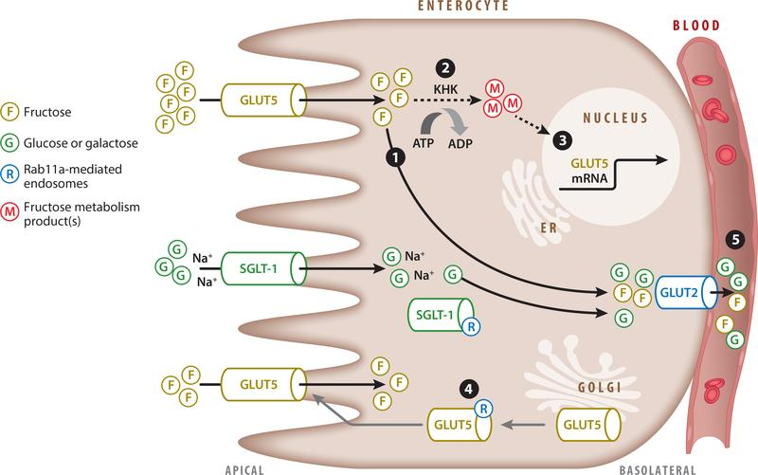
Fructose Absorption
GLUT5 allows for facilitated diffusion of fructose across the apical membrane. On the basal side GLUT2 facilitates the diffusion of fructose out of the cell and into the blood.
KHK phosphorylates fructose via ATP conversion to ADP. This phosphorylated fructose will activate the increased transcription of GLUT 5.
Notes:
https://www.ncbi.nlm.nih.gov/pmc/articles/PMC6457363/

Slide 14
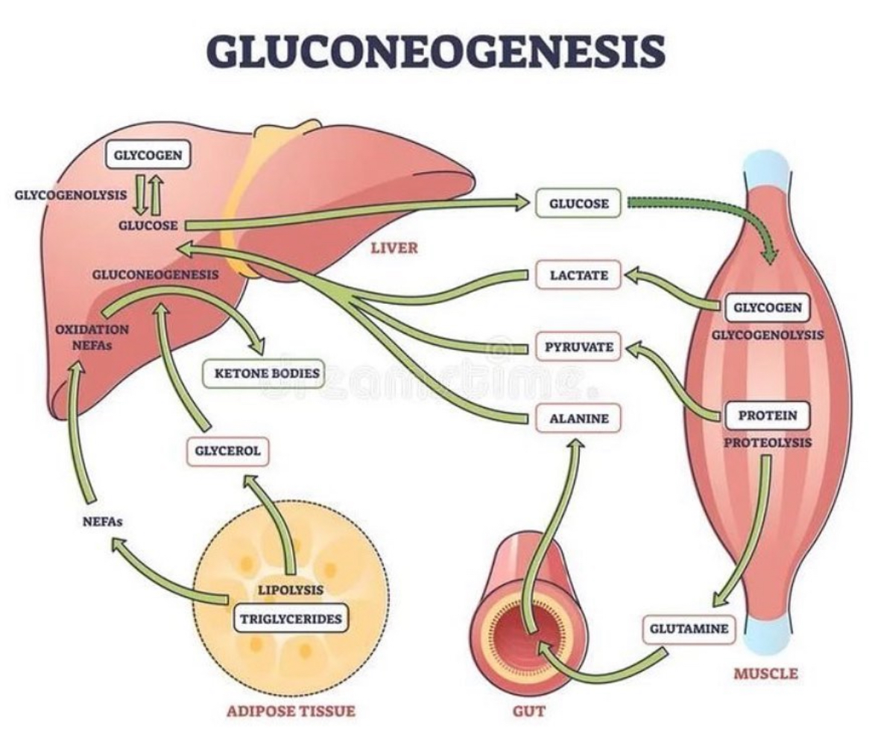
Gluconeogenesis
In conditions of sustained low glucose levels, the body will begin to utilize an array of other non-carbohydrate molecular sources in order to maintain appropriate energy levels
Notes:
https://www.ncbi.nlm.nih.gov/pmc/articles/PMC6457363/

Slide 15
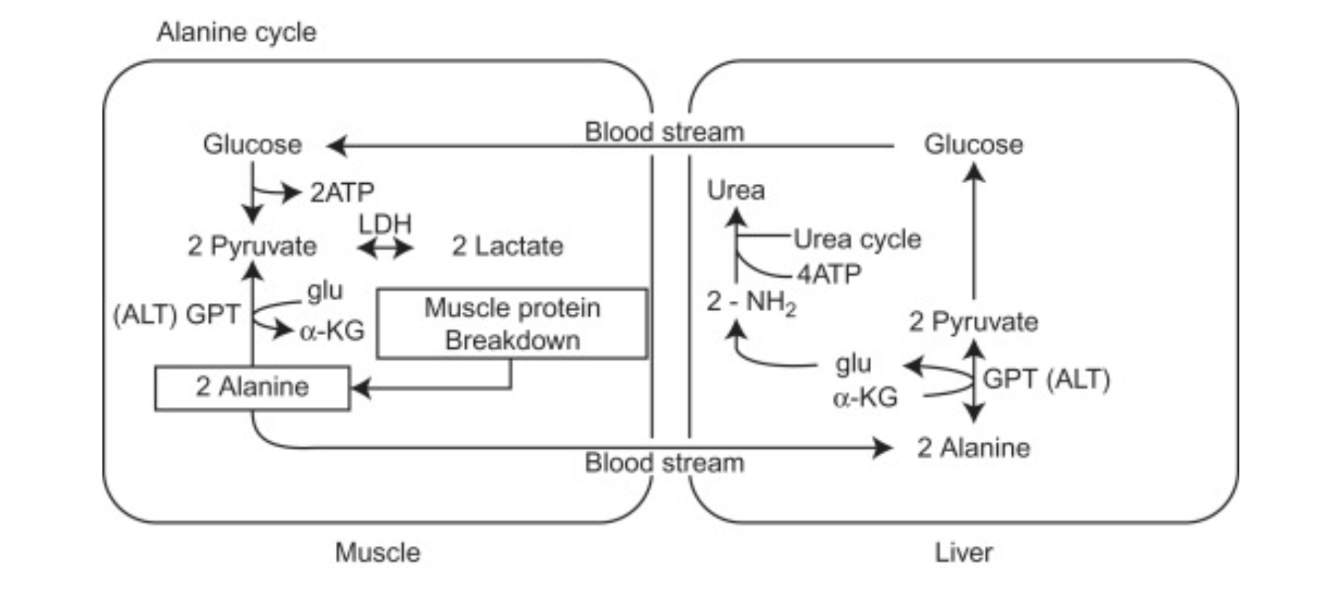
Glucose-Alanine Cycle
In circumstances of high amino acid content, protein breakdown will begin to occur. Because alanine is found in high percentage in most proteins, when proteins breakdown, alanine is released in high quantity into the bloodstream and taken up by the liver where it reacts with alanine transaminase to form pyruvate.
Notes:
https://www.sciencedirect.com/topics/neuroscience/glucogenic-amino-acid

Slide 16
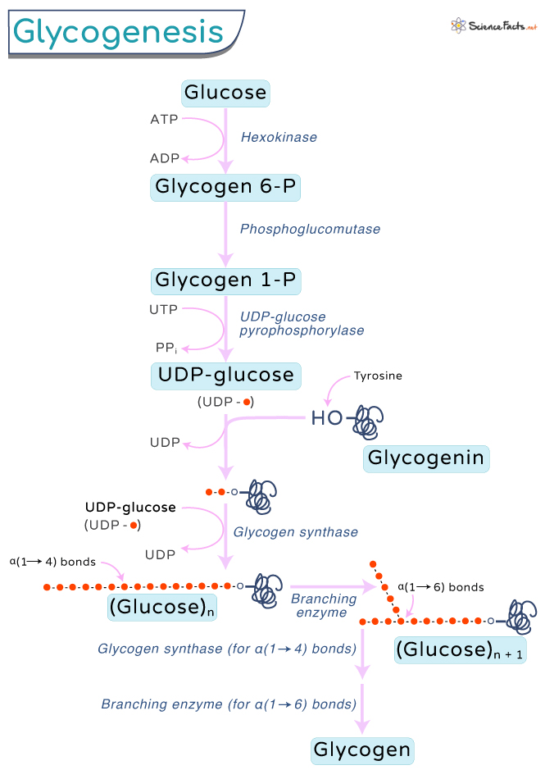
Glycogenesis
When a meal high in carbohydrates is consumed, glucose will raise the blood sugar via the mechanisms previously described. When this occurs, insulin will be released. Insulin will act on the GLUT proteins to allow for the facilitated diffusion of glucose across the membrane.
Once insulin is introduced into the system, the pathway of normal glycolysis gets diverted into the glycogenesis pathway seen here.
Notes:
Mostly in the liver and muscle cells

Slide 17
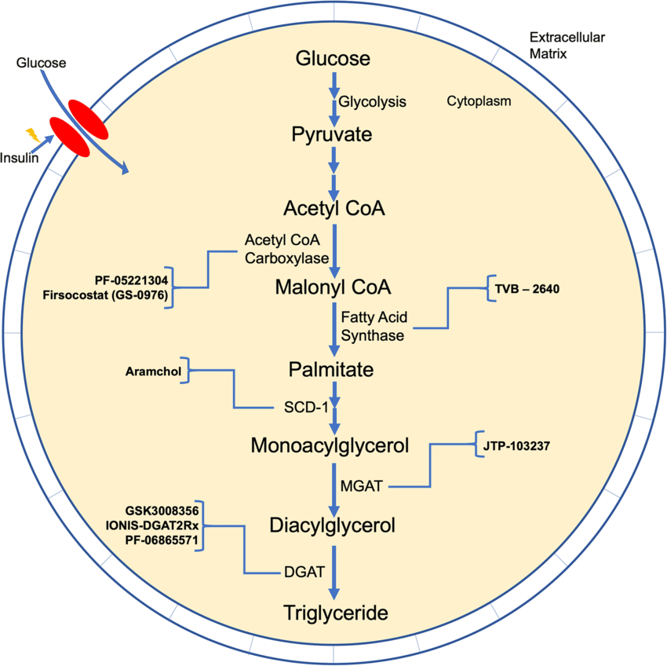
Lipogenesis
Once glycogen storage is at it’s maximum the process of lipogenesis will occur.
This process starts with normal a glycolysis reaction ending in pyruvate. Furthermore pyruvate will undergo its conversion step to produce Acetyl CoA, the starting material for fatty acid synthesis.

Slide 18
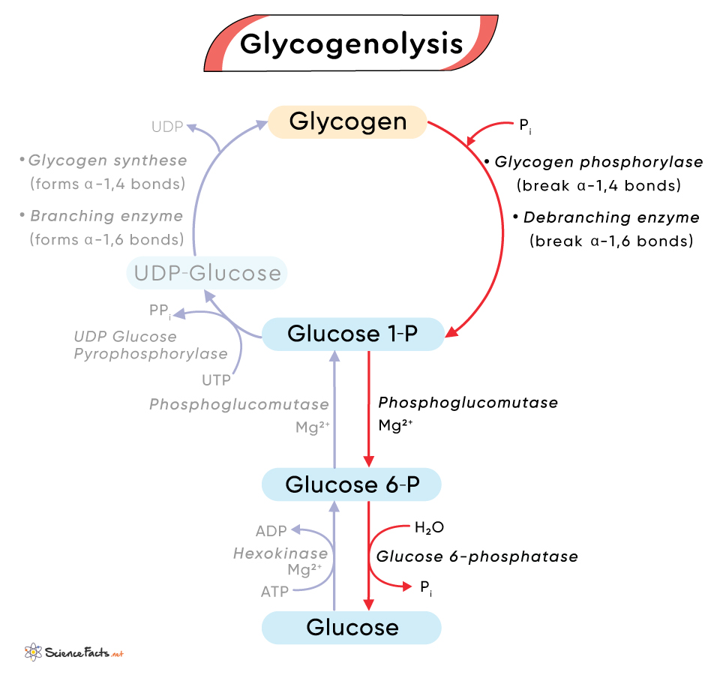
Glycogenolysis
Under conditions of low fat storage we undergo the process of glycogenolysis.
During this process, glycogen storage units are taken from the liver and muscles and broken down to create glucose for the body to utilize.

Slide 19
Carbohydrates and Nutrition

Slide 20
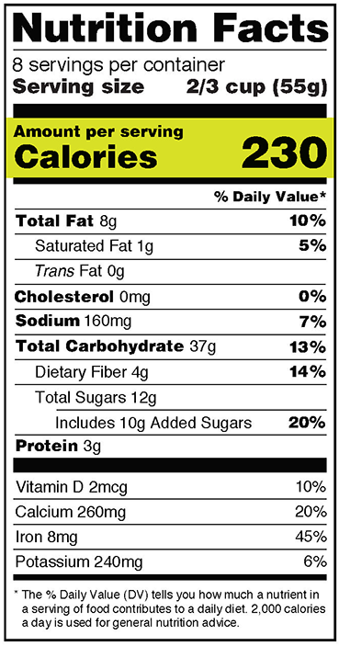
Calories
A measurement of the amount of energy in a food or drink
1 Kcal = 1000 calories = 1484 Joules (J)
1g of carbohydrate = 4 calories

Slide 21
Basal Metabolic Rate
The amount of calories you burn when you are performing basic life functions
Measurement based on weight, height, age, and sex
Typically higher in men than in women

Slide 22
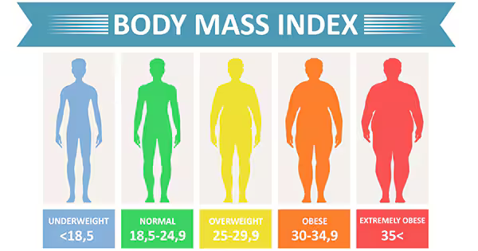
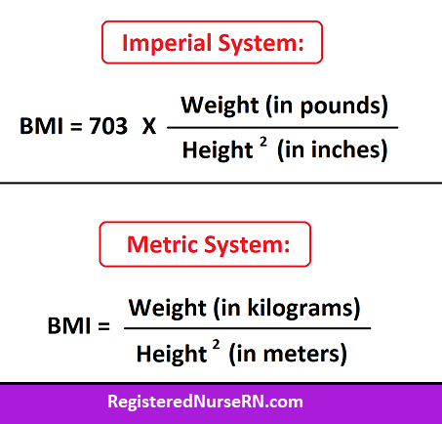
Body Mass Index (BMI)
A measure of weight adjusted for height.
Not an entirely accurate metric considering it cannot take into consideration the muscle content of weight

Slide 23
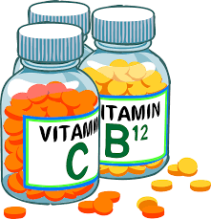
Vitamins
Fat Soluble:
Vitamin A
Vitamin K
Vitamin E
Vitamin D
Water Soluble:
Vitamin B Group
B1
B2
B3
B5
B6
B7
B9
B12
Vitamin C

Slide 24
Summary
Carbohydrates are sugars that provide us with energy
Broken down from larger polysaccharide structures via hydrolysis reactions
Absorbed in the small intestine
Can be synthesized from other biomolecules
Notes:
https://www.ncbi.nlm.nih.gov/pmc/articles/PMC6457363/

Slide 25
The End

